Slide 1

Relation Extraction
Classical ML and NN approaches on TACRED/V dataset
Natural Language Processing and Information Extraction, TU Wien (2023W)
NLPizza
Silvia Bonomi (12302476)
Andrea Nugara (12306319)
Samuele D’Avenia (12302519)
Maria Pronestì (12305796)

Slide 2
Relation Extraction (RE)
Relation extraction is the task of extracting relationships between concepts and entities from text.
Focus on task of slot filling, i.e. given a sentence along with the subject and object identify the relationship between the two.
Mark is survived by his brother John.
per:siblings
SUBJ
OBJ
Notes:
The main task was RE which means that given a sentence you have to identify the entities and assign a relation to them. we decided to focus on the second part of the task, called slot filling, as the datasets we used already provided us the entities inside the sentences. So our main goal was to classify the relation between given entities. Here is an example: mark is survived by his brother John: subj and obj are identified by some tag that we will see later, the goal is to output the relation per:siblings.

Slide 3
Datasets
Features of interest
TACRED is a supervised relation extraction dataset, obtained via crowdsourcing and containing 42 relations. [1]
TACREV is a revisited version, in which the most challenging examples have been reannoted by linguistic experts. [2]
Used for validation and testing
subj and subj_type
standford_pos
obj and obj_type
standford_ner
Notes:
We used two datasets: TACRED made of 106k examples and its revisited version called TACREV. The former one was collected between 2009 and 2014 and annotated by crowdworkers.It has 41 possible relations plus no relation for a total of 42 classes. Starting from TACRED, the most challenging examples have been manually relabelled by linguistic experts and the result of this operation is the second dataset, TACREV, which is used for validation and test set. TACRED and TACREV have the same structure with many features. here we reported the ones that we used in our models:
subj -> indicate wheter the considered token is the subject entity of the sentence
if the token is the subject entity, then its type, either PERSON or ORGANIZATION, is specified.
the same holds for the object entity, however more types can be displayed for that (17, including for example LOCATION, CITY, DATE, COUNTRY…..)
POS(part-of-speech) which for example specify if the word “love” is a nerb or a noun
NER(named entity recognition) are obtained by running the StandfordCoreNLP tool
all the results that we are going to show are obtained by considering the best model validated on the tacrev dev set and testing this model on the tacrev test set because we think that the corrections done by linguistic experts could be beneficial for the model performance

Slide 4
Preprocessing:
Stopwords carry information about the relations.
Similar issues with application of lemmatization and stemming.
Mark is from Paris
Mark Paris
Remove stopwords
Notes:
Other issues with stopwords removal: we would be unable to classify relations including pronouns, would lose significance of phrasal verbs for example.
Similar issues with loss of information that may be key for correctly identifying relations (if they ask for example something like AIG founded ALICO (so we have to extract subsidiary, after lemmatisation AIG found ALICO we would be unsure of the correct relation whether it is subsidiary of the opposite relation one, like members).
A first attempt was the usage of relation specific regex patterns for the task.
This is however very time consuming and was done for some of the easiest ones. To avoid having every sentence applied to the same relations we only considered the appearence of patterns between subject and object (or some words between/after those). This approach has many issues, mainly being time consuming to develop, not guaranteeing only one relation being assigned, and working particularly bad on sentences with distant subject and object, where we could have many different words in between the entities.

Slide 5
Preprocessing:
Stopwords carry information about the relations.
Similar issues with application of lemmatization and stemming.
Relation specific regex:
per:spouse check if marry/married/… occurs between subject and object.
Extremely fast
Explainable
Many patterns to design
Does not work well when subj and obj are distant
Mark is from Paris
Mark Paris
Remove stopwords
Notes:
Other issues with stopwords removal: we would be unable to classify relations including pronouns, would lose significance of phrasal verbs for example.
Similar issues with loss of information that may be key for correctly identifying relations (if they ask for example something like AIG founded ALICO (so we have to extract subsidiary, after lemmatisation AIG found ALICO we would be unsure of the correct relation whether it is subsidiary of the opposite relation one, like members).
A first attempt was the usage of relation specific regular expression patterns for the task.
This is however very time consuming and was done for some of the easiest ones. To avoid having every sentence applied to the same relations we only considered the appearence of patterns between subject and object (or some words between/after those). This approach has many issues, mainly being time consuming to develop, not guaranteeing only one relation being assigned, and working particularly bad on sentences with distant subject and object, where we could have many different words in between the entities.

Slide 6
Random Forest
EMBEDDINGS
FastText (100 dimensions) pretrained model: mean of embeddings for each sentence
ADDITIONAL FEATURES
Distance between subject and object.
Cosine similarity between subject and object embeddings
One hot encoding of subj_types and object_types.
One hot encoding of Standford POS.
CLASSIFIER
Balanced class weights to handle class imbalance
Notes:
Our approach to relation extraction starts using a Random Forest classifier. We began with the utilization of a pre-trained FastText model, where we opted to reduce the dimensionality of the embeddings to 100 for computational efficiency. For each sentence, we aggregated the embeddings by taking their average, forming a foundation for our subsequent analysis.
To enrich the information available to our model, we incorporated additional features. Specifically, we included the distance between the subject and object entities, as well as the similarity between them, calculated through the cosine similarity of their respective embeddings. Furthermore, we represented the subject and object types and Stanford POS (Part of Speech) attributes using one-hot encoding.
These diverse attributes collectively served as input to our Random Forest classifier. We performed hyperparameter tuning, focusing on the number of estimators and the maximum depth of the trees, to ensure optimal model performance. To address the challenge of class imbalance, with certain relations having a surplus of instances, while others are represented by only a few, we balanced the classes to obtain a fair representation of each relation class.

Slide 7
Results RF
(*) Means the relation was never predicted on the test set
Relation | F1 | Precision | Recall | # Train | # Test
org:alternate:names | 77% | 73% | 80% | 742 | 245
org:website | 72% | 71% | 74% | 104 | 27
per:stateorprovinces_of_residence | 70% | 54% | 98% | 311 | 73
…
per:country_of_death org:dissolved org:shareholders per:alternate_names … | 0% | 100% (*) | 0% | 6-101 | 1-10
per:city_of_birth per:parents org:parents Org:subsidiaries | 0% | 0% | 0% | 113-196 | 4-76
Overall | 48% | 46% | 49% | 63528 | 15509
Notes:
we used microaveraging F1 score function which does not reward the model for correctly predicting no_relation label.
for all the measure use microavarage score that don rewar the model for a right precictio of no_relation
Here are the results of the random Forest: In the upper part of the table we can see the 3 best performing relations, achieving a maximum of 73% precision and 80% recall. While in the lower part we have many relations which were never predicted (which means that have precision 1 and recall 0), and many others that have both precision and recall equal to 0 meaning that they are false positive: the model assign their labels to wrong instances.
what we can observe is that the number of instances in the train set might influence the behavior of the model but not that much, as for example org:website has just 100 instances, as some of the relations that the model never predicts.

Slide 8
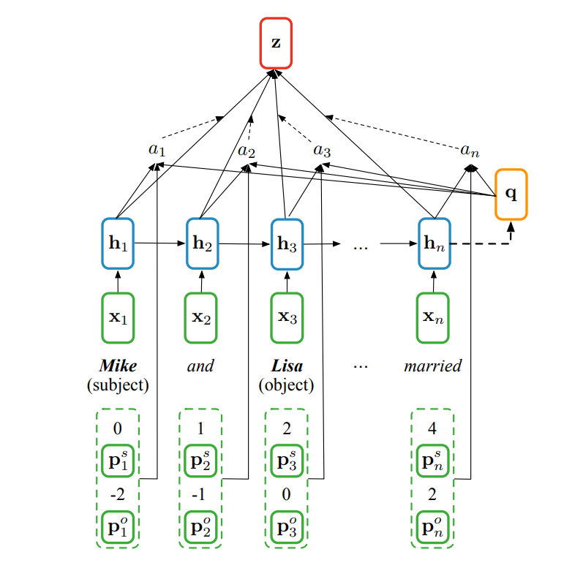
DL Models
Positional-aware LSTM, as proposed by Zhang et al. [1]
2-layer stacked unidirectional LSTM with dropout and an attention layer
Entity masking is performed SUBJ-sub_type and OBJ-obj_type
Input: concatenation of word embeddings, POS and NER embeddings
Notes:
Model description: unidirectional LSTM

Slide 9
Results (PA-LSTM)
(*) Means the relation was never predicted on the test set
Relation | F1 | Precision | Recall | # Train | # Test
org:alternate_names | 92% | 96% | 88% | 742 | 245
org:founded | 88% | 87% | 89% | 84 | 37
per:age | 87% | 79% | 96% | 364 | 201
…
org:members | 0% | 0% | 0% | 155 | 16
org:shareholders | 0% | 0% | 0% | 113 | 4
org:member_of | 0% | 100% (*) | 0% | 70 | 3
org:dissolved | 0% | 100% (*) | 0% | 22 | 1
per:country_of_death | 0% | 100% (*) | 0% | 6 | 10
Overall | 69.2% | 69.2% | 69.5% | 63528 | 15509
Notes:
TALK ABOUT THE METRIC
Relations where a lower and higer F1 levels were achieved. Note that in some instances (where we have like 1-4 instances on test set, claiming that the model does not work well on those relations would be a long shot, due to the fact that there are so little instances of those. We would require the collection of more sentences from the testing set).
Also note that it does not appear like number of training instances is

Slide 10
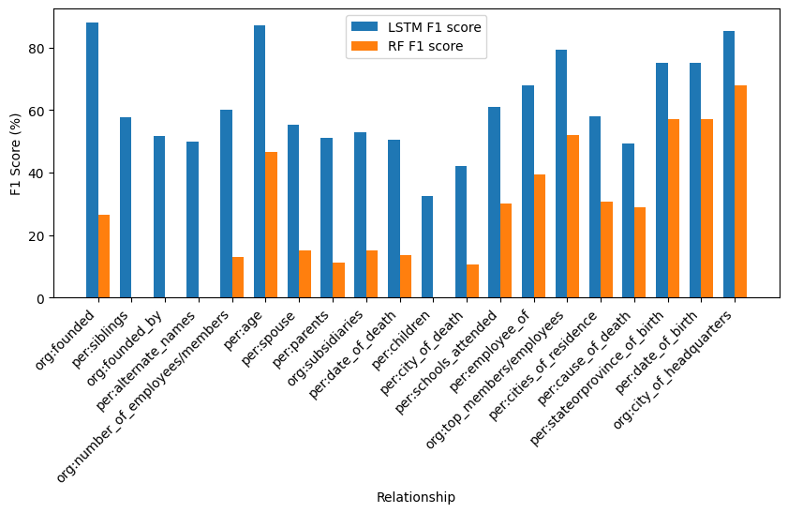
Model | F1 | Precision | Recall | #Recall 0
RF | 48% | 46% | 49% | 9
PA-LSTM | 69.2% | 69.2% | 69.5% | 5
Notes:
Describe differences between the models.
Consider the fact that the RF model is significantly more efficient than the LSTM model.

Slide 11
Error Analysis
Trying to identify relation-agnostic aspects of the sentences that affect the performance (sentence length, distance between entities).
Notes:
For the different models we decided to perform a more detailed error analysis by considering two aspects.
First of all we try to identify sentence characteristics which we believe may cause issues. These are for example the sentence length (maybe the model loses the importance of the subject and object entity as there are more terms) but also the distance between the two entities of the sentence (for example for the LSTM model it may lose the information about the first entity when it reaches the last one).
If they ask about why RF: we noticed larger distance between entities have more no relation. Maybe the model learnt that when it sees long distance it should output no_relation, and the re-weighting schemes do not account for this sufficiently.
The second part of the error analysis is focused on determining whether the model is capable of predicting groups of relations which were identified to be similar. For these, we looked at the slot-filling guidelines for the different relations, where there are some relations which are highlighted to be similar, see here for example the fact that subsidiaries and org members are pointed. Another characteristics of the relations is the order, as we have so called inverse relations: see for example members and members of. Starting from these, and also considering potentially similar meaning of those, we investigate the errors within these classes.

Slide 12

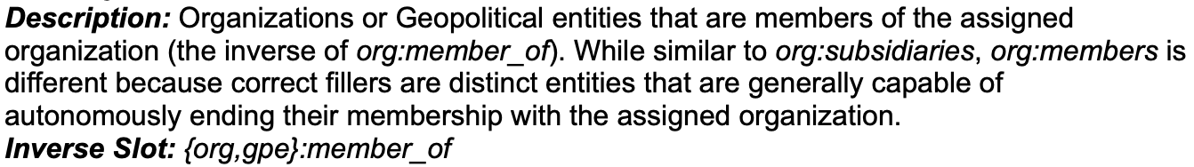
Error Analysis
Trying to identify relation-agnostic aspects of the sentences that affect the performance (sentence length, distance between entities).
Exploration into groups of relations of similar meaning, as outlined in the annotation guidelines.
Notes:
For the different models we decided to perform a more detailed error analysis by considering two aspects.
First of all we try to identify sentence characteristics which we believe may cause issues. These are for example the sentence length (maybe the model loses the importance of the subject and object entity as there are more terms) but also the distance between the two entities of the sentence (for example for the LSTM model it may lose the information about the first entity when it reaches the last one).
If they ask about why RF: we noticed larger distance between entities have more no relation. Maybe the model learnt that when it sees long distance it should output no_relation, and the re-weighting schemes do not account for this sufficiently.
The second part of the error analysis is focused on determining whether the model is capable of predicting groups of relations which were identified to be similar. For these, we looked at the slot-filling guidelines for the different relations, where there are some relations which are highlighted to be similar, see here for example the fact that subsidiaries and org members are pointed. Another characteristics of the relations is the order, as we have so called inverse relations: see for example members and members of. Starting from these, and also considering potentially similar meaning of those, we investigate the errors within these classes.

Slide 13
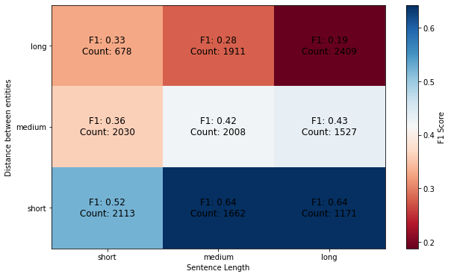
Error Analysis (RF)
The best combination is when the sentence is long but the distance between subject and object is small.
The worst case is when both the sentence length and the distance between entities are long.
Notes:
In the heatmap is shown the relation between the sentence length and the distance between subj and obj entities. We can observe that the best combination is when the sentence is long but the distance between subj and obj is small, while the worst case is when both the distances are long.
….

Slide 14
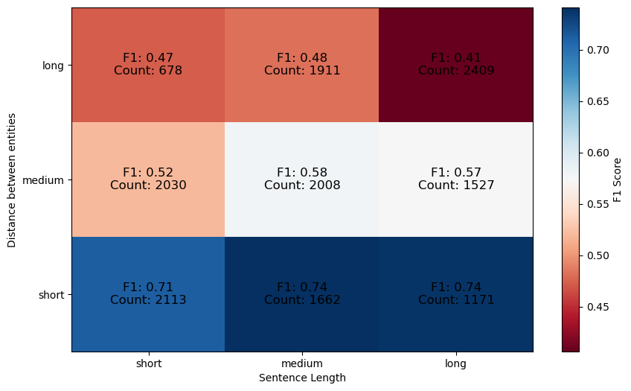
Error Analysis (DL)
F1 score way above average for shorter sentences.
Worst performance on long sentences with long distance between entities
Recall seems to be more affected.
Notes:
We observe a similar behaviour to that we saw for the RF model. In general it appears that the most challenging instances are those with long sentence length and large distance between the two entities. We note that the model has a much larger F1 score when considering sentences with short distance between the entities, while performance is below average on all other combinations.
By having a closer look at the precision and recall values obtained when looking at the different groups, we note that while also precision is affected, the main drop for entities with longer instances occurs when we consider recall.

Slide 15
Analysis of similar relations
Consider: org:members_of, org:members, org:shareholders, org:parents, org:subsidiaries
Most common wrong assignments involve no_relation label. Other errors are mostly within similar groups. This agrees with changes from TACRED to TACREV.
no_relation (18)
org:shareholders (1)
org:subsidiaries (1)
no_relation (18)
org:parents (1)
org:top_members (1)
org:parents
org:shareholders
(TACRED)
(TACRED)
(TACREV)
(TACREV)
Notes:
For the slides we report the analysis done on relations which we identified as all pointing to some sort of relationship between different organizations and entities, and are shown at the top of the slides (those with same colour represent inverse relations as pointed out before.
When analyzing this sub group of relations we noted that the most common errors appear to be the model either outputting a relation but the correct one is no relation, or the reverse happening. For the majority of other errors of the model, the mis-predictions appear to be in the majority of cases within these identified groups of no relations, both for the random forest and for the LSTM model.
If we focus on the relations which were modified when moving from TACRED to TACREV (counts reported here are those from the test dataset), it appears that the majority of the errors which were fixed, consist of moving from no_relation to other relation or also within groups. For example for org:parents we see that they were moved to no relation, shareholders and its inverse subsidiaries.
Other than these relations being similar we believe the following could be another issue as to why the models seem to mix up similar relations. In fact, if we assume that the same labelling errors which are identified on the train and test dataset are also present in the training set, then we can imagine that both models have learnt to predict on some wrong instances, which may potentially be causing issues. In fact keep in mind that the TACRED training set was NOT fixed like the other two, and it was annotated using crowd sourcing. While going through the examples we notices some clearly misclassified sentences.

Slide 16
Other identified errors
Various errors in prediction are due to mislabeled NER
the Italian design company Alessi
NCAI, based in Washington, DC
(prediction) per:origin
(true) org:country_of_headquarters
OBJ-NATIONALITY
SUBJ-PERSON
(prediction) org:city_of_headquarters
(true) org:state_of_headquarters
SUBJ-ORGANIZATION
OBJ-LOCATION
Notes:
Another class of errors which we identified when looking at the LSTM model appear to be caused by wrong NER assignments to the subject or object entity.
We report here two examples which are significant for this issue:
In the first one, we have the company alessi being being identified as a person, and hence the predicted relation is that of per:origin rather than the correct one of org:countr_of_headquarters.
In the second one we see one of many examples where the obj or subj are location entities. Due to masking used for model training., the model does not have the word itself but only the OBJ-OBJ-type pair. In some cases these locations are assigned the more general NER tag LOCATIOn rather than specific ones like CITY or COUNTRY, which are key for the model being able to determine which of these two appears to be the case. In particular we noted that DC is the most problematic ones, as in some cases it was wrongly misclassified as COUNTRY.

Slide 17
References
[1] Yuhao Zhang, Victor Zhong, Danqi Chen, Gabor Angeli, and Christopher D. Manning. Position-aware attention and supervised data improve slot filling. In Proceedings of the 2017 Conference on Empirical Methods in Natural Language Processing, pages 35–45, Copenhagen, Denmark, September 2017. Association for Computational Linguistics. doi: 10.18653/v1/D17-1004. URL https://aclanthology.org/D17-1004/
[2] Christoph Alt, Aleksandra Gabryszak, and Leonhard Hennig. TACRED revisited: A thorough evaluation of the TACRED relation extraction task. In Proceedings of the 58th Annual Meeting of the Association for Computational Linguistics, pages 1558–1569, Online, July 2020. Association for Computational Linguistics. doi: 10.18653/v1/2020.acl-main.142. URL https://aclanthology.org/2020.acl-main.142/

