Slide 1
All plots and summaries

Slide 2
OUR DATA

Slide 3
Frequency (time) – our data

Slide 4
Mathematical Area (time) – our data
As is - No smoothing.
Smoothed with 5 moving average points
Note: I am not including the Absolute area since it is almost the same as the Mathematical.
Note: This is not updated for 470, 475 and 480.

Slide 5
Area - normalized
Normalized to 450
Normalized to 490

Slide 6
Area - normalized
Normalized to 450
Normalized to 490

Slide 7
Area - normalized
Normalized to 450
Normalized to 490

Slide 8
Area - normalized
Normalized to 450
Normalized to 490

Slide 9
Area - normalized
Normalized to 450 new way

Slide 10
Area - normalized
Normalized to 450
Normalized to 490

Slide 11
GERMAN PAPER DATA

Slide 12
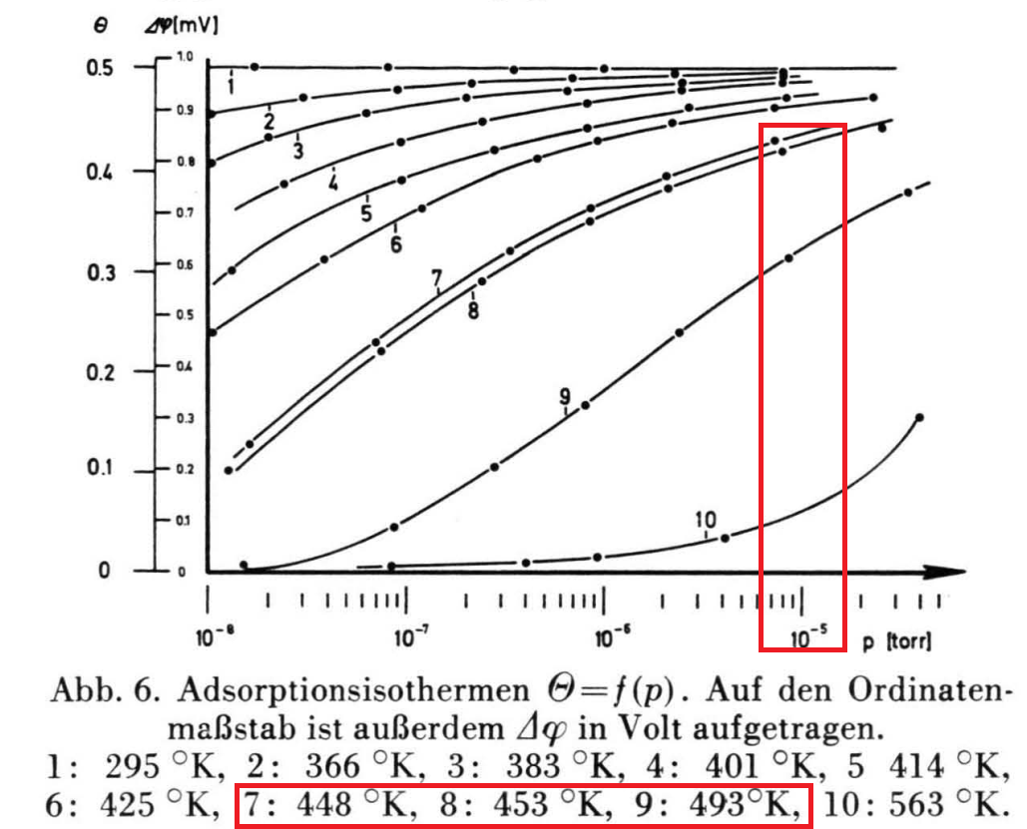
Digitized
Interpolated
Pressure of interest
We obtain expected coverage at saturation for each temperature.

