Slide 1
Some Updates

Slide 2
Frequency (time) – our data

Slide 3
Frequency (time) – our data - Smoothing

Slide 4
Mathematical Area (time) – our data
NOT SMOOTHED
SMOOTHED

Slide 5
Mathematical Area (time) – our data
UNNORMALIZED
NORMALIZED (ref490)

Slide 6
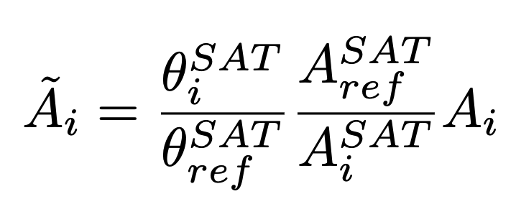
Area normalized (testing)
Normalized area
Measured area
i – refers to temperature T_{i}
ref – temperature chosen as reference
SAT – at saturation
A_{i} - area for temperature T_{i}

Slide 7


Area normalized (testing)
Normalized area
Measured area
i – refers to temperature T_{i}
ref – temperature chosen as reference
SAT – at saturation
A_{i} - area for temperature T_{i}

Slide 8
Area (time) – Normalized examples

Slide 9
Area (time) – smoothed

Slide 10
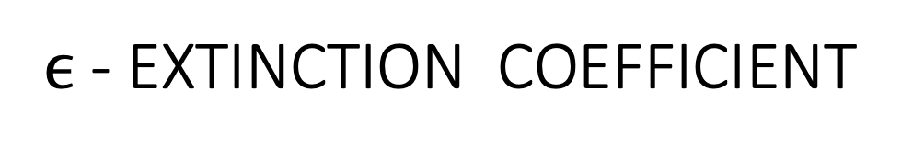
$ϵ$ - EXTINCTION COEFFICIENT

Slide 11
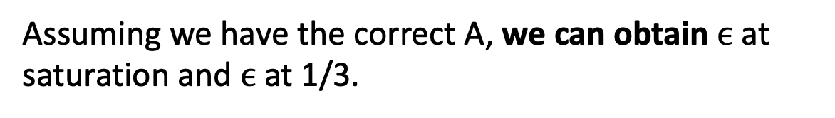
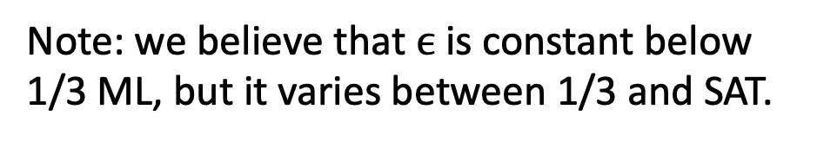
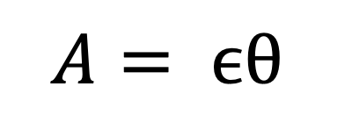
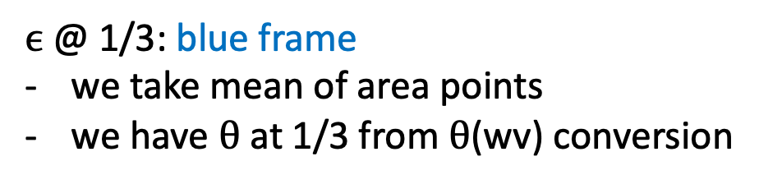

$$A= ϵθ$$
Beer’s Law
Assuming we have the correct A, we can obtain $ϵ$ at saturation and $ϵ$ at 1/3.
$ϵ$@ SATURATION: green frame
we take mean of area points
we have $θ$ at SAT from German paper
$ϵ$@ 1/3: blue frame
we take mean of area points
we have $θ$ at 1/3 from $θ$(wv) conversion
Note: we believe that $ϵ$ is constant below 1/3 ML, but it varies between 1/3 and SAT.

Slide 12
COVERAGE Conversion

Slide 13
COVERAGE vs WV fitting

Slide 14
Coverage vs Time

Slide 15
Coverage vs Time – All together

