Slide 1

My Lab
Marija Iloska
PhD student (Fall 2018 – present)
Department of Electrical & Computer Engineering
PI: Dr. Mónica Bugallo
CoSiNe
communications
signal processing
networking
signal processing

Slide 2
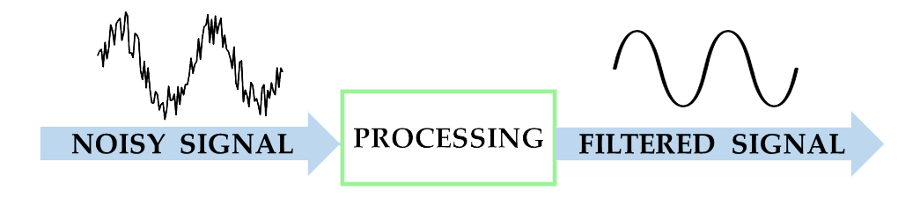
Signal Processing
Signal processing deals with the analysis, modification, filtering, and synthesis of signals, as well as with extracting information that is carried by signals.
Statistical Signal Processing
Statistical signal processing is an approach which treats signals as stochastic processes.

Slide 3
Examples
Audio processing
Image processing
Video processing
(e.g. speech recognition, music, sound detection, noise cancellation )
(e.g. noise reduction, compression, editing, medical imaging)
(e.g. noise reduction, frame rate, coloring, edge manipulation)
Biomedical processing
Internet of things
Seismic processing
Financial processing
(e.g. EEG, ECG processing)
(e.g. sensors, automation, device communications)
(e.g. earthquakes, magma movement, volcanic eruptions)
(e.g. stock market, options prices, and derivatives)

Slide 4


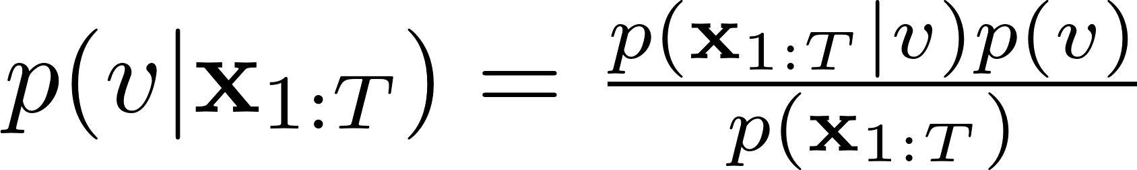
Bayesian Inference
Data
Model:
What we know
What we want
Position of bird at time t
Velocity of bird (constant)
Parameter
Bayes Theorem
Posterior
distribution
Likelihood
Prior

Slide 5
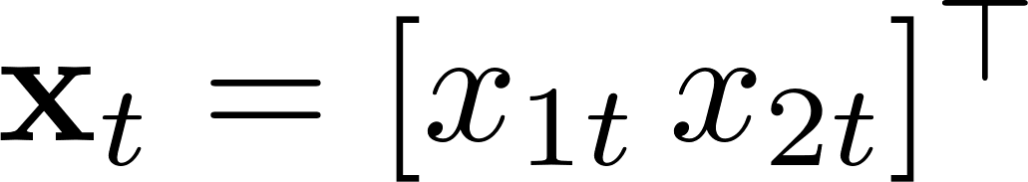
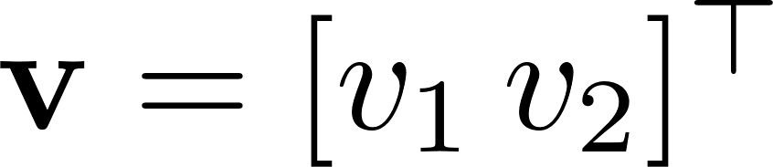
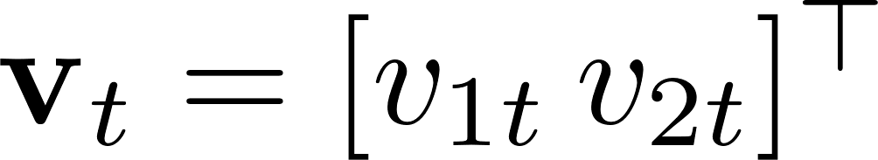
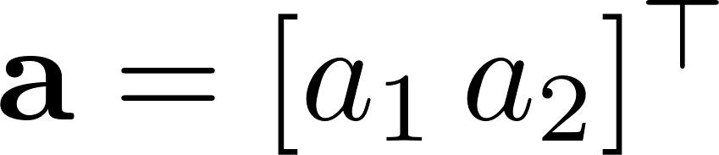
Bayesian Inference
1 bird 1 velocity
2 birds 2 velocities
2 birds 2 x T velocities (t) 2 accelerations

Slide 6
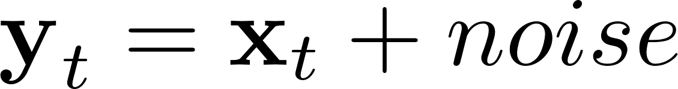
Bayesian Inference
But wait! There is more…
Measurements are imprecise
Bayes Theorem ??

Slide 7
Approximation
where

Slide 8
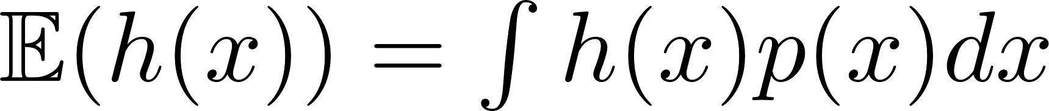
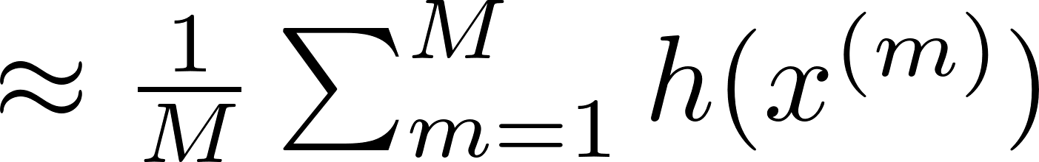
Monte Carlo (MC)
Some
function
Probability
distribution
Draw samples from p(x)
Use sampling to approximate the integral

Slide 9
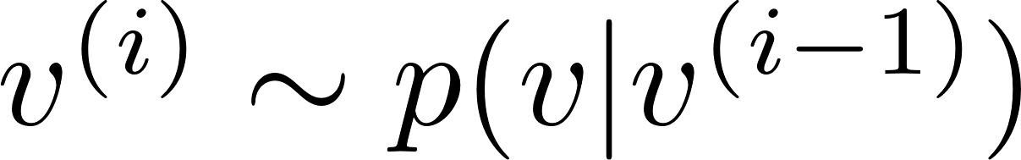
Markov Chain Monte Carlo (MCMC)
Iterative approaches
I iterations
Goal
Draw samples from the posterior distribution
{
1. You give a range of possible values
2. Random search in given range
Loop i
Draw a sample. Search is based on previous sample.
3. Evaluate the drawn sample
Use help of collected data
4. Accept/Reject sample
If New sample > Old sample → keep new sample
5. Repeat loop

Slide 10
Markov Chain Monte Carlo (MCMC)
Example of converged chain
The Markov Chain

Slide 11
Networks Examples
Social networks
y₁
y₂
Gene regulatory networks
Financial networks
y₃
Animal flocking networks
Chemical reaction networks

Slide 12
Adjacency Matrix A
Networks
y₁ y₂ y₃
y₁
y₂
y₃
1
0 0
0 0
0
y₁
3.0
1
y₂
1
1
-0.1
0.8
TOPOLOGY
-4.4
Coefficient Matrix C
y₃
y₁ y₂ y₃
y₁
y₂
y₃
0 0 -4.4
3.0 0 0
-0.1 0.8 0

Slide 13
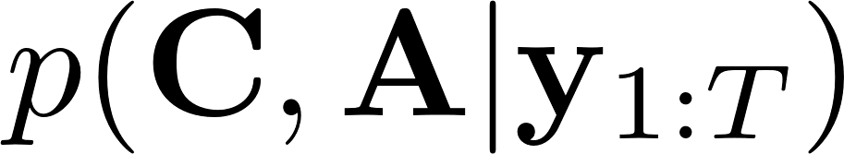
What do I do?
My goal is to estimate the network - matrix C and matrix A
Use Bayesian inference
- Find the posterior distribution
- No direct way. Use MC methods (I use MCMC, Sequential MC)
y₁
3.0
y₂
Challenges?
-0.1
0.8
- Huge number of unknown parameters!
- Sparsity!!
-4.4
y₃
- The network may vary (eventually)
- Model selection

Slide 14
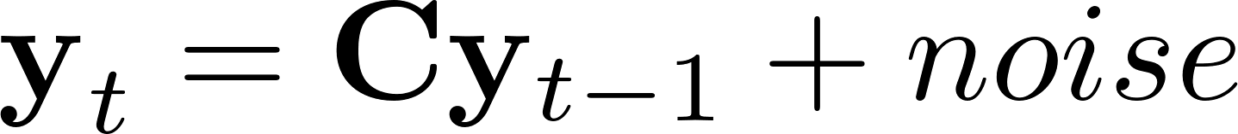
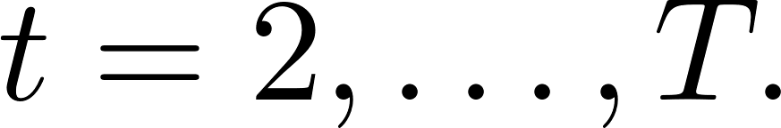
Currently
y₁
3.0
y₂
-0.1
0.8
-4.4
y₃
I use a Gibbs sampler – an MCMC method
I constructed 7 different strategies based on Gibbs samplers
Synthetic Data
Example: Estimation of A
0 < F-score < 1
F-score = 1 perfect estimation

Slide 15

Currently
y₁
3.0
y₂
-0.1
0.8
-4.4
y₃
Real Data
Financial network (dimension 27)
global stock market indices
C
price correlation matrix
A_{13,12}
27 x 27 parameters in C
C_{13,12}
Results example:
Converged Markov chain of a random element in C and A

Slide 16
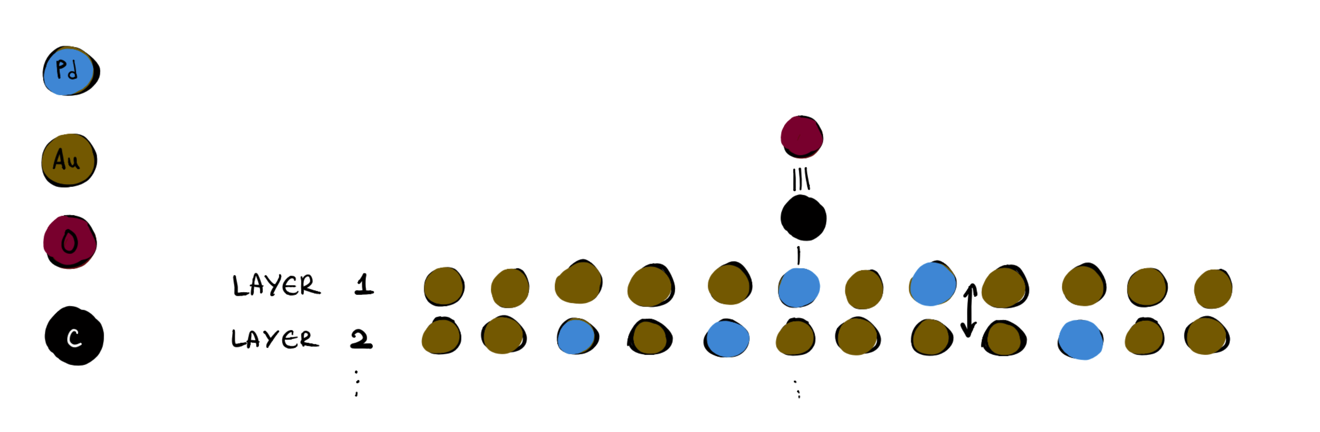
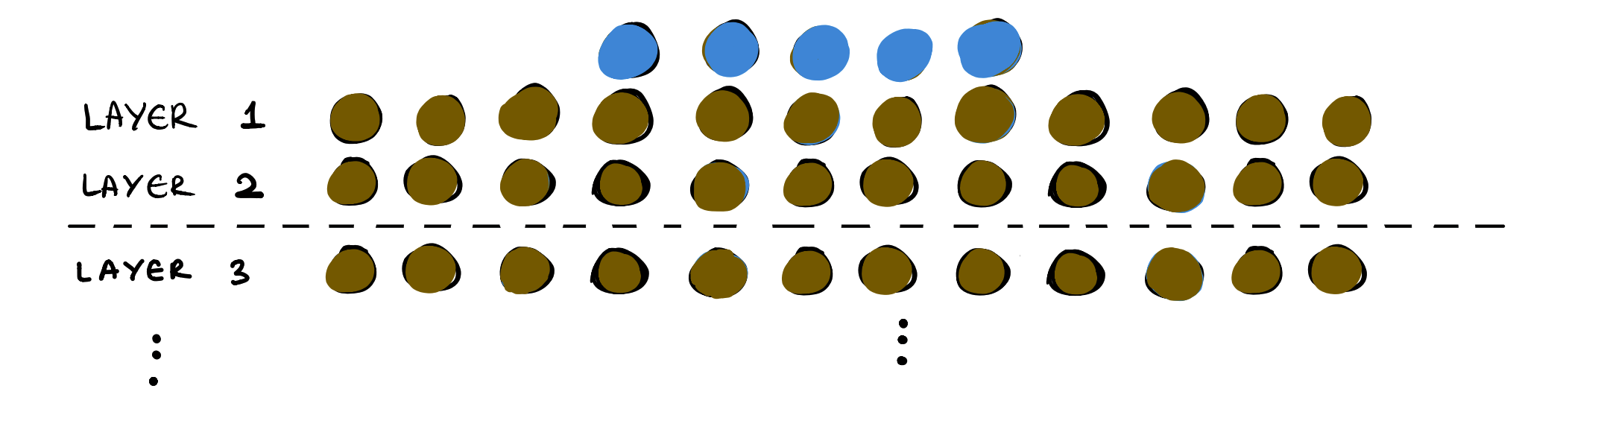
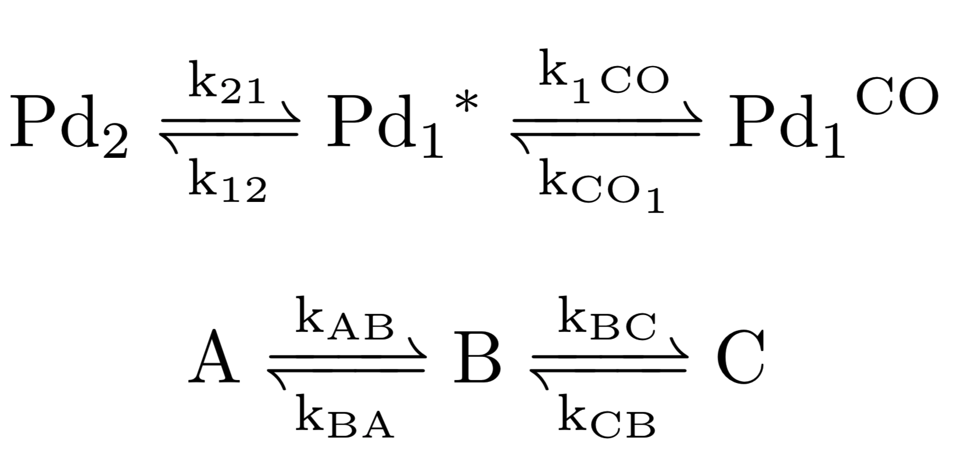
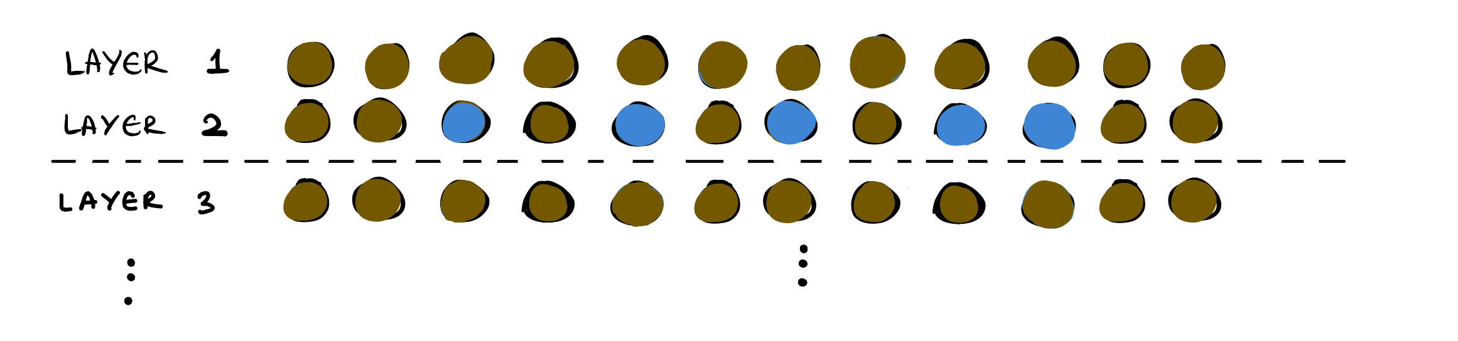
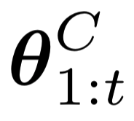
Bimetallic diffusion model
Reminder
My goal is to find a model…
based on the chemical equation:
Data I have:
IRRAS measurements – coverage of C

Slide 17
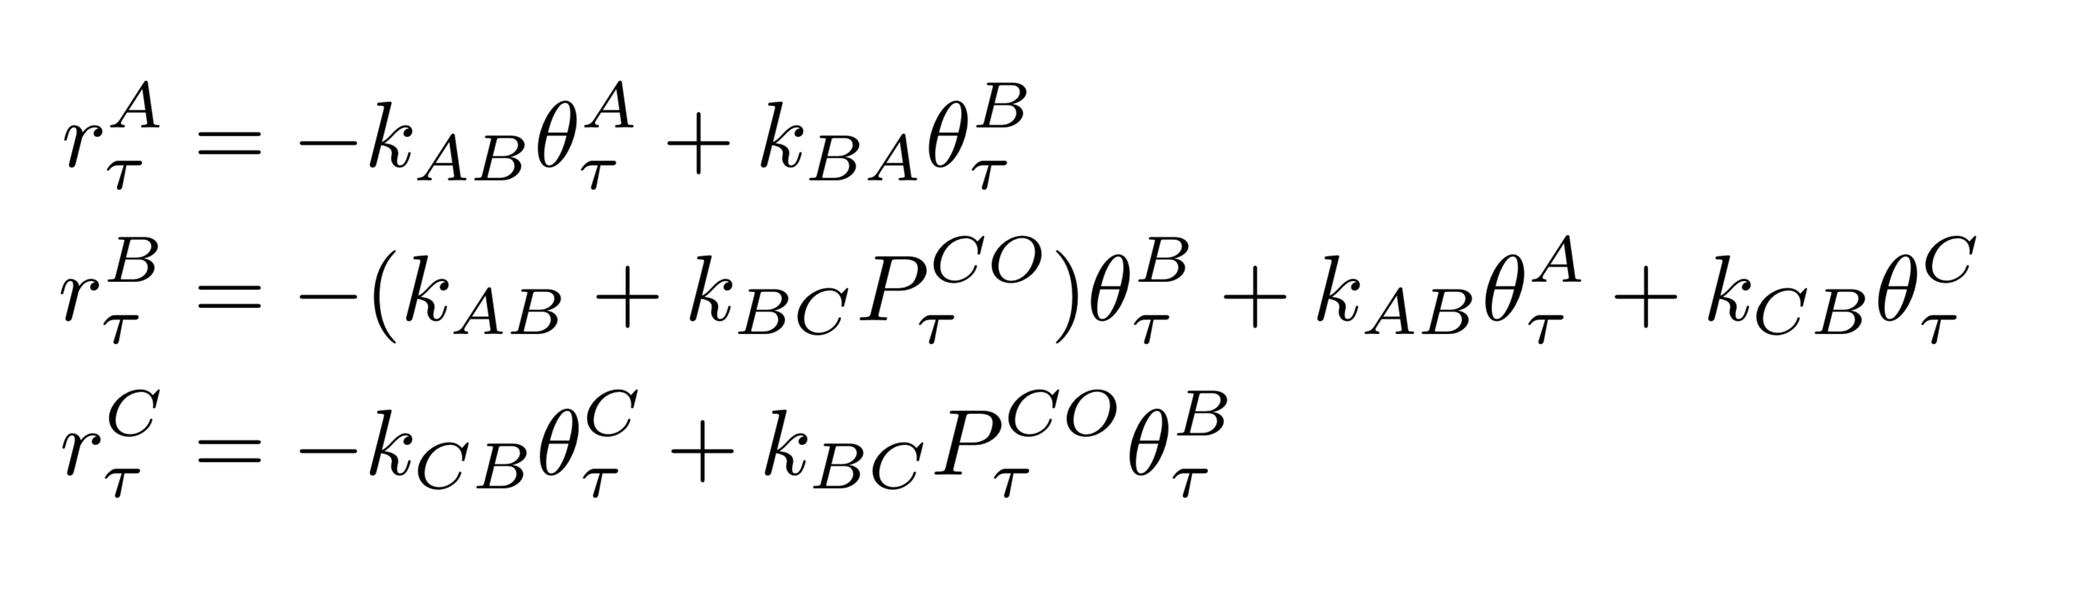
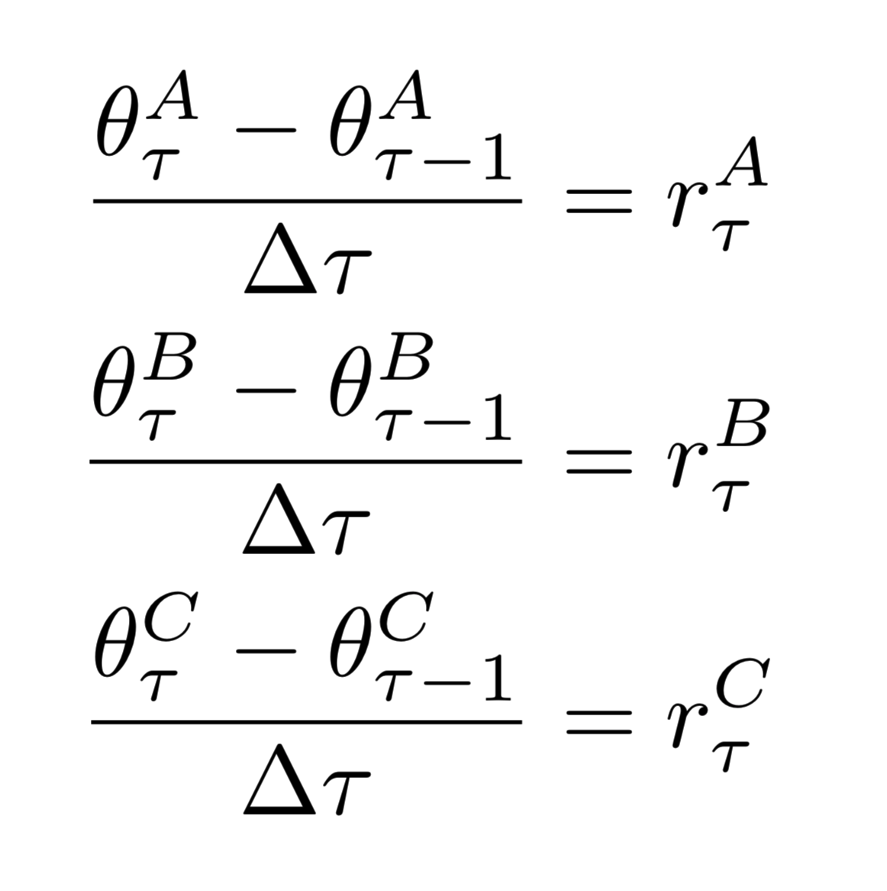
Bimetallic diffusion model
I need to use the reaction rate equations:
Use Bayesian inference to find the unknowns:
Ultimate goal:
Find the posterior distribution

