Slide 1
All plots and summaries

Slide 2
OUR DATA

Slide 3
Frequency (time) – our data

Slide 4
Mathematical Area (time) – our data
As is - No smoothing.
Smoothed with 5 moving average points
Note: I am not including the Absolute area since it is almost the same as the Mathematical.
Note: This is not updated for 470, 475 and 480.

Slide 5
GERMAN PAPER DATA

Slide 6
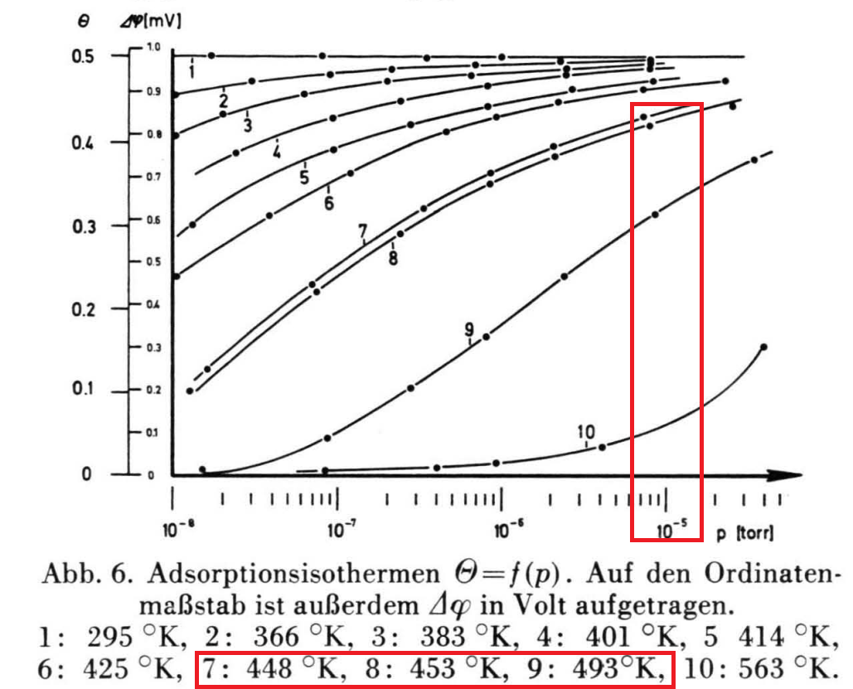
Digitized
Interpolated
Pressure of interest
We obtain expected coverage at saturation for each temperature.

Slide 7
COVERAGE vs WAVENUMBER

Slide 8
Constant pressure experiment (our data)
COV vs WV results
our WV (P) data + COV (P) from slide 6 (German paper)

Slide 9
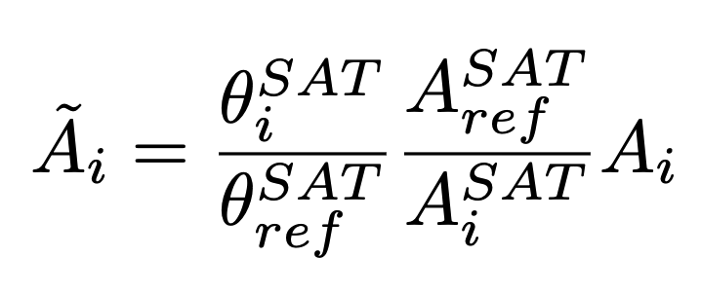
Area normalized (testing)
Normalized area
i – refers to temperature T_{i}
ref – temperature chosen as reference
SAT – at saturation
A_{i} - area for temperature T_{i}

Slide 10
Area - normalized
450 K as reference
490 K as reference

Slide 11
Area - normalized
450 K as reference
490 K as reference

Slide 12
Area - normalized
450 K as reference
490 K as reference

Slide 13

$ϵ$ - EXTINCTION COEFFICIENT

Slide 14
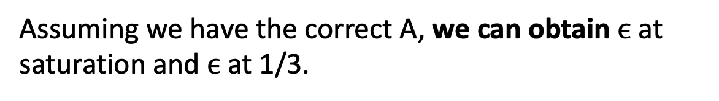
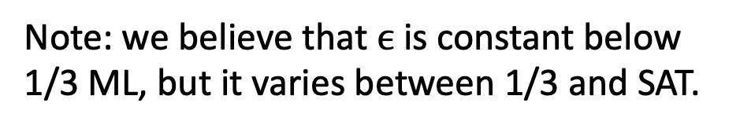
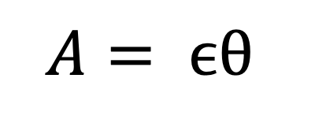
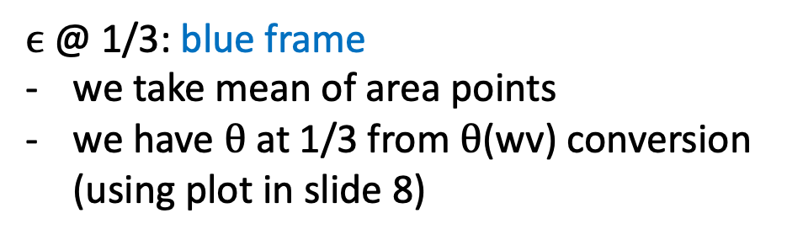

$$A= ϵθ$$
Beer’s Law
Assuming we have the correct A, we can obtain $ϵ$ at saturation and $ϵ$ at 1/3.
$ϵ$@ SATURATION: green frame
we take mean of area points
we have $θ$ at SAT from German paper
$ϵ$@ 1/3: blue frame
we take mean of area points
we have $θ$ at 1/3 from $θ$(wv) conversion (using plot in slide 8)
Note: we believe that $ϵ$ is constant below 1/3 ML, but it varies between 1/3 and SAT.

