Slide 1
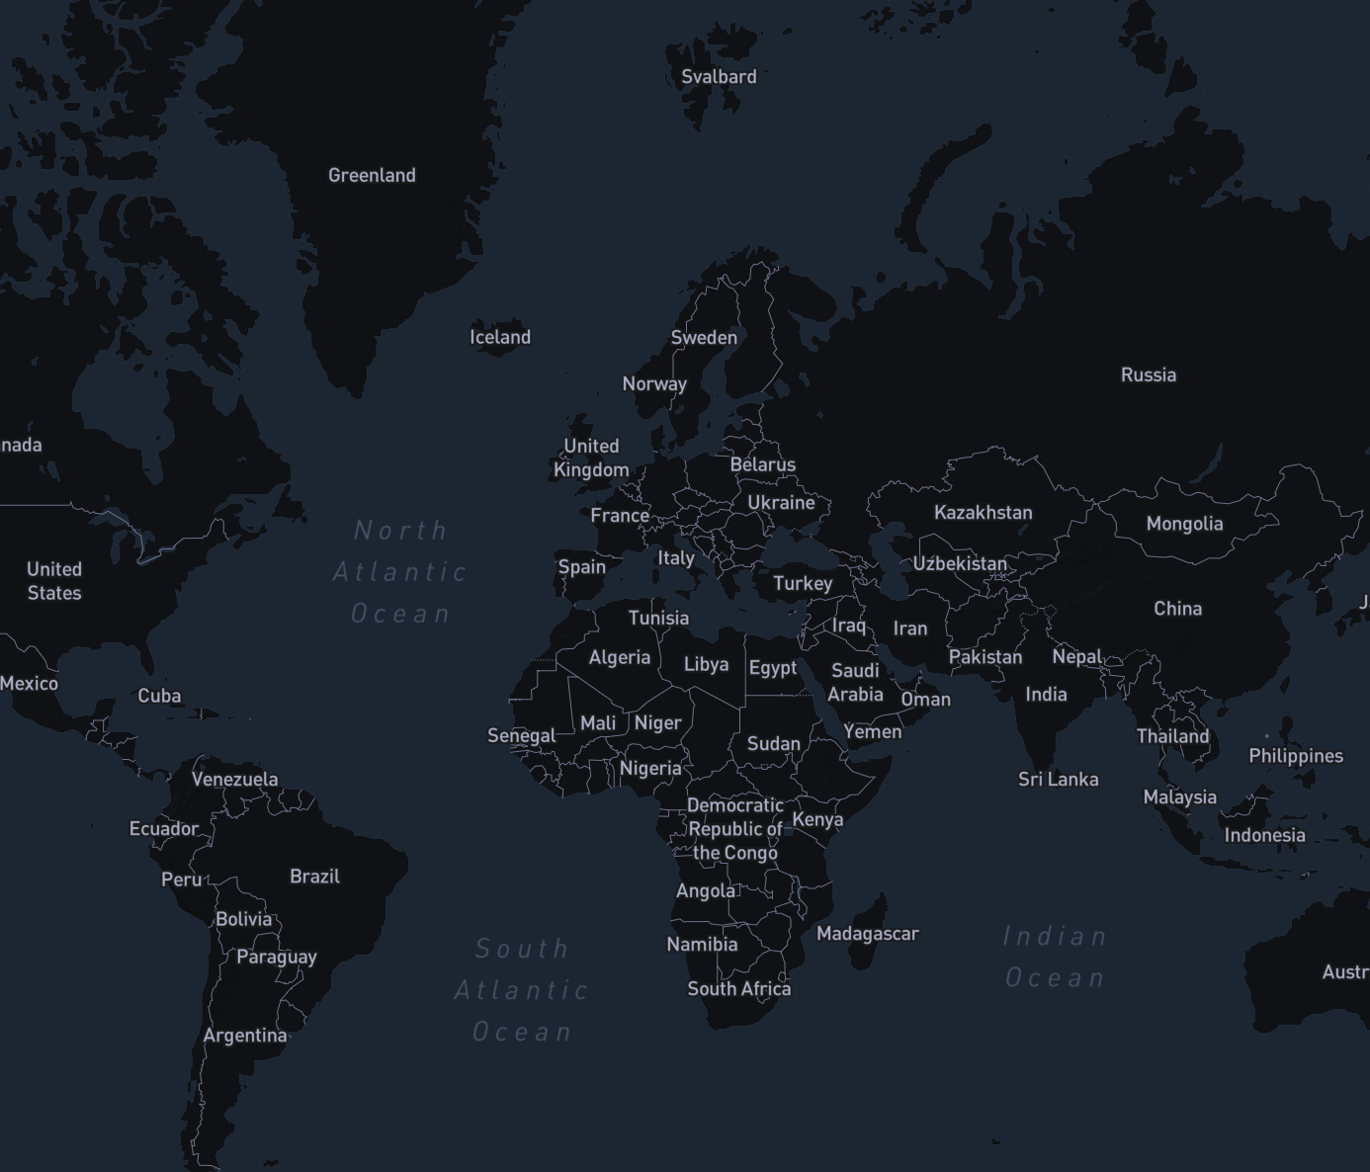
Interactive map and pins database
Marija Trifkovic
May 10th, 2021

Slide 2
Description
An interactive map that users can add pins to for various reasons
Users can pin places they have visited or places they are interested in or any other place
Users can see all the other places pinned by different users
Users can delete pins and get notifications about new pins

Slide 3
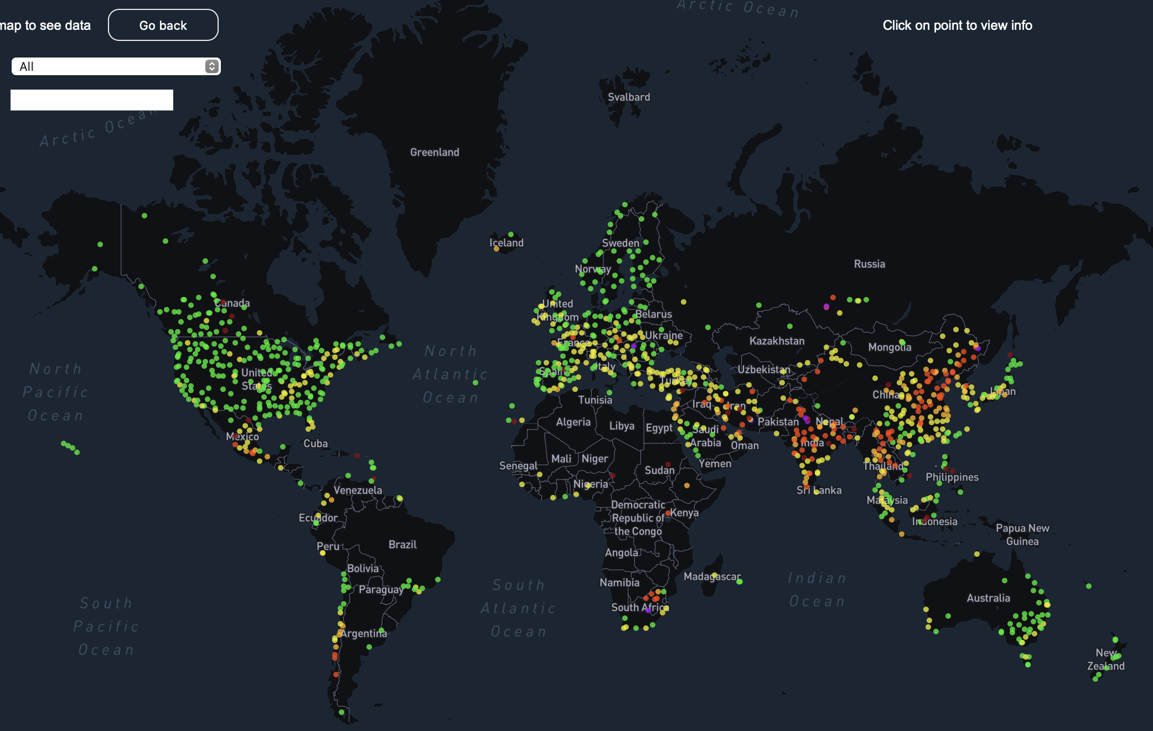
Visual Documentation- Interactive map example
https://github.com/marija2/acc-hw5
Interactive map used for Homework 5 will be used to visualize places pinned by users

Slide 4
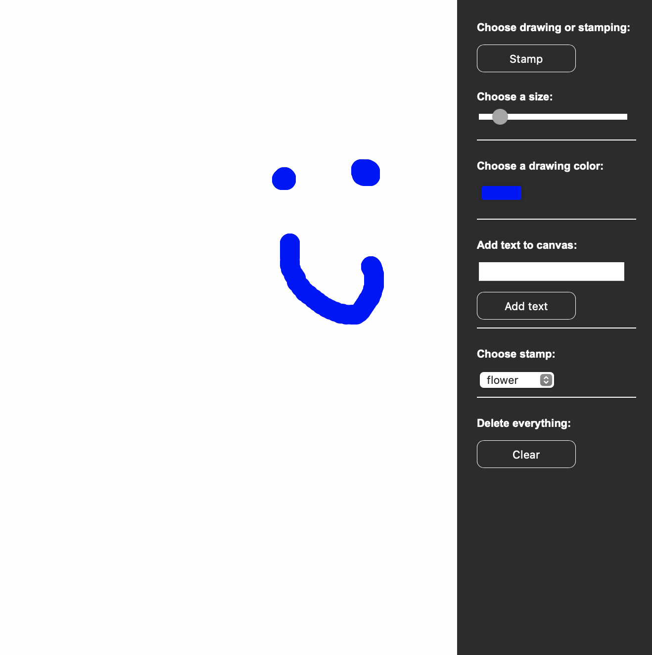
Visual Documentation-Collaborative drawing example
https://github.com/marija2/acc-hw7
Collaborative drawing from Homework 7 will be used as a guide for drawing pins on the map for all users as well as sending notifications

Slide 5
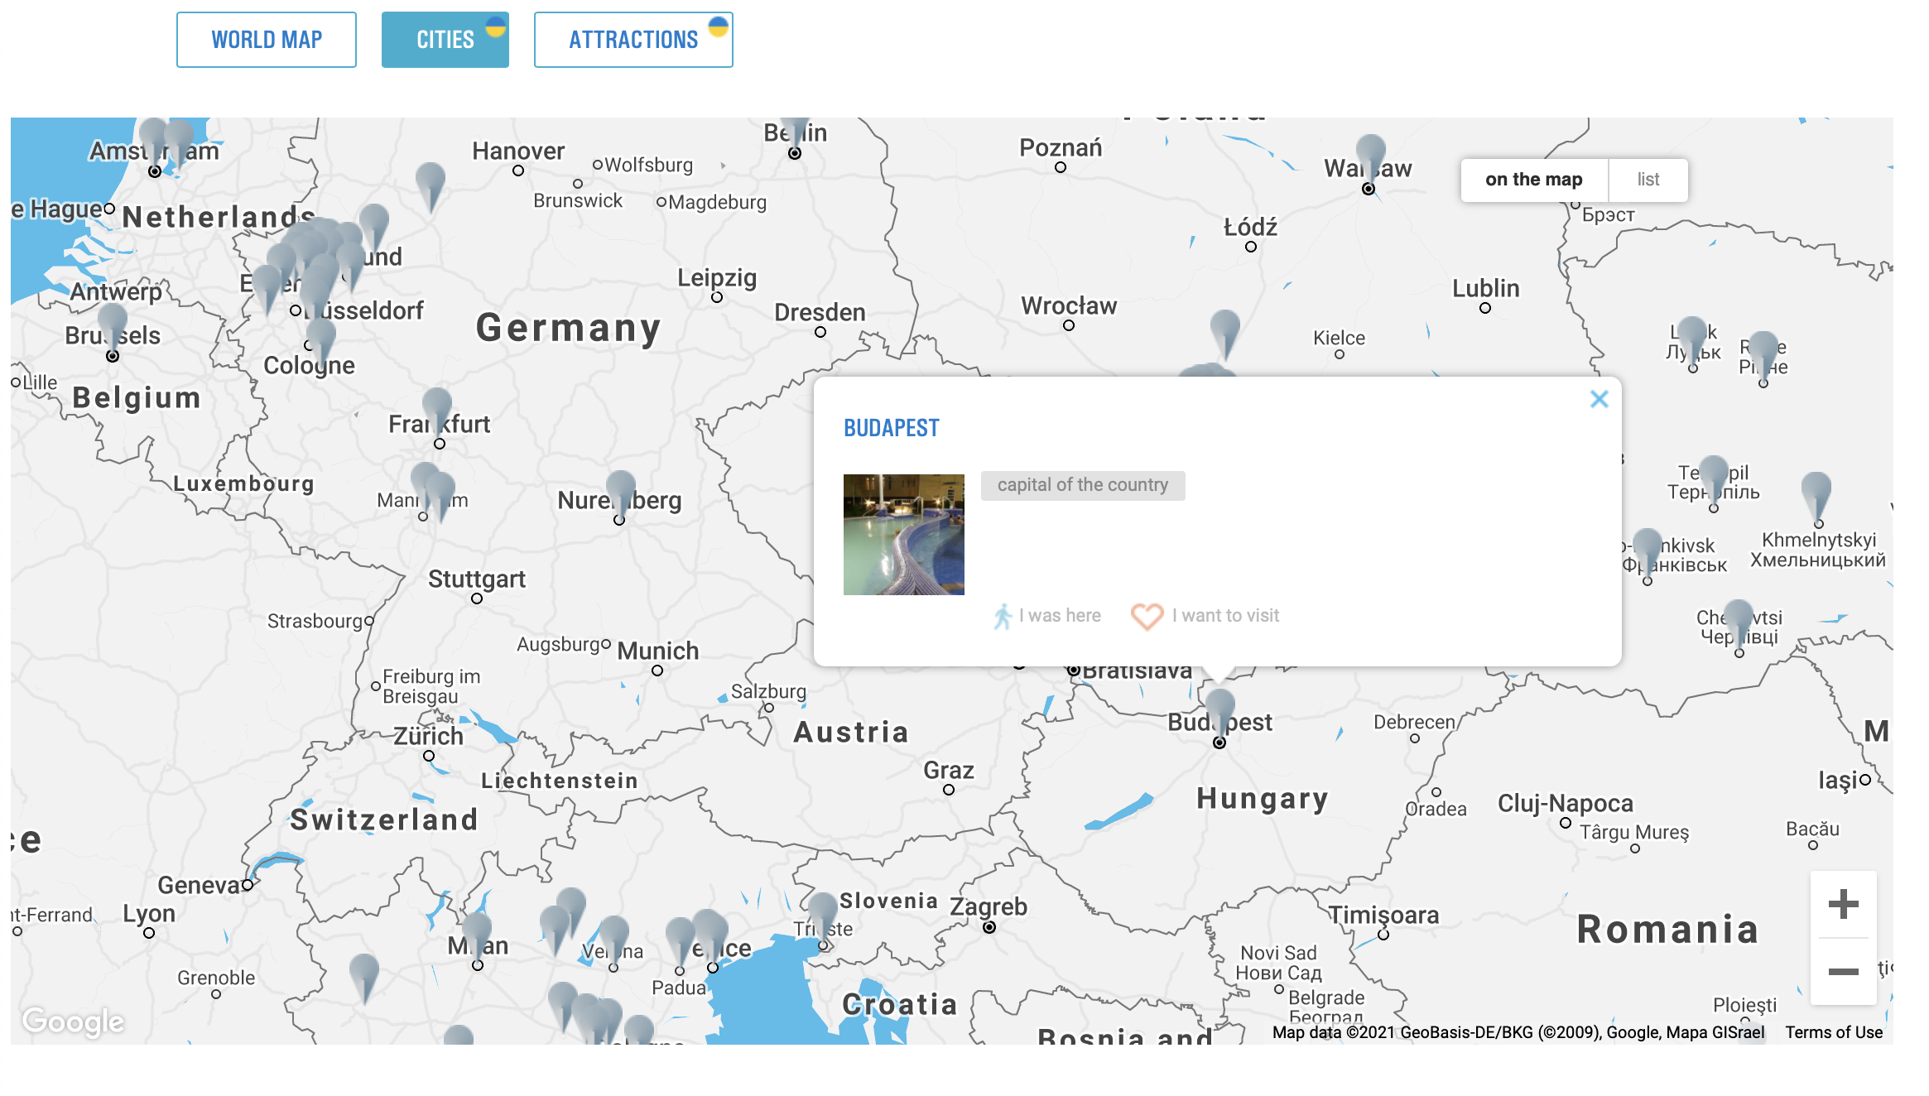
Resources
https://ua.igotoworld.com/en/visited-map/visited-places-map.htm#/CitiesWorldMap – will be used as inspiration for how the pins will look and how much information each pin will contain

Slide 6
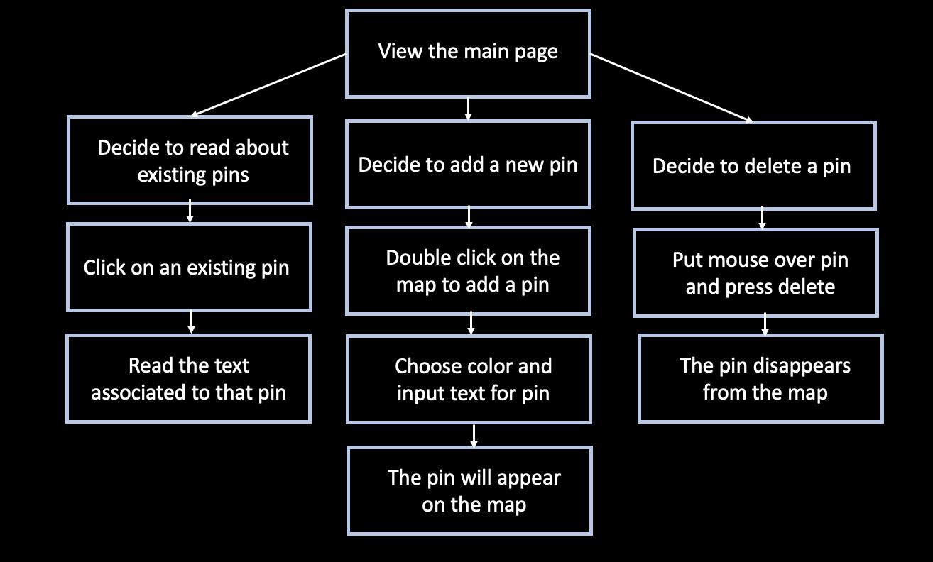
User workflow

Slide 7
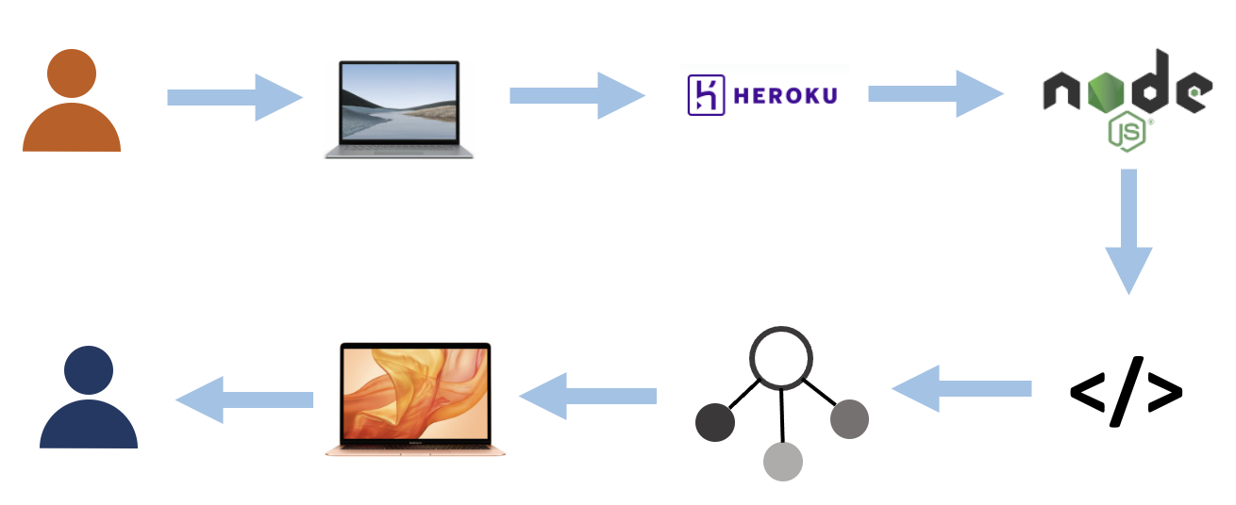
Tech diagram

Slide 8
Thank you for your attention!
Marija Trifkovic
May 10th, 2021

