Slide 1
Tech Stack
ASP.NET Core 8
Angular 18
PostgreSQL
PostGIS
RabbitMQ
gRPC / Protobuf
SignalR
Docker Compose
Ocelot
RideBuddy
Microservices Ridesharing Platform
Autori
Marija Markovic · Marko Savic · Dragana Zdravkovic
Razvoj softvera 2

Slide 2
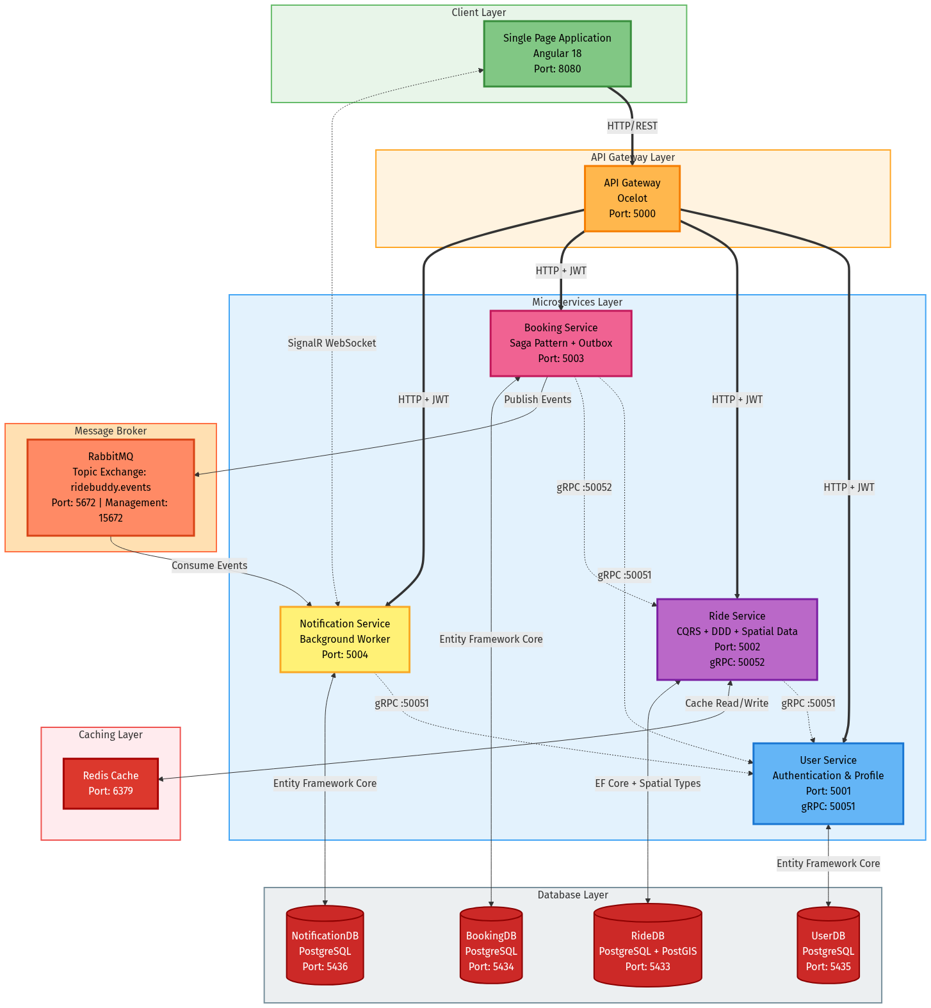
Arhitektura Sistema
Kljucne komponente:
• Angular 18 SPA → Ocelot Gateway (:5000)
• 4 mikroservisa (.NET 8): User, Ride, Booking, Notification
• PostgreSQL po servisu (Database per Service)
Komunikacija:
• gRPC — sinhrona (HTTP/2 + Protobuf)
• RabbitMQ — asinhrona (Outbox Pattern)
• SignalR — WebSocket push ka klijentu

Slide 3
Kljucne Dizajn Odluke
Clean Architecture + DDD
CQRS + MediatR + Outbox
Auth + Logging + Deploy
• 4 sloja: Domain, Application, Infrastructure, API
• Zavisnosti uvek ka unutra (Dependency Rule)
• AggregateRoot: Id + Version + DomainEvents
• ValueObject: strukturalna jednakost
• Repository Pattern + Factory Method
• Commands (pisanje) i Queries (citanje)
• MediatR: Logging → Validation → Handler
• Outbox: atomicno pisanje, retry do 5x svakih 10s
• At-least-once garantija isporuke
• BackgroundService za obradu outbox redova
• JWT HS256 — jedino User Svc izdaje token
• Shared secret key — svi servisi validiraju
• Serilog: named placeholders, structured log
• Docker Compose + .env + auto-migrate EF Core
• Health check /health na svakom servisu

Slide 4
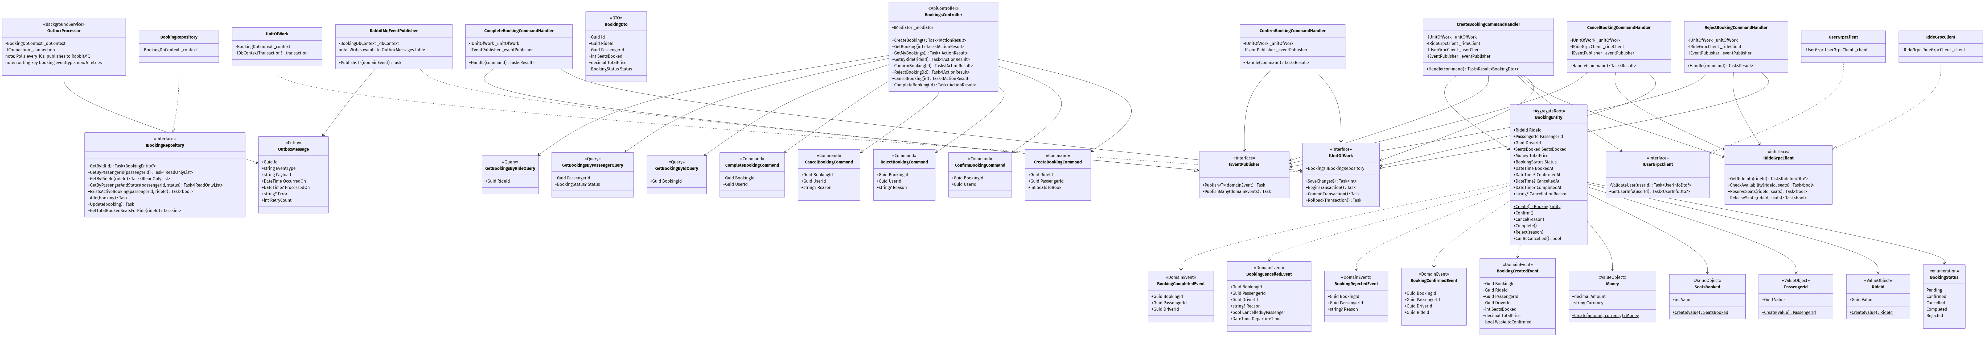
Booking Service
Domain:
• BookingEntity: Pending → Confirmed/Rejected → Completed/Cancelled
• Private constructor + Create() factory method
• Saga: 7 koraka sa kompenzacijom
Saga kompenzacija:
• ReserveSeats (gRPC → Ride Svc)
• Greska → Rollback + ReleaseSeats
Infrastruktura:
• Result<T> umesto exception-a
• MediatR pipeline: Log → Validate → Handle
• Outbox → RabbitMQ (5 tipova evenata)

Slide 5
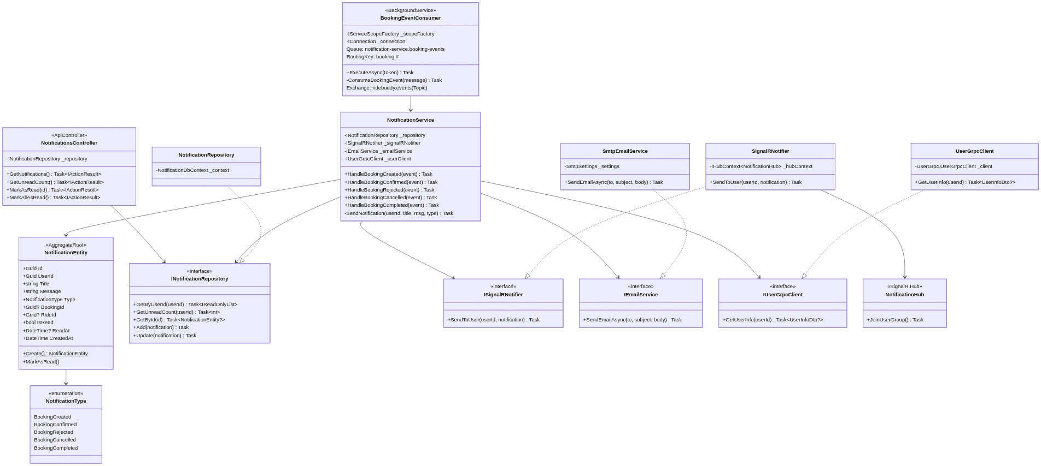
Notification Service
Konzumiranje evenata:
• BackgroundService konzumira booking.# (sve events)
• prefetchCount=1, manual ack/nack
• IServiceScopeFactory (scoped dep. u singletonu)
Kanali:
• Inicijalna strana → samo email
• Druga strana → DB + SignalR + email
• MailKit STARTTLS (umesto System.Net.Mail)
• gRPC → UserService za ime i email
SignalR:
• Grupe user-{userId}, JWT via ?access_token=

Slide 6
User Service
Autentifikacija i Domain
gRPC Server i Infrastruktura
• ASP.NET Core Identity — bcrypt, jedinstven email
• Jedini servis koji izdaje JWT tokene (HS256)
• Claims: sub, email, role — svi servisi validiraju
• UserEntity (AR): Email, FirstName, LastName, Role
• Value Objects: Email, PhoneNumber, UserId
• Domain Events: UserRegisteredEvent
• gRPC server (:50051): ValidateUser, GetUserInfo
• Pozivaju ga: Booking, Notification, Ride servis
• .proto → auto-generisani klijentski kod (Grpc.Tools)
• REST: POST /register, POST /login, GET/PUT /users
• PostgreSQL 5435 + Identity tablice
• Outbox → ridebuddy.events (user.*)

Slide 7
Ride Service
Domain i Geospatijalni podaci
gRPC Server i Komunikacija
• RideEntity: Scheduled → InProgress → Completed/Cancelled
• AutoConfirmBookings flag (vozac bira rezim)
• Value Objects: Location (lat/lon), Money, SeatsCount
• PostGIS ekstenzija za geospatijalne upite
• NetTopologySuite — LINQ nad prostornim kolonama
• PostgreSQL + PostGIS (port 5433)
• gRPC server (:50052): GetRideInfo, CheckAvailability
• ReserveSeats / ReleaseSeats (poziva Booking Svc)
• gRPC klijent → UserService (ValidateDriver)
• RideCancelledEvent → Booking Svc otkazuje rezervacije
• REST: CRUD voznji + paginisana pretraga
• Concurrency token: Version property na entitetu

Slide 8
Frontend — Angular 18 SPA
Arhitektura
Real-time i State
• SPA: jedno HTML ucitavanje, klijent-side routing
• TypeScript + RxJS (reaktivno programiranje)
• HTTP interceptori: auto-inject JWT na svaki poziv
• Moduli: Auth, Ride, Booking, Notification
• Passenger i Driver pogledi razdvojeni
• Angular DI sistem (slicno .NET-u)
• SignalR: konekcija na /hubs/notifications
• JWT via ?access_token= (WS ne podrzava headere)
• Slusa ReceiveNotification → azurira badge
• NotificationType enum zrcali backend (0–4)
• BehaviorSubject: broadcast stanja svim pretpl.
• Observables za asinhrono ucitavanje podataka

Slide 9
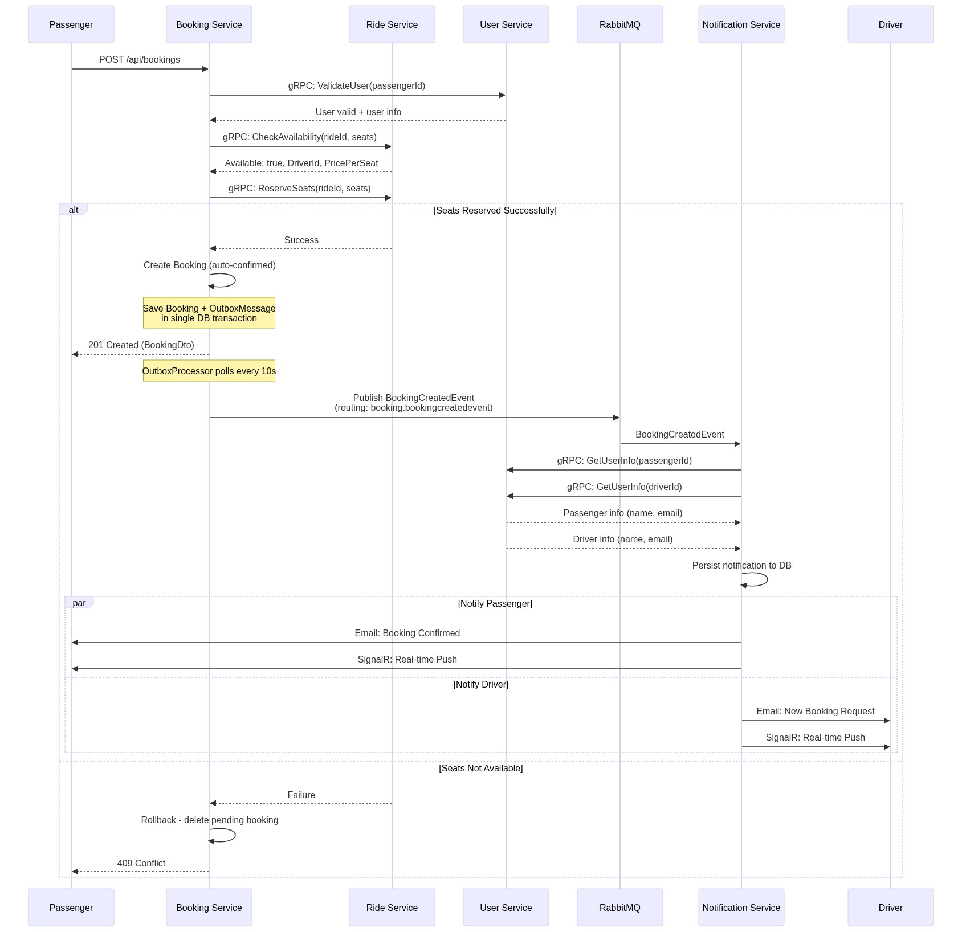
Srecan Tok — Kreiranje Rezervacije
Tok:
• Angular → Ocelot → Booking Svc
• Booking Svc izvrsava sagu (7 koraka)
• Outbox → RabbitMQ → Notification Svc
• NS salje email + SignalR push
Kljucni koraci sage:
• ValidateUser (gRPC → US)
• GetRideInfo (gRPC → RS)
• ReserveSeats (gRPC → RS)

Slide 10
?
Pitanja
Hvala na paznji!
Marija Markovic · Marko Savic · Dragana Zdravkovic

