Slide 1
Two Lists Enter,
One Search Leaves!
Introducing the Pairwise PubMed Search Generator
Marijane White, MSLIS
whimar@ohsu.edu

Slide 2
Hello!
I’m Marijane. (she/they)
Currently
Data and Research Engagement Librarian @ Oregon Health & Science University
MLA Systematic Review Services Specialization
Previously
Content Manager/Corporate Librarian
Software Testing/Quality Assessment
Interests
Making building searches less annoying
Making searches more reproducible
Python programming
Technical Writer/Editor
BS in Computer Engineering
Ontologist/Semantic Modeler
~18 years in software industry

Slide 3
Today
PubMed’s Proximity Search
Pairwise Combinatorics
Pairwise PubMed Search Generator
Get ready to answer a poll:
Go to www.menti.com
Enter the code on the poll slide to participate

Slide 4
PubMed’s Proximity Search

Slide 5
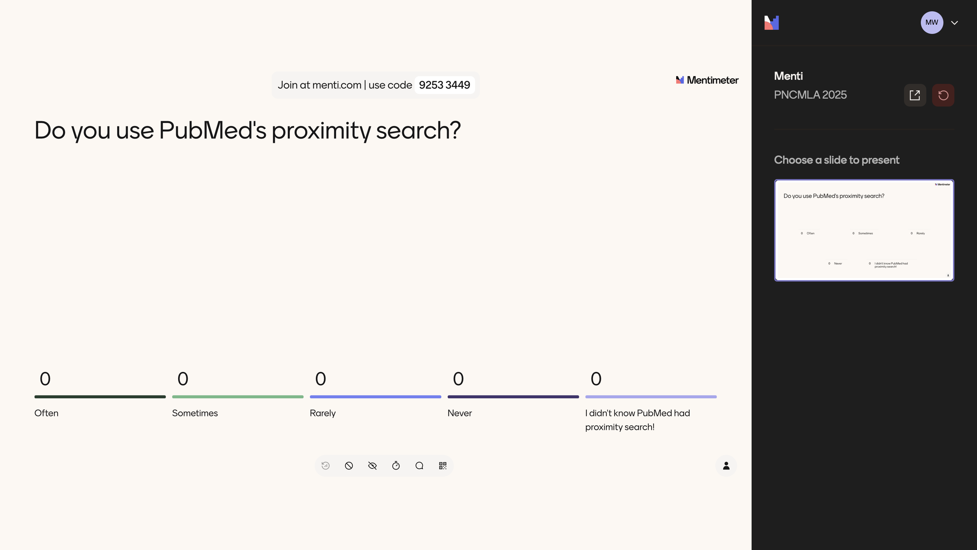
Poll: Do you use PubMed’s proximity search?

Slide 6
Limitations of PubMed’s proximity search
“Unusual syntax”[tiab:~5]
No truncation!
Building searches is tedious and error-prone
Title, Title/Abstract, and Affiliation fields only

Slide 7
Why is PubMed’s proximity search like that?
Short answer: Because Solr, the open source search engine software PubMed is currently built upon
Clues from the Standard Query Parser docs:
  Specifying Terms: A phrase is a group of words surrounded by double quotes such as "hello dolly”
  Wildcard Searches: Wildcard characters can be applied to single terms, but not to search phrases
  Proximity Searches: To perform a proximity search, add the tilde character ~ and a numeric value to the end of a search phrase. For example, to search for "apache" and "jakarta" within 10 words of each other in a document, use the search: "jakarta apache"~10

Slide 8
Pairwise Combinatorics

Slide 9
What does “pairwise” mean?
1 A
2 B
3 C
1 A
1 B
1 C
2 A
2 B
2 C
3 A
3 B
3 C
Notes:
The lists do not have to be the same length
the total number of pairs is the product of the length of both lists
long lists mean many pairs

Slide 10
What are pairwise techniques used for?
Decision Making Tools
Ranking Choices
Experimental Research Design
Statistical Analyses
Usability Testing
Software Test Generation
… not much in libraries or by librarians

Slide 11
Pairwise PubMed Search Generator

Slide 12
Development Timeline
2018
A Research Team asks the Library about combining long lists of genes with long lists of keywords to search all the pairings in PubMed
Solved with a short Python script
Stalled out turning it into a tool
2022
NLM introduces proximity search in PubMed
2024
Started reusing 2018 code for proximity search string generation
Got serious about turning it into a tool
2020
NLM launches the new PubMed

Slide 13
What can it do?
Generate search strings
  Combine a list of MeSH main headings with a list of subheadings
  Combine two lists of search terms in a proximity search
  Combine two lists of search terms with Boolean AND (intersection)
Launch searches
  Copy to clipboard
  Launch via button
Built-in example term lists
  Search topic: frailty measures

Slide 14
Why use it?
Eliminates tedious manual typing of variations and combinations
Prevents syntax errors
Easily create complex and lengthy search strategies
Makes proximity searching in PubMed more accessible

Slide 15
Demo
https://pairwise-pubmed.streamlit.app/

