Slide 1
Data Challenge
Marije Filius
25-05-2018

Slide 2
Overview
Challenge
Overview of the solution
Next actions

Slide 3
Challenge
Make a docker container setup with:
  Kafka as a pub/sub system
  Ability to load ‘some data’
  Ability to consume and transform that data
  Ability to write the result in a database

Slide 4
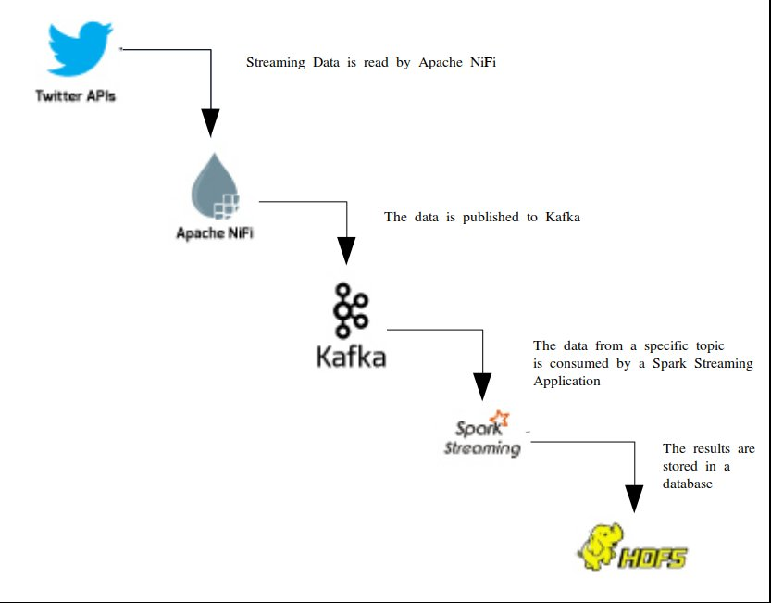
Overview of the solution

Slide 5
Apache NiFi
“An easy to use, powerful, and reliable system to process and distribute data.” (https://nifi.apache.org/)
Goal: Get all Twitter-Feeds and publish them on Kafka
Alternatives:
  Apache Kafka, Apache Airflow, GeoKettle and more...
https://www.predictiveanalyticstoday.com/top-ten-alternatives-for-apache-nifi/

Slide 6
Apache Kafka
“Kafka® is used for building real-time data pipelines and streaming apps. It is horizontally scalable, fault-tolerant, wicked fast, and runs in production in thousands of companies.” (https://kafka.apache.org/)
Goal: Create a distributed streaming platform for distributing the twitter-feed.

Slide 7
Spark Streaming
“Spark Streaming makes it easy to build scalable fault-tolerant streaming applications.” (https://spark.apache.org/streaming/)
Goal: Consume the data from the Kafka Topic and do some ‘arbitrary’ transformations
Alternatives:
  Apache Flink
  Batched analyses

Slide 8
Hadoop Distributed File System
“The HDFS is a distributed, scalable, and portable file system written in Java for the Hadoop framework.” (http://hadoop.apache.org/)
Goal: Store the results
Alternatives:
  ElasticSearch (In combination with Kibana? )
  Cassandra
  Amazon S3
  Hbase, SolR...

Slide 9
Next actions
Look at the performance and choices for each of the elements with regards to the actual requirements
Run the different containers on a PaaS
  Kubernetes
  Rancher (2.0)
Add the NiFi Template automatically with the secrets as arguments

Slide 10
Thanks for the opportunity!

