Slide 1
Data Challenge
Marije Filius
25-05-2018

Slide 2
Overview
Challenge
Overview of the solution
Next actions
1

Slide 3
Challenge
Make a docker container setup with:
Kafka as a pub/sub system;
the ability to load ‘some data’;
the ability to consume and transform that data; and
the ability to write the result in a database.
1

Slide 4
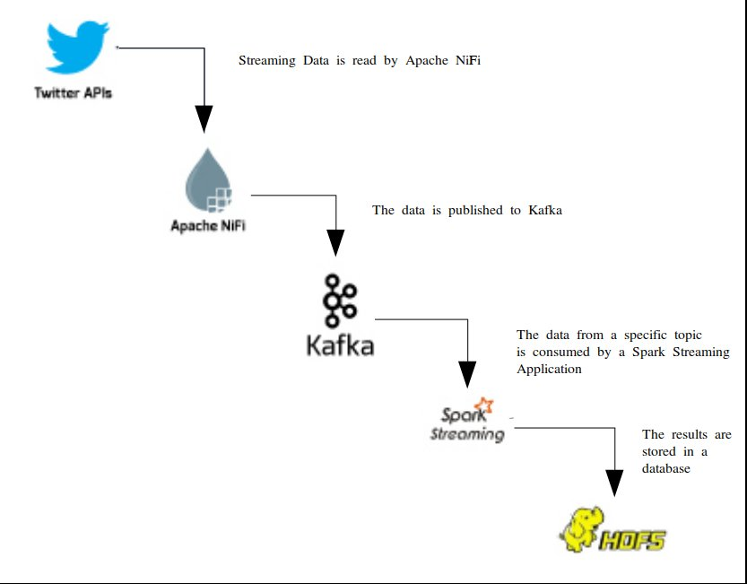
Overview of the solution
1

Slide 5
Apache NiFi
“An easy to use, powerful, and reliable system to process and distribute data.” (https://nifi.apache.org/)
Goal: Get all Twitter-Feeds and publish them on Kafka
Alternatives:
Apache Kafka;
Apache Airflow;
GeoKettle.
1

Slide 6
Apache Kafka
“Kafka® is used for building real-time data pipelines and streaming apps. It is horizontally scalable, fault-tolerant, wicked fast, and runs in production in thousands of companies.” (https://kafka.apache.org/)
Goal: Create a distributed streaming platform for distributing the twitter-feed.
1

Slide 7
Spark Streaming
“Spark Streaming makes it easy to build scalable fault-tolerant streaming applications.”
(https://spark.apache.org/streaming/)
Goal: Consume the data from the Kafka Topic and do some ‘arbitrary’ transformations.
Alternatives:
Apache Flink; and
batched analyses.
1

Slide 8
Hadoop Distributed File System
“The HDFS is a distributed, scalable, and portable file system written in Java for the Hadoop framework.”
(http://hadoop.apache.org/)
Goal: Store the results.
Alternatives:
ElasticSearch (In combination with Kibana?);
Cassandra;
Amazon S3; and more
(e.g.) Hbase, SolR...
1

Slide 9
Next actions
Analyze the performance and choices for each of the elements with regards to the actual requirements.
Include: Storing data outside of Docker in the correct format, with the correct compression
Run the different containers on a PaaS, such as:
Kubernetes; or
Rancher (2.0).
Add the NiFi Template automatically with the secrets as arguments.
1

Slide 10
Thanks for the opportunity!
<number>

