Slide 1
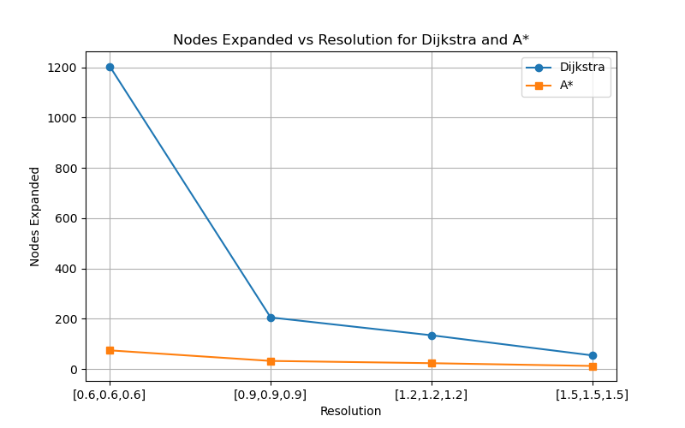
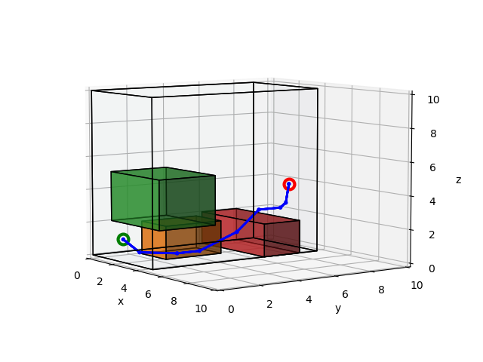

Dijkstra path for Resolution = [1.2, 1.2, 1.2]
The above figure shows plots of the nodes_expanded for Dijkstra and A* algorithm and Resolution = [0.6, 0.6, 0.6], [0.9,0.9,0.9], [1.2,1.2,1.2], [1.5,1.5,1.5]. The figure suggests nodes_expanded decreases as the resolution becomes larger. Also, nodes_expanded for A* is smaller than nodes_expanded for Dijkstra.
The right two figures show the path taken for Resolution = [1.2,1.2,1.2] for Dijkstra (top) and A* (bottom) algorithms. The main difference was that the A* has a larger leap to go over the red box.
A* path for Resolution = [1.2, 1.2, 1.2]

