Slide 1

MACHINE LEARNING & CONTENT ANALYTICS
ELESA VASILOPOULOU p2822028
Evangelia vlachantoni p2822002
Marilena gkotsi p2822029

Slide 2
Main Idea
Creating a baseline intuition that will classify each line of abstract to a specific argument label.
Then, using neural networks will try to create a model that predicts argument and structure labels.
Finally, try to detect cluster abstracts with themselves and with specific features as well.

Slide 3
Goals and Expectations
To discover the power of neural networks more specific the application on text recognition
Enrich our skills in Python Programming language
Create a model that predicts structure and argument labels accurately with low level of error
Compare our results with our baseline intuition created as first step

Slide 4
Methodology

Slide 5
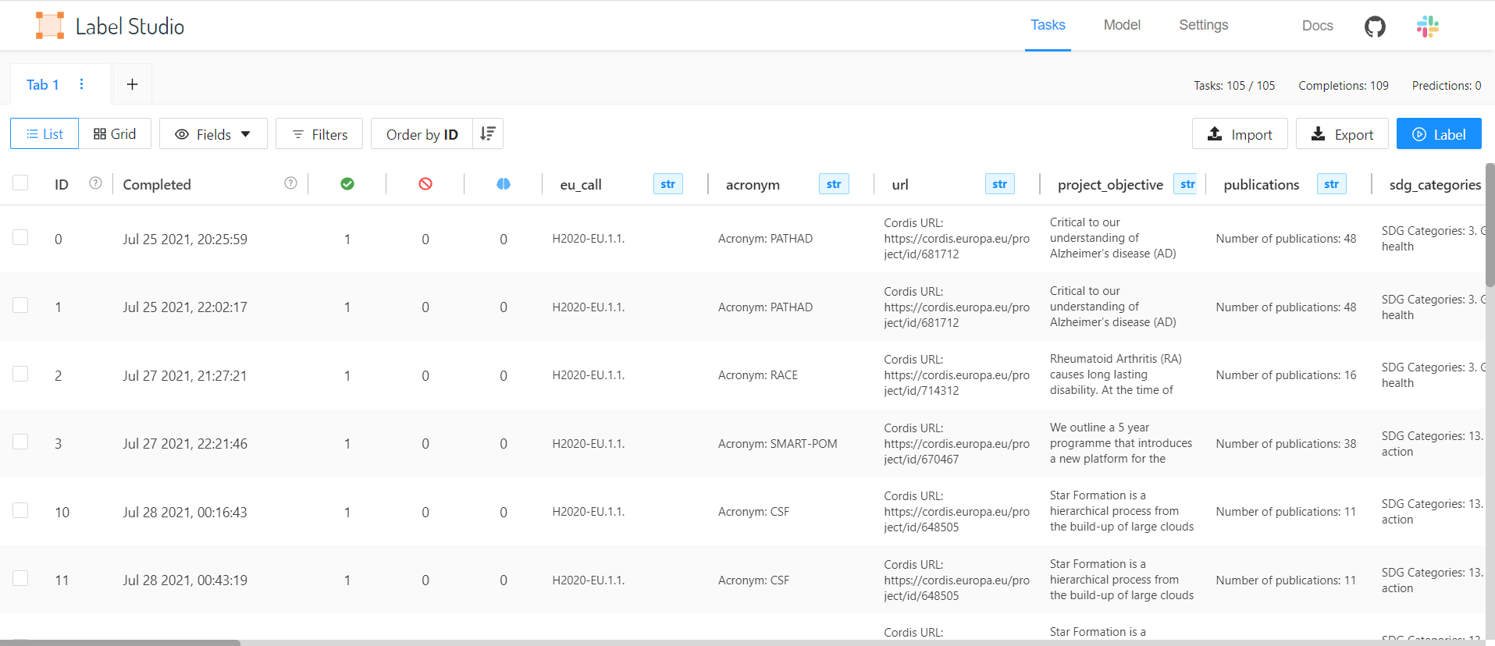
Data Collection
We conducted annotation procedure in over 100 scientific abstracts without collaboration. This phase of methodology, was a necessary step in order to create our dataset in following steps.

Slide 6
Description of the Data (1)
All three datasets contain three columns named Document, Sentences and Labels.
The first column of each dataset contains the doi number of each abstract
the second column contains the sentences
last column the labels of each category
The labels of argument are divided into two subcategories:
Claim
Evidence
Structure’s labels :
Background,
Objective/Aim
Method
Result
Conclusion

Slide 7
Description of the Data (2)
Citation labels are divided in four different categories:
Positive
Negative
Neutral
Irrelevant

Slide 8
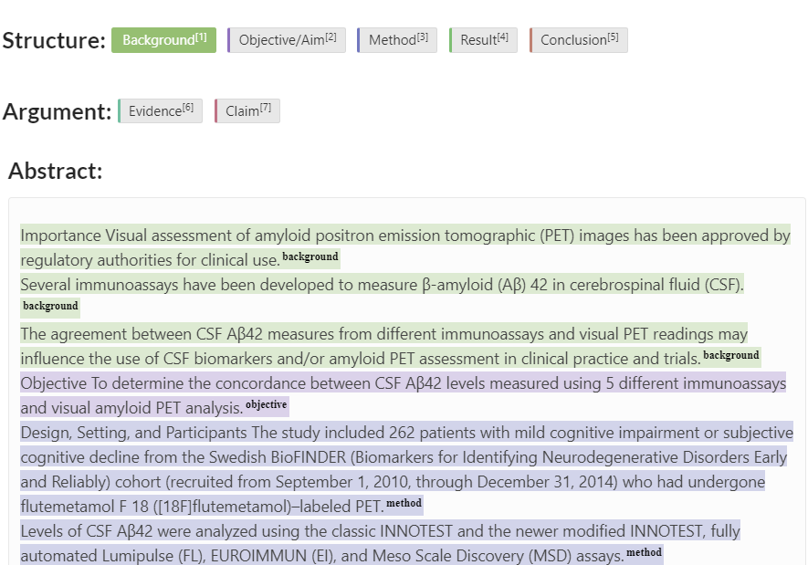
Annotation
Append the appropriate label according three categories:
the structure label (background, objective/aim, method, results, conclusion)
the argument label (evidence, claim)
the citation’s label (positive, negative, neutral, irrelevant)

Slide 9
Data Processing
Import json files
Create a dataframe in which assign the sentence column
Assign each row of sentence in a list
Create a dataframe which contains each sentence with a correspondent document id
Same process to column labels and at the end a new data frame was prepared, named datargument, ready to be used.

Slide 10
Experiments in Argument/Structure Prediction

Slide 11
Intuitive Baseline (1)
Create a bug of keywords recently appeared in each argument label category
We create a dataframe with one column containing all abstract’s words
Eliminate the factor of lower case or upper case letters
Delete special characters such as commas, points etc.
Dropping out all duplicates
Create the list that will use to check if the sentence of the abstract is containing one of them

Slide 12
Intuitive Baseline (2)
Baseline intuition will be applied in argument labels forming an iterative repetition in each sentence which will examine whether there is or not a keyword justifying whether the argument label belongs to claim or evidence
In case that one word included in the list exists also in the sentence, the corresponding label will be assigned
From 954 sentences labeled as CLAIM we detected 443 correctly, but using the for loop 3997 were labeled as CLAIM, which means 3554 labels were wrongly appended
From 1578 sentences labeled as EVIDENCE we detected 1017 correctly, but using the for loop 5521 were labeled as EVIDENCE which means that 4330 were wrongly appended

Slide 13
Intuitive Baseline (3)
Due to the fact that the results obtained by the previous method were not very encouraging so we tried a different approach using as assumption that the last sentence is always the claim.
According to that method we correctly labeled 473 out of 954 sentences, minimizing the number of the wrongly appended labels
The second base rule to label the evidence sentences is based to the assumption that the evidence contain arithmetical results therefore arithmetic symbols
This method found 921 Evidence sentences (total of 1578) and from them the 405 were assigned correctly. This method also minimized the wrongly appended labels

Slide 14
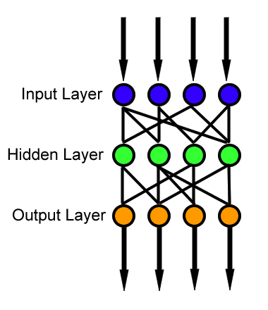
Feed Forward Network Method
The information moves in only one direction—forward—from the input nodes, through the hidden nodes (if any) and to the output nodes. There are no cycles or loops in the network.

Slide 15
Argument and Structure Prediction
Loading our dataset
Seperate sentences and labels columns into two different variables
Create train-validation and test dataset
Split train-validation into two separated datasets
Label encoding, using OneHotEncoder
Create embeddings with CountVectorizer
Creation of tokens of the sentences in order to count them and find the most frequent.
Remove the stop words from the list and create dictionary
Train the model
Fitting the CountVectorizer only on the Training Dataset
Model Evaluation and Prediction using Test Dataset

Slide 16
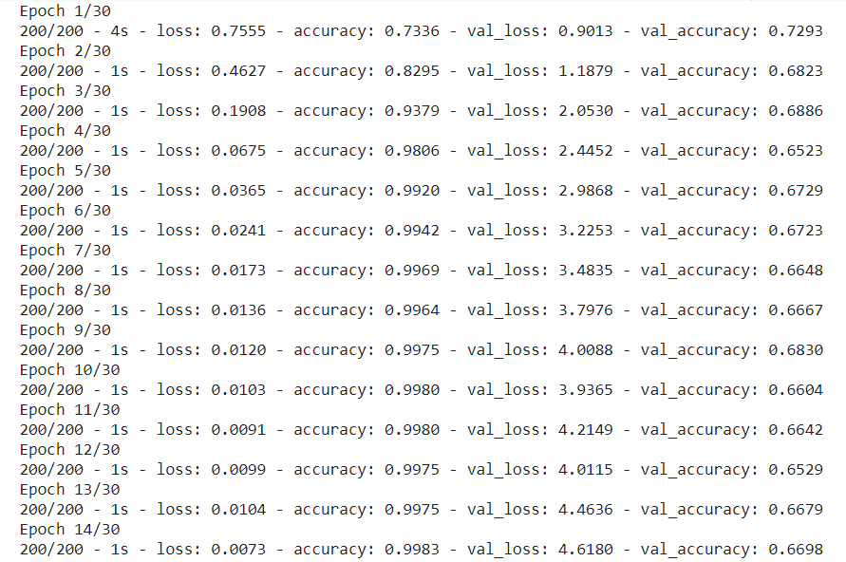
Argument Loss - Accuracy

Slide 17
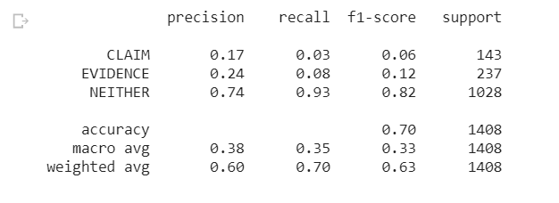
Classification Report for Argument Prediction
The precision for claim is 0.17, for evidence, 0.24 and for neither 0.74 which means that the model predicts better the label “neither”
The recall for claim is 0.03, for evidence 0.08 and for neither 0.93 which means that 93% were correct found positive
The f1 for claim is 0.06, for evidence 0.12 and for neither 0.82.
Support is the number of actual occurrences of the class in the specified dataset.
Imbalanced support in the training data may indicate structural weaknesses in the reported scores of the classifier and could indicate the need for stratified sampling or rebalancing.

Slide 18
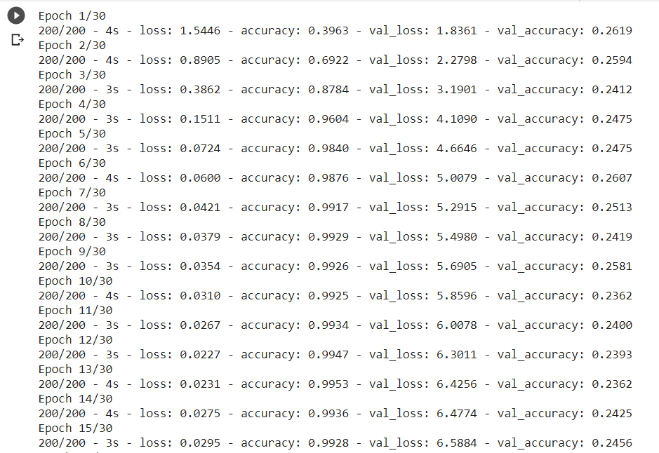
Structure Loss - Accuracy

Slide 19
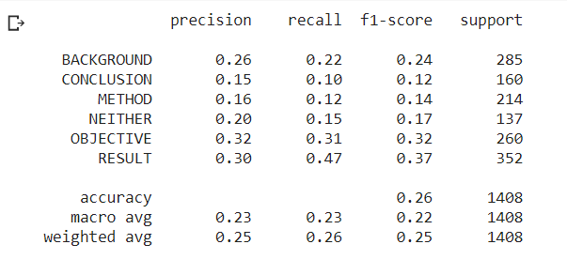
Classification Report for Structure Prediction
Structure prediction model provided slightly better results in the prediction of result objective and result label in comparison to other labels but still with many errors. This claim it is identified also by the recall ratio where the 31% for objective is predicted correctly and the 47% for result is predicted correctly as well.

Slide 20
Abstract Clustering

Slide 21
K-means
Our aim is to use any of the embeddings created for:
Abstract
Project objective (each abstract belongs to a project)
EU Call (each project belongs to an EU call)
Claim only or Claim and Evidence
to create clusters using embeddings from the abstract or a combination of features of any of the above-mentioned categories.

Slide 22
Elbow method

Slide 23
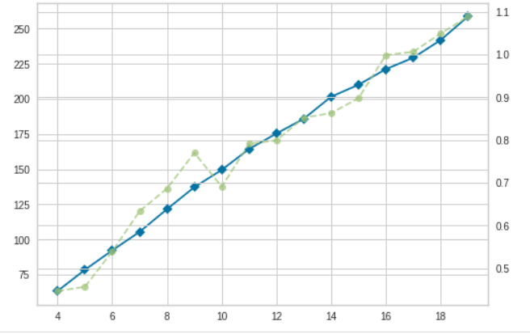
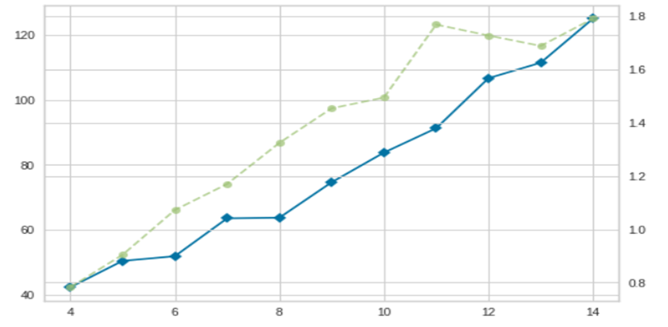
Elbow method for abstract embeddings
Elbow method with eu_call embeddings
Elbow method with all document embeddings and claim

Slide 24
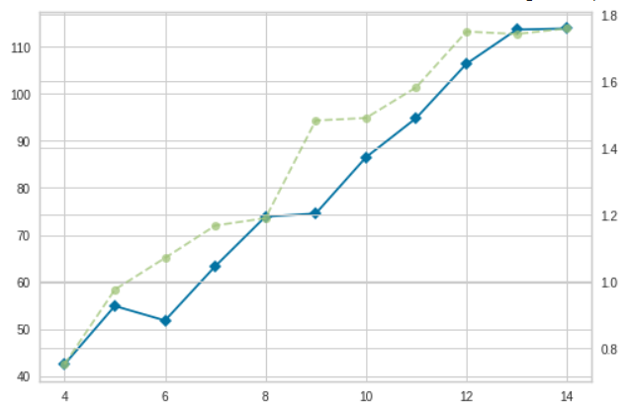
Elbow method with all document embeddings and claim_evidence

Slide 25
Silhouette method

Slide 26
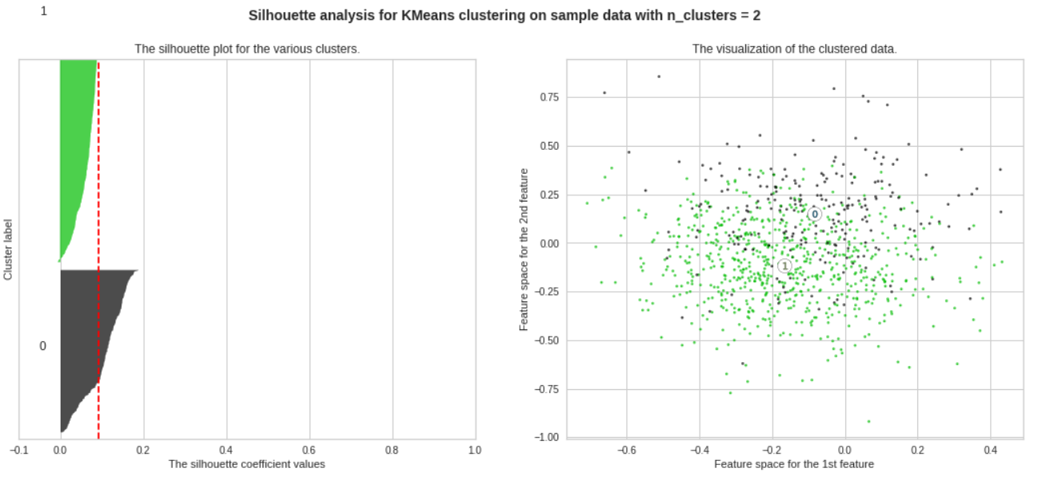
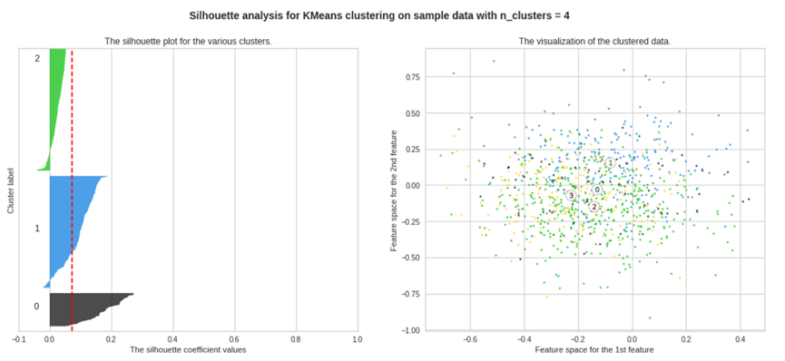
Silhouette method for abstract embeddings k=2
Silhouette method for abstract embeddings k=4

Slide 27
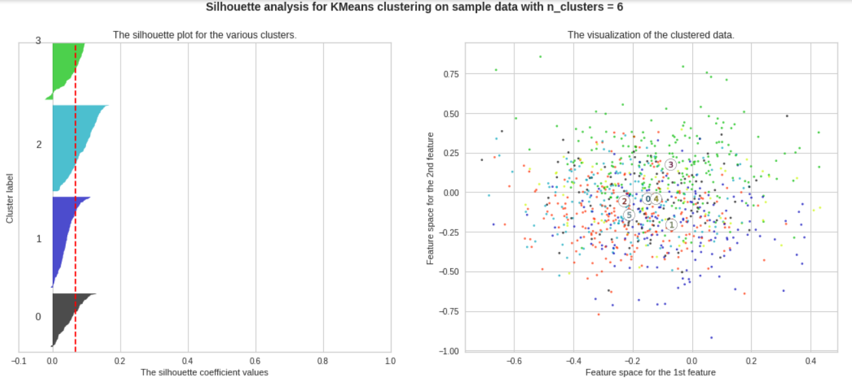
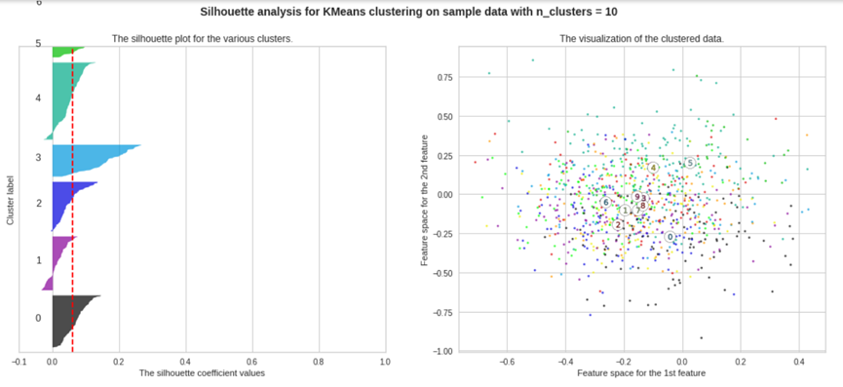
Silhouette method for abstract embeddings k=6
Silhouette method for abstract embeddings k=10

Slide 28
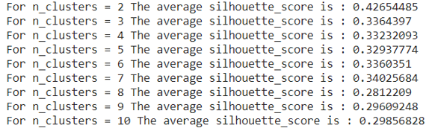
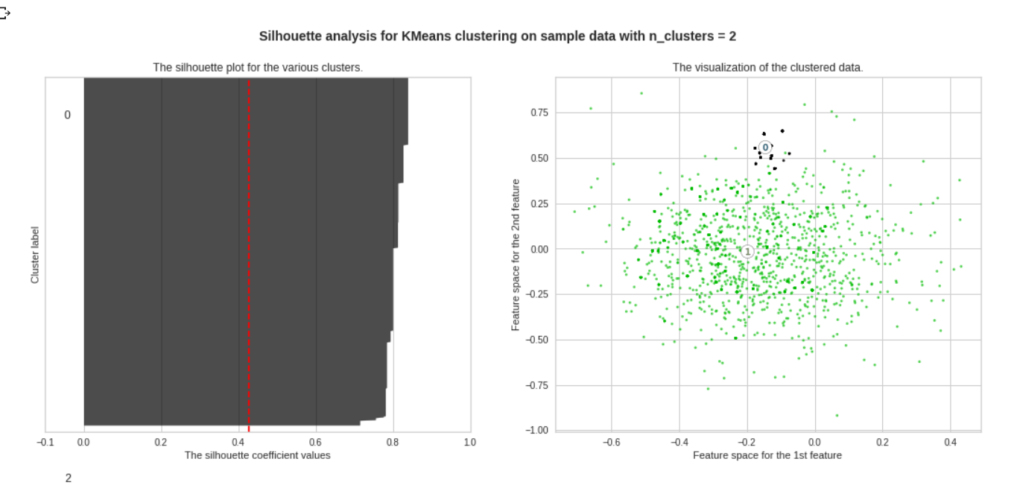
Silhouette Scores for the method for abstract embeddings and features
Silhouette method for abstract embeddings and features k=2

Slide 29
Results and Quantitave Analysis and Errors

Slide 30
Quantitave Analysis and Errors
The model for argument prediction could not predict well claim and evidence, in comparison to the neither label, the two first were predicted with errors.
A reason that this event occurs, is because of the way the words were tokenized or combined with the previous and the words after
Maybe there were key-phrases all over 105 abstracts that were repeated declaring claim or evidence and our model due to its performance on keywords could not increase his success rate
The same explanation we give for structure prediction as well.

Slide 31
Regarding errors in Clustering
Using sentences’ embeddings
Scientific abstracts utilize common words
Difficult to discern which word goes in the correspondent bin

Slide 32
This project gave us the chance to meet and understand the power of neural networks and clustering capabilities, but as always there is space for ameliorate a prediction’s model.

Slide 33


Slide 34


