Slide 1

Python for AI and Machine Learning
Lecture 01
Marilson Campos
UCSC Extension - 2022

Slide 2
About Me
Marilson Campos
Software Architect with 20+ years of experience.
Background in Machine Learning and Search engines
Designing ML & Big Data systems since 2007
- Some relevant presentations
Hadoop Summit 2013
Apache Impala User Group - 2015
Strata 2016 – Use case @ Cloudera Booth
Impala spotlight – Cloudera 2016

Slide 3
About You
Your current role
Why are you taking this class?

Slide 4
About the class What we will cover
Python language
Commonly used Unix commands
Use of Notebooks & Python IDE
Foundations Combinatorics / Statistics
Some Libraries used in Ai: NumPy, Pandas, Matplotlib
Exploratory Data Analysis
ML Model Building (Skitlearn)

Slide 5
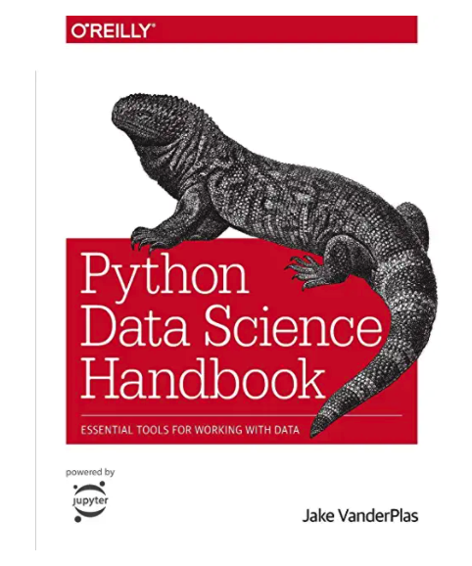
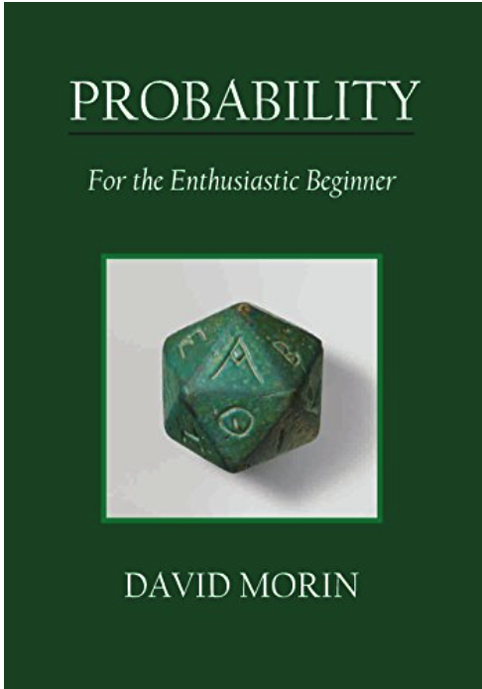
Recommended Books
Python Data Science
Probability/Math

Slide 6
About the class At the end of this class, I expect you to…
Create python programs and know how to optimize programs.
Create and use python notebooks.
Use pandas to load data, do math using NumPy and plot graphics in matplotlib/seaborn.
Continue to learn.

Slide 7
About the class Class Material vs The Project
We are covering some non-trivial concepts.
If you miss few advanced details, don’t worry too much. Important: If you are lost, please stop me! And ask for clarification.
I want to make the class as interactive as possible.
Material in the class is harder than the assignments.
This is by design, so advanced students can also benefit from the class.
To succeed in this class, you need to spend time witting code!

Slide 8
Installing Python & PyCharm
The following links will allow you install the
required tools
Pycharm Edu edition
https://www.jetbrains.com/pycharm-edu/
Anaconda Navigator
https://docs.anaconda.com/anaconda/install/

