Slide 1
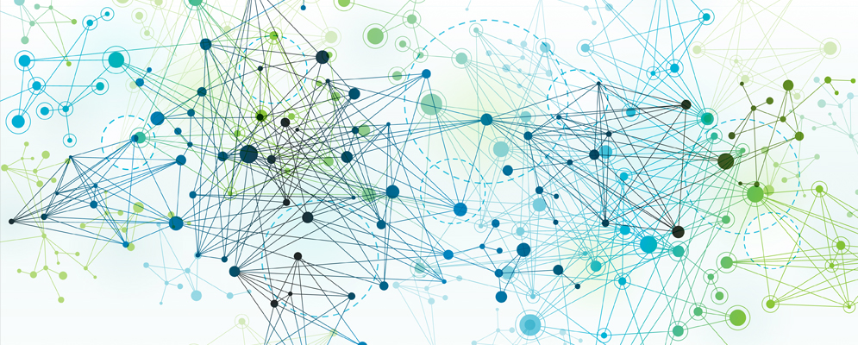
Python for AI and Machine Learning
ML/AI Process & Concepts
Marilson Campos
UCSC Extension - 2021

Slide 2
Problem-Solving: Traditional Vs AI/ML
Traditional problem solving
Start from Requirements
Derive Rules/Sequence of Commands
Test program against the set of known examples.
AI/ML problem solving
Start from Data
Select ’model type’ and possibly the features to use.
Create pipeline to extract knowledge from data.
Validate ‘learnings’ against new data

Slide 3
ML Model Example 1 – Linear Regression
Assumes the answer is a linear combination of input values.
Example:
Predict rent amount based on:
# of bedrooms (beds)
# of bathrooms (baths)
Neighborhood ‘score’: number from 1 to 5 (zone)
After training, we could have learned the following formula:
Rent = (342 * beds) + (159 * baths) + (250 * zone)

Slide 4
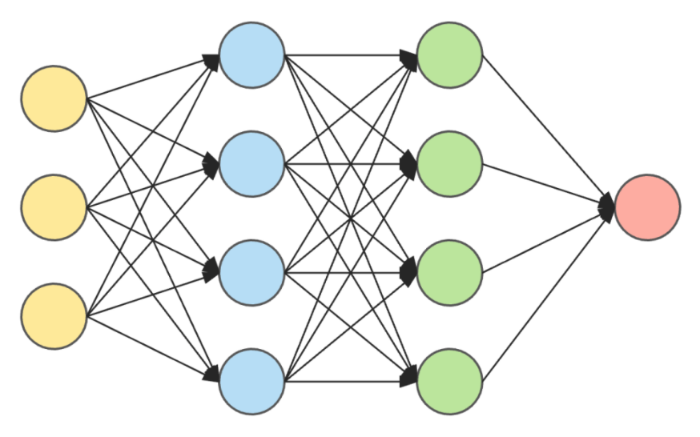
ML Model Example 2 – Neural Network
Model contains several ‘layers’ of ‘neurons interconnected.
Example:
Recognize the zip code handwritten in a letter.

Slide 5
Terminology - 1
Model = The mathematical construct we use to learn and make inferences about data.
Target Variable = The answer(‘output’) of a model.
Predictor = The inputs used to produce an output.
Feature = A data element or some derivation of it used as a predictor.

Slide 6
Terminology - 2
Cost function = A function that defines the ‘price’ of each error the model makes. The goal is to minimize the average price we pay for errors.
Model Parameter = An internal value of a model that is unknown and will be ‘learned’ during model training.
Model Hyperparameter = A parameter that the modeler provide to the model. Example: Number of trees to use in tree-based models.

Slide 7
Goal of Model Training
Use data ‘examples’ to build an artifact (model) that captures the ‘general’ trends of that data.
Generalization is the process of extracting this underlying knowledge that goes beyond the ‘current data set’

Slide 8
Bias / Variance Trade off
Bias: A model with high bias is more ‘stubborn’ and pays less attention to the dataset. It tends to oversimplify (underfit = adapt less)
Variance: A model with high variance pays too much attention to the data. A single record can shift the model wildly. It tends to over complicate (overfit = adapt more)

Slide 9
Find the sweet spot in the Bias/Variance blend.
Underfit
Overfit
To much
Bias
To much
Variance
Right balance
Generalization

Slide 10
Bias / Variance Trade off
How to control Bias/Variance
Option 1: Pick models that are flexible depending on the problem.
Ex: linear regression vs. tree-based models
- Option 2: Regularization
Regularization allows you to put a price on model complexity. So simpler models are preferred unless the errors are a lot larger.

Slide 11
ML Model Lifecycle
1
Data Acquisition
2
Exploratory Data Analysis
3
Model Selection
Data Hygiene
4
Feature Engineering
Model Training
5
6
Model Performance
Monitoring
Model
Validation
7
Learnings
Feedback
Deployment

Slide 12
About the class What we will cover
The Goal of model training.
The learning process
Model Selection
Model Training
Data preparation
Feature Engineering
Synthetic Data generation
Cross Validation
Model Tunning & Model Drift
Bias / Variance Tradeoff
Cross validation
ML Model Building

Slide 13
About the class What we will cover
The Goal of model training.
The learning process
Model Selection
Model Training
Data preparation
Feature Engineering
Synthetic Data generation
Cross Validation
Model Tunning & Model Drift
Bias / Variance Tradeoff
Cross validation
ML Model Building

Slide 14
About the class At the end of this class, I expect you to…
Create python programs and know how to optimize programs.
Create and use python notebooks.
Use pandas to load data, do math using Numpy and plot graphics in matplotlib.
Continue to learn using the Recommended books.

Slide 15
About the class Class Material vs The Project
We are covering some non-trivial concepts.
If you miss few advanced details, don’t worry too much. Important: If you are lost, please stop me! And ask for clarification.
I want to make the class as interactive as possible.
Material in the are harder than the final project.
This is by design, so advanced students can also benefit from the class.
To succeed in this class, you need to spend time witting code.

Slide 16
Installing Python & PyCharm
The following links will allow you install the
required tools
Pycharm Edu edition
https://www.jetbrains.com/pycharm-edu/
Anaconda Navigator
https://docs.anaconda.com/anaconda/install/

