Slide 1

Python for AI and Machine Learning
Lecture 01
Marilson Campos
UCSC Extension - 2023

Slide 2
About Me
Marilson Campos
System Architect with 20+ years of experience.
Background in AI, Machine Learning, and Search engines
- Few relevant presentations
Hadoop Summit 2013
Apache Impala User Group - 2015
Strata 2016 – Use case @ Cloudera Booth
Impala spotlight – Cloudera 2016

Slide 3
About You
What do you do
Why are you taking this class?
What do you expect to learn?

Slide 4
About the class What we will cover
Python language
Few commonly used Unix commands
Use of Notebooks & Python IDE
Foundations of Combinatorics / Statistics
Use relevant Libraries: NumPy, Pandas, Matplotlib
Exploratory Data Analysis – Titanic Project
ML Model Building using Scikit-learn, TensorFlow/Keras.

Slide 5
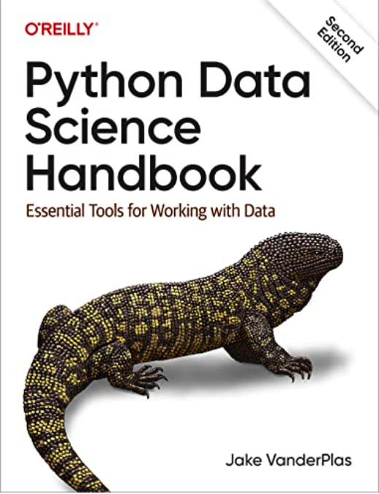
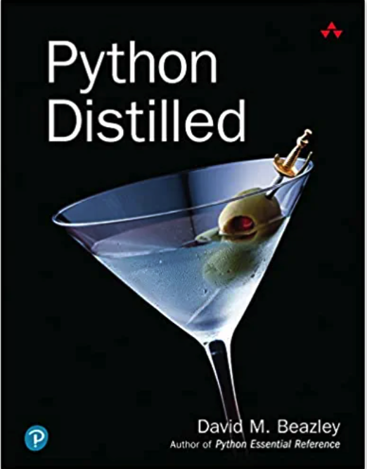
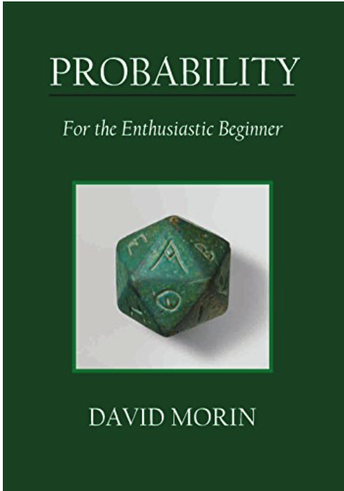
About the class Recommended books
Python Data Science
Python Foundation
Probability/Math

Slide 6
About the class At the end of this class, I expect you to…
Notebooks
Create and use python notebooks.
Know how to optimize programs.
Libraries
Use pandas to load data
Do math using NumPy
Plot graphics in matplotlib/seaborn.
ML/AI
Intuition about AI problem solving
Apply feature engineering
Create and optimize ML models.

Slide 7
About the class Class Material vs The Project
We are covering some non-trivial concepts.
If you miss a few details, don’t worry too much. Important: If you are lost: please stop me! and ask for clarification. Your questions will most certainly benefit others.
I want to make the class as interactive as possible.
The material covered in the class is more challenging than the assignments.
This is by design, so more advanced students can also benefit from the class.
To succeed in this class, you need to:
Spend time witting code!

Slide 8
Development Environment Jupyter & Python IDE
The following links will allow you to install the
required tools
PyCharm Edu edition
https://www.jetbrains.com/pycharm-edu/
Anaconda Navigator
https://docs.anaconda.com/anaconda/install/

