Slide 1
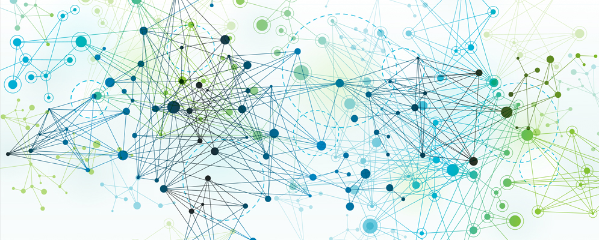
Python for AI and Machine Learning
Neural Networks, AI Problem Solving
Marilson Campos
UCSC Extension - 2023

Slide 2
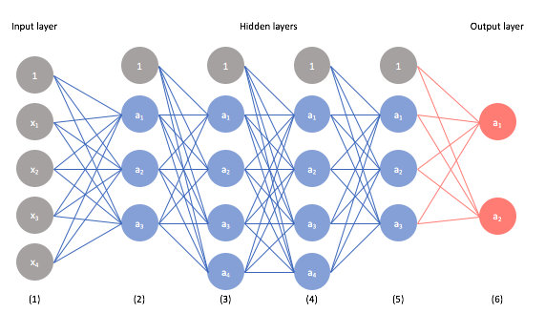
Neural Networks

Slide 3
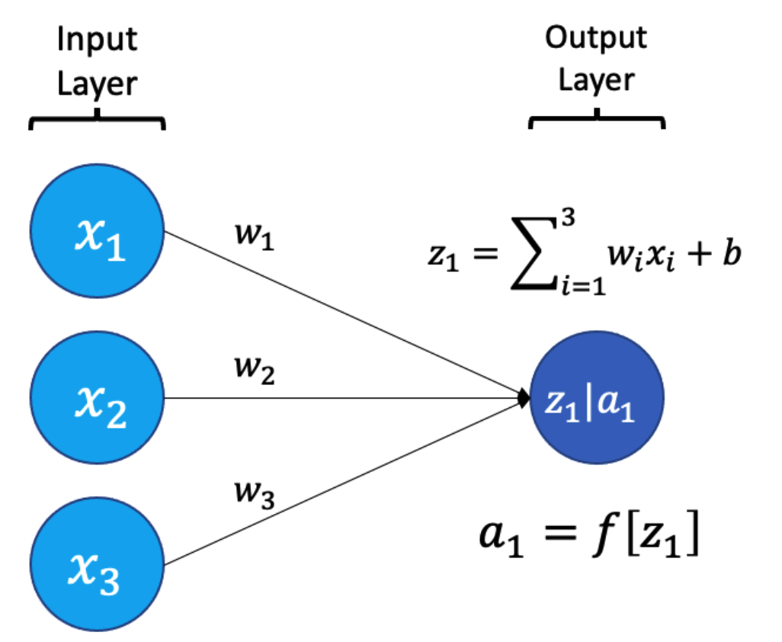
Neural Network Unit

Slide 4
Neural Networks
Demo

Slide 5
What is problem framing?
Process of understanding the context where a potential AI solution would be used and delineating what is in-scope and out-of-scope.
Also, defining the approach to validate if AI/ML is the right tool to solve it.
Finally, what success looks like?

Slide 6
Understanding the problem
What business problem is the system trying to solve?
- Don’t use technical terms here.
- Describe the business outcome.
Reduce the percentage of fake photos to 15%
Detect 85% of fraudulent transactions.
What’s the baseline?
How good is a solution using traditional techniques can be?

Slide 7
A clear use case for AI
Can we do better than traditional techniques?
What about maintenance costs?
What is the business impact of errors?
Do we have enough reliable data to build models?

Slide 8
Predictive power
Does the data contain ‘features’ that can be used to predict?
How much will the data change over time?
What are the thresholds for model drift?

Slide 9
Model output and actions
Classification, Regression, etc.
Proxy labels vs. Real labels.
What actions does the system take based on the results?

Slide 10
Project priority
Good value
High Value
Ciao
How?
Now
Wow
Difficult
Easy

Slide 11
Project outcomes
Continue improving
Stop improving
Results are good enough, but we can make it better.
Results are good enough, and there is no need to make it better.
Results are not good enough, but we can make it work
Results are not good.
We don’t think we can make it work.
Good Results
Bad Results

Slide 12
Model monitoring
Monitor the profiles of data inputs.
Monitoring model predictions.
Model versioning.

Slide 13
AI development culture
Feature Store.
Continuous improvement.
A/B testing on models.
Simulation engines

