Slide 1
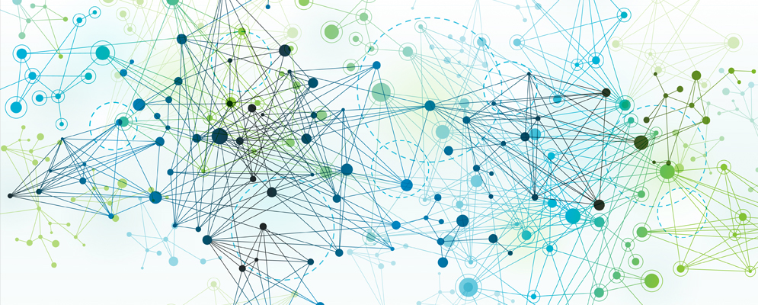
Python for AI and Machine Learning
Scikit-Learn
Marilson Campos
UCSC Extension - 2023

Slide 2
Scikit-Learn
One of the most popular Python Machine learning libraries.
Covers:
Classification
Regression
Clustering

Slide 3
Scikit-Learn
Two main components.
Transformers -> Transform the data set.
Fit method to learn about the data.
Transform method to make the adjustments.
Estimators -> Make predictions
Fit method to ’learn the model.’
Predict method to make predictions using the data.

Slide 4
Idea

Slide 5
Scaling
Used to avoid variables with large values dominating the model.
Cons: Loose interpretability.
Transformers to perform scaling:
Standard scaler
Min/Max scaler
Robust scaler
Normalizer

