Slide 1

Hadoop: Distributed Processing of Big Data
Lecture 02
Marilson Campos
UCSC Extension - 2022

Slide 2
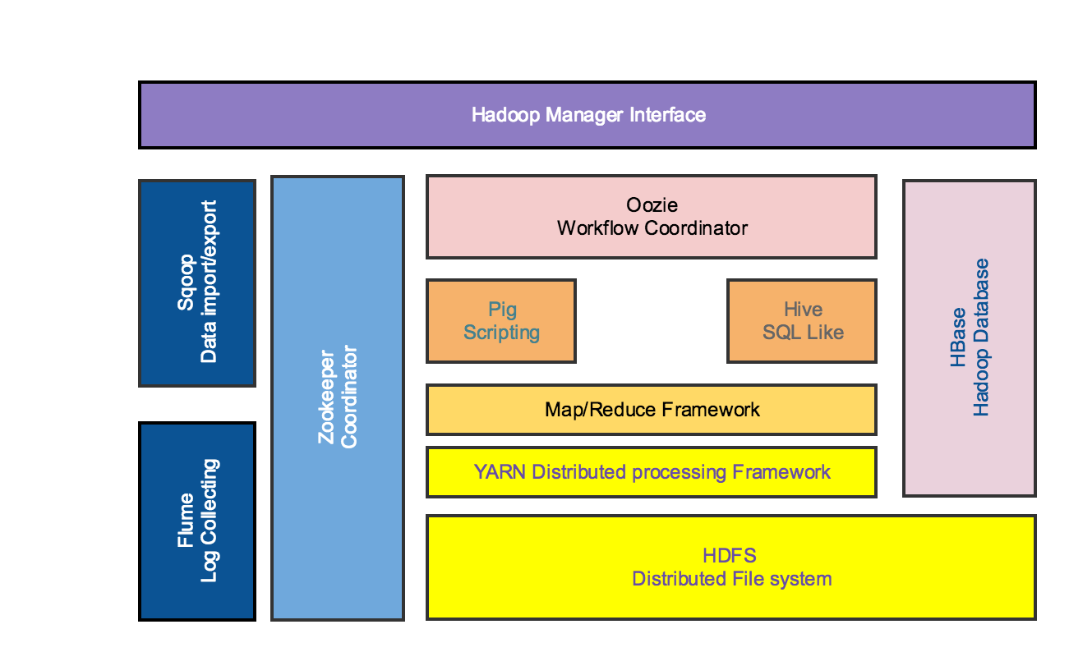
Hadoop is born The Hadoop Stack

Slide 3
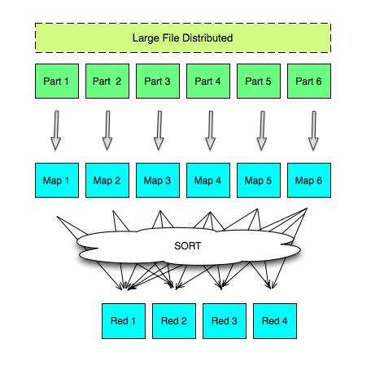
Map/Reduce Map Reduce Review

Slide 4
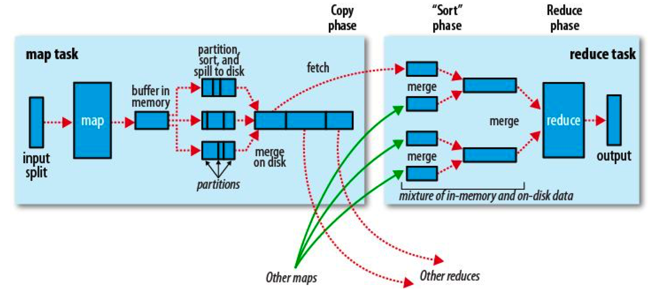
Map/Reduce A little more detailed view

Slide 5
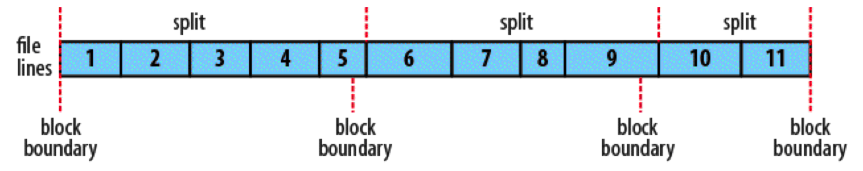
Map/Reduce Split vs Block boundary

Slide 6
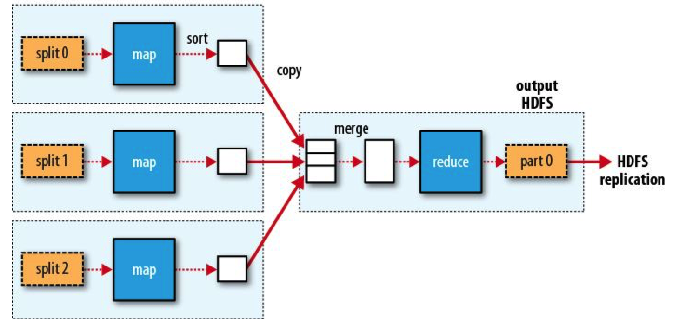
Hadoop Map/Reduce MR Splits and dataflow 1 reducer

Slide 7
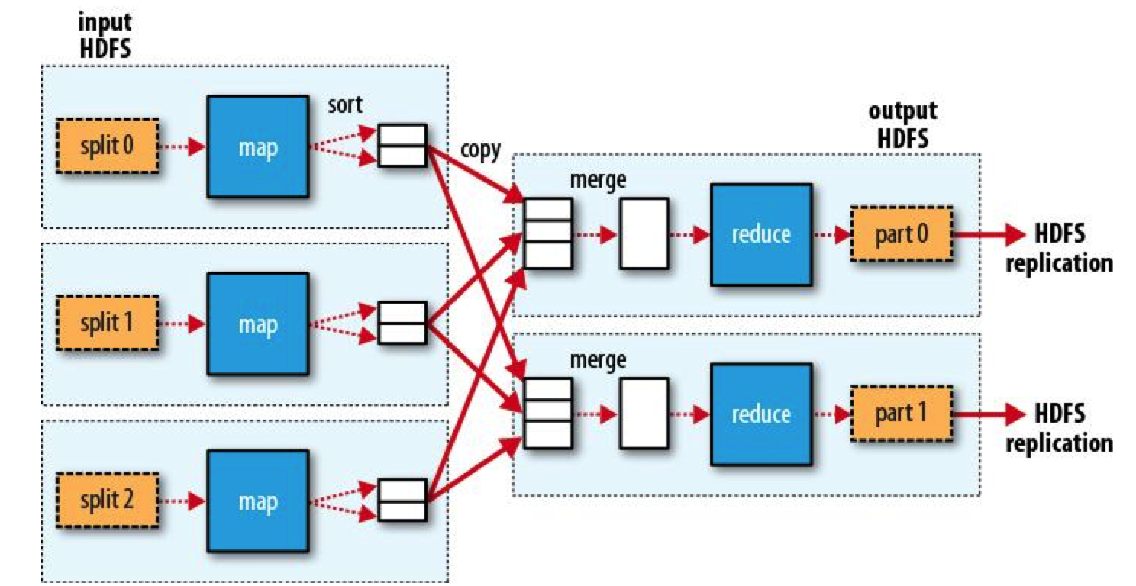
Hadoop Map/Reduce MR Splits and dataflow multiple reducers

Slide 8
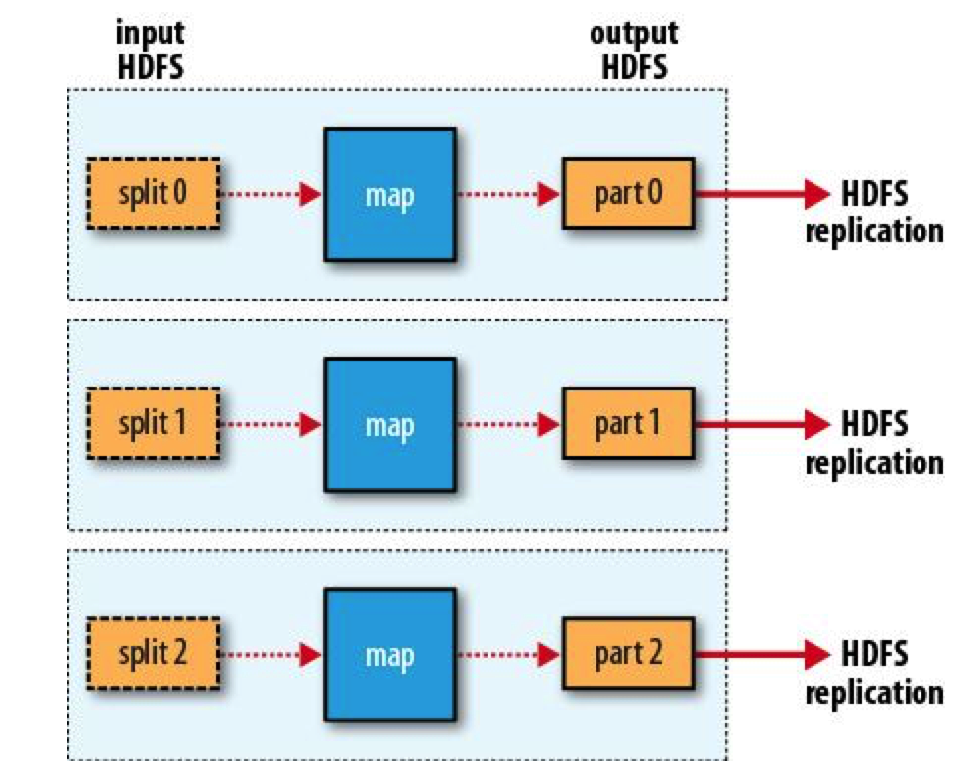
Hadoop Map/Reduce MR Splits and dataflow Zero reducers

Slide 9
Hadoop basics Hadoop command line
- General command format for Apache Hadoop:
<program> <cmd-group> [<options…]

Slide 10
Hadoop basics Hadoop command line
Originally everything was under one program “hadoop”
As the codebase grew, the functionality has been moved into 3 programs.
“hadoop” – high level commands
“hdfs” – commands related with storage
“mapred” – commands related with M/R execution.

Slide 11
Hadoop basics Hadoop command line
Hadoop – User command groups
* archive
* distcp
* fsck
* jar
* job
* queue
* version
* classpath

Slide 12
Hadoop basics Hadoop command line
Hadoop archive
It allows you to store a whole sub-directory tree in a single file in HDFS.
> hadoop archive -archiveName <filename.har> -p <hdfs_dir> <dest_dir>

Slide 13
Hadoop basics Hadoop command line
Hadoop distcp
“Distributed copy” command allow parallel copy to different locations of cluster or to/from another cluster.
> hadoop distcp hdfs://<nn1>:8020/<source> hdfs://<nn2>:8020/<target>
Refer to:
https://hadoop.apache.org/docs/r2.6.5/hadoop-mapreduce-client/hadoop-mapreduce-client-core/DistCp.html

Slide 14
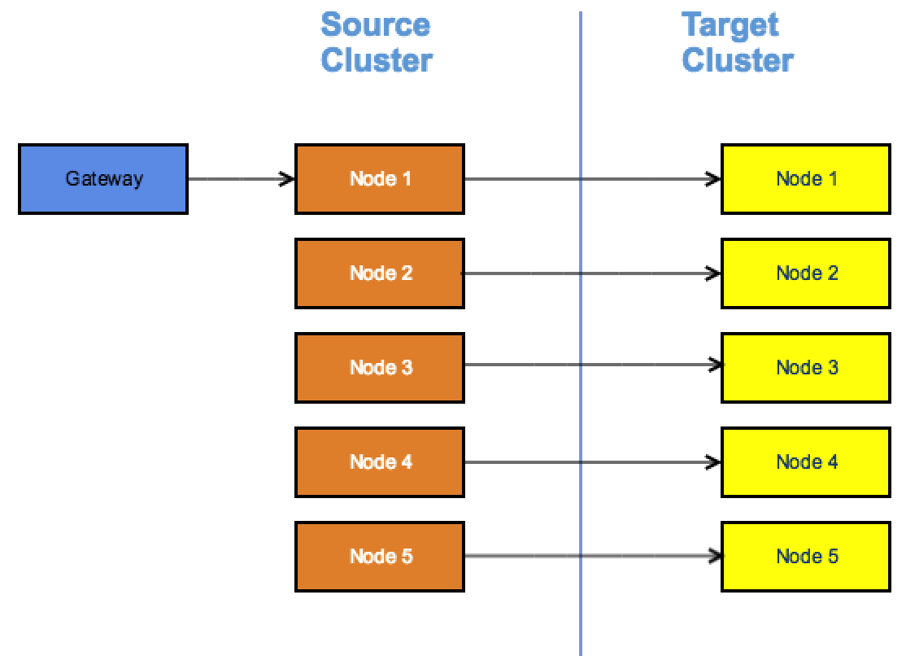
Hadoop basics Hadoop command line
Hadoop distcp

Slide 15
Hadoop basics Hadoop command line
Hadoop fsck
Deprecated: Use hdfs fsck
We will cover this command on the HDFS command section.

Slide 16
Hadoop basics Hadoop command line
Hadoop jar
Runs a jar file. Users can bundle their Map Reduce code in a jar file and execute it using this command.
Used in streaming.
Usage: hadoop jar <jar> [mainClass] args...

Slide 17
Hadoop basics Hadoop command line
Hadoop Job
Each Job is composed of tasks:
- Map tasks perform the map operation
- Reduce tasks perform the reduce operator
Hadoop give each task 3 chances to succeed before if fails the jobs.
Speculative execution:
If one task seems to be slow, Hadoop launches another task for the same work. It will pick the results of the one that finishes first and ignores the other(s).

Slide 18
Hadoop basics Hadoop command line
Hadoop job
Deprecated. Use mapred job
Usage:
mapred job
-submit<job-file>
-status<job-id>
-counter<job-id><group-name><counter-name>
-kill<job-id>
-events<job-id><from-event-#><#-of-events>
-history [all]
-list
-kill-task <task-id> -> Does not count against failed attempts.
-fail-task <task-id>
-set-priority <job-id> [VERY_HIGH, HIGH, NORMAL, LOW, VERY_LOW]

Slide 19
Hadoop basics Hadoop command line
Hadoop Job Queues
Define resource allocations for groups of jobs.
There are several types of queues.
We will cover them later in this class.
Example: I can define the following queues:
prod_etl -> “production etl” with 60% of resources.
dev -> “development” with 15% of resources.
default -> with 25% of resources.

Slide 20
Hadoop basics Hadoop command line
Hadoop queue
Deprecated. Use mapred queue
Usage: mapred queue
-list
-info <job-queue-name>
-showJobs
-showacls

Slide 21
Hadoop basics Hadoop command line
Hadoop - Administration
- daemonlog

Slide 22
Hadoop basics Hadoop command line
What is a daemon
“A daemon is a type of program on Unix-like operating systems that runs unobtrusively in the background, rather than under the direct control of a user, waiting to be activated by the occurrence of a specific event or condition.”

Slide 23
Hadoop basics Hadoop command line
List the daemons in Hadoop
Use:
> sudo jps
‘sudo’ Unix command allows you to run another command as admin.

Slide 24
Hadoop basics Hadoop command line
Hadoop daemonlog
Get/Set the log level for each daemon.
Usage:
hadoop daemonlog -getlevel <host:port> <name>
hadoop daemonlog -setlevel <host:port> <name> <level>
LEVEL = (ERROR, WARN, INFO)

Slide 25
Hadoop basics HDFS command line
HDFS – User command groups
- dfs
- fsck

Slide 26
Hadoop basics HDFS DFS command line
HDFS DFS options
cat | cp | getmerge | put | tail
chgrp | du | ls | rm | test
chmod | dus | lsr | rmr (****) | text
chown | expunge | mkdir | setfacl | touchz
copyFromLocal | get | moveFromLocal | setfattr
CopyToLocal | getfactl | moveToLocal | setrep
count | getfattr | mv | stat

Slide 27
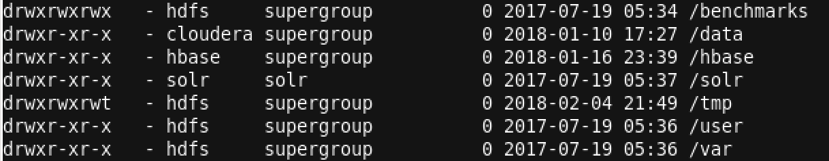
Hadoop basics Hadoop command line
HDFS Access Rights
Control who can operate in files and folders.
is dir? owner group other
drwxrwxrwx -> [d] [rwx] [rwx] [rwx]
Flags: ‘r’ = read, ‘w’ = write, ‘x’ = execute Selector: ‘u’ = owner, ‘g’ = group, ‘o’ = other
o+wx = allow others to write and execute
u-x = disallow user to execute

Slide 28
Hadoop basics HDFS DFS – access rights
Access rights commands = [chgrp, chmod, chown]
chmod -> change access rights for user,group,other
Usage: hdfs dfs -chmod [-R] MODE URI
Ex: hdfs dfs –chmod a+w /tmp
Everybody can write to /tmp

Slide 29
Hadoop basics HDFS DFS – access rights
Access rights commands = [chgrp, chmod, chown]
chown -> change the user that “owns” of the dir/file.
Usage: hdfs dfs -chown [-R] USER URI
Ex: hdfs dfs –chown joe /tmp/joe

Slide 30
Hadoop basics HDFS DFS – access rights
Access rights commands = [chgrp, chmod, chown]
chgrp -> changes user-group that a path belongs to.
Usage: hdfs dfs -chgrp [-R] GROUP URI
Ex: hdfs dfs -chgrp operators /tmp/dir1
(‘operators’ in this example is a group name)

Slide 31
Hadoop basics HDFS DFS – Copying from cluster to local
Copying = [CopyToLocal, get]
CopyToLocal /get -> Get files our of the cluster
Usage:
hdfs dfs -copyToLocal URI <localdir>. hdfs dfs -get URI <localdir>

Slide 32
Hadoop basics HDFS DFS – Copying a cluster dir to local
Copying = [getmerge]
getmerge -> get data from a hdfs directory into a local file
Usage:
hdfs dfs –getmerge <src> <local-file>

Slide 33
Hadoop basics HDFS DFS – copy from local to cluster
Copying = [put, copyFromLocal]
put, copyFromLocal -> copy files from local disk and loads into the cluster
Usage:
hdfs dfs –put <src> <hdfs-file>
You can use the –f option to force.

Slide 34
Hadoop basics HDFS DFS – view & create directories
View/create = [ls, lsr, mkdir]
ls -> list files from a directories.
lsr -> list files recursively.
mkdir -> creates an HDFS directory.

Slide 35
Hadoop basics HDFS DFS – delete data
delete = [rm, rmr, expunge]
rm -> Removes files from a folder.
rmr -> removes everything below the directory.
(** Danger **)
expunge -> delete the data on trash location.

Slide 36
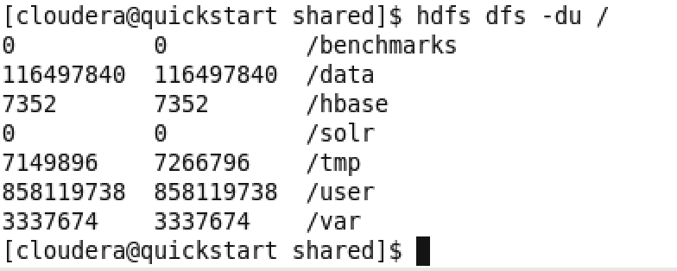
Hadoop basics HDFS DFS – get information
Get info = [du, dus]
du -> Displays sizes of files and directories contained in the given directory

Slide 37
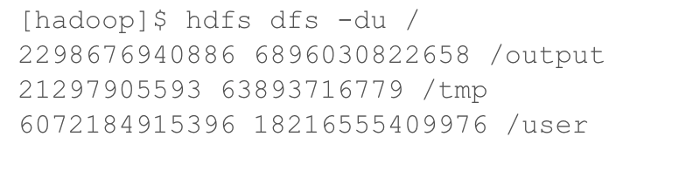
Hadoop basics HDFS DFS – get information
Get info = [du, dus]
First column => file size
Second column => Disk space taken

Slide 38
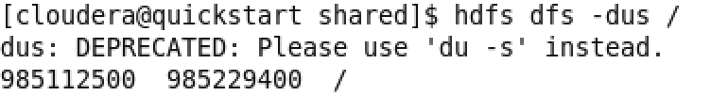
Hadoop basics HDFS DFS – get information
Get info = [du, dus]
dus -> display results above in a summary.

Slide 39
Hadoop basics HDFS DFS – replication
Replication = [setrep]
setrep -> Sets the replication factor of a location in the cluster.
The -w flag makes the command to wait for the replication to complete.
If the value of the new factor is bigger than the current replication value. This will only apply to new data written after the command.

Slide 40
Hadoop basics HDFS DFS – get info
Get info = [stat, test]
stat -> prints information about a file in the cluster.
test -> perform tests in hdfs files.
-e = exists, -z = zero size, -d=directory
returns zero if true.

Slide 41
Hadoop basics HDFS DFS – see contents
Contents= [tail, text]
tail -> prints the end of the file.
text -> view inside of zip files.

Slide 42
Hadoop basics HDFS DFS – marker files
markers= [touchz]
touchz -> Create a file of zero length.
Usage: hdfs dfs -touchz pathname
We can use this command to create “marker files” that will be explained later in the class.

Slide 43
Hadoop basics HDFS balancer – Spread the data
hdfs hdfs balancer -> Makes sure that the files are spread across all nodes.
This is useful when you ‘add’ new nodes to the cluster as the new ’nodes’ have no data.

Slide 44
Hadoop basics HDFS FSCK – File System check
hdfs fsck -> Verifies the state of the distributed file system.
Usage:
hdfs fsck [GENERIC_OPTIONS] <path>
[-list-corruptfileblocks |
[-move | -delete | -openforwrite]

Slide 45
Q & A

