Slide 1

Spark: Spark Concepts and Python Intro
Lecture 03
Marilson Campos
UCSC Extension - 2022

Slide 2
Spark Spark Vs MR
Map/Reducer
MR Job 1
HDFS -> MR Job 2
….
HDFS -> MR Job n
Data is written and read multiple times.
Op1 -> Op2 … -> OpN
Round trips to disk are eliminated.
Spark

Slide 3
Spark Spark RDD
RDD → Resilient Distributed Dataset
- Why Resilient ? Because its Fault tolerant and can rebuild itself if parts of the data are removed from memory.
- Distributed because is spread across the nodes of the cluster.
- Dataset: It appears to the user as a local dataset but in reality, the data is distributed.

Slide 4
Spark Spark Cluster
SparkContext → Is the handle to connect to a cluster.
We will use the variable named as ‘sc’.
Ways to load data into RDD:
1. sc.parallelize → converts a local collection to an RDD.
Used mostly in test code.
2. sc.textFile → reads file from HDFS or local filesystem and returns an RDD.
3. sc.read.format(<format_name>).load(<file_path>)

Slide 5
Spark Functional Programming
Anonymous functions.
words = input.flatMap(lambda x: x.split())
“lambda” is a codename to tell the interpreter
that no name is needed. So, this function is
only used by the enclosing function.
In this example the function “flatMap”

Slide 6
Spark Transformations and Actions
Transformation → Operation that returns an RDD.
Lazy operation => Executed across the nodes.
Action → Operation that returns anything BUT an object of type RDD.
Eager operation => Depends on the command. Can be Executed on the driver and/or across the nodes.

Slide 7
Spark Word Count
from pyspark import SparkConf, SparkContext
conf = SparkConf().setMaster("local").setAppName(”WC_01")
sc = SparkContext(conf=conf)
input = sc.textFile(”article.txt")
words = input.flatMap(lambda x: x.split()) ← transformation
wordCounts = words.countByValue() ← action
for word, count in wordCounts.items():
print(word + " " + str(count))

Slide 8
Spark SetMaster options
SetMaster(str_value)
Examples:
local → Runs Spark locally with one worker thread
(i.e. no parallelism at all).
local[K] → Runs Spark locally with K worker threads
ideally, set this to the number of cores on your machine – 1 in case of VMs.
local[K,F] → Runs Spark locally with K worker threads and F maxFailures
See spark.task.maxFailures for an explanation of this variable
local[*] → Runs Spark locally with as many worker threads as logical cores on
your machine.

Slide 9
Spark Python Lambda
# Regular python function
def make_tuple(x):
return (x, 1)
# Lambdas are functions with no name. Used in place.
lambda x: (x, 1)
In Spark we use functions that expect functions as parameters.
For example, the map operator:
# Using anonymous functions
recs = words.map(lambda x: (x, 1))
# Using regular functions
recs = words.map(make_tuple)
# Notice that we are passing the function not calling it like make_tuple(1)!

Slide 10
Spark SetMaster options (cont)
SetMaster(str_value)
Examples:
local[*,F] → Runs Spark locally with as many worker threads as logical cores
on your machine and F maxFailures.
spark://HOST:PORT → Connects to the given Spark standalone cluster master.
The port must be whichever one your master is configured to use.
(7077 is the default port)
spark://HOST1:PORT1,HOST2:PORT2 → Connects to the given Spark
standalone cluster with standby masters with Zookeeper.
The list must have all the master hosts in the high availability cluster
set up with Zookeeper.
The port must be whichever each master is configured to use.

Slide 11
Spark Transformations
map(f) → ‘f’ is a function that transform a single element into
another element.
Example:
counts = (
txt_rdd.flatMap(lambda line: line.split(" ")) # word list
.map(lambda word: (word, 1)) # list of tuples
.reduceByKey(lambda x, y: x + y)
)
counts.saveAsTextFile("hdfs://...")
Map receives each word and generates a pair (tuple) containing the ‘word’ and the number one. Ex: (‘Apple’, 1)

Slide 12
Spark Transformations
flatMap(f) → ‘f’ is a function that transform a
single element into `a list of elements.
Example:
counts = (
txt_rdd.flatMap(lambda line: line.split(" "))
.map(lambda word: (word, 1))
.reduceByKey(lambda x, y: x + y)
)
counts.saveAsTextFile("hdfs://...")
FlatMap splits each line into a list. Then it appends the
elements of the list into the result.
Only a single list of words gets returned.

Slide 13
Spark Transformations
filter(f) → ‘f’ is a function examines a single element and
returns a Boolean. (f is a predicate). Filter returns only elements for which ‘f’ is True.
Example:
counts = (
txt_rdd.flatMap(lambda line: line.split(" "))
.filter(lambda word: word not in (“the”, “a”))
.map(lambda word: (word, 1))
.reduceByKey(lambda x, y: x + y)
)
counts.saveAsTextFile("hdfs://...")
Filter only returns words that are not part of the “stop words”. Stop works are words in NLP that are typically removed from processing.

Slide 14
Spark Transformations
mapPartition(f) → Converts each partition of the source RDD into many elements of the result (possibly none).
In mapPartition(), the map() function is applied on each partition simultaneously. It’s a map operation over partitions and not over the elements of the partition.
mapPartitionWithIndex(f) → Same as MapPartitions besides that ’f’ function receives an additional parameter index representing the
partition number.

Slide 15
Spark Transformations
union(other_rdd) → returns the union of both RDDs.
Example:
rdd_union = rdd1.union(rdd2).union(rdd3)
We get the elements in any of the RDDs in new RDD.
The key rule of this function is that the input RDDs should be of the same type.

Slide 16
Spark Transformations
intersection(other_rdd) → returns a RDD with elements on both RDDs.
Example:
rdd_common = rdd1.intersection(rdd2)
We get only the common elements of both RDDs in new RDD.

Slide 17
Spark Transformations
distinct() → returns a RDD without duplicates.
Example:
counts = (
txt_rdd.flatMap(lambda line: line.split(" "))
.distinct()
.map(lambda word: (word, 1))
.reduceByKey(lambda x, y: x + y)
)
counts.saveAsTextFile("hdfs://...")
The ‘distinct’ operator will break the ‘word count’ program as all counts with be equal to one.

Slide 18
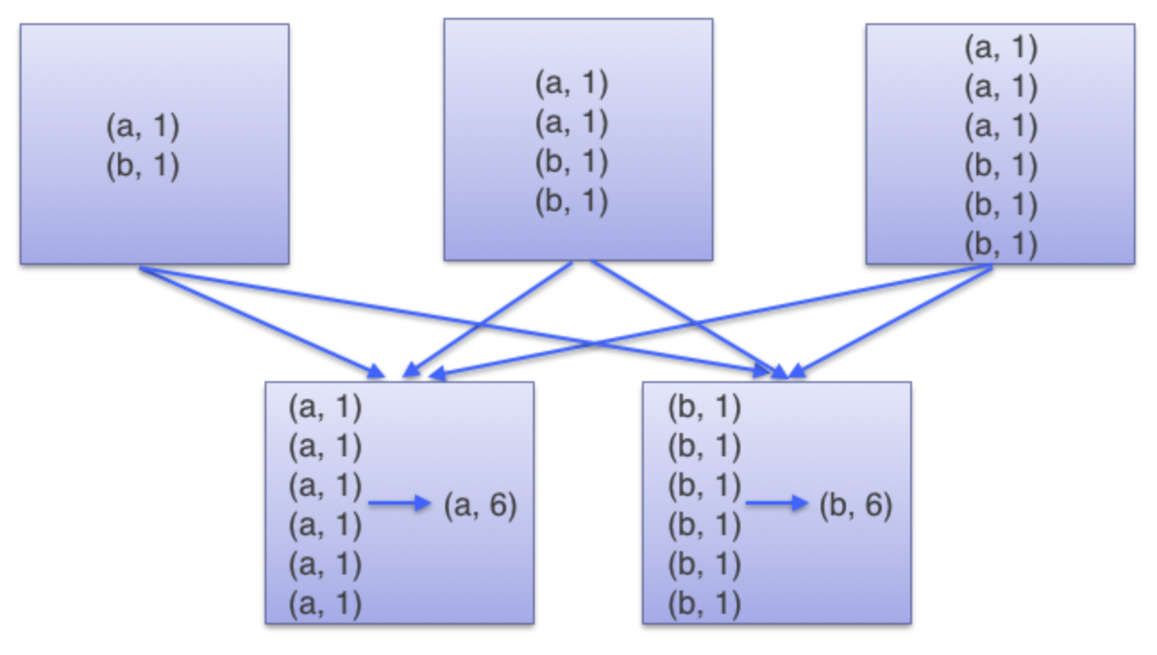
Spark Transformations
groupByKey(f) → Operate into pairs and uses ‘f’ to combine two elements but does not work will large datasets.
Example:
All pairs need to travel thru the network. It should be avoided because consumes
lots of memory.

Slide 19
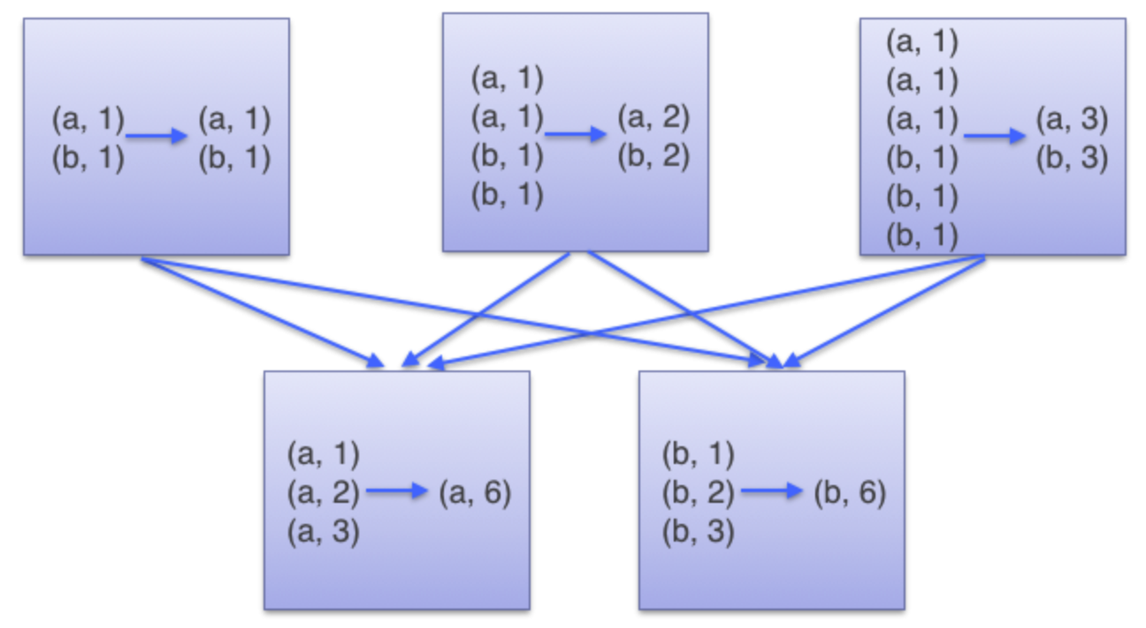
Spark Transformations
reduceByKey(f, [num_tasks]) → Operate into pairs and uses ‘f’ to combine two elements
Example:
Its like using combiner on Map/Reduce, reduces the data
moving in the network.

Slide 20
Spark Transformations
sortByKey(ascending=True, num_parts=None, key_func) → Operate into pairs of (key, value) and uses ‘f’ to order the two elements using the key. If key_func is provided we can alter the key that will be used for sorting.
Example:
names_freq.sortByKey().collect()
[
('AADEN', 18),
('AADEN', 11),
('AADEN', 10),
('AALIYAH', 50)…

Slide 21
Spark Transformations
join(other_dataset) → Operate into pairs of (key, value) joins two RDDs using the key
Example:
rdd1 = sc.parallelize([("foo", 1), ("bar", 2), ("baz", 3)])
rdd2 = sc.parallelize([("foo", 4), ("bar", 5), ("bar", 6)])
rdd1.join(rdd2)
[('bar', (2, 5)), ('bar', (2, 6)), ('foo', (1, 4))]

Slide 22
Spark Transformations
coalesce(num_parts) → Return a new RDD that is reduced into num_parts partitions.
Example:
my_list = [1, 2, 3, 4, 5]
sc.parallelize(my_list, 3).glom().collect()
[[1], [2, 3], [4, 5]]
sc.parallelize(my_list,3).coalesce(1).glom().collect()
[[1, 2, 3, 4, 5]]

Slide 23
Spark Actions
count() →
Returns the number of elements in the RDD.
collect() →
Returns all the elements of RDD as local collection.
(In our case a python collection)
take(n) →
Returns ’n’ elements from the RDD.
Notice that all values returned are not RDD!

Slide 24
Spark Actions
top(n) →
Returns the top ’n’ elements from the RDD.
countByValue() →
Returns a collection of tuples with a value and its frequency.
Example:
If a rdd called ‘nums’ contains :{1, 2, 2, 3, 4, 5, 5, 6} then,
the command “nums.countByValue()” will produce
{(1,1), (2,2), (3,1), (4,1), (5,2), (6,1)}

Slide 25
Spark Actions
reduce(combine_f) → Combine the elements in the RDD by
applying ‘combine_f’ continuously to return a single value.
fold(zero_value, combine_f) → Combine the elements
in the RDD by applying ‘combine_f’ continuously.
Example:
sc.parallelize([1, 2, 3, 4, 5]).fold(0, add)
Fold returns valid result even with empty input.

Slide 26
Spark Actions
aggregate(zero, seq_op, comb_op) → Aggregate the
elements of each partition, and then combine the results for all
partitions, using a given combine functions and a
neutral “zero value.”
Example:
zero = (0, 0)
seq_op = (lambda t, y: (t[0] + y, t[1] + 1))
comb_op = (lambda t1, t2: (t1[0] + t2[0], t1[1] + t2[1]))
sc.parallelize([1, 2, 3, 4]).aggregate(zero, seq_op, comb_op)
Produces:
(10, 4)

Slide 27
Spark Actions
foreach(f) → perform the operation ’f’ to each
element of the RDD after its retrieved to the local computer.
(not parallelized!)
Also, notice that it will not return anything.
Typically, this command is used for printing results.

Slide 28
Spark Reduce vs ReduceByKey
Reduce →
Is an action and returns a single value.
(action)
ReduceByKey →
Is a transformation and returns an RDD.
(transformation)

Slide 29
Spark Word Count v2
from pyspark import SparkConf, SparkContext
conf = SparkConf().setMaster("local").setAppName("WordCount")
sc = SparkContext(conf = conf)
input = sc.textFile(”/data/book_text.txt")
words = input.flatMap(lambda x: x.split())
wordCounts = words.map(lambda x: (x, 1)).reduceByKey(lambda x, y: x + y)
wordCountsSorted = wordCounts.map(lambda x: (x[1], x[0])).sortByKey()
word_counts = wordCountsSorted.collect()
for pair in word_counts :
count = str(pair[0])
word = pair[1]
print(word + ": " + count)

Slide 30
Spark Understanding Spark Docs in Scala
fold() :
fold[A](z: A)(f: (A, A) => A): A
Function fold needs 2 parameters:
- a zero value to start from.
- a function that receives two elements of type A and
returns one element of type A.

Slide 31
Spark Understanding Spark Docs in Scala
Currying
fold[A](z: A)(f: (A, A) => A): A
A function can have multiple sets of parameters.
Each time you call with one set it will return another function with
the params removed
foldWithZero = fold(0)
Doc for the function
foldWithZero[A](f: (A, A) => A): A
result = foldWithZero(f)

Slide 32
Spark Parallel Reduce Operations
fold() :
fold[A](z: A)(f: (A, A) => A): A
Combine pairs of elements In parallel using “f” until there is a single
value and returns the value.
Difference between fold and reduce is that fold is better prepared
to handle empty collections

Slide 33
Spark Parallel Reduce Operations
aggregate() :
Aggregate[A, B](z: => B)(seqop: (B, A) => B, combop: (B, B) => B): B
Parallelizable and allows to change the return value.

Slide 34
Python
Python for
Big Data

Slide 35
Why Python
Python
→ Clean language
→ Easy create scripts
Python vs Java (JVM)
→ Python is used to “glue” data pipelines steps.
→ Java is used for building the step as it has direct
access to Hadoop M/R Api.

Slide 36
Some Resources
Start Here:
Think Python: How to Think Like a Computer Scientist
by Allen B. Downey
Data Science with Python
Python Data Science Handbook: Essential Tools for Working with Data
by Jake VanderPlas
Python for Data Analysis: Data Wrangling with Pandas, NumPy, and IPython
by Wes McKinney

Slide 37
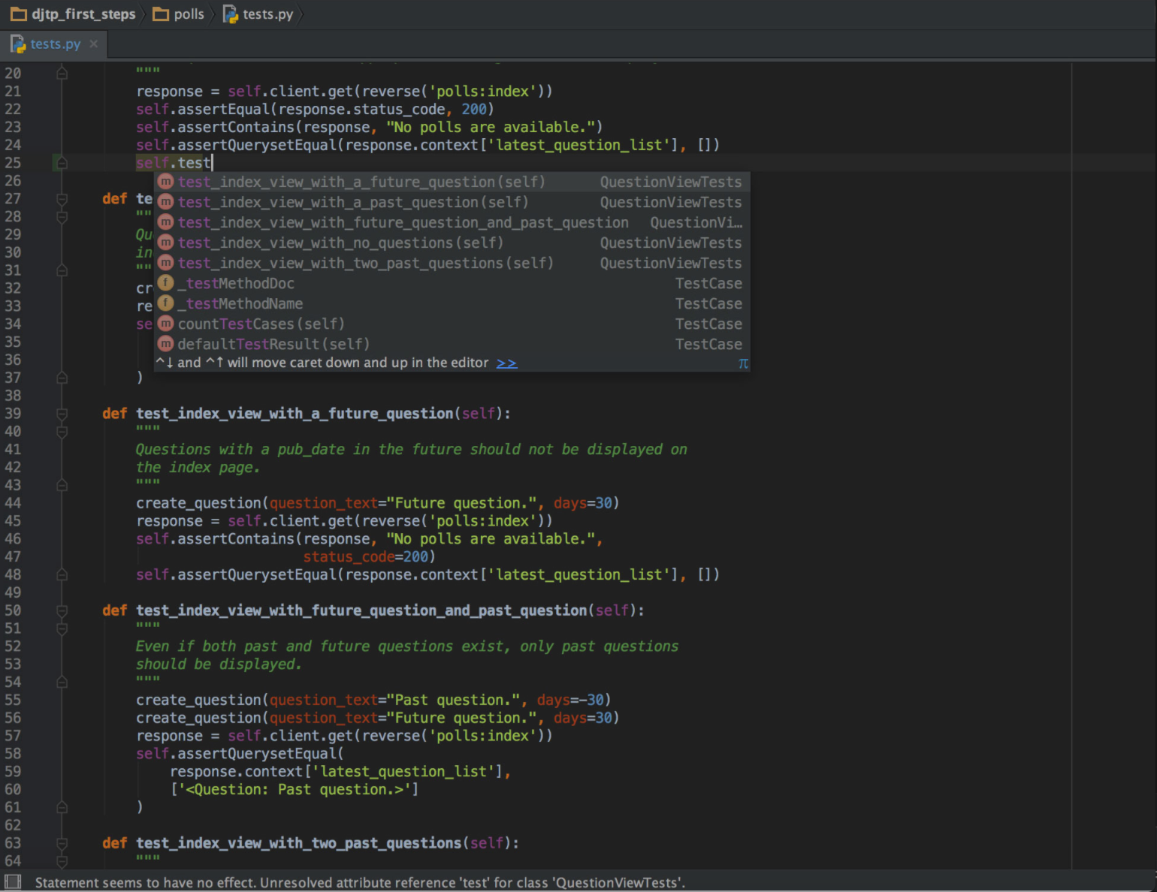
Python for Big Data Lab PyCharm install

Slide 38
Python Zen Of Python
Beautiful is better than ugly.
Explicit is better than implicit.
Simple is better than complex.
Complex is better than complicated.
Flat is better than nested.
Sparse is better than dense.
Readability counts.
Special cases aren't special enough to break the rules. Although practicality beats purity.
Errors should never pass silently. Unless explicitly silenced.
In the face of ambiguity, refuse the temptation to guess.
There should be one-- and preferably only one --obvious way to do it. Although that way may not be obvious at first unless you're Dutch.
Now is better than never. Although never is often better than *right* now.
If the implementation is hard to explain, it's a bad idea.
If the implementation is easy to explain, it may be a good idea.
Namespaces are one honking great idea -- let's do more of those!

Slide 39
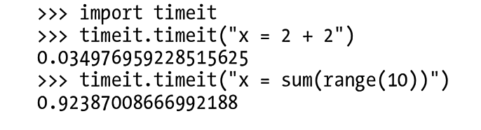
Python How to test performance

Slide 40
Python Lists in Python
List_a = []
List_b = [“a”, “b”, ”c”, 1]
for elm in list_b:
print(elm)
List_b.append(100)
List_b.extend([3,4])

Slide 41
Python Dictionaries in Python
dict_a = dict()
dict_b = {‘a’:100, ‘b’:200, ‘c’:300}
For elm in dict_b:
print(elm)
dict_b[‘x’] = 100
for key, value in enumerate(dict_b):
print(“{0}={1}”.format(key, value))

Slide 42
Python Sets in Python
set_a = set()
set_b = set([“a”, "b”, “c”])
for elm in set_b:
print(elm)

Slide 43
Python Tuples in Python
rec = ('Mark’, 31, ‘male’)
rec[0]
Mark
Rec[1]
31
# --- Dataclasses - New in Python ----
from dataclasses import dataclass
@dataclass
class Person:
name: str
age: int
gender: str
p1 = Person('jon', 23, 'male’)
p1.name
p1.age

Slide 44
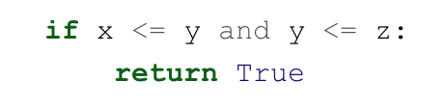

Python Idioms
Bad
Good

Slide 45
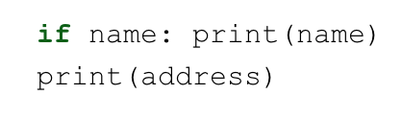
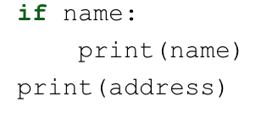
Python Idioms
Bad
Good

Slide 46
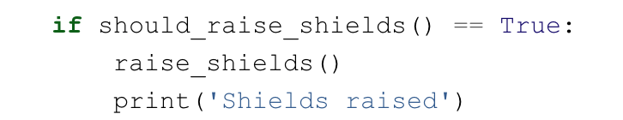
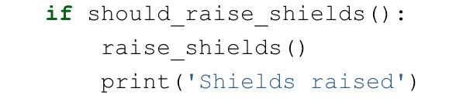
Python Idioms
Bad
Good

Slide 47
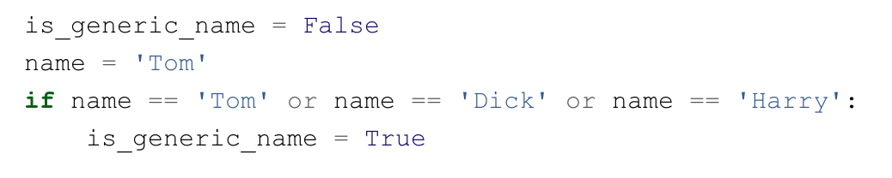
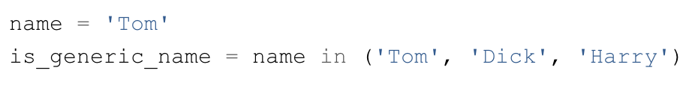
Python Idioms
Bad
Good

Slide 48
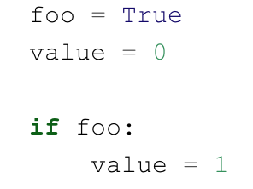
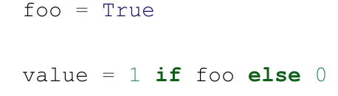
Python Idioms
Bad
Good

Slide 49
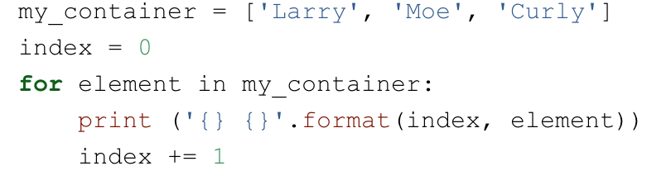
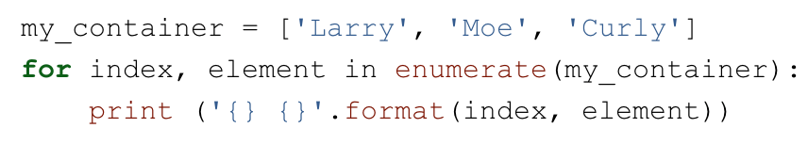
Python Idioms
Bad
Good

Slide 50
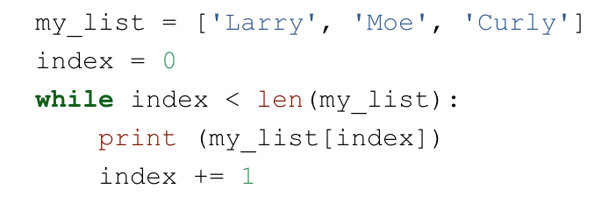
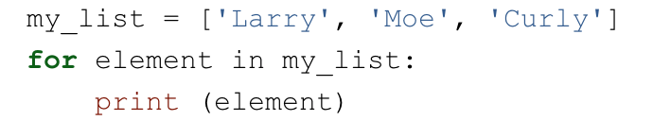
Python Idioms
Bad
Good

Slide 51
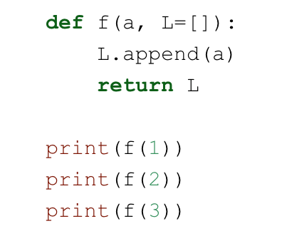
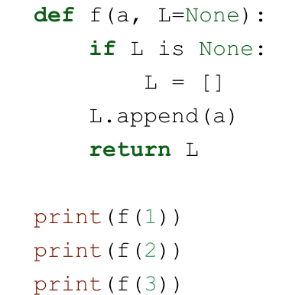
Python Idioms
Bad
Good

Slide 52
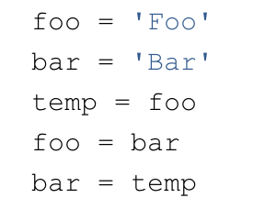
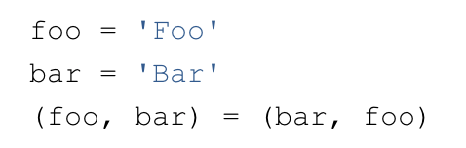
Python Idioms
Bad
Good

Slide 53
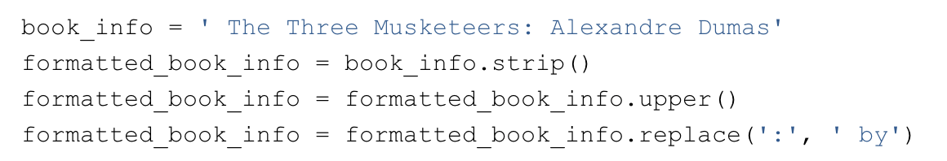
Python Idioms
Bad
Good

Slide 54
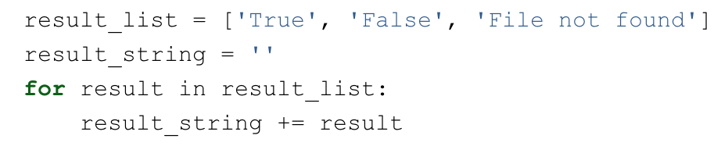

Python Idioms
Bad
Good

Slide 55
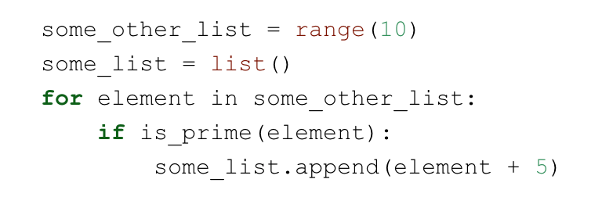
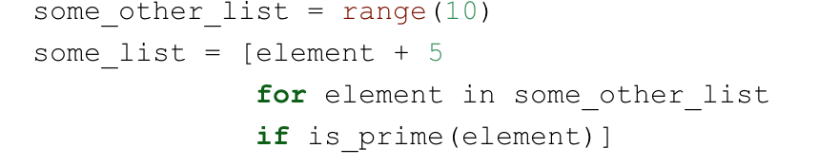
Python Idioms
Bad
Good

Slide 56
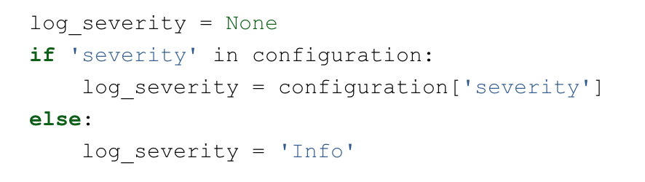
Python Idioms
Bad
Good

Slide 57
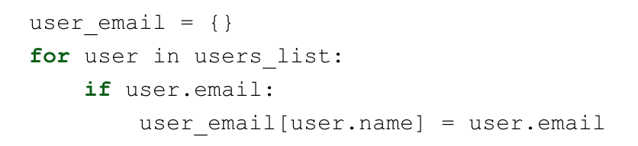
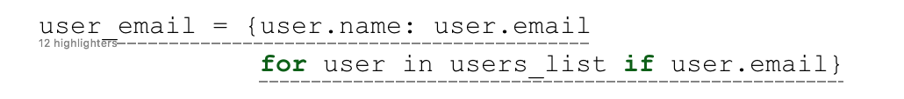
Python Idioms
Bad
Good

Slide 58
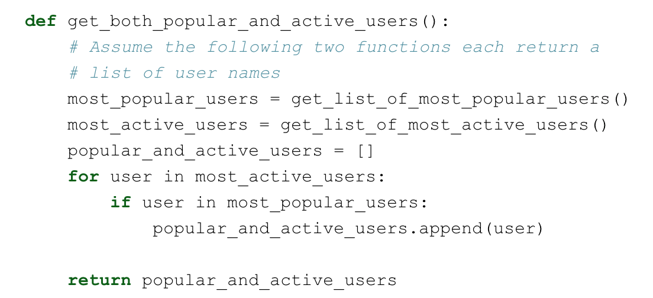
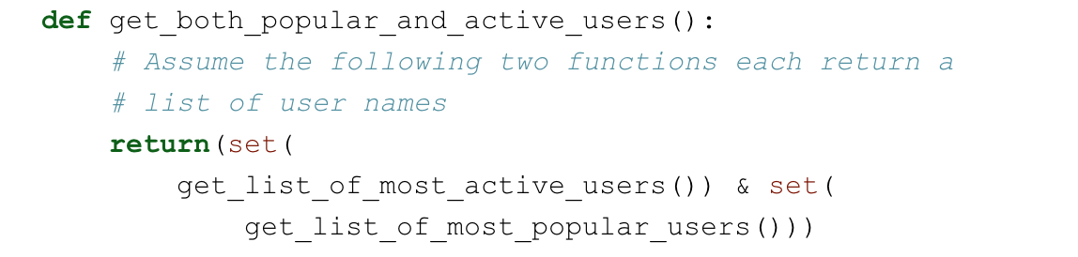
Python Idioms
Bad
Good

Slide 59
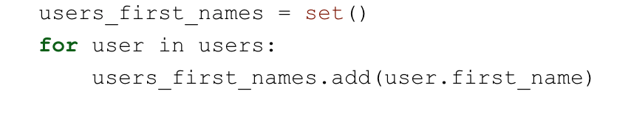
Python Idioms - Bad
Bad
Good

Slide 60
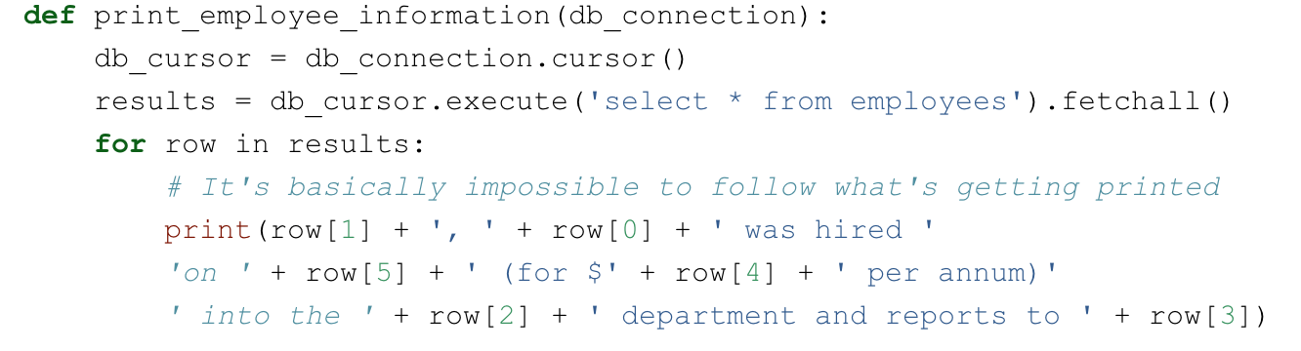
Python Idioms
Bad

Slide 61
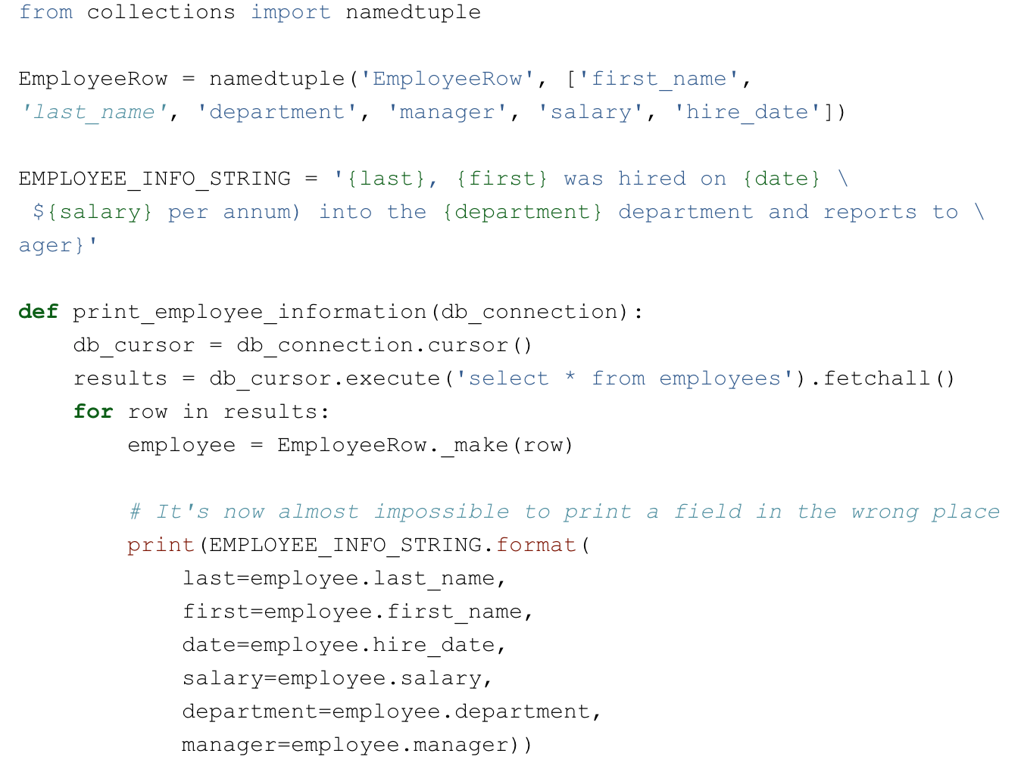
Python Idioms
Good

Slide 62
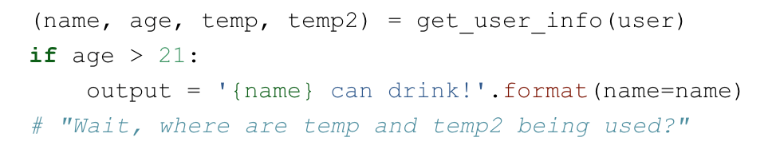
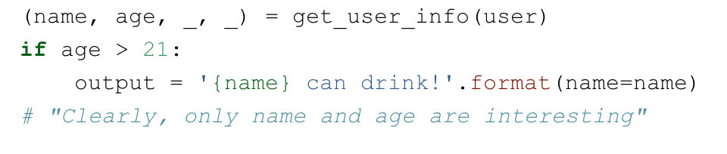
Python Idioms
Bad
Good

Slide 63
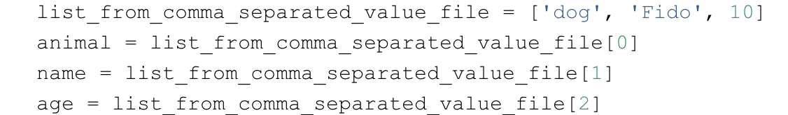
Python Idioms
Bad
Good

Slide 64
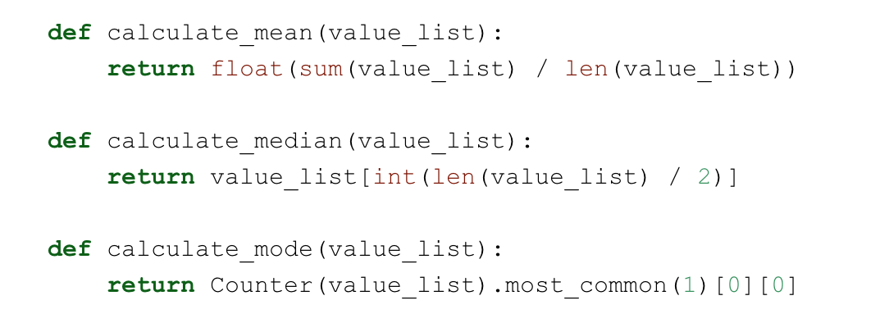
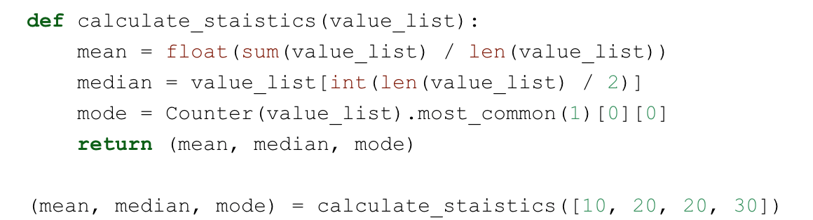
Python Idioms
Bad
Good

Slide 65
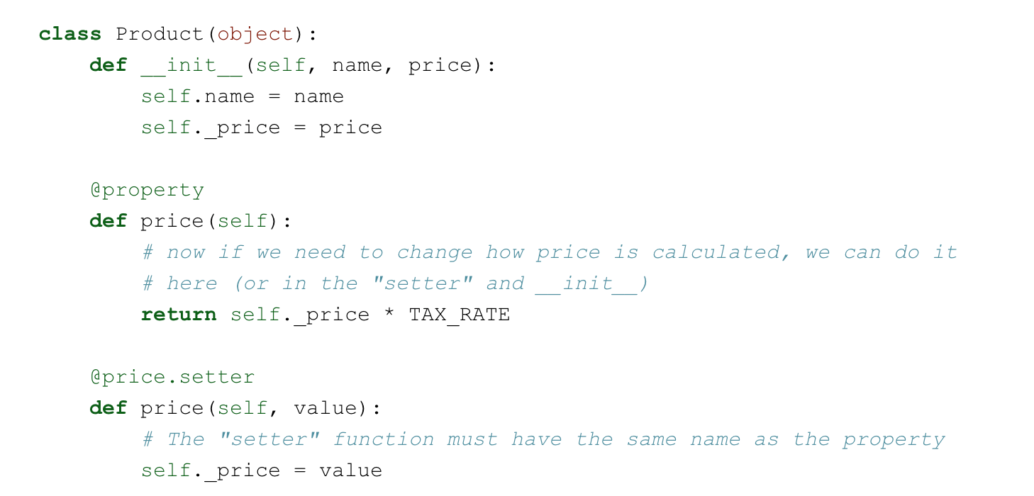
Python Idioms
Use properties

Slide 66
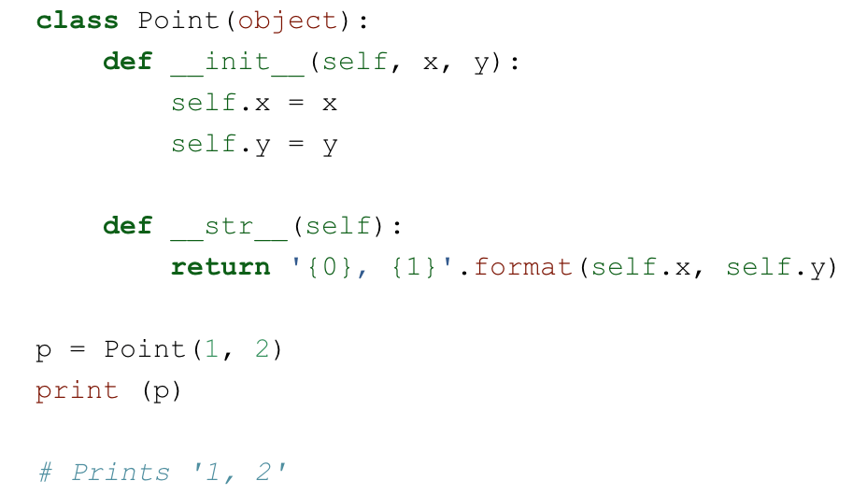
Python Idioms
Implement __str__ functions

Slide 67
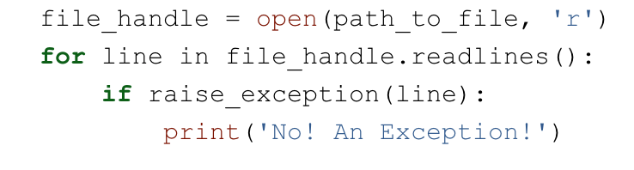
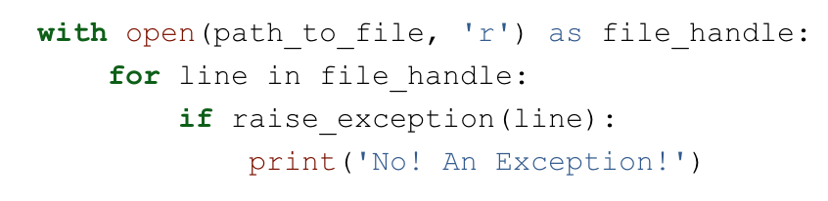
Python Idioms
Bad
Good

Slide 68
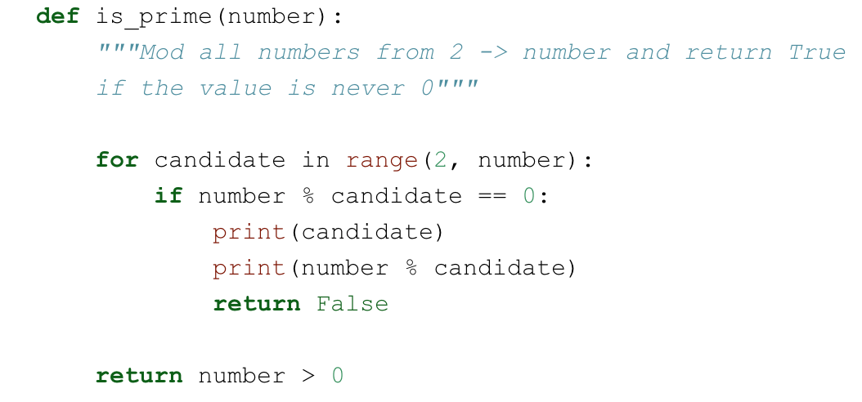
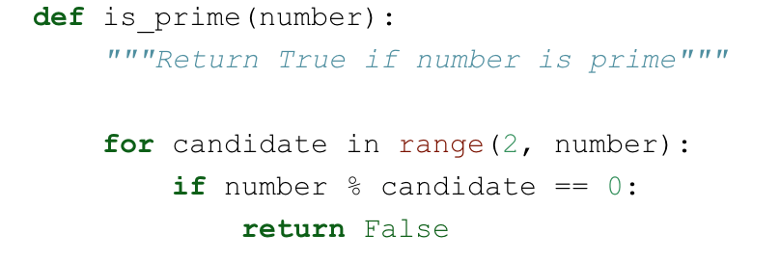
Python Idioms
Bad
Good
Comments are used
to describe what
you do

Slide 69

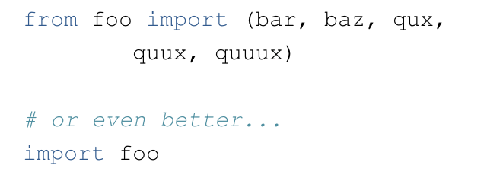
Python Idioms
Bad
Good

Slide 70
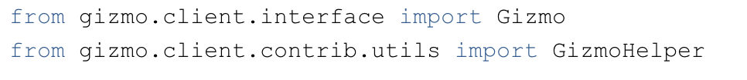
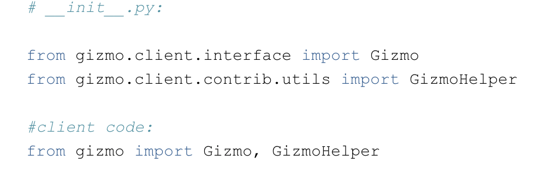
Python Idioms
Bad
Good

Slide 71
Python Functional Programming
Higher order function ➤
Function that have parameters that are also functions or return a function.
In the context of Spark, most transformations have parameters that are functions.
Example: Map.

Slide 72
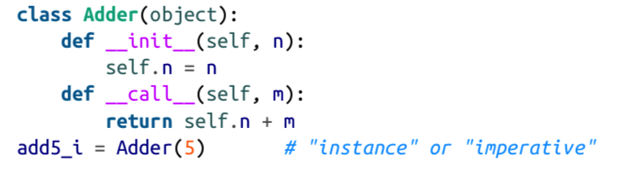
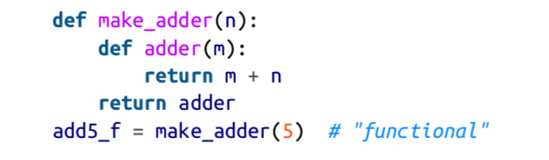
Python Functional Programming - Closures

Slide 73
Python Functional Programming
We will continue Functional programming
and Spark next week.

