Slide 1

Spark: HDFS, Yarn, Lab
Lecture 04-05
Marilson Campos
UCSC Extension - 2022

Slide 2
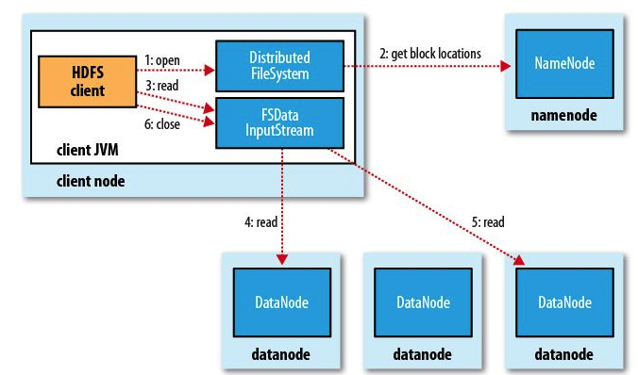
Hadoop HDFS
HDFS Read

Slide 3
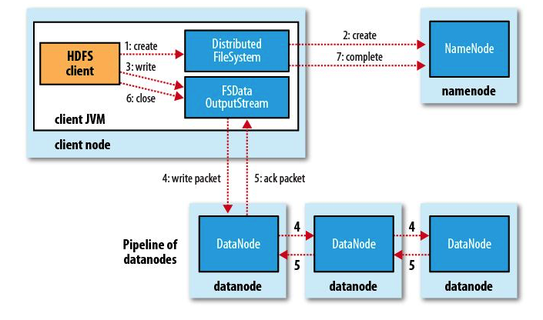
Hadoop HDFS
HDFS Write

Slide 4
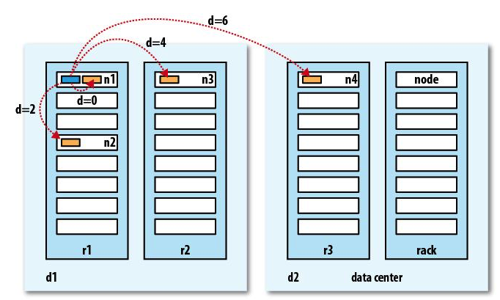
Hadoop HDFS
Rack Awareness

Slide 5
Hadoop HDFS
Network traffic patterns
Website stack traffic
- Many relatively small requests
- Data flows vertically
- “Sharding” data
https://en.wikipedia.org/wiki/Shard_(database architecture)
Hadoop stack traffic
- Large continuous data transfers
- Data flows horizontally
- data natively distributed

Slide 6
Hadoop HDFS
HDFS Data Integrity
Data can be corrupted during transmission or at rest.
HDFS maintains a CRC-32 for each 512 bytes.
CRC-32 adds an overhead of a little less than 1% of size.
Datanodes verify data coming from clients and other
Datanodes during replication.
Also, the “DataNodes” run a background thread called
“DataBlockScanner” continuously.

Slide 7
Hadoop HDFS
HDFS Data Integrity
When the “DataBlockScanner” finds an inconsistency
it will use the “replicas” to heal itself.

Slide 8
Hadoop HDFS Administration
HDFS Data Integrity
Cluster Backups
- Typically, we don't have space for backup all the data.
Solution:
- Backup the “meta-data” of the data from the
“NameNodes”.
With popularity of the cloud technology some
companies are backing up critical parts using services
like Amazon S3 glacier.

Slide 9
Hadoop HDFS Administration
HDFS Data Integrity
Periodical File System checks
use command “hdfs fsck -report”
There are options to try to ”fix” things.
I recommend run the “report” option to detect errors and review results before issuing commands.

Slide 10
Hadoop HDFS Administration
HDFS Adding new nodes.
Adding new nodes currently is done using a Web interface provided by each distribution.
One step that is still manual is to make sure you run the Balancer (start-balancer.sh) once you finished to add nodes.
You can add as many nodes and the run the balancer at the end.

Slide 11
Hadoop HDFS Administration
HDFS Removing nodes.
Removing nodes is also done via Web interface.
** Important **
In the case of removing more than one ”datanode”, Its highly recommended to remove one node at time and run the balancer after the removal.

Slide 12
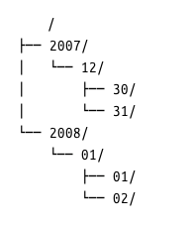
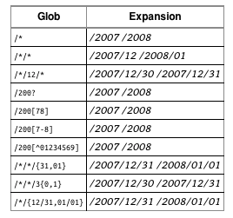
Hadoop HDFS
HDFS Globs

Slide 13
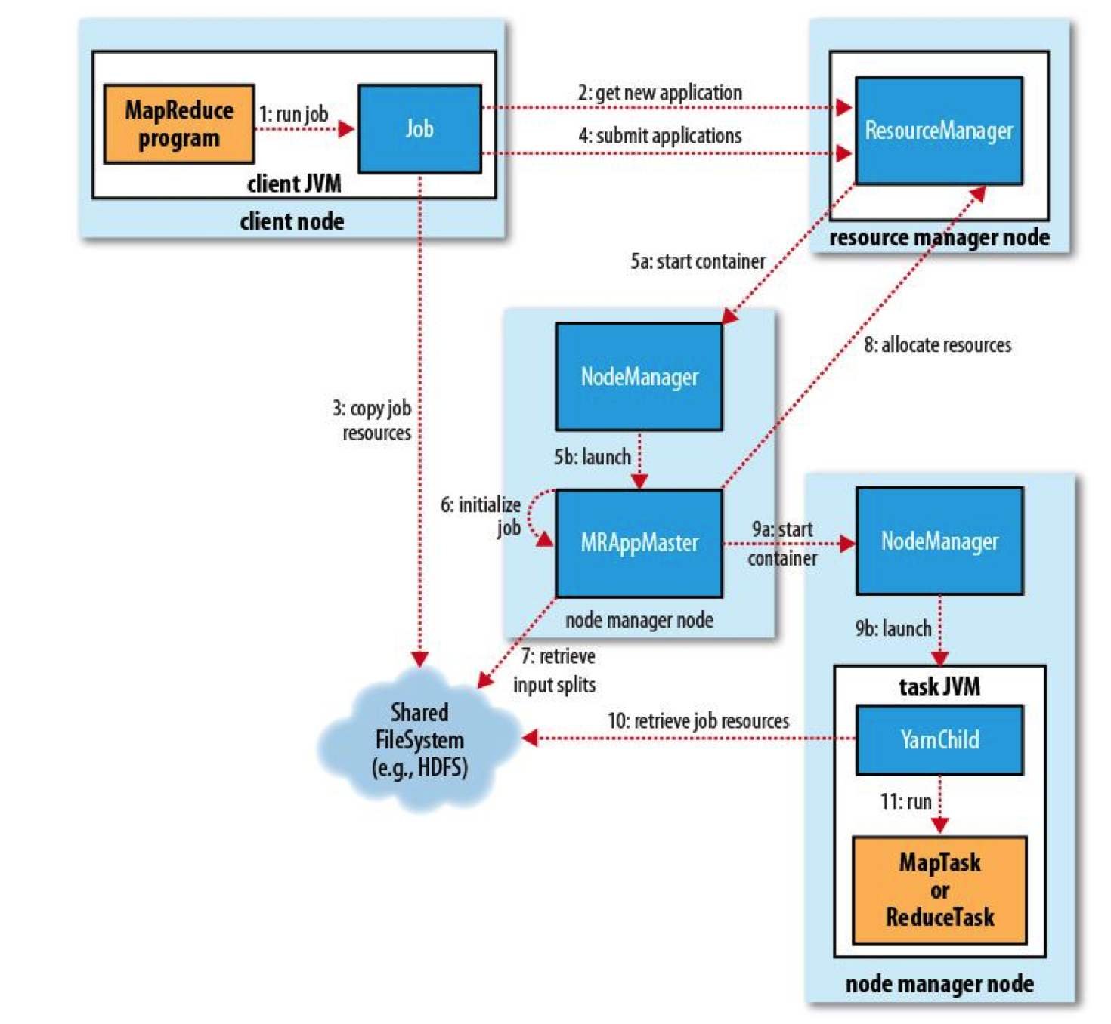
Hadoop Job Submission & Execution
Map/Reduce V2

Slide 14
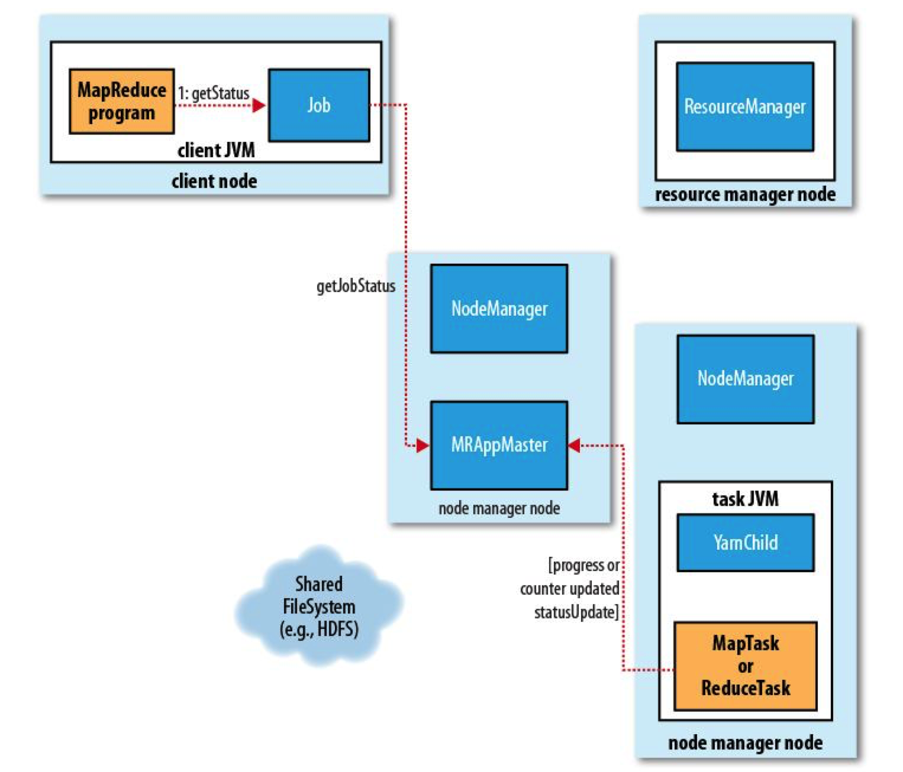
Hadoop Job Submission & Execution
Progress V2

Slide 15
Hadoop Job Submission & Execution
Types of Job Failures
Task Failure
- A task fails, gets restarted and keeps failing until if fails the job.
- Control the number o retries before giving up.
mapreduce.map.maxattempts
mapreduce.reduce.maxattempts
- Control acceptable percentage of failure
mapreduce.map.failures.maxpercent mapreduce.reduce.failures.maxpercent

Slide 16
Hadoop Job Submission & Execution
Types of Job Failures
App Master Failure
- After failure is restarted or recovered.
- Control the number o retries before giving up.
yarn.resourcemanager.am.max-retries
- Control if retrieve state from previous runs
yarn.app.mapreduce.am.job.recovery.enable

Slide 17
Hadoop Job Submission & Execution
Types of Job Failures
Node Manager Failure
- Node manager fails to send heartbeat
- Blacklisted

Slide 18
Hadoop Job Submission & Execution
Types of Job Failures
Resource Manager Failure
- The most serious
- Property to set a class to handle state
yarn.resourcemanager.store.class
- Normally kept in memory, but there is also a “Zookeeper” based that retain state.

Slide 19
Hadoop Job Submission & Execution
Jobs
Job Schedulers
- FIFO – First in First out
Jobs executed in sequence of scheduling.
Pros:
Simple
Cons:
One large job blocks everybody.

Slide 20
Hadoop Job Submission & Execution
Jobs
Job Schedulers
- FIFO – First in First out
Recent versions allow to set Job priority.
- This only rearranges jobs waiting on the queue.
- If a large job is running other jobs are still blocked.

Slide 21
Hadoop Job Submission & Execution
Jobs
Job Schedulers
- Fair Scheduler
Jobs are allocated in pools
- Support preemption of jobs.
New job comes and forces a running job to give up resources.
- Avoids blocking jobs.

Slide 22
Hadoop Job Submission & Execution
Jobs
Job Schedulers
- Capacity Scheduler
Jobs are allocated in “queue”
Each queue is processed using FIFO w/ Priorities
- Can Create hierarchy.
Ex: prod/critical prod/normal and office.
- Avoids blocking jobs.

Slide 23
Hadoop Reduce - Copy
M/R
- First stage of reduce phase
Maps complete at different times. So the copy phase starts the before the “Map” phase is complete.
mapred.reduce.parallel.copies: Defines how many threads each reducer daemon can use to pull data from the mapper.

Slide 24
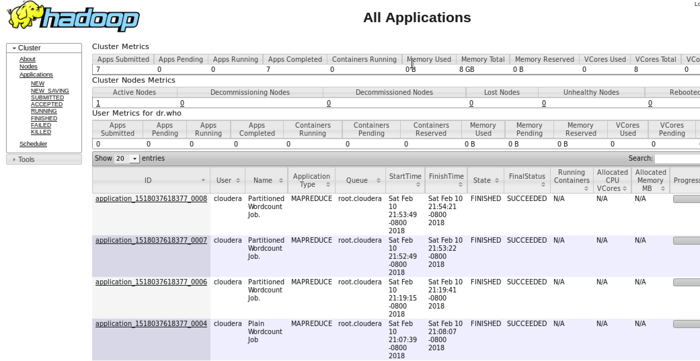
Hadoop navigation Yarn Web UI
Clicking on one application link takes to the application run page.

Slide 25
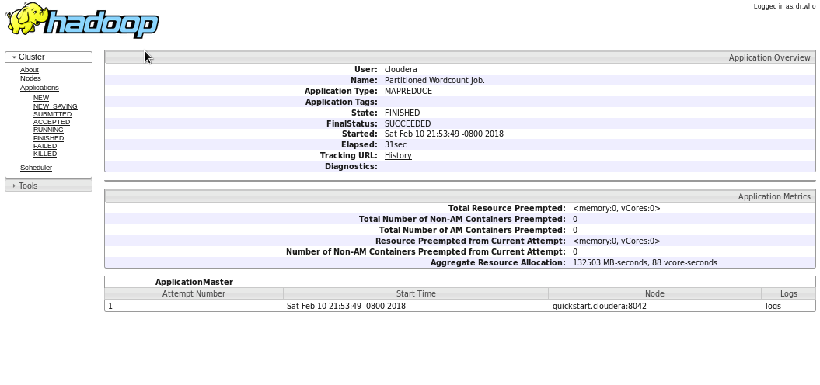
Hadoop navigation Yarn Web UI
”History” link
shows more details.
Application Master
Node

Slide 26
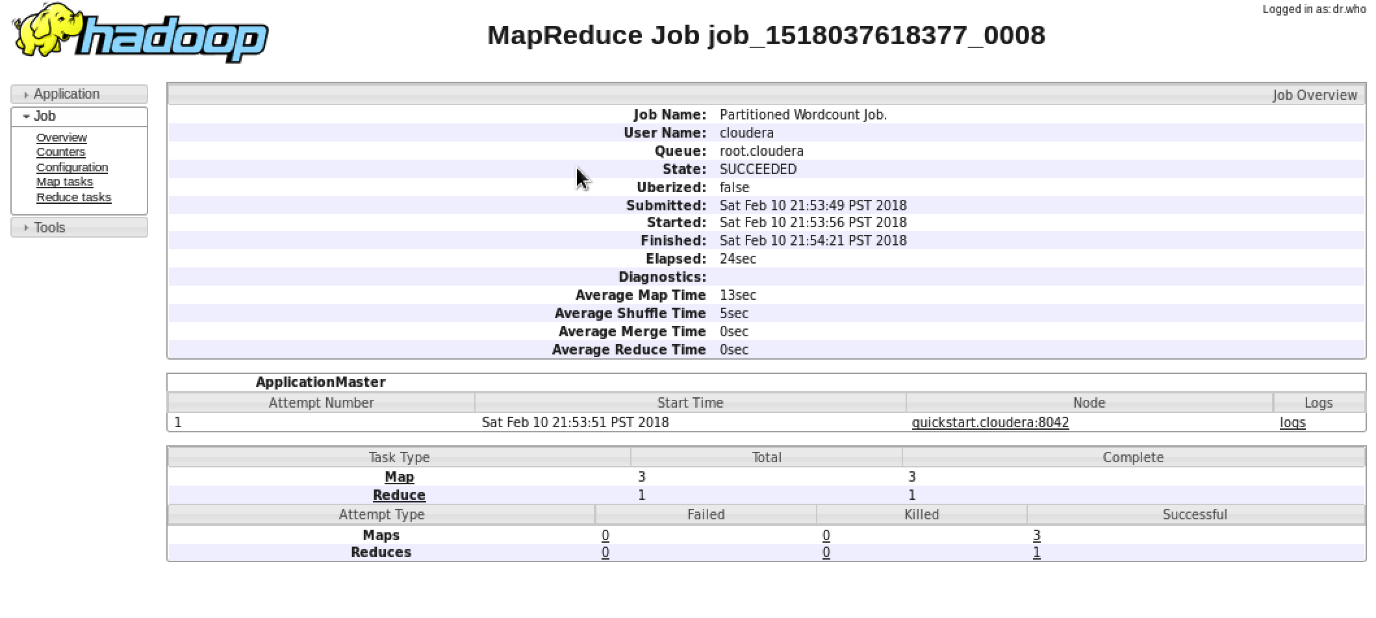
Hadoop navigation Yarn Web UI
”Maps” or Reduce links
Show the tasks.

Slide 27
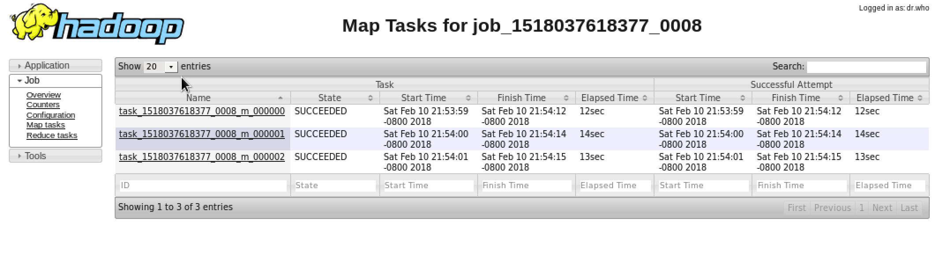
Hadoop navigation Yarn Web UI
Lists the tasks for a particular map.
Clicking on the “task” link…

Slide 28
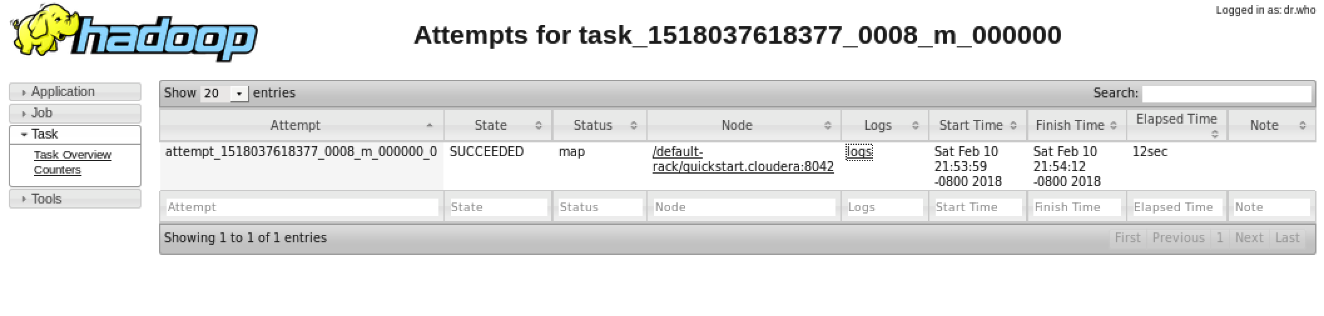
Hadoop navigation Yarn Web UI
We can see the logs for a particular
attempt on the ‘logs’ Link.
Shows information about task execution attempts.
In this case the first attempt succeed (end with ‘_0’)

Slide 29
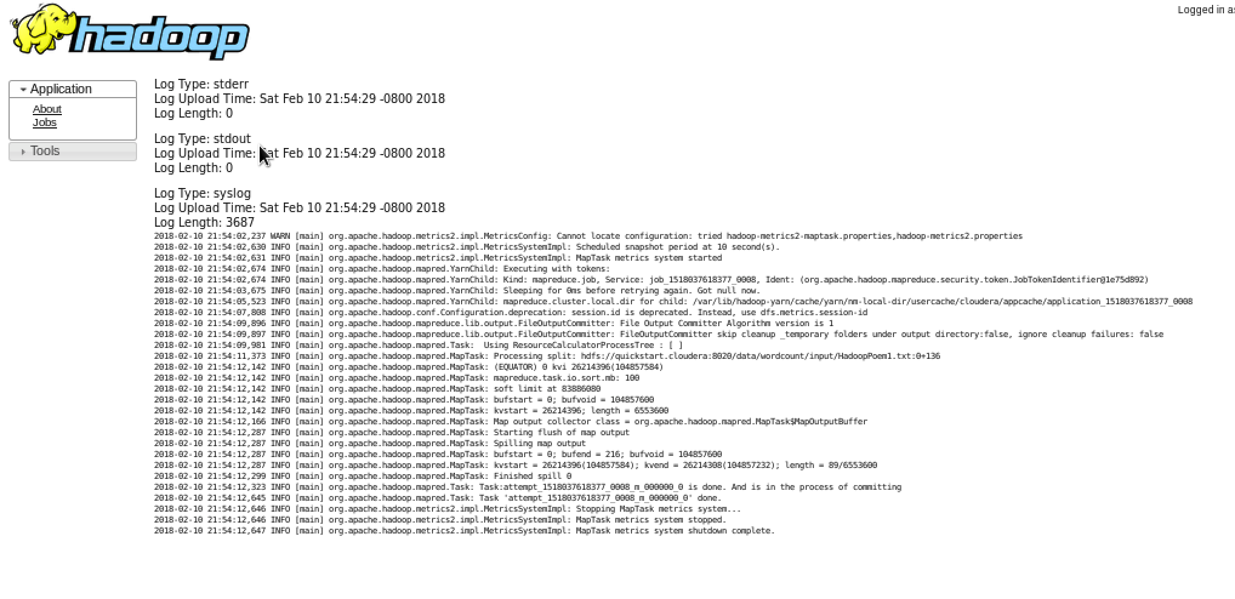
Hadoop navigation Yarn Web UI
Notice that in a real cluster these logs are being produced in
the node that executed that attempt.

Slide 30
Q & A

