Slide 1
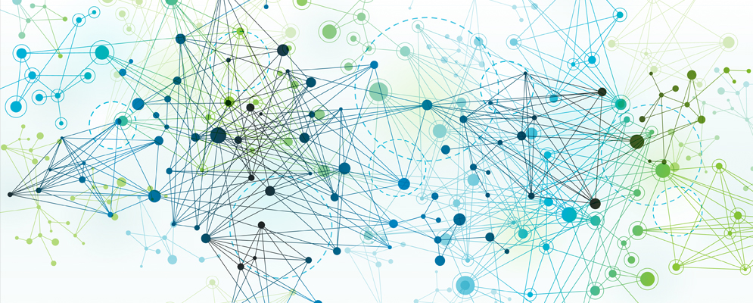
Labs: Spark Extras & Hive Lab 1
Lecture 07 –Labs
Marilson Campos
UCSC Extension - 2021

