Slide 1
M
M
M
B
Marilyn Braojos
B
M
M
B
Notes:
Women in STEM

Slide 2
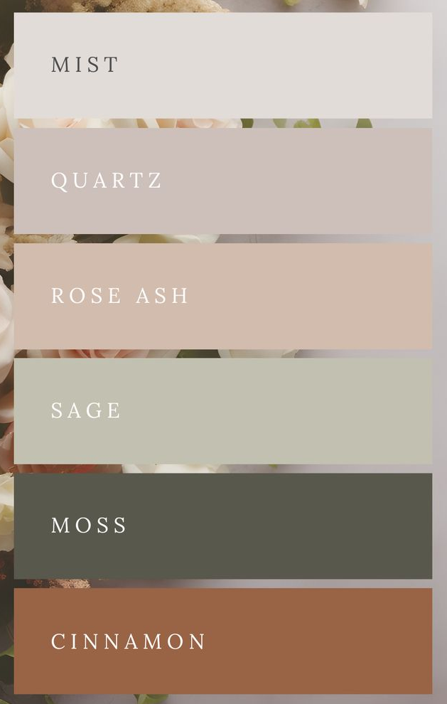
Color Palette Option #1
Color | RGB
Mist | 224, 220, 217
Quartz | 203, 192, 187
Rose Ash | 206, 189, 175
Sage | 194, 192, 179
Moss | 88, 88, 77
Cinnamon | 145, 102, 74

Slide 3
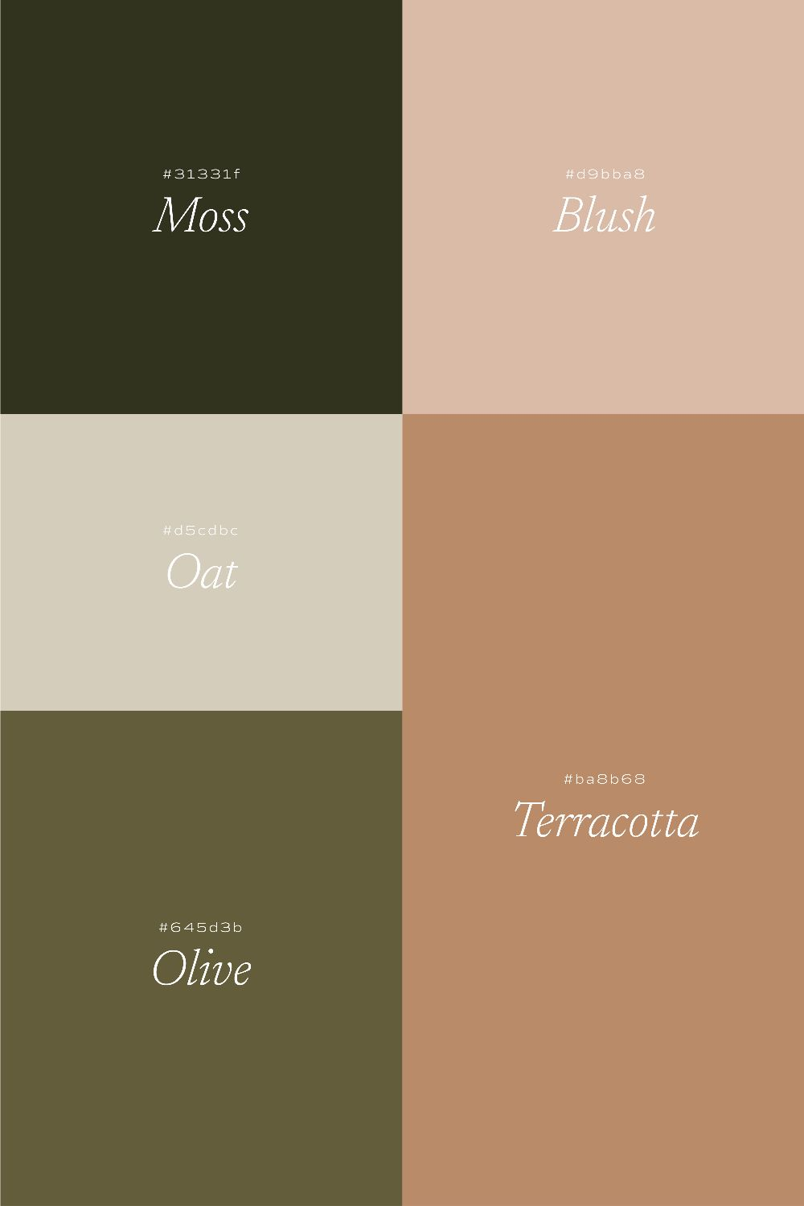
Color Palette Option #2
Color | RGB
Moss | 49, 51, 32
Blush | 213, 188, 170
Oat | 211, 205, 189
Olive | 98, 93, 63
Terracotta | 178, 141, 110

Slide 4
Notes:
Connect with me: Linked In
Contact Me: marilynbraojos@gmail.com
Webname: marilynbraojos.com
Find out what I’m working on right now!

Slide 5
M
B
Marilyn Braojos

