Slide 1

Apache Spark™ is a unified analytics engine for large-scale data processing

Slide 2
Why Spark?
Speed
Ease of Use
Generality
Runs Everywhere

Slide 3
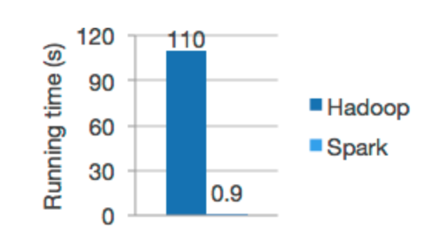
Speed
Speed
Run workloads 100x faster.
Apache Spark achieves high performance for both batch and streaming data, using a state-of-the-art DAG scheduler, a query optimizer, and a physical execution engine.

Slide 4
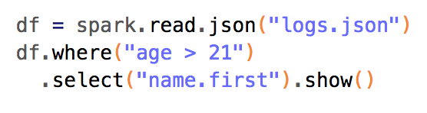
Ease of Use
Write applications quickly in Java, Scala, Python, R, and SQL.
Spark offers over 80 high-level operators that make it easy to build parallel apps. And you can use it interactively from the Scala, Python, R, and SQL shells.

Slide 5
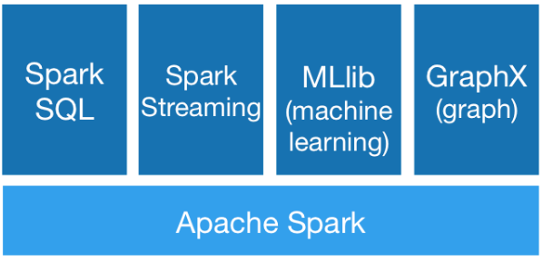
Generality
Combine SQL, streaming, and complex analytics.
Spark powers a stack of libraries including SQL and DataFrames, MLlib for machine learning, GraphX, and Spark Streaming. You can combine these libraries seamlessly in the same application.

Slide 6

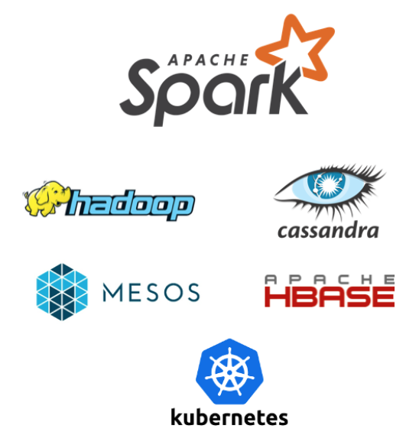
Runs Everywhere
Spark runs on Hadoop, Apache Mesos, Kubernetes, standalone, or in the cloud. It can access diverse data sources.
You can run Spark using its standalone cluster mode, on EC2, on Hadoop YARN, on Mesos, or on Kubernetes. Access data in HDFS, Alluxio, Apache Cassandra, Apache HBase, Apache Hive, and hundreds of other data sources.

Slide 7
