Slide 1
Shuffling

Slide 2
GroupBy Shuffle
Does not aggregate data before moving it across the network
Increased latency

Slide 3
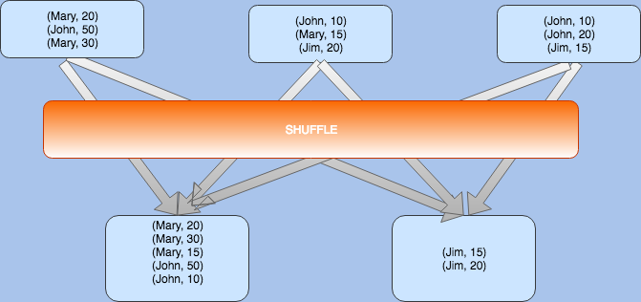
GroupBy Shuffle

Slide 4
ReduceBy Shuffle
Aggregates (reduces) data on worker before shuffle
Should be the preferred over GroupBY

Slide 5
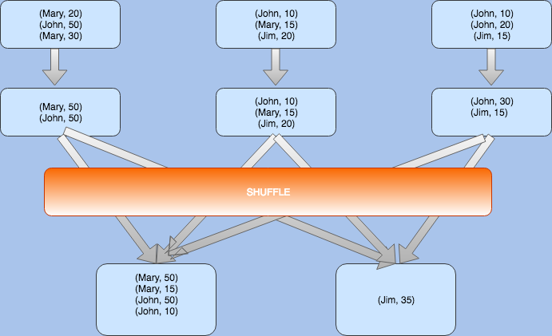

Slide 6
Hash Partitioning
By default, Spark uses hash partitioning to determine which key-value pair should be sent to which machine.
…. How to decide what to use for buckets ……

