Slide 1

The Apache Hadoop framework is composed of the following modules
Hadoop Common: contains libraries and utilities needed by other Hadoop modules
Hadoop Distributed File System (HDFS): a distributed file-system that stores data on the commodity machines
Hadoop YARN: a resource-management platform responsible for managing compute resources in clusters and using them for scheduling of users' applications
Hadoop MapReduce: a programming model for large scale data processing

Slide 2
Hadoop and HDFS
Good for:
Large files
Streaming Data Access (web logs, not real time; batch)
write-once-read-many
Not good for:
Lots of small files
Random Access
Low-Latency Access

Slide 3
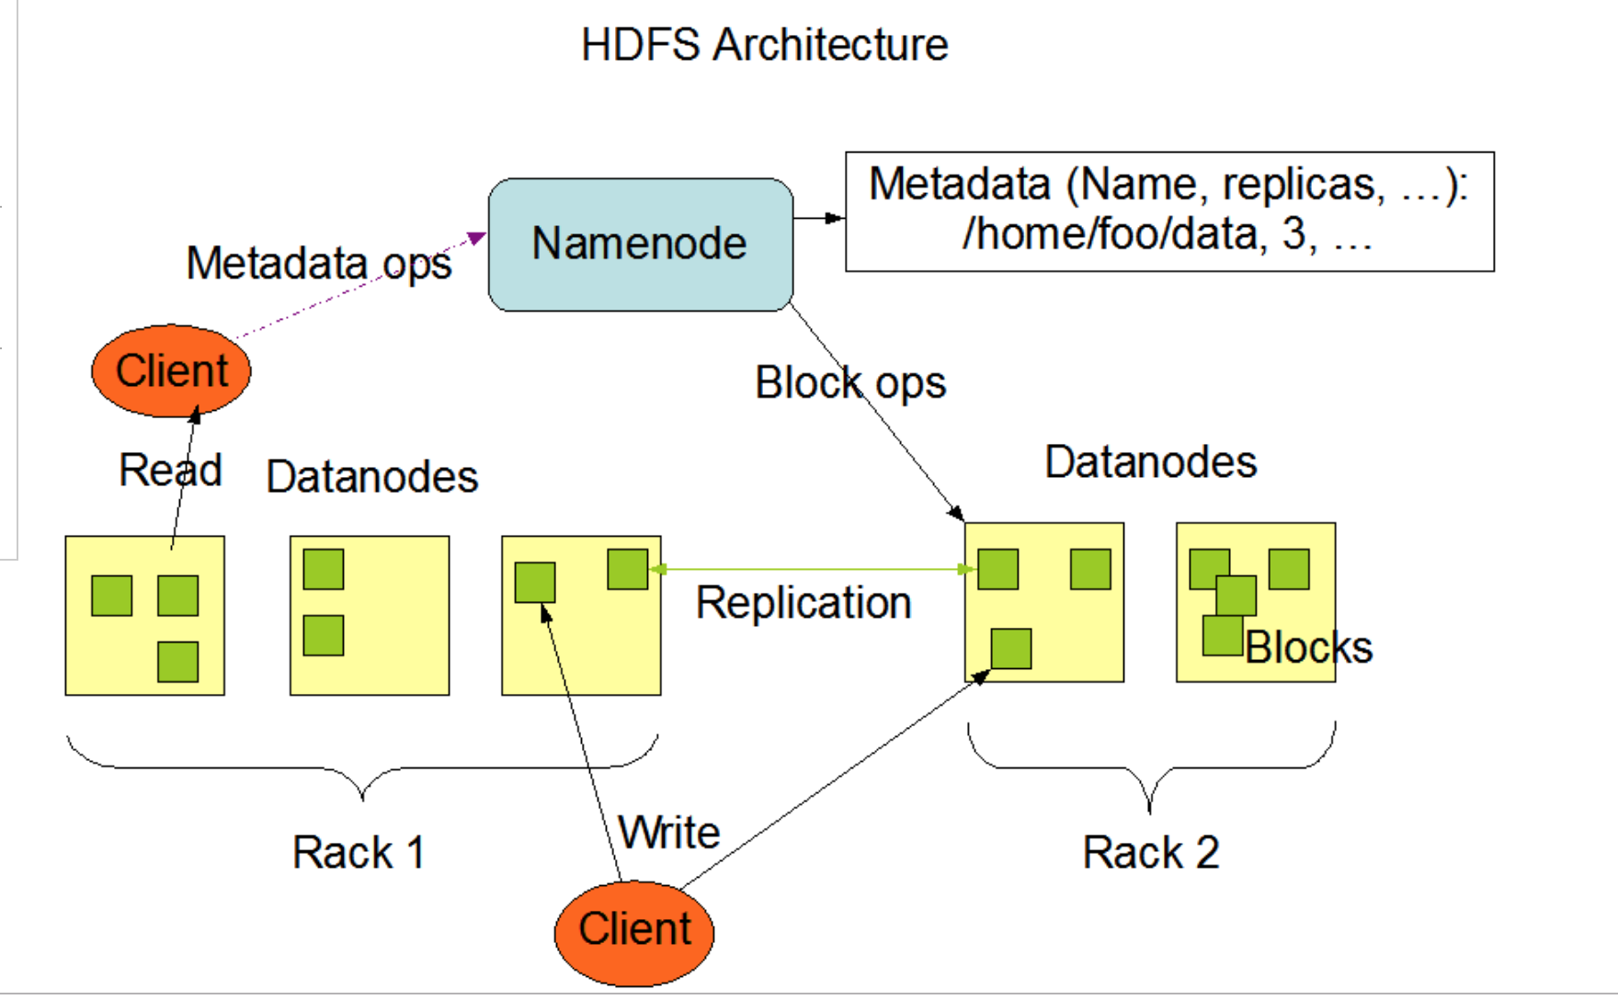
source

Slide 4
HDFS
Master
Single NameNode for managing file system metadata
DataNodes
Multiple DataNodes store data as blocks
SecondaryNameNode
Backup for NameNode
Checkpointing

Slide 5
HDFS Files
HDFS files are broken into blocks
Basic unit for reading/writing
Default 64MB, often larger in production
Good for large files and high throughputs
Blocks may have replicas
One block can be stored in multiple locations
Makes HDFS fault tolerant

Slide 6
NameNode and DataNodes
The NameNode executes file system namespace operations like opening, closing, and renaming files and directories. It also determines the mapping of blocks to DataNodes.
The DataNodes are responsible for serving read and write requests from the file system’s clients. The DataNodes also perform block creation, deletion, and replication upon instruction from the NameNode.

Slide 7
The File System Namespace
HDFS supports a traditional hierarchical file organization. A user or an application can create directories and store files inside these directories. The file system namespace hierarchy is similar to most other existing file systems.

Slide 8
More HDFS …..
Data Replication - blocks of a file are replicated for fault tolerance
The Persistence of File System Metadata - uses a transaction log called the EditLog
The Communication Protocols - All HDFS communication protocols are layered on top of the TCP/IP protocol
Robustness - The three common types of failures are NameNode failures, DataNode failures and network partitions.
Data Organization – works well with LARGE files – no little files
Accessibility – Java, C, REST (HTTP) Client

Slide 9
HDFS Put
Put Command
Write a file to HDFS
hdfs dfs –put </source path> </destination path>

Slide 10
HDFS List
List Command
The ‘list’command displays all the available files inside a particular path.
hdfs dfs –ls </source path>

Slide 11
HDFS Get
Get Command
‘get’ copies a file from HDFS to the local drive
hdfs dfs –get </source path> </destination path>

Slide 12
HDFS mkdir
Make Directory Command
Create a new directory in HDFS
hdfs dfs –mkdir </source path>

Slide 13
HDFS Cat
View contents of particular file
Display the contents of an HDFS file
hdfs dfs –cat </path[filename]>

Slide 14
HDFS copyToLocal
copyToLocal is similar to get command, except that the destination is restricted to a local file reference
hdfs dfs –copyToLocal </source> </dest>

Slide 15
HDFS copyFromLocal
copyFromLocal is similar to put command, except that the source is restricted to a local file reference
hdfs dfs –copyFromLocal </source path> </destination path>

Slide 16
HDFS rm
Removing a File
hdfs dfs –rm </path[filename]>

