Slide 1
Spark Streaming - TCP

Slide 2
Workflow
Start the TPC Server
Start Spark Streaming
Find the lab here

Slide 3
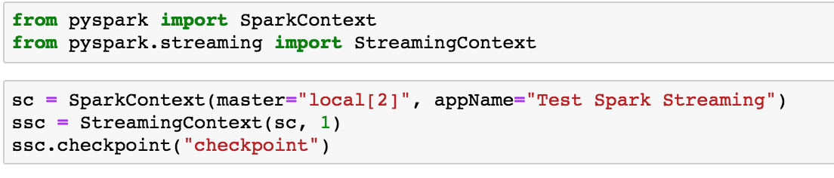
Open your note book to 01-Stream-TCP
Follow along …..
Create a Spark Context and a Streaming Context

Slide 4
ssc = new StreamingContext(sc, 1)
The second parameter of (sc, 1), represents the time interval at which streaming data will be divided into batches.

Slide 5
After a StreamingContext is defined you do the followin:
Define the input sources
Applying transformations on the Dstreams
Define output operations on DStreams.
Start receiving data – streamingContext.start()
Stop processing streamingContext.stop()

Slide 6
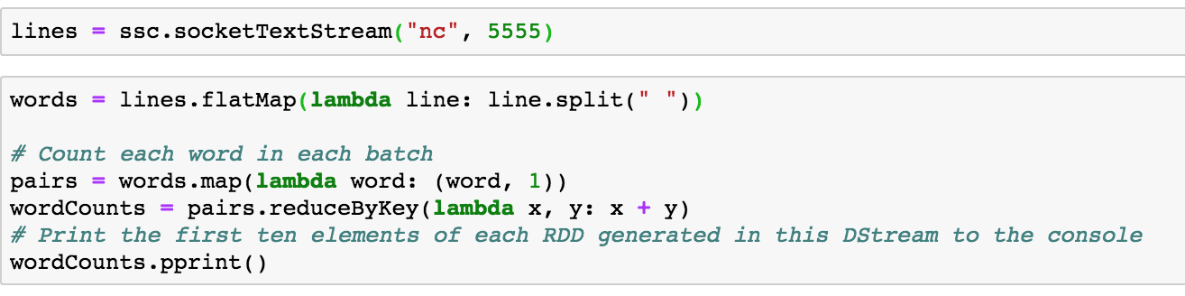
Define Transformations

Slide 7
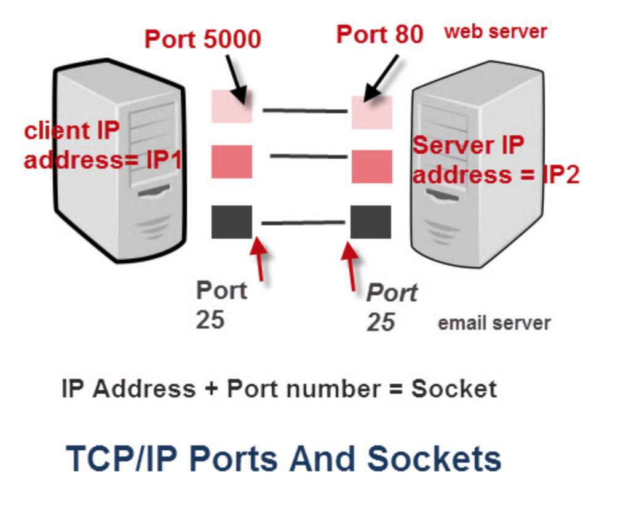
What is TCP? [source]

Slide 8
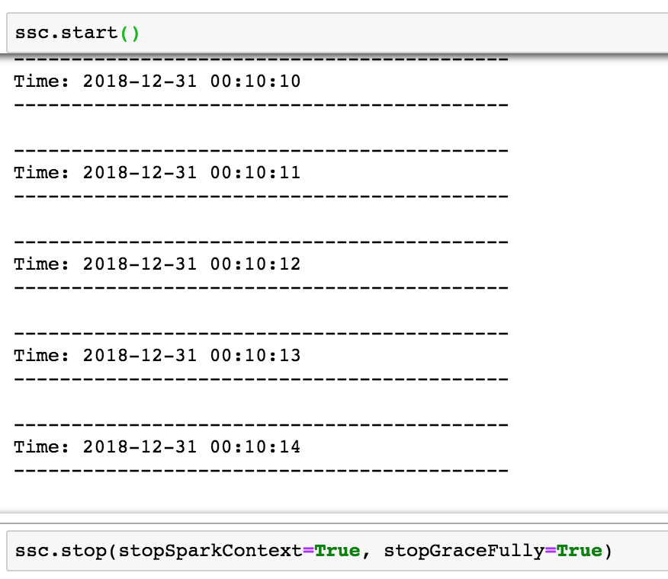
Start Streaming

Slide 9
Tear down the lab
Follow instructions to terminate the NC server and Streaming container

