Slide 1
Operating Systems

Slide 2
Manages:
Processes via a Scheduler
A File System – Hierarchy of Directories and Files
A Network Interface – To communicate with other machines
Memory
Applications – Browser and Shell

Slide 3
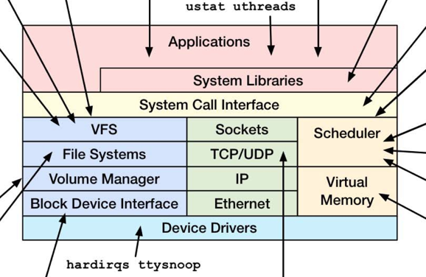
Linux [source]

Slide 4
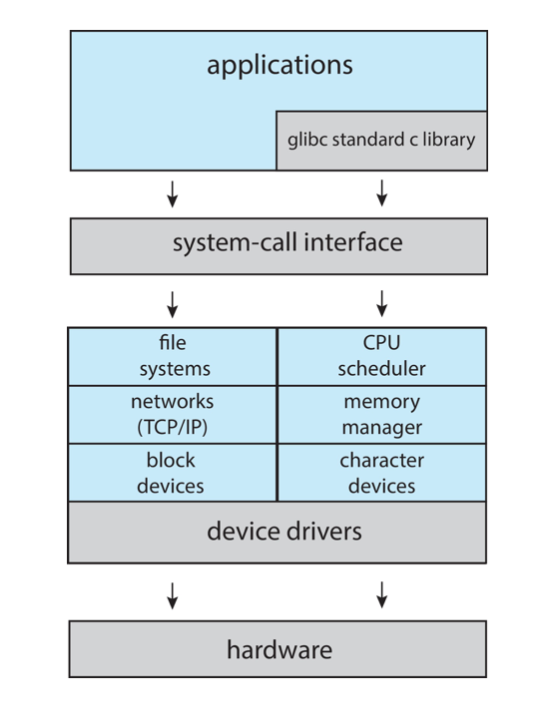
Linux System [source]

Slide 5
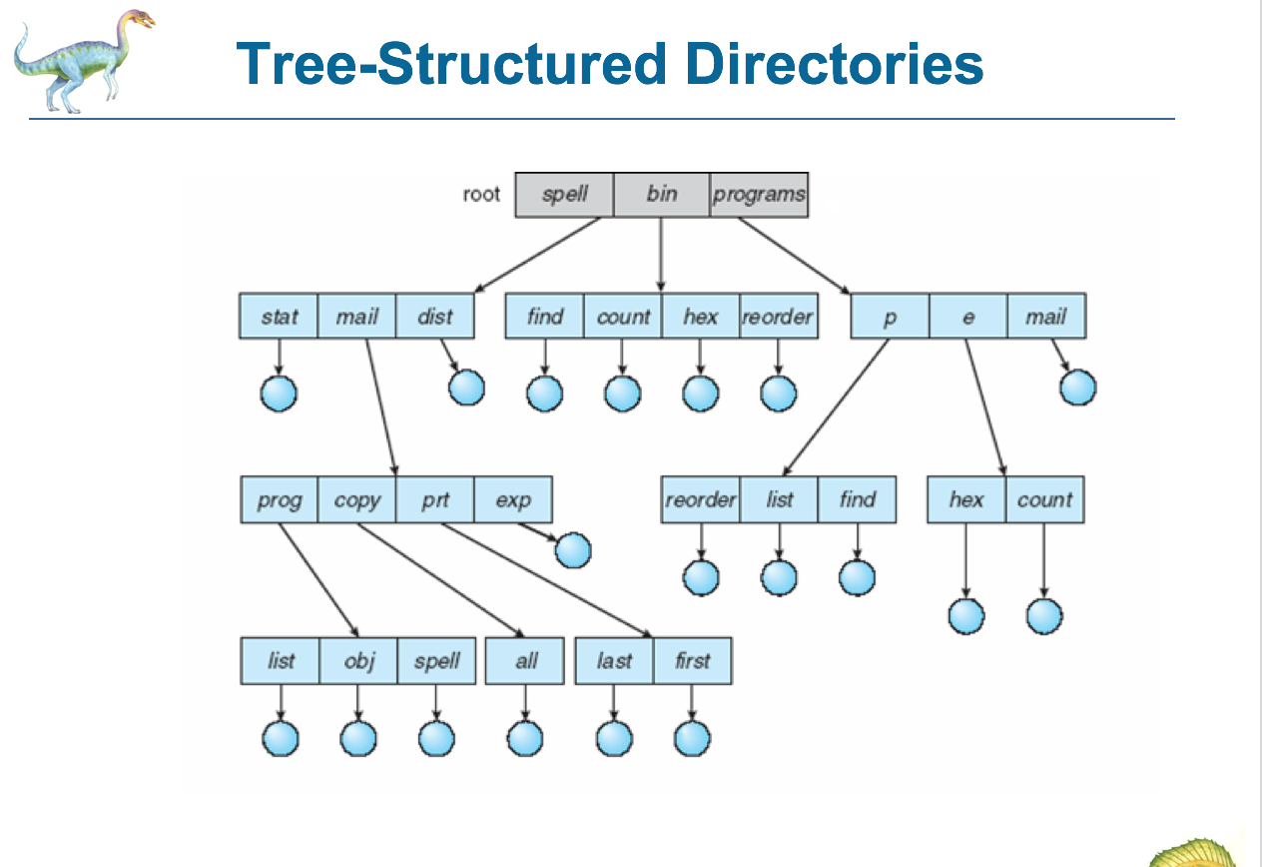
File System [source]

Slide 6
Traversing Directory Structure
pwd – current working directory
cd - change directory
absolute path
cd /Users/user_name/directory_name
relative path
mkdir mydir
cd mydir
cd .. // go up one level

Slide 7
File Operations
Create a new file
Copy a file
cp file1 file2
Move a file
mv file1 file2
Remove a file
rm file
Remove a directory and all of it contents
rm –rf dir_name

Slide 8
Distributed Systems [source]
Distributed system is collection of loosely coupled processors interconnected by a communications network
Processors variously called nodes, computers, machines, hosts

Slide 9
Communication between nodes
ssh
tcp/ip http
ssh kristen.cs.cu.edu
you can transfer files, get to a bash prompt, etc

Slide 10
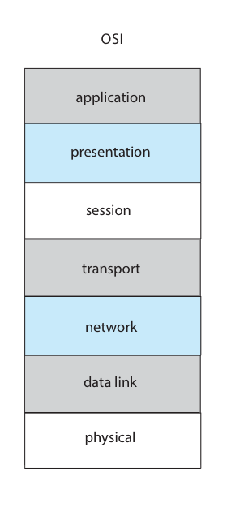
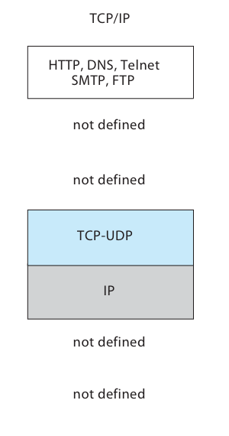


The OSI and TCP/IP Protocol Stacks [source]
socket = URL + port 127.0.0.1:8080

Slide 11
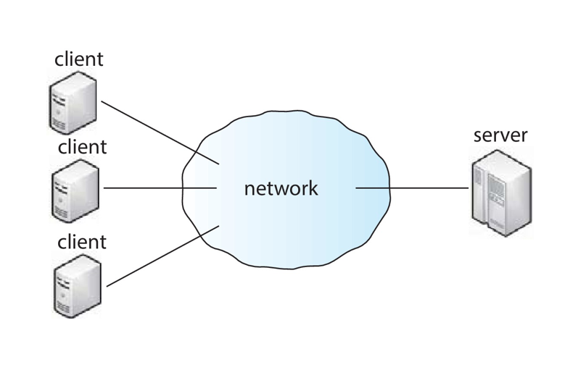
Client Server Model [source]
http://127.0.0.1:8880

Slide 12
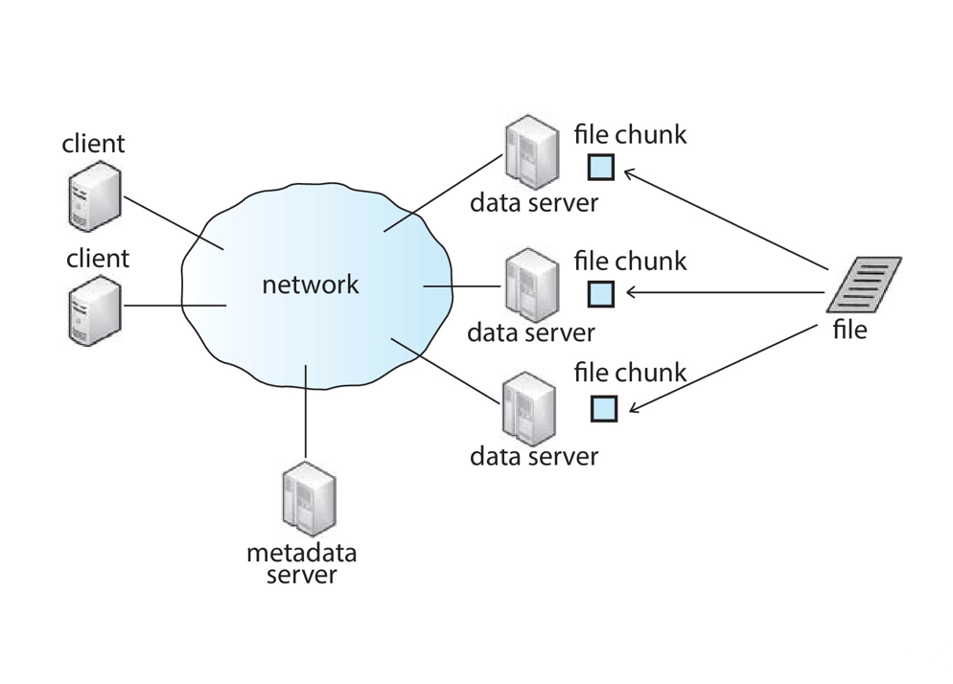
Cluster Based Model – Hadoop [source]
Distributed File System

