Slide 1

Master-Worker Architecture
Spark uses a master-worker architecture.
The driver that talks to a coordinator called the master that manages worker where executors run.
Credit

Slide 2
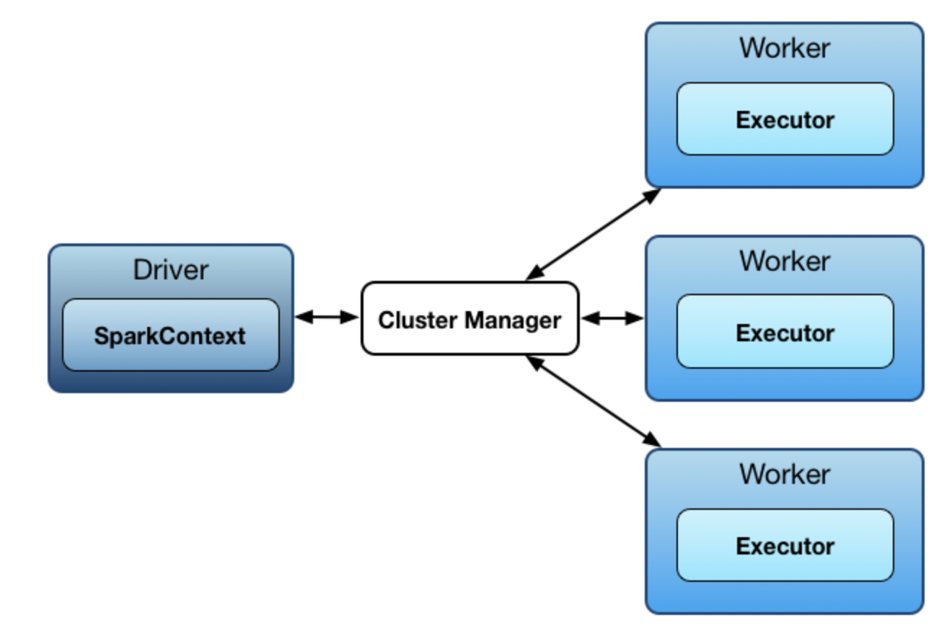
Master-Worker Architecture

Slide 3
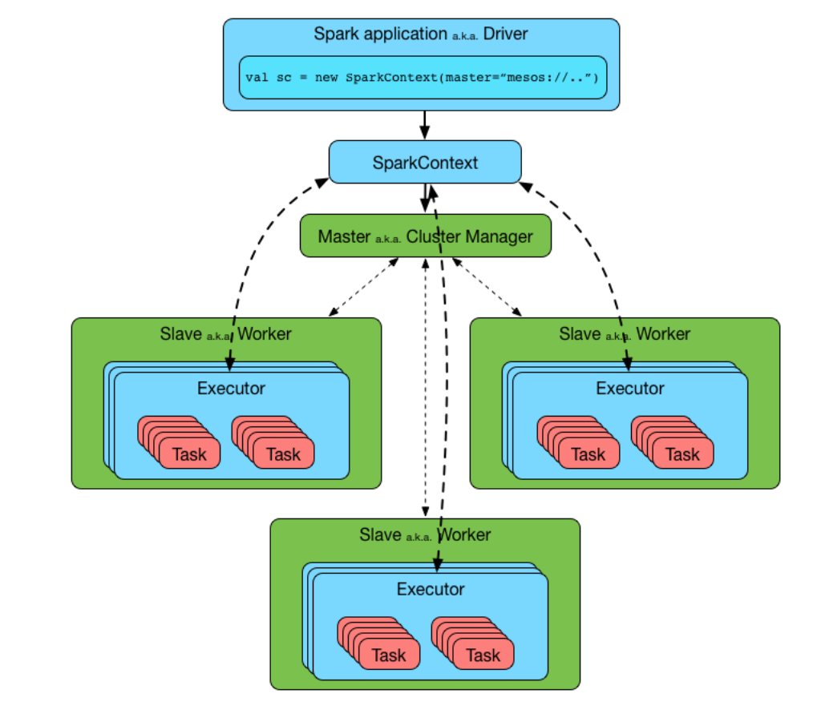
The driver and the executors run in their own Java processes. You can run them all on the same machne or separate machines

Slide 4

Spark Architecture
An executor is a distributed agent that is responsible for executing tasks
A master is a running Spark instance that connects to a cluster manager for resources.
Workers are running Spark instances where executors live to execute tasks. They are the compute nodes in Spark.
Every Spark application starts by creating SparkContext
SparkConf is the Spark Configuration

Slide 5
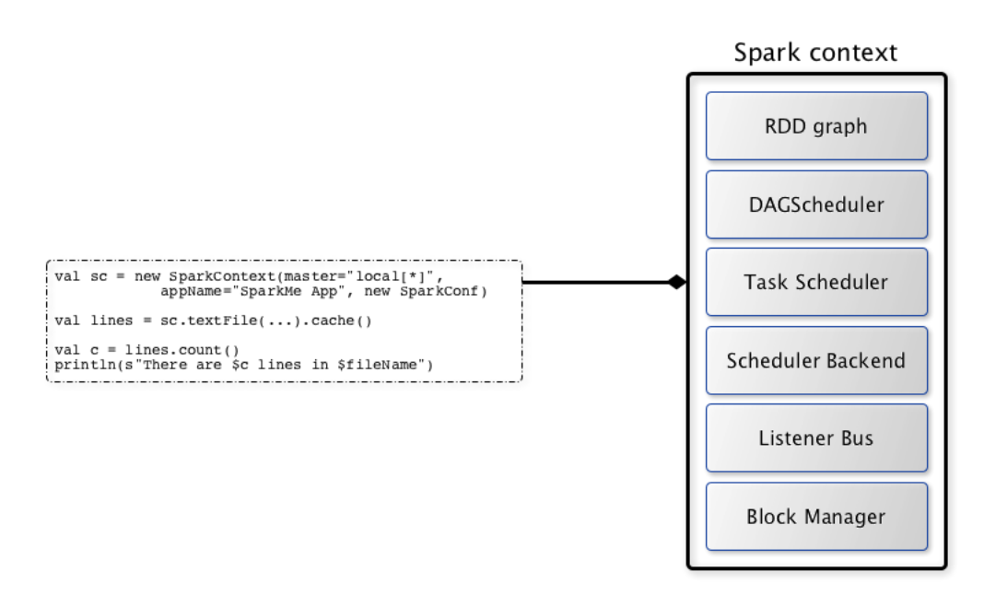
SparkContext — Entry Point to Spark Core

Slide 6
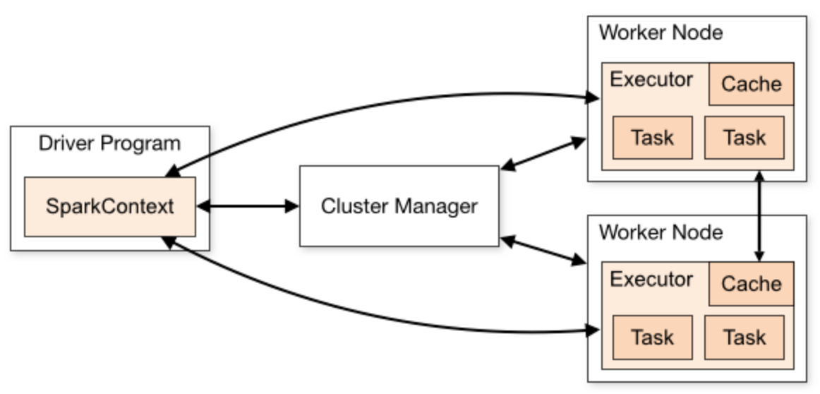
Summary Architecture

