Slide 1
Resilient Distributed Datasets (RDDs)
An Introduction

Slide 2

Resilient Distributed Datasets (RDDs)
Primary abstraction that allow Spark to distribute data
Fault tolerant – if they are destroyed they can be recreated by the driver and sent to a new worker
Immutable – once created you cannot change them. Instead you perform transformations on them and create new RDDs.
Unstructured and semi-structured data
Remain in memory
Many input sources : HDFS, S3, csv, json

Slide 3
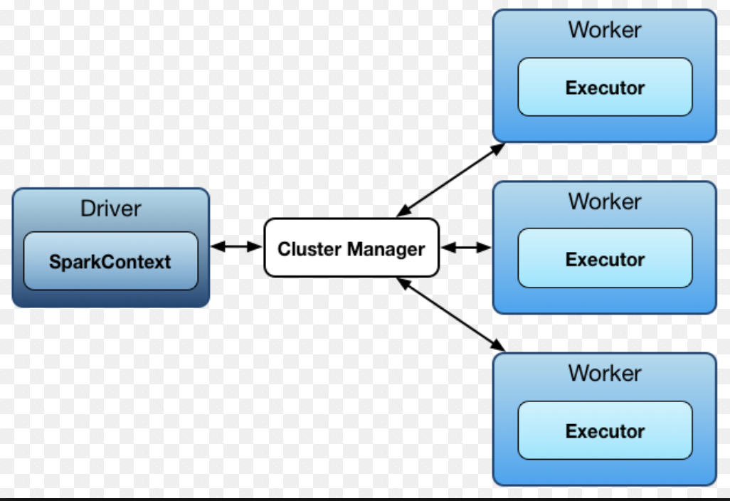
RDD operations
Transformations – map, flatmap, join
Lazy operations
Take place on the worker nodes
Actions – count, distinct, reduce
Eager operations
Results returned to the driver and
summarized or written to
storage
[Source]

Slide 4

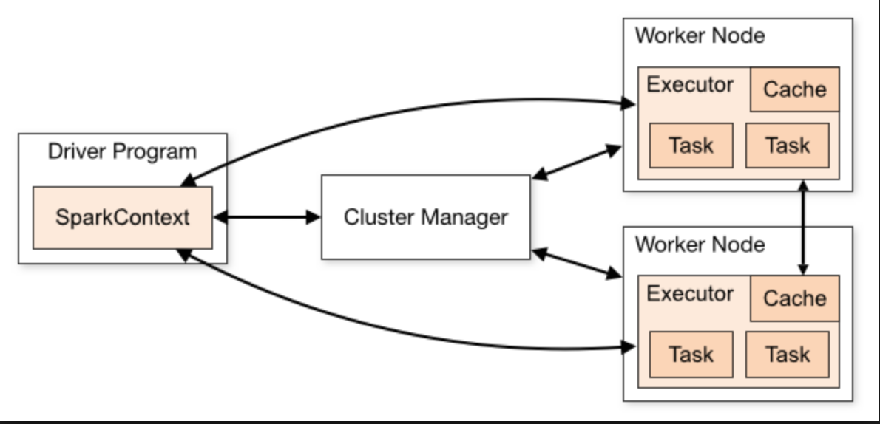
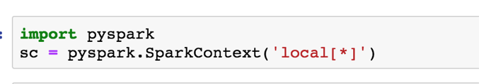
Your entry point into Spark is the Spark Context

Slide 5
Creating RDDs
You can create an RDD in one of three ways:
Parallelizing an existing collection in your driver program
Referencing a dataset in an external storage system, such as a shared filesystem, HDFS, HBase, or any data source offering a Hadoop InputFormat
By transformations on another RDD

Slide 6
Resilient Distributed Datasets (RDDs)
Parallelizing an existing collection in your driver program
>>> data = [1, 2, 3, 4, 5] //Python List
>>> distData = sc.parallelize(data) // RDD
Referencing a dataset
>>> distFile = sc.textFile("data.txt") //RDD

Slide 7
Resilient Distributed Datasets (RDDs)
Given an RDD you can create a new RDD using transformations.
>>> data = [1, 2, 3, 4, 5]
>>> rdd1 = sc.parallelize(data)
>>> rdd2 = rdd1.map(lambda x : x + 1)

Slide 8
Resilient Distributed Datasets (RDDs)
rdd2 = rdd1.map(lambda x : x +1)

Slide 9
Transformations on RDDs
Transform one RDD to another
map
flatmap
filter
fold
aggregate

Slide 10
Basic Transformations
nums = sc.parallelize([1, 2, 3])
# Pass each element through a function
squares = nums.map(lambda x: x*x) # => {1, 4, 9}
# Keep elements passing a predicate
even = squares.filter(lambda x: x % 2 == 0) # => {4}
# Map each element to zero or more others
nums.flatMap(lambda x: range(0, x)) # => {0, 0, 1, 0, 1, 2}

Slide 11
Resilient Distributed Datasets (RDDs)
To get the results of a transformation back to the driver, you must issue an action
>>> data = [1, 2, 3, 4, 5]
>>> rdd1 = sc.parallelize(data)
>>> rdd2 = rdd1.map(lambda x : x + 1)
>>> rdd2.collect()

Slide 12
Resilient Distributed Datasets (RDDs)
Actions
collect
count
reduce
take(n)
Reference : https://spark.apache.org/docs/latest/rdd-programming-guide.html - actions

Slide 13
Basic Actions - Eager
nums = sc.parallelize([1, 2, 3])
# Retrieve RDD contents as a local collection nums.collect() # => [1, 2, 3]
# Return first K elements nums.take(2) # => [1, 2]
# Count number of elements nums.count() # => 3
# Merge elements with an associative function nums.reduce(lambda x, y: x + y) # => 6
# Write elements to a text file nums.saveAsTextFile(“hdfs://file.txt”)

Slide 14

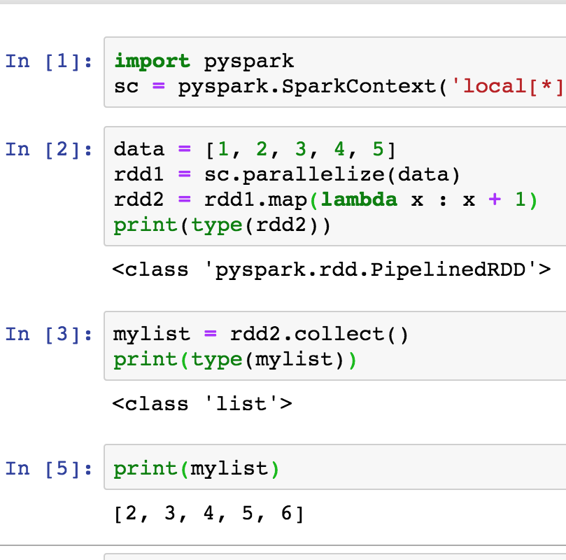
Resilient Distributed Datasets (RDDs)

Slide 15
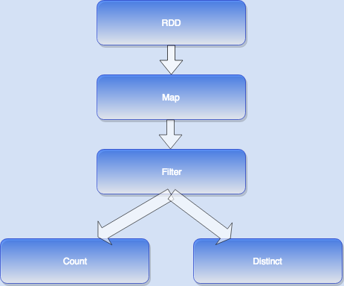
Lazy Evaluation - An execution plan, a DAG (directed acyclic graph) of tasks is sent to the workers. It is not executed until an action is run

