Slide 1
Key-Value Pairs (Pair RDDs)

Slide 2
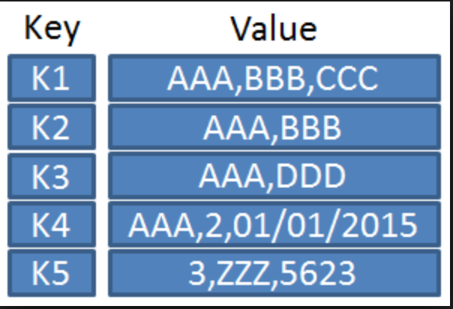
Key-Value Pairs (Pair RDDs)
Spark provides special operations for key-value pairs. These are widely used on the distributed platforms.
In Python key-value pairs are dictionaries
In Java and Scala they are maps
Spark will make use of tuples to create a
pair RDD.

Slide 3
Key-Value Pairs (Pair RDDs)
We often extract fields from an RDD and treat it as a key for the purpose of creating aggregations.
Here we extract the first word from a line of text and place it in a tuple:
“001 The quick brown fox “ ---- > (001, “001 The quick brown fox”)
Creating a pair RDD using the first word as the key in Python
pairs = lines.map(lambda x: (x.split(" ")[0], x))

Slide 4
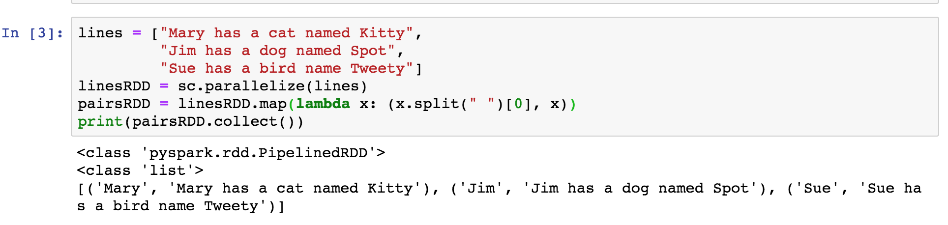
Key-Value Pairs (Pair RDDs)
Create a key-value pair

Slide 5
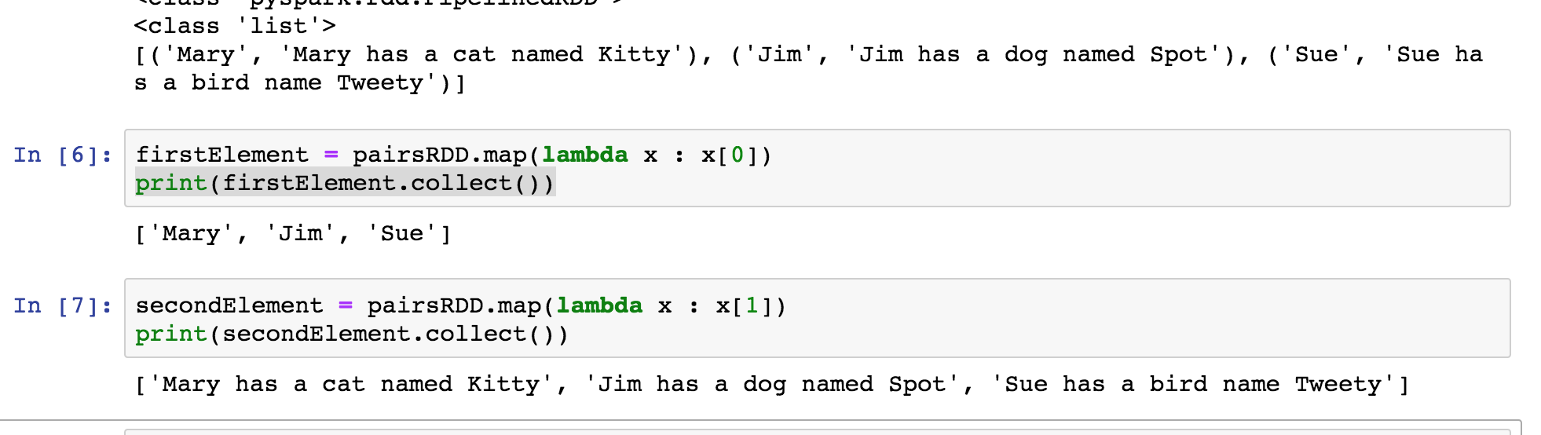
Extracting the Elements of Key-Value Pairs (Pair RDDs)
Examine the tuple created

Slide 6
Key-Value Pairs (Pair RDDs)
Operations on pair RDDs
keys()
values()
groupByKey()
reduceByKey(func)
mapValues(func)
sortByKey()
join
Reference : https://spark.apache.org/docs/latest/rdd-programming-guide.html - working-with-key-value-pairs

Slide 7
Example
words = ["one", "two", "two", "three", "three", "three"]
# Create an RDD of tuples (Pair RDD)
wordPairsRDD = sc.parallelize(words).map(lambda word : (word, 1))
[('one', 1), ('two', 1), ('two', 1), ('three', 1), ('three', 1), ('three', 1)]

Slide 8
Pair RDDs – Keys()
rdd = [('one', 1), ('two', 1), ('two', 1), ('three', 1), ('three', 1), ('three', 1)]
rdd.keys()
['one', 'two', 'two', 'three', 'three', 'three']

Slide 9
Pair RDDs - Values
rdd = [('one', 1), ('two', 1), ('two', 1), ('three', 1), ('three', 1), ('three', 1)]
rdd.values()
[1, 1, 1, 1, 1, 1]

Slide 10
groupByKey() is a Transformation
rdd = [('one', 1), ('two', 1), ('two', 1), ('three', 1), ('three', 1), ('three', 1)]
wordCountsWithGroup = rdd.groupByKey()
print (type(wordCountsWithGroup))
<class 'pyspark.rdd.PipelinedRDD’>
print(wordCountsWithGroup.collect())
[('two', <pyspark.resultiterable.ResultIterable object at 0x7fc5cf2c63c8>), ('three', <pyspark.resultiterable.ResultIterable object at 0x7fc5cf2c6400>), ('one', <pyspark.resultiterable.ResultIterable object at 0x7fc5cf2c6438>)]

Slide 11
groupByKey()
rdd = [('one', 1), ('two', 1), ('two', 1), ('three', 1), ('three', 1), ('three', 1)]
# GroupByKey then list values (perform an action)
rdd.groupByKey() \
.mapValues(list)
[('two', [1, 1]), ('three', [1, 1, 1]), ('one', [1])]

Slide 12
GroupByKey and Sum
rdd = [('one', 1), ('two', 1), ('two', 1), ('three', 1), ('three', 1), ('three', 1)]
rdd.groupByKey().mapValues(sum)
[('two', 2), ('three', 3), ('one', 1)]

Slide 13
ReduceByKey(function) – A Transformation
rdd = [('one', 1), ('two', 1), ('two', 1), ('three', 1), ('three', 1), ('three', 1)]
rdd.reduceByKey(lambda x, y : x + y)
[('two', 2), ('three', 3), ('one', 1)]

Slide 14
ReduceByKey(function) – A Transformation
rdd = [('one', 1), ('two', 1), ('two', 1), ('three', 1), ('three', 1), ('three', 1)]
wordCountsWithReduce = rdd.reduceByKey(lambda x, y : x + y)
print(type(wordCountsWithReduce))
class 'pyspark.rdd.PipelinedRDD'>

Slide 15
ReduceByKey(func) followed by Action
wordCountsWithReduce = rdd.reduceByKey(lambda x, y : x + y)
print(wordCountsWithReduce.collect())
[('two', 2), ('three', 3), ('one', 1)]

Slide 16
Key-Value Pairs (Pair RDDs)
ReduceByKey – similar to groupByKey except it aggregates/reduces on the worker before shuffle. ReduceByKey is preferred.
Performs a reduction in the lambda function.
rdd.reduceByKey(lambda function)
The shape returned is a list of tuples:
[ (key1, value1),
(key2, value2),
……
(key3, value3) ]

Slide 17
Key-Value Pairs (Pair RDDs)
Lab – Word Count

