Slide 1
Key-Value Pairs (Pair RDDs)

Slide 2
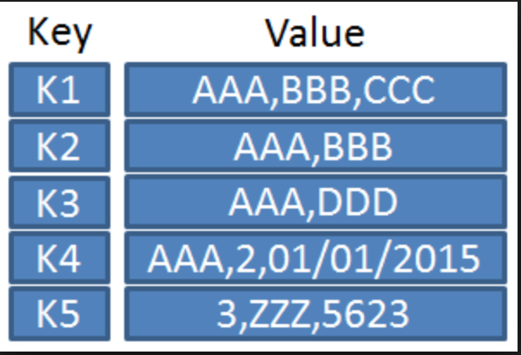
Key-Value Pairs (Pair RDDs)
Spark provides special operations for key-value pairs. These are widely used on the distributed platforms.
In Python key-value pairs are dictionaries
In Java and Scala they are maps
Spark will make use of tuples to create a
pair RDD.

Slide 3
Key-Value Pairs (Pair RDDs)
We often extract fields from an RDD and treat it as a key for the purpose of creating aggregations.
Here we extract the first word from a line of text and place it in a tuple:
“001 The quick brown fox “ ---- > (001, “001 The quick brown fox”)
Creating a pair RDD using the first word as the key in Python
pairs = lines.map(lambda x: (x.split(" ")[0], x))

Slide 4
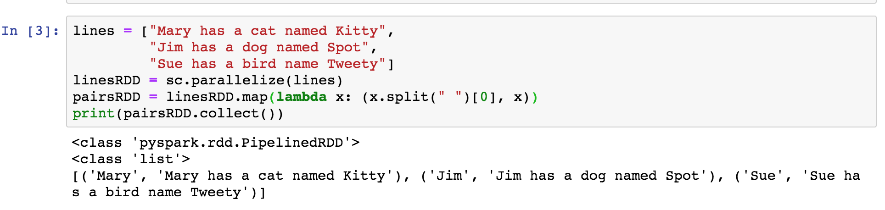
Key-Value Pairs (Pair RDDs)
Create a key-value pair

Slide 5
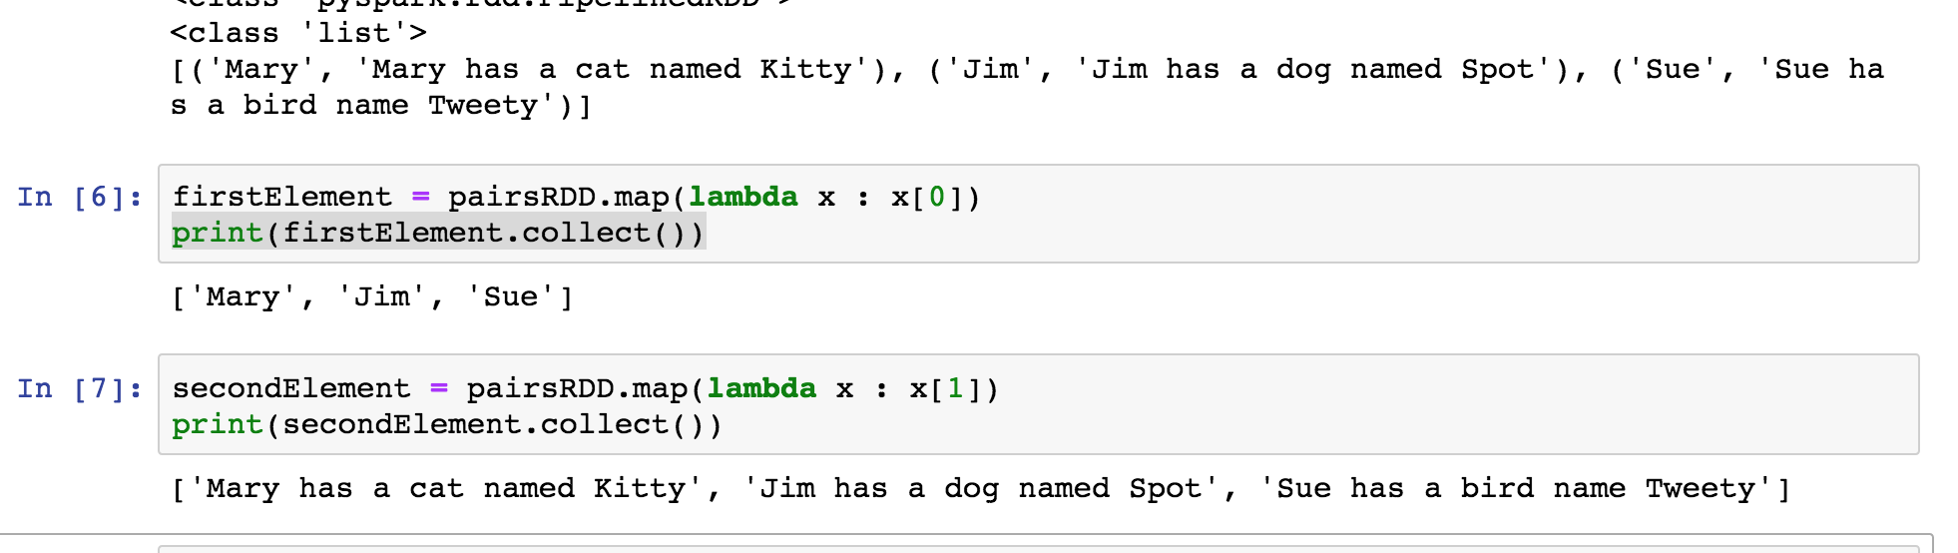
Extracting the Elements of Key-Value Pairs (Pair RDDs)
Examine the tuple created

Slide 6
Key-Value Pairs (Pair RDDs)
Operations on pair RDDs
reduceByKey
groupByKey
keys
values
join
Reference : https://spark.apache.org/docs/latest/rdd-programming-guide.html - working-with-key-value-pairs

Slide 7
Key-Value Pairs (Pair RDDs)
GroupByKey
rdd.groupByKey()
mylist = [(1,3), (1,5), (2,4), (3,4), (2,8)]
rdd = groupByKey(mylist)
This returns a tuple like this:
[(1, [3, 5]),
(2, [4, 8]),
(3, [4])
A list of tuples (with a list) – makes printing interesting ……

Slide 8
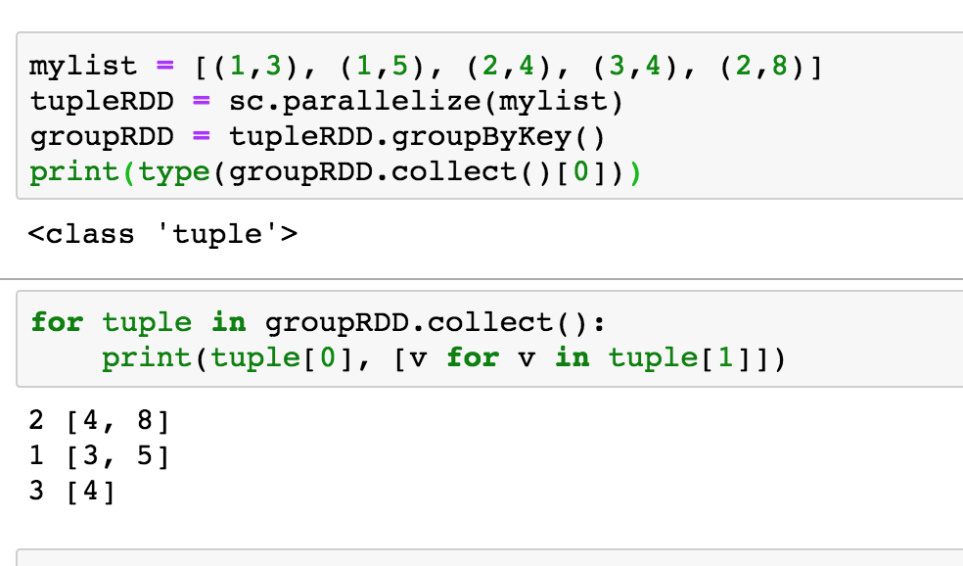
Key-Value Pairs (Pair RDDs)

Slide 9
Key-Value Pairs (Pair RDDs)
ReduceByKey – similar to groupByKey except it aggregates/reduces on the worker before shuffle. ReduceByKey is preferred.
Performs a reduction in the lambda function.
rdd.reduceByKey(lambda function)
The shape returned is a list of tuples:
[ (key1, value1),
(key2, value2),
……
(key3, value3) ]

Slide 10
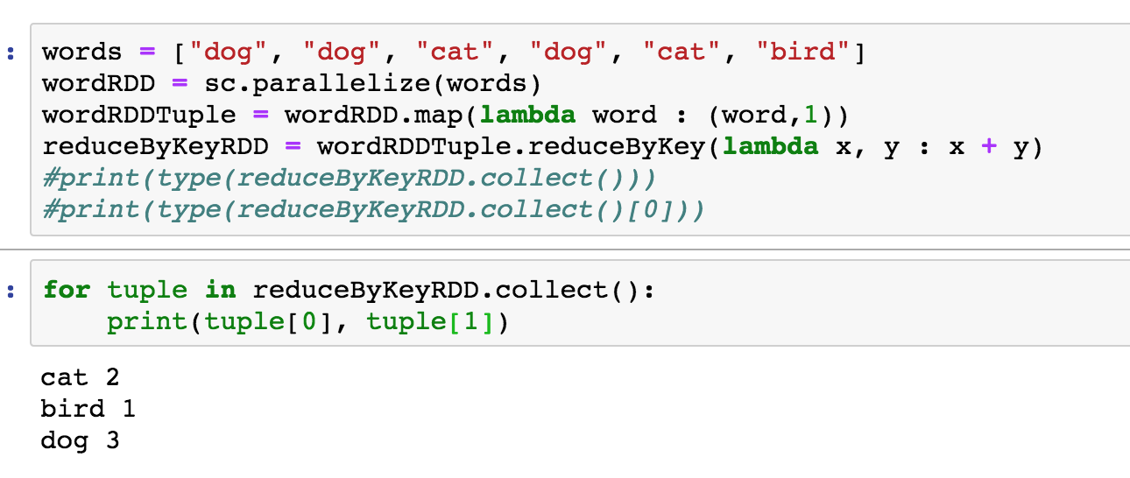
Key-Value Pairs (Pair RDDs)

Slide 11
Key-Value Pairs (Pair RDDs)
Lab – Word Count

