Slide 1
Introduction to MapReduce

Slide 2

Programming Model for parallel computation
Execution environment
Software package

Slide 3

What is Hadoop MapReduce
Distributed Storage
Distributed Computation
Fault Tolerance
Analytics

Slide 4
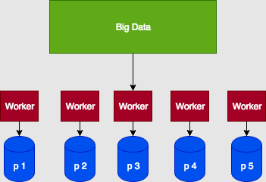
Distributed File System

Slide 5
Computation
Developed at Google
Storage – Apache Hadoop – open source
Programming Abstraction – Map and Reduce
Take functions to the data
Limited computations - aggregations
Supports scalable, fault tolerant system
Fundamental Pattern - Aggregations

Slide 6
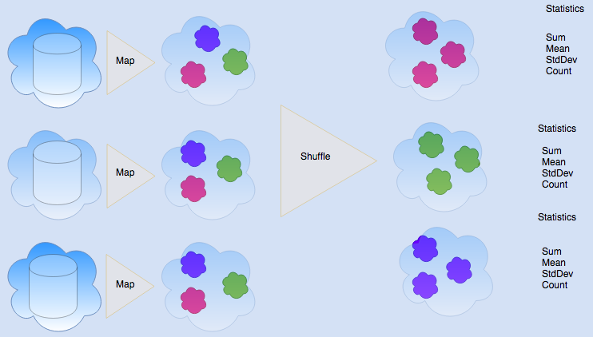
Aggregation Statistics
GroupBy – Scatter/Gather
Sum, Mean, Count, StdDev

Slide 7
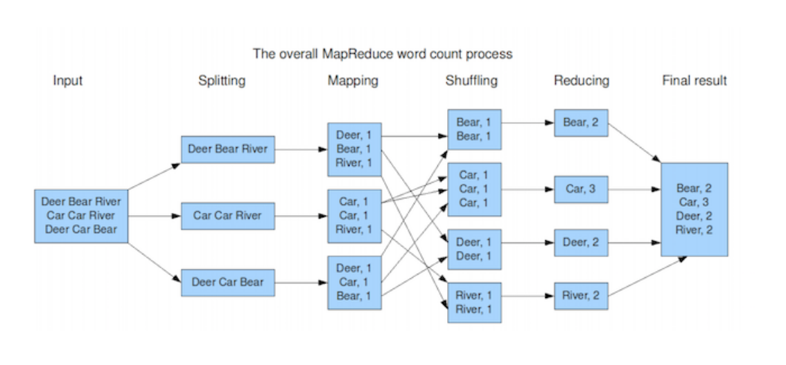
MapReduce Abstraction [Diana MacLean]

Slide 8
Importance of Key Value Abstraction
Groups based on Key Values
Bucket determined by a hashing function:
hash = f(key) - determines bucket for the shuffle

Slide 9
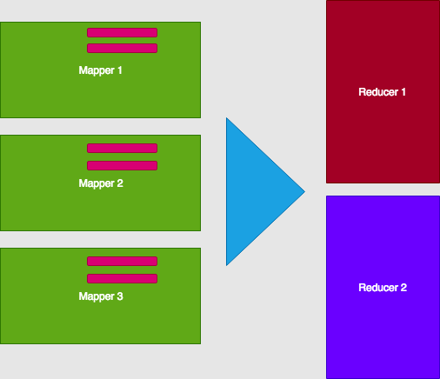
Mappers and Reducers

Slide 10
Fault Tolerance
If a machine goes down, simply start a new one

