Slide 1
Resilient Distributed Datasets (RDDs)

Slide 2
Resilient Distributed Datasets (RDDs)
Primary abstraction that allow Spark to distribute data
Fault tolerant – if they are destroyed they can be recreated by the driver and sent to a new worker
Immutable – once created you cannot change them. Instead you perform transformations on them and create new RDDs.
Unstructured and semi-structured data
Many input sources : HDFS, S3, csv, json

Slide 3
Resilient Distributed Datasets (RDDs)
You can create an RDD in one of three ways:
Parallelizing an existing collection in your driver program
Referencing a dataset in an external storage system, such as a shared filesystem, HDFS, HBase, or any data source offering a Hadoop InputFormat
By transformations on another RDD

Slide 4
Resilient Distributed Datasets (RDDs)
Parallelizing an existing collection in your driver program
>>> data = [1, 2, 3, 4, 5] //Python List
>>> distData = sc.parallelize(data) // RDD
Referencing a dataset
>>> distFile = sc.textFile("data.txt") //RDD

Slide 5
Resilient Distributed Datasets (RDDs)
Given an RDD you can create a new RDD using transformations.
>>> data = [1, 2, 3, 4, 5]
>>> rdd1 = sc.parallelize(data)
>>> rdd2 = rdd1.map(lambda x : x + 1)

Slide 6
Resilient Distributed Datasets (RDDs)
rdd2 = rdd1.map(lambda x : x +1)

Slide 7
Resilient Distributed Datasets (RDDs)
Transformations on RDDs
map
flatmap
filter
fold
aggregate

Slide 8
Resilient Distributed Datasets (RDDs)
To get the results of a transformation back to the driver, you must issue an action
>>> data = [1, 2, 3, 4, 5]
>>> rdd1 = sc.parallelize(data)
>>> rdd2 = rdd1.map(lambda x : x + 1)
>>> rdd2.collect()

Slide 9
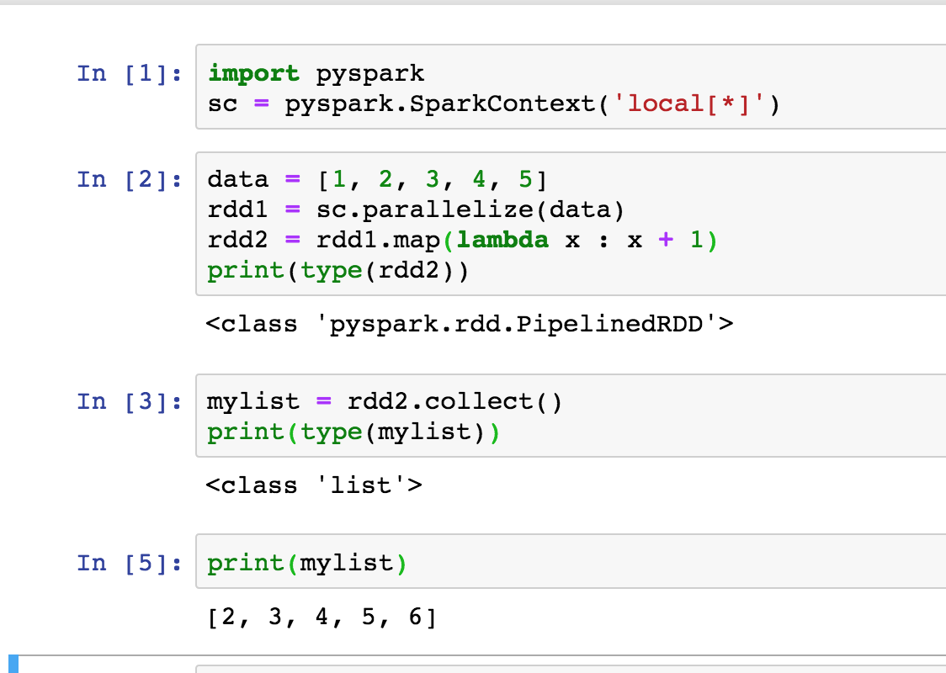
Resilient Distributed Datasets (RDDs)

Slide 10
Resilient Distributed Datasets (RDDs)
Actions
collect
count
reduce
take(n)
Reference : https://spark.apache.org/docs/latest/rdd-programming-guide.html - actions

Slide 11
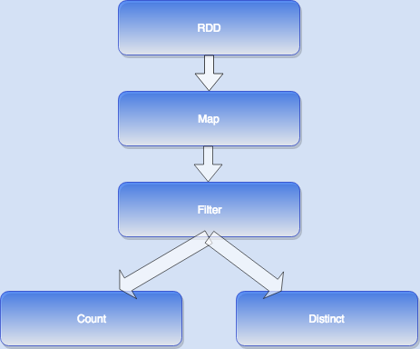
Lazy Evaluation - An execution plan, a DAG (directed acyclic graph) of tasks is sent to the workers. It is not executed until an action is run

