Slide 1
Spark SQL

Slide 2
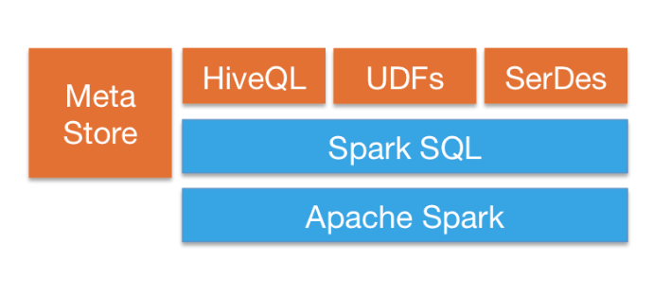
Spark SQL
Seamlessly mix SQL queries with Spark programs.
Connect to any data source the same way.
Run SQL or HiveQL queries on existing warehouses.
Connect through JDBC or ODBC.
https://spark.apache.org/sql/
Notebook (SparkSQL-02-GettingStarted)

Slide 3
Conclusion
Semi-Structured Data can be read directly into a “structured” object called a Spark DataFrame
Unstructured data must be passed through an RDD and parsed piece by piece.

Slide 4
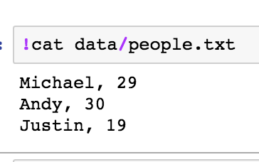
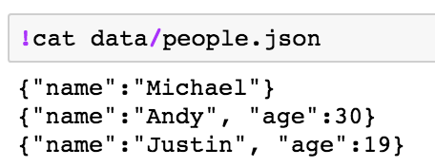
Objectives
Ingest and run SQL queries on semi-structured data(json) and on unstructured data( text file)
select * from people; // this is the goal

Slide 5
Schema
In the case of json, we can infer the scheme
With a text file we must explicitly declare it.

Slide 6
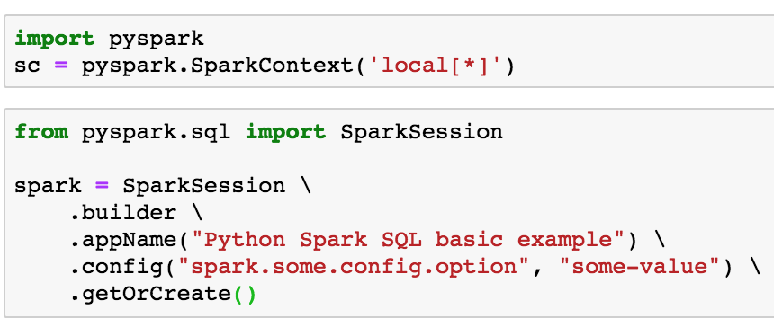
Start the Spark Context and Spark Session

Slide 7
Case of Json
Semi-structured Data
Start a sqlContext
Read Json into a DataFrame
Register the DataFrame as an SQL Table
Perform SQL Query
Display results

Slide 8
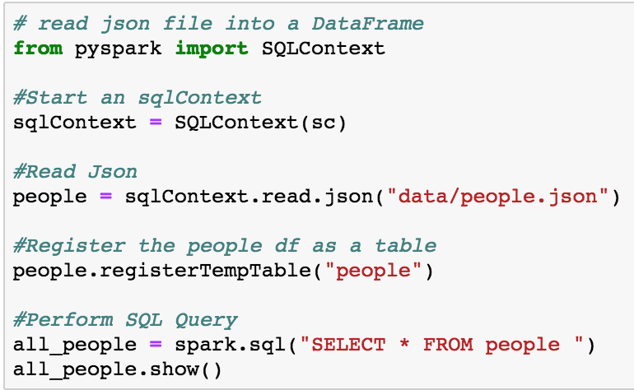
Json

Slide 9
Unstructured Data: text file to SQL
Import a ROW type (lots of imports with Spark SQL)
Read text into a lines RDD
Parse the lines RDD into a parts RDD
Move each line of the parts RDD to a ROW where the first element p[0] is a name and p[1] is an age. This defines the schema and converts the RDD to a DataFrame
Register the table
Perform SQL Queries

Slide 10
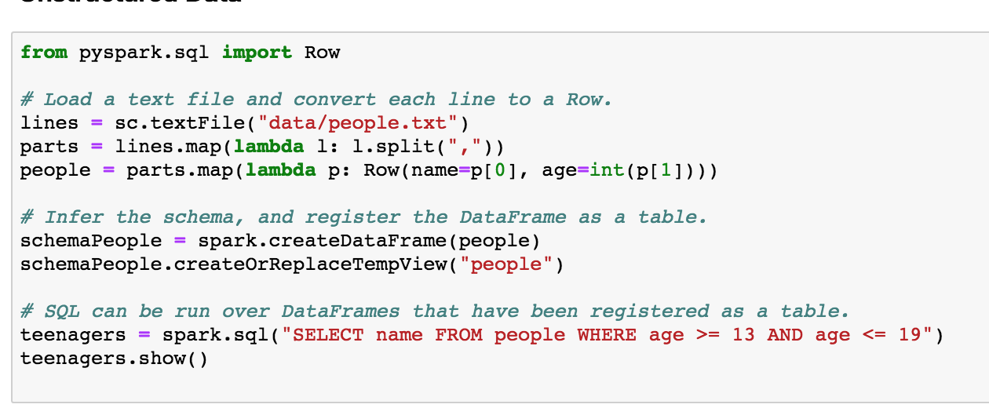
Text to SQL

