Slide 1
DataFrames – Types and Operations

Slide 2
DataFrame Abstraction
DataFrame is an RDD + Schema
It has a set of types
A set of operations you can perform on it
This permits optimizations
Easier to reason about
(notebook : DataFramesTypesAndOperations)

Slide 3
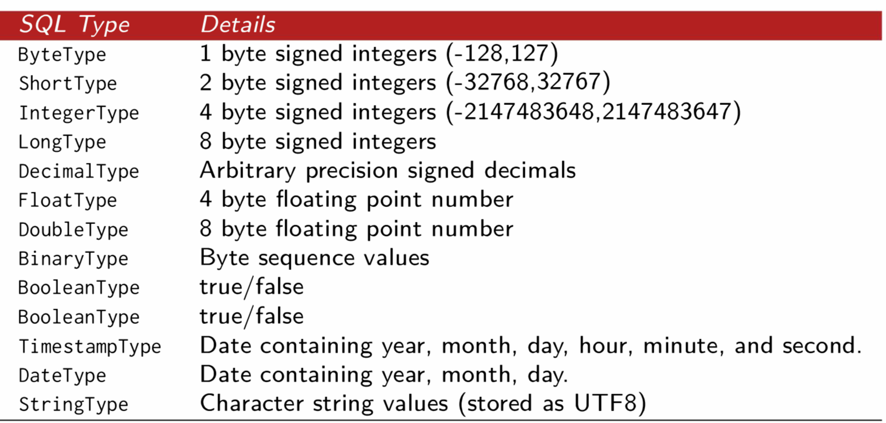
DataFrame Types

Slide 4
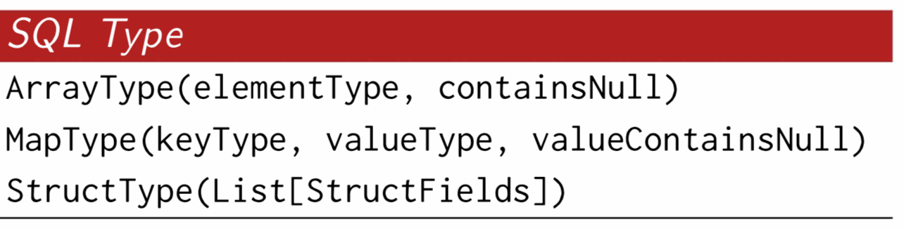
DataFrame Complex Types

Slide 5
DataFrame Operations
select
where
limit
orderBy
groupBy
join

Slide 6
Workflow
Create an input file of semi-structured data (csv, json, etc)
Create the schema based on types above
Read the file into a DataFrame
Start your analysis

Slide 7
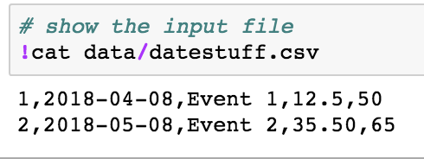
Create the input source

Slide 8
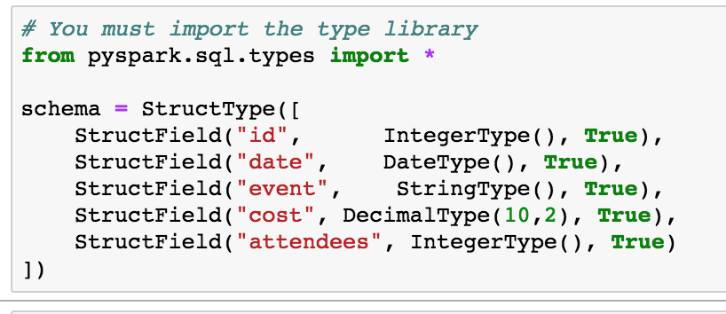
2. Create your schema

Slide 9
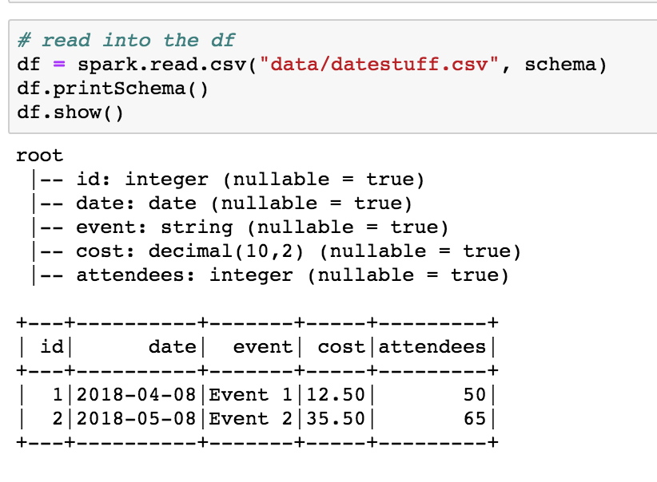
3. Read the file

Slide 10
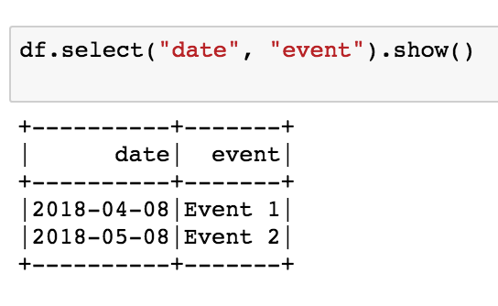
4. Analyze – Select a few columns

Slide 11
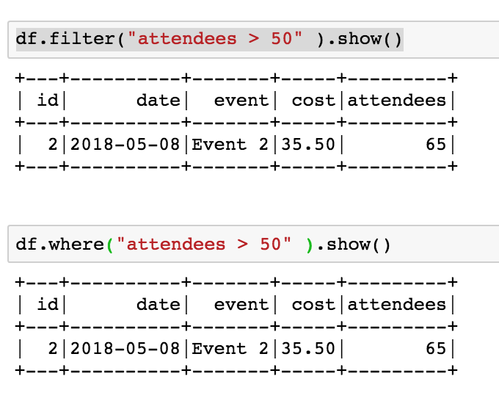
Filter and Where are the same

Slide 12
Special Note about Operations
You cannot change the values of a DataFrame. There is no “update column”
Every operation on a DataFrame produces another DataFrame
We will visit this again later
This is implied with functional programming

Slide 13
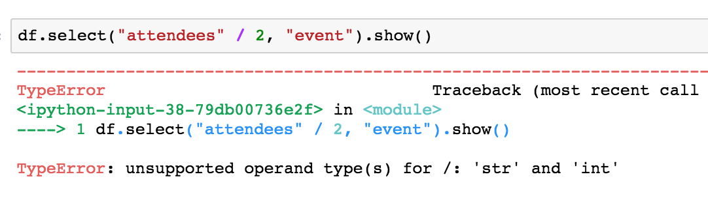
You can’t do this

