Slide 1
DataFrames Aggregations

Slide 2
DF Common Transformations
select
df.select(cols) --> df
groupBy
df.orderBy(cols) --> “grouped data df”
agg
df.agg( {op: col }) -- > df
orderBy
df.sortBy(cols) → df
join
df1.join(df2) → df notebook : DFSortAggJoin

Slide 3
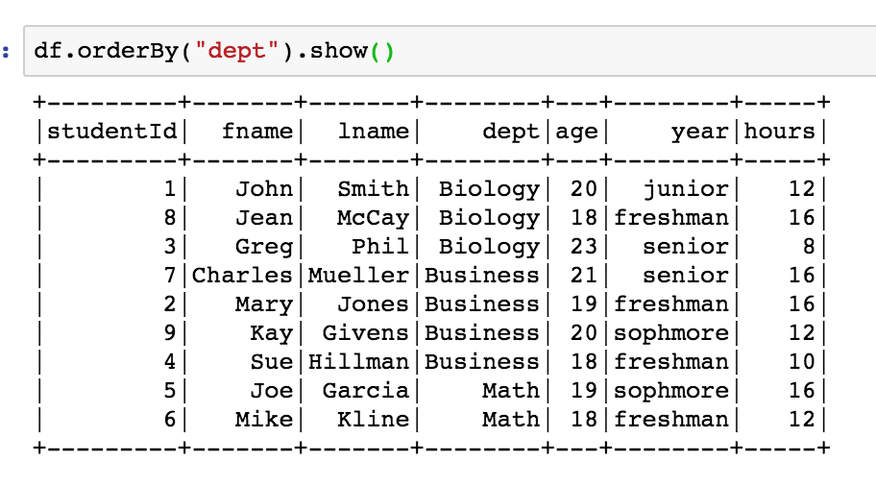
DF Transformation - OrderBy

Slide 4
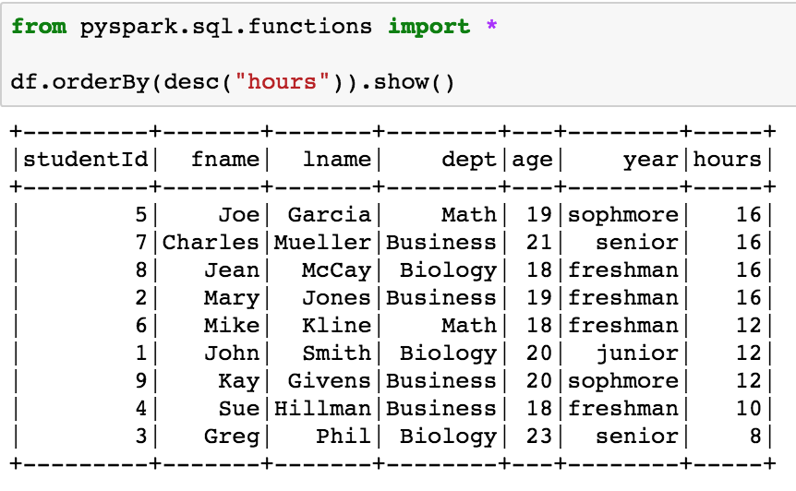
OrderBy – descending order
Note you must import pyspark.sql.functions

Slide 5
Transformations - Aggregate
Aggregate performs functions such as sum, count, avg … in a rather awkard way.
df.agg({‘col1’:’op1', ‘col2’:’op2’, …. ‘coln' : ‘opn’}) returns a df

Slide 6
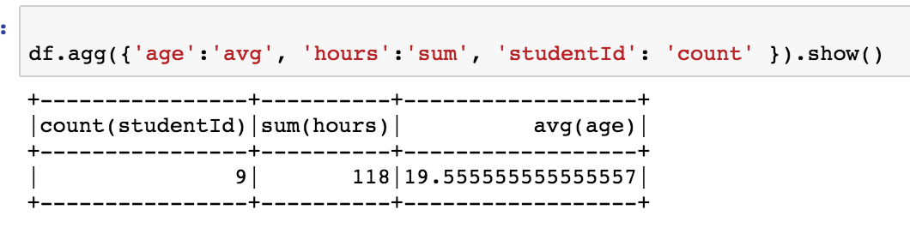
Transformations - Aggregate

Slide 7
Transformations - Join
df.join( df2, df.key = df.key2)
inner, left, right joins are supported

Slide 8
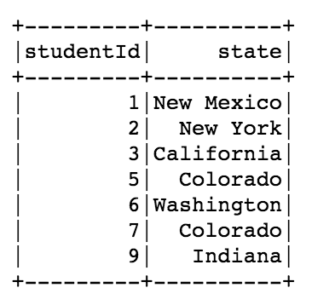
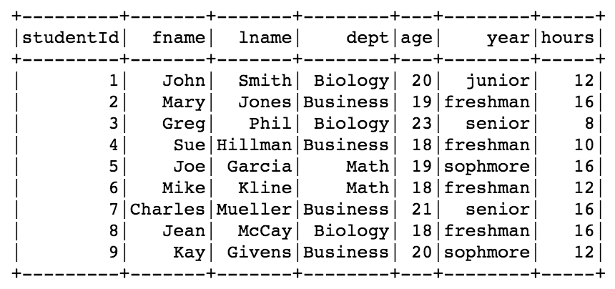
Transformations - Join
df.join(df2, df.studentId == df2.studentId).show()

Slide 9
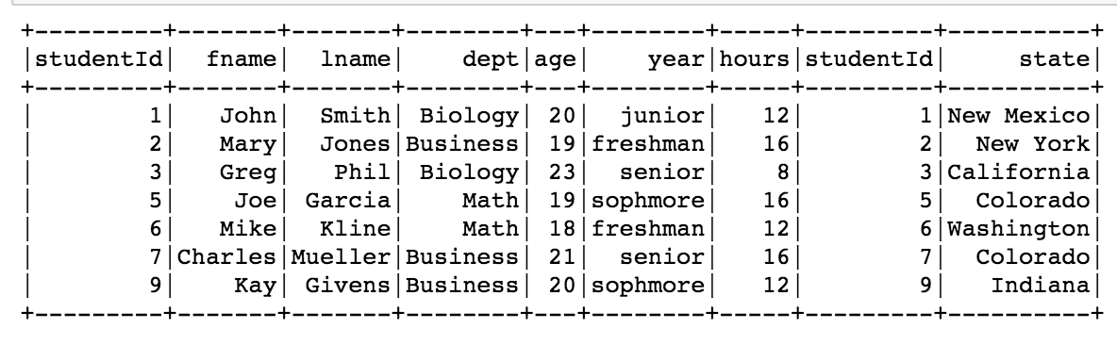
Transformations - Join
df.join(df2, df.studentId == df2.studentId).show()

