Slide 1
Transformations - GroupBy

Slide 2
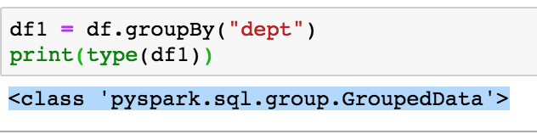
GroupBy
df.groupBy(cols) returns a funny thing called:
<class 'pyspark.sql.group.GroupedData’>
Notebook: DfGroupBy

Slide 3
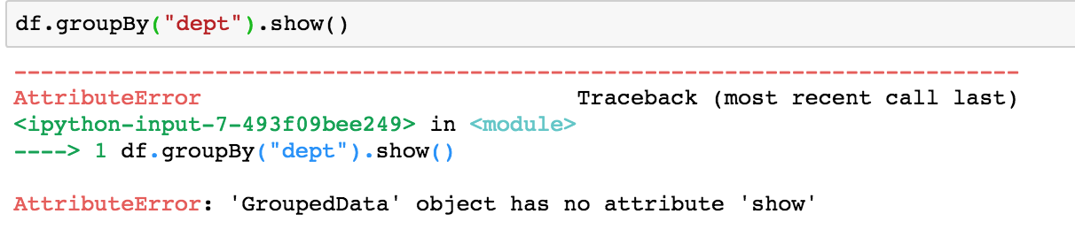
Grouped Data
You can’t “show” it, you can’t “collect” it.

Slide 4
Dealing with GroupData
A GroupBy function returns a RelationalGroupedBy dataset
It has a standard set of aggregation functions defined on it:
count
sum
min
max
avg
Follow GroupBy with an aggregation …..

Slide 5
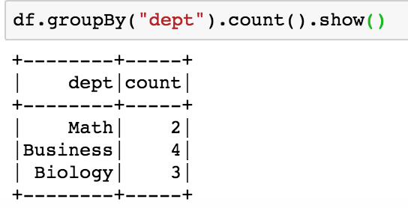
Grouped Data
It will count everything in its sub-categories

Slide 6
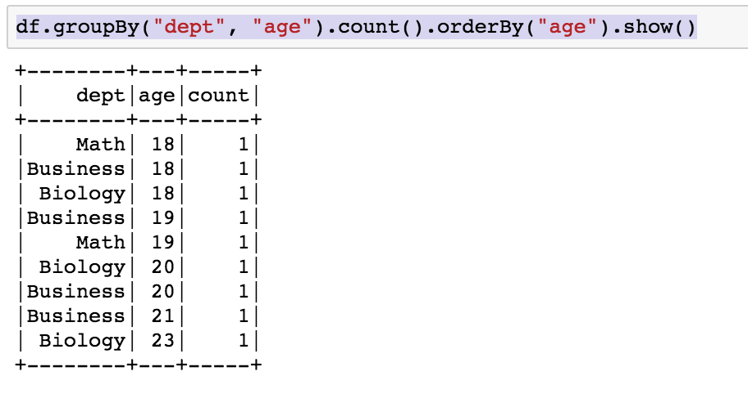
GroupBy … OrderBy .. a very common pattern

Slide 7
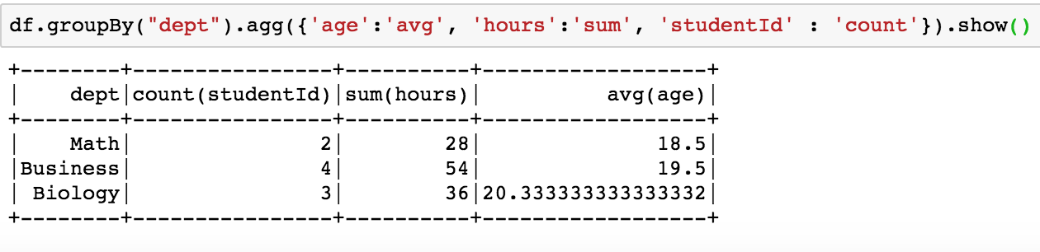
GroupBy with Aggregate

