Slide 1
Streaming

Slide 2
Batch, Microbatch and Stream Processing
Batch and Microbatch – when new data arrives it is aggregated into batches and processed at some time in the future.
Apache Spark
Streaming – data is processed as it arrives
Apache Kafka - KSQL

Slide 3
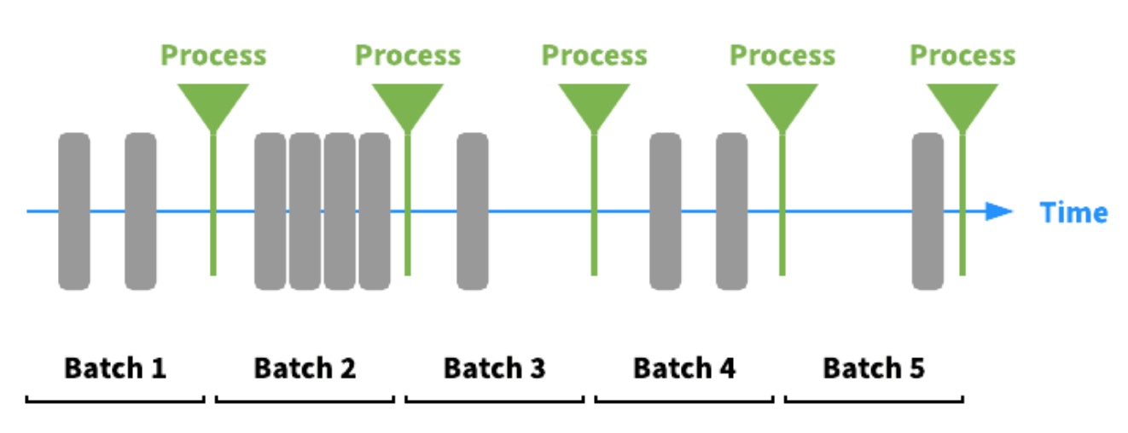
Batch and Microbatch
Data is processed on a time interval or when triggered by some condition. [source]

Slide 4
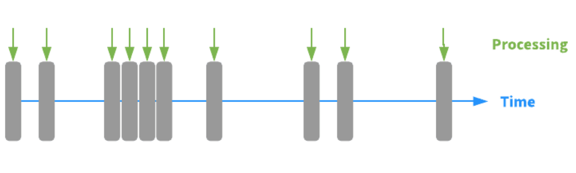
Streaming
Data is processed as it arrives. [source]

Slide 5
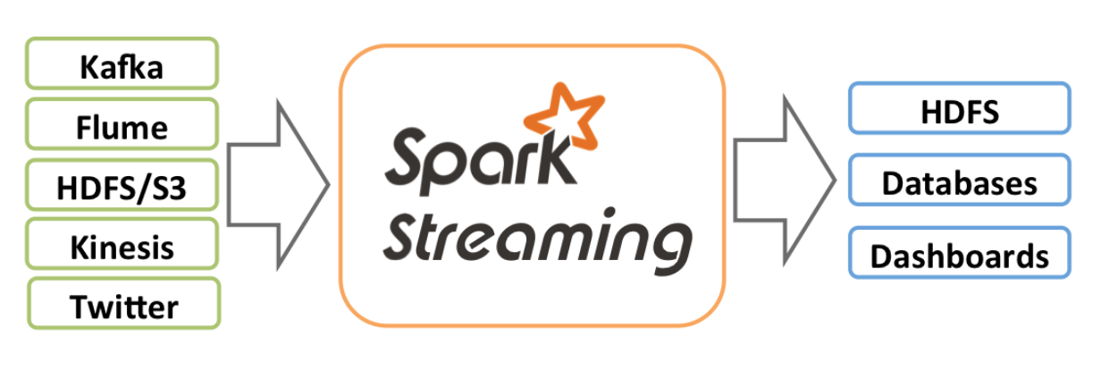
Spark Streaming
Can accept data from many sources and sink to several databases and file systems.

Slide 6
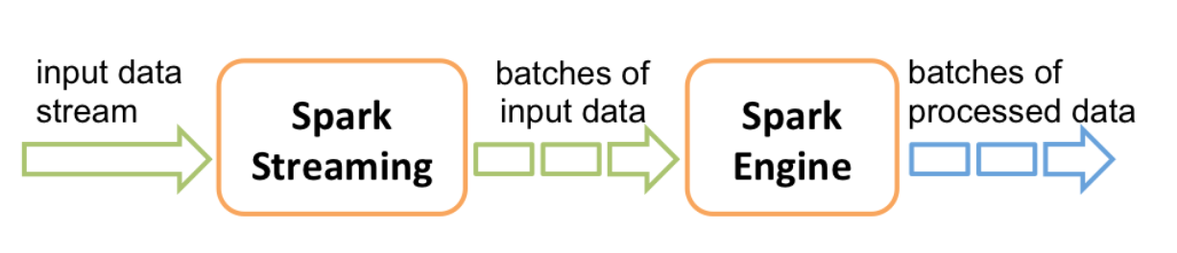
Microbatch approach
The source is broken up into time divisions an processed.

Slide 7
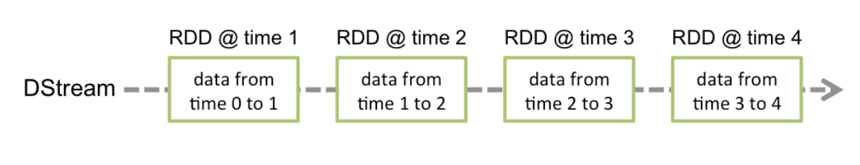
Dstreams
The fundamental abstraction is the Dstream a sequence of RDDs

Slide 8
Receivers
Spark Streaming provides two categories of built-in streaming sources.
Basic sources: Sources directly available in the StreamingContext API. Examples: file systems, and socket connections.
Advanced sources: Sources like Kafka, Flume, Kinesis, etc. are available through extra utility classes. These require linking against extra dependencies as discussed in the linking section.

Slide 9
Operations on Dstreams
Operations on Dstreams are:
Ingestion
Transformation
Output
Rather than transformations and actions

Slide 10
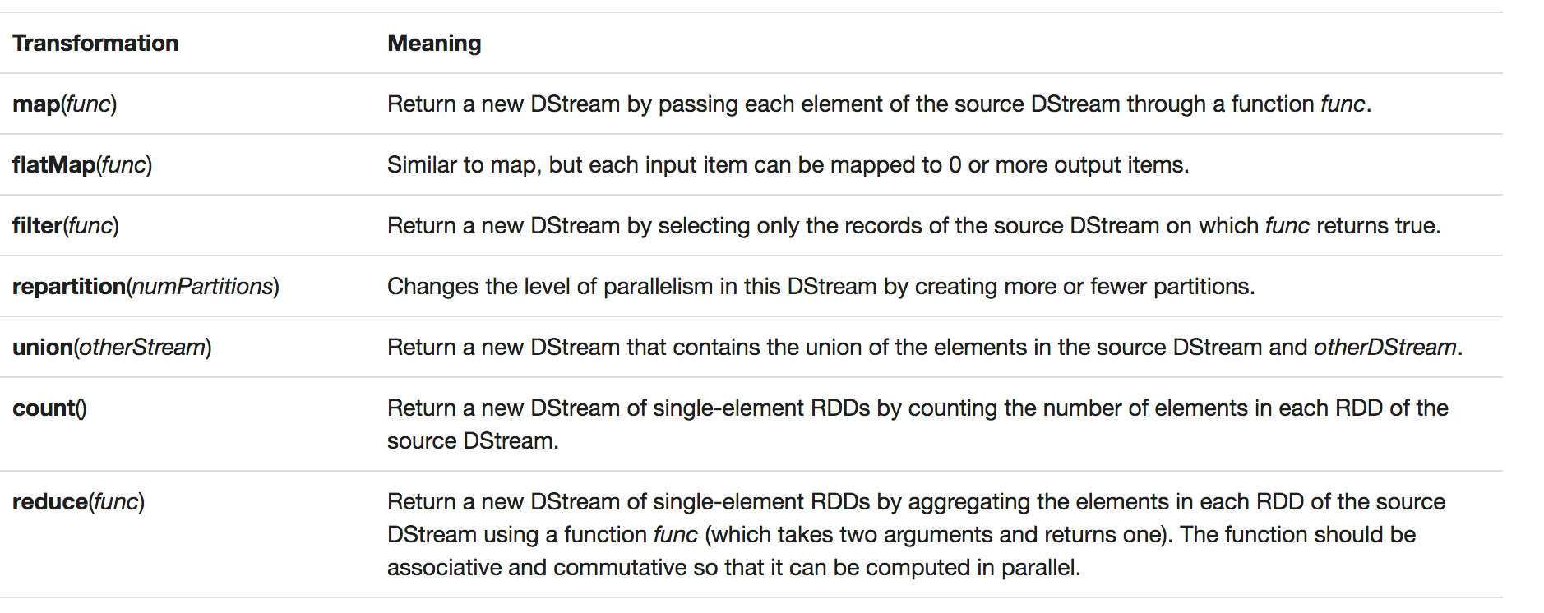
Transformations on DStreams

Slide 11
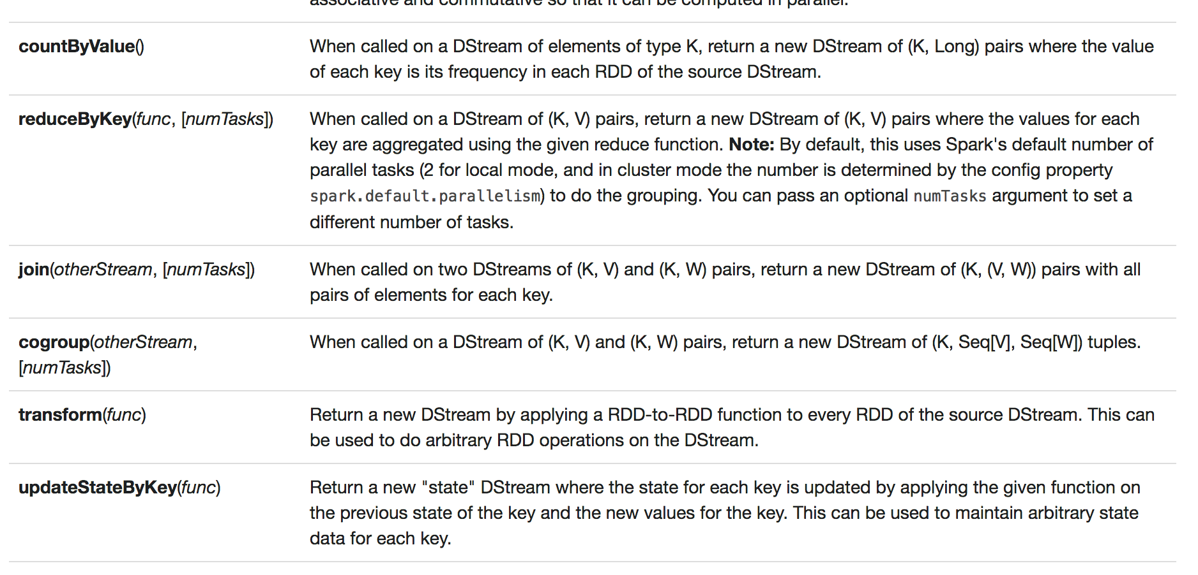
Transformations on DStreams

