Slide 1
Publish/Subscribe - Kafka

Slide 2
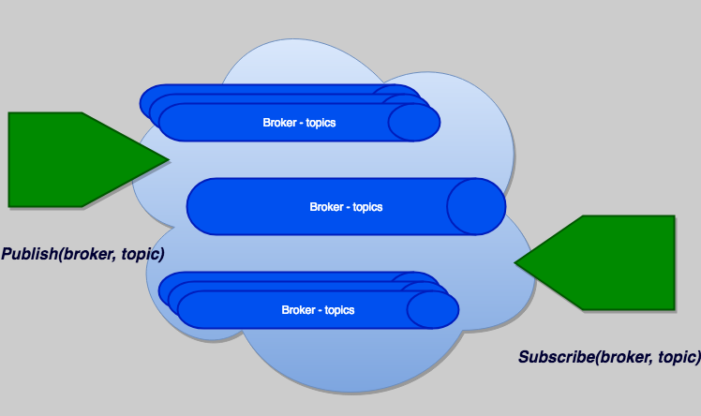
Publish/Subscribe Abstractions
Publish a topic to a broker – publish(broker, topic)
Subscribe to a topic on a broker – subscribe(broker, topic)

Slide 3
Advantages
Decouples producer and consumer. Consider a slow consumer.
Many processes can subscribe to the data.
It scales. Too much traffic? Start another broker.
If consumer fails, replay the log with another machine.

Slide 4
Disadvantage
Additional overhead
Backpressure – messages pile up and no one consumes them.

Slide 5
Distributed Streaming Platform
Apache Kafka® is a distributed streaming platform that can:
Publish and subscribe to streams of records, similar to a message queue or enterprise messaging system.
Store streams of records in a fault-tolerant durable way.
Process streams of records as they occur. Order of events is preserved.

Slide 6
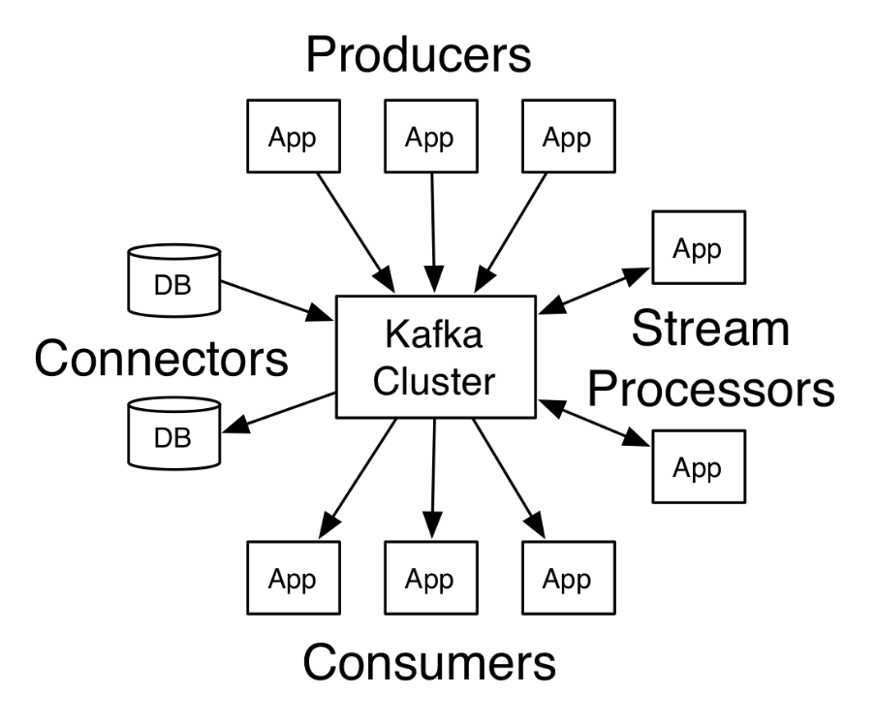
Publish/Subscribe

Slide 7
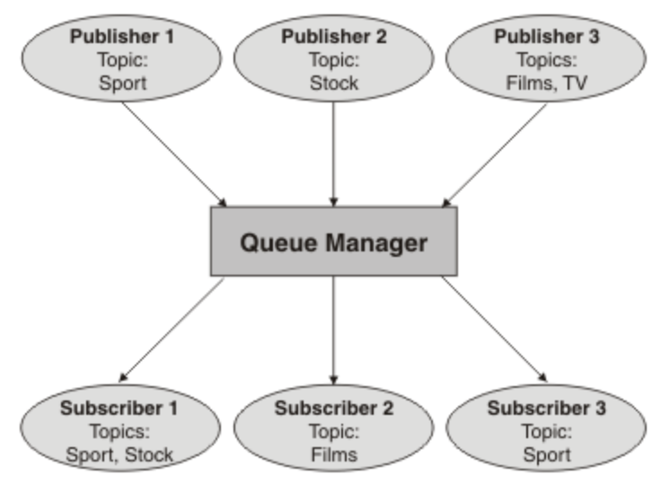
Pub/Sub – [source – IBM]
Publishers put messages on the queue
Subscribers pull messages off the queue

Slide 8
Use Cases
Building real-time streaming data pipelines that reliably get data between systems or applications.
Building real-time streaming applications that transform or react to the streams of data

Slide 9
Architecture Overview
Kafka is run as a cluster on one or more servers (brokers) that can span multiple datacenters.
The Kafka cluster stores streams of records (events) in categories called topics.
Each record consists of a key, a value, and a timestamp.

Slide 10
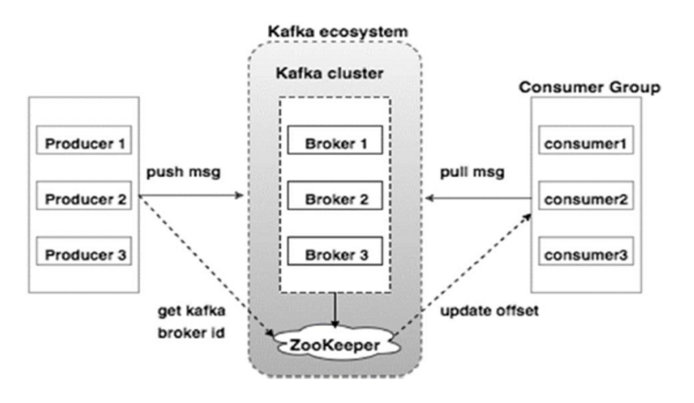
Architecture – Brokers [source]

Slide 11
Kafka APIs
The Producer API allows an application to publish a stream of records to one or more Kafka topics.
The Consumer API allows an application to subscribe to one or more topics and process the stream of records produced to them.
The Streams API allows an application to act as a stream processor, consuming an input stream from one or more topics and producing an output stream to one or more output topics, effectively transforming the input streams to output streams.
The Connector API allows building and running reusable producers or consumers that connect Kafka topics to existing applications or data systems. For example, a connector to a relational database might capture every change to a table.

Slide 12
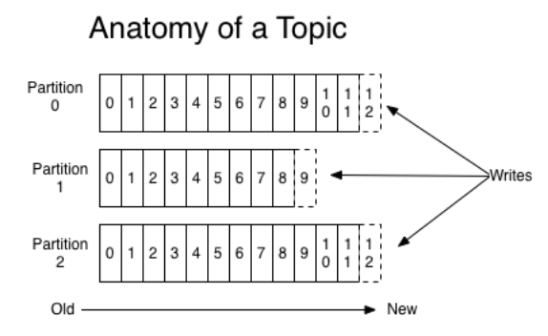
Topics and Logs
A topic is a category or feed name to which records are published.
For each topic, the Kafka cluster maintains a partitioned log

Slide 13
Partitions and Logs
Each partition is an ordered, immutable sequence of records that is continually appended to—a structured commit log. The records in the partitions are each assigned a sequential id number called the offset that uniquely identifies each record within the partition.
The Kafka cluster durably persists all published records—whether or not they have been consumed—using a configurable retention period. For example, if the retention policy is set to two days, then for the two days after a record is published, it is available for consumption, after which it will be discarded to free up space. Kafka's performance is effectively constant with respect to data size so storing data for a long time is not a problem.

Slide 14
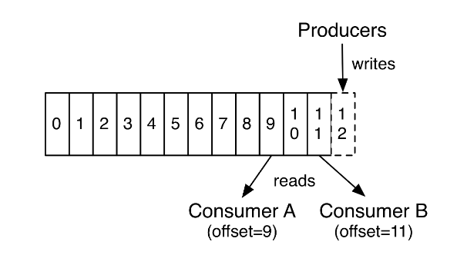
Data is read in the order it arrives

Slide 15
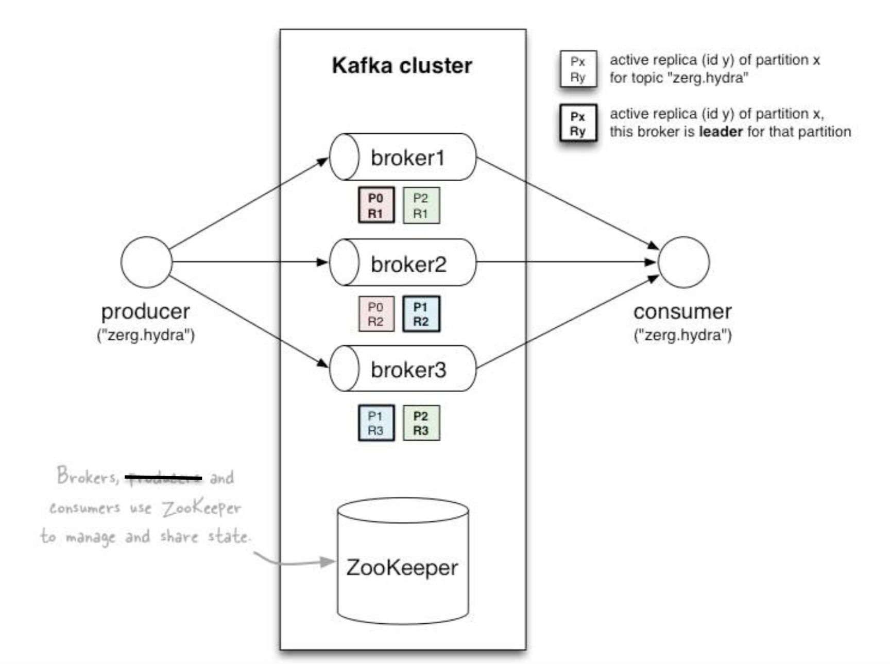
Partitions are used for redundancy

Slide 16
Summarize
Publishers publish messages(events) to topics on brokers within the Kafka cluster.
Subscribers subscribe to topics within brokers
Messages (events) within topics arrive as an ordered sequence of events.
This ordering is by the arrival time of the message(event) to the Kafka cluster.
Messages(events) are consumed in the order they arrive to the Kafka cluster.

Slide 17
Implications for Time Series Analysis
You must consider the following with respect to time
The time an event actually occurred. For example, the time a stock price changed.
The time this event arrived at the Kafka cluster. What happens if the data arrives late?
The time that the event is processed or consumed by a Kafka subscriber. What if you have a slow consumer?

