Slide 1

Introduction to MapReduce
A brief discussion

Slide 2

Overview
Hadoop MapReduce is a software framework for easily writing applications which process vast amounts of data (multi-terabyte data-sets) in-parallel on large clusters (thousands of nodes) of commodity hardware in a reliable, fault-tolerant manner.
The framework sorts the outputs of the maps, which are then input to the reduce tasks. Typically both the input and the output of the job are stored in a file-system. The framework takes care of scheduling tasks, monitoring them and re-executes the failed tasks.

Slide 3


MapReduce
Programming Model for parallel computation
Execution environment
Software package

Slide 4
What is Hadoop MapReduce
Distributed Storage
Distributed Computation
Fault Tolerance
Analytics

Slide 5
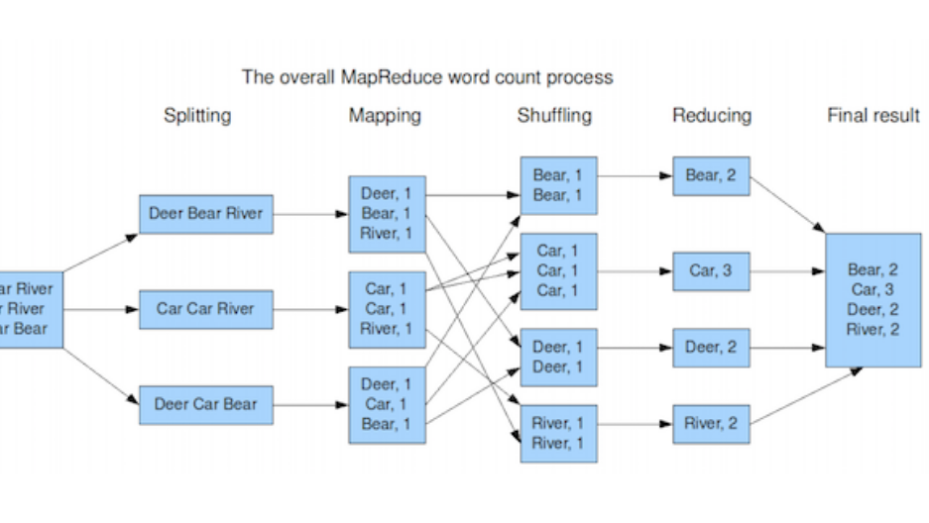
MapReduce Abstraction [Diana MacLean]

Slide 6
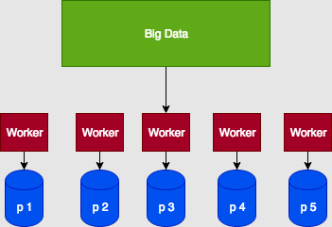
Distributed File System

Slide 7
Computation
Developed at Google
Storage – Apache Hadoop – open source
Programming Abstraction – Map and Reduce
Take functions to the data
Limited computations - aggregations
Supports scalable, fault tolerant system
Fundamental Pattern - Aggregations

Slide 8
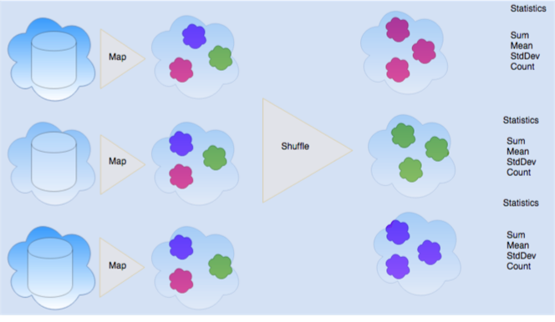

Slide 9
Importance of Key Value Abstraction
Groups based on key values
Bucket determined by a hash function:
hash = f(key) - determines bucket for the shuffle, what to aggregate with, etc.
previous slide, word is the key of the hash function:
hash = f(word)

Slide 10
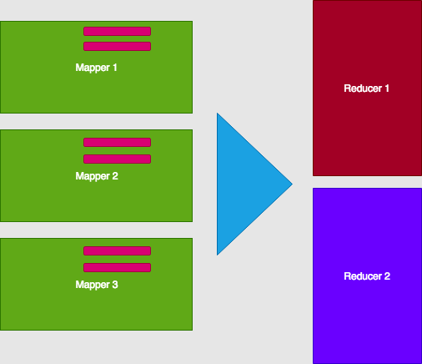
Mappers and Reducers

Slide 11
Fault Tolerance
If a machine goes down, simply start a new one

