Slide 1
Homework 3

Slide 2
Iteration
notebook

Slide 3
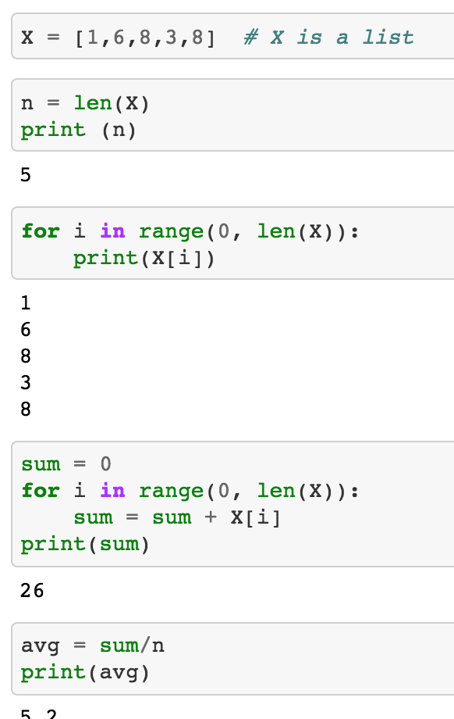

Slide 4
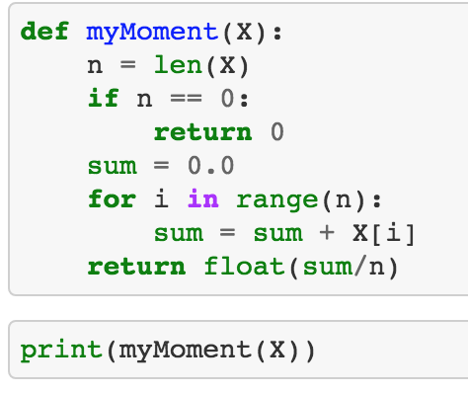

Slide 5
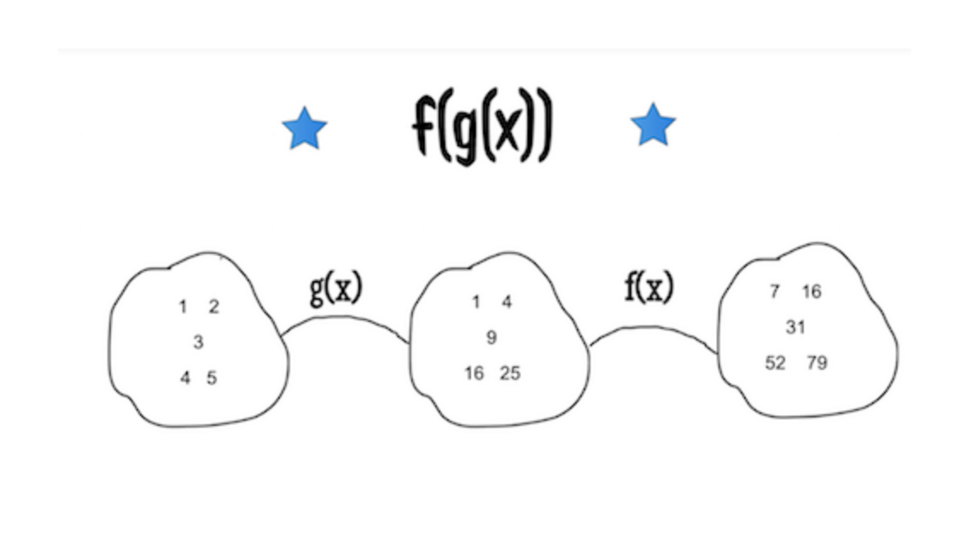
Functional Programming

Slide 6
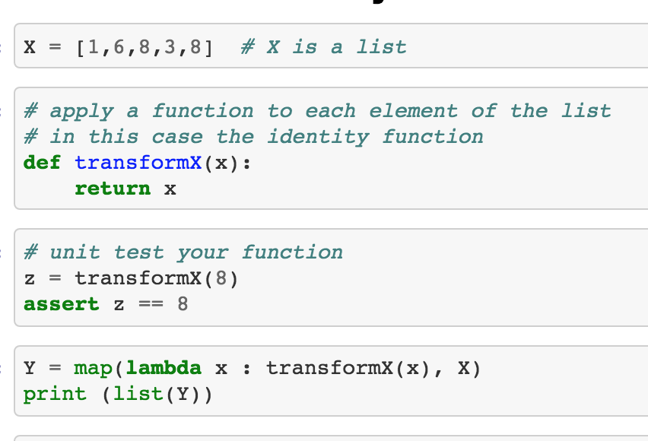
Map

Slide 7
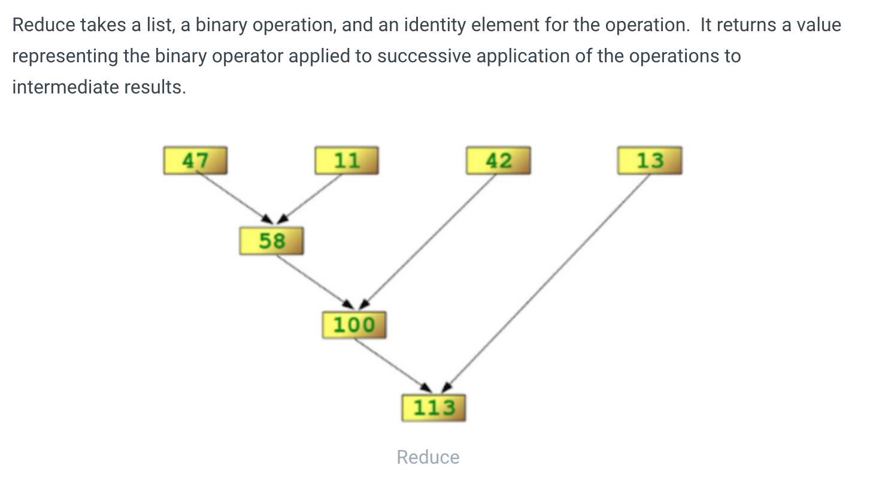

Slide 8


Slide 9
