Slide 1
Web Server Logs

Slide 2
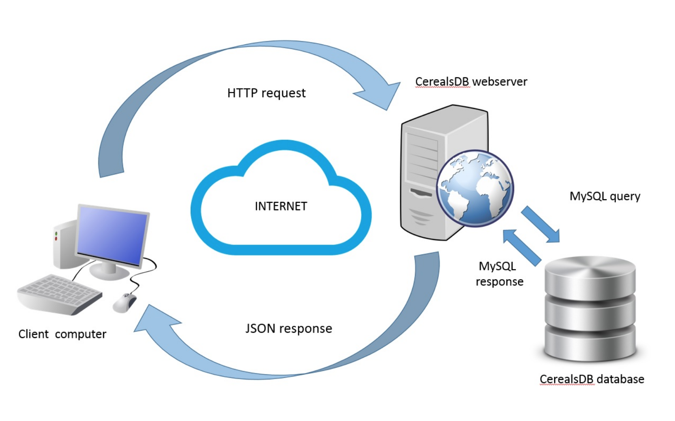
Web Services [photo credit]

Slide 3
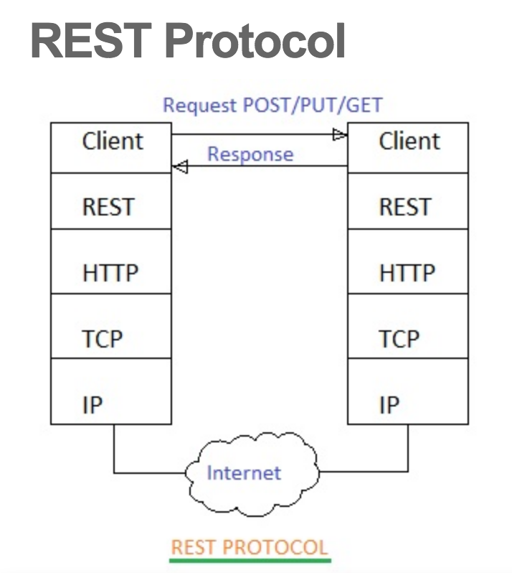
Rest Protocol [source]

Slide 4
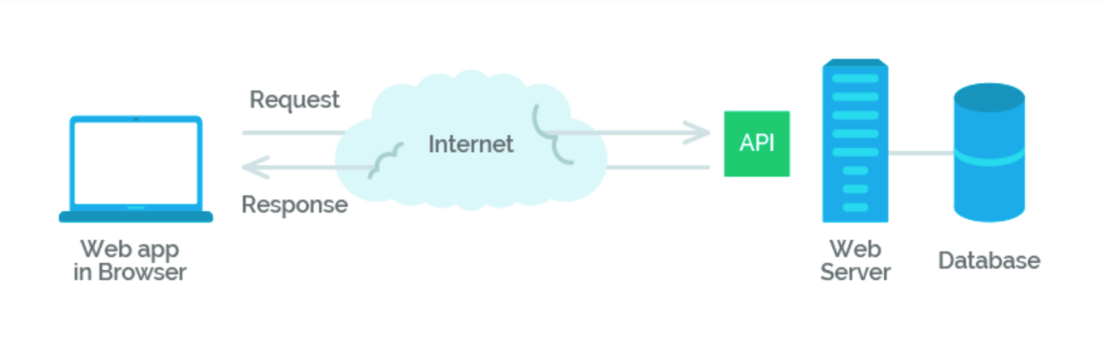
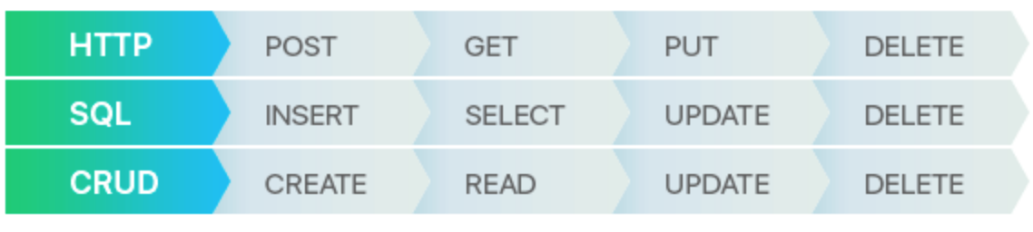
Restful API [source]

Slide 5
Web Logs – Common Log Format [source]
127.0.0.1 - frank [10/Oct/2000:13:55:36 -0700] "GET /apache_pb.gif HTTP/1.0" 200 2326
- 127.0.0.1 - This is the IP address of the client (remote host) which made the request to the server.
- The "hyphen" in the output indicates that the requested piece of information is not available.
frank This is the userid of the person requesting the document as determined by HTTP authentication
[10/Oct/2000:13:55:36 -0700] - The time that the server finished processing the request.
GET /apache_pb.gif HTTP/1.0" (\"%r\")The request line from the client is given in double quotes.
200 - This is the status code that the server sends back to the client.
2326 (%b)The last entry indicates the size of the object returned to the client, not including the response headers

Slide 6
Date ----> 10/Oct/2000:13:55:36 -0700
The time that the server finished processing the request. The format is:[day/month/year:hour:minute:second zone] day = 2*digit month = 3*letter year = 4*digit hour = 2*digit minute = 2*digit second = 2*digit zone = (`+' | `-') 4*digit

Slide 7
Path ----> GET /apache_pb.gif HTTP/1.0
GET – Request type (GET, PUT, POST, DELETE)
PATH – What service is requested:
/bank/customer_services
/bank/account_balance
/bank/find_location
……

Slide 8
Web Logs – 2xx - Success [source]
2xx - Success
These HTTP status codes indicate that the server successfully accepted the request. IIS 7.0 and later versions use the following success HTTP status codes:200 - OK. The client request has succeeded.
201 - Created.
202 - Accepted.
203 - Nonauthoritative information.
204 - No content.
205 - Reset content.
206 - Partial content.

Slide 9
Web Logs – 3xx - Redirection[source]
These HTTP status codes indicate that the client browser must take more action to fulfill the request. For example, the client browser may have to request a different page on the server. Or, the client browser may have to repeat the request by using a proxy server.
301 - Moved permanently.
302 - Object moved.
304 - Not modified.
307 - Temporary redirect.

Slide 10
Web Logs – 4xx - Client error[source]
These HTTP status codes indicate that an error occurred and that the client browser appears to be at fault. For example, the client browser may have requested a page that does not exist. Or, the client browser may not have provided valid authentication information.

Slide 11
Web Logs – 4xx - Client error [source]
400 - Bad request. The request could not be understood by the server due to malformed syntax. The client should not repeat the request without modifications.
401 - Access denied
403 - Forbidden.
404 - Not found.
405 - Method Not Allowed.
406 - Client browser does not accept the MIME type of the requested page.
408 - Request timed out.
412 - Precondition failed.

Slide 12
Web Logs – 5xx - Server error [source]
500 - Internal server error.
501 - Header values specify a configuration that is not implemented.
502 - Web server received an invalid response while acting as a gateway or proxy.
503 - Service unavailable.

