Slide 1

Fuzzy Control

Slide 2
Motivation for Fuzzy Control
Question:
Can you read the text?
Can you read it now?
Now?
Notes:
I want to start my presentation with a question: Can you read…. Okay, I guess nearly all of you will say defintly „no“. So: Can you read it now? I think now you will think (or say) something like: „it‘s better, but still not good“. Okay. Now? I guess now you all agree that you can read the text defnitly. This is my first example for fuzzy: in most human interactions there is no binary „yes“ or „no“ as there are grey zones. Those can be describt using fuzzy sets, which I will explain you later. But this is not the only use for fuzzy. Now imagine this: ….. You have no exact concept of the ball: you don‘t exacty knwo how heavy it is, and how exactly it will behave, when you throw it. I think most of you will miss the basket at first try. But after a few throws you will make it and hit the basket reproducable. So: how did you do it? Did you calculate how to throw the ball? I guess no ;) You tried and adjusted the forse and the angle acordingly until you hit the target. That‘s another big advantage of fuzzy: You can use fuzzy logic to create certain behaviors that would otherwise require complex mathematics, or where there is simply no concrete mathematical formal. Especially in embedded systems where the calculation power is limited, fuzzy can help reducing the computational effort.
After you got a rough overview of what fuzzy control is. I will start with the theorie behind this.

Slide 3
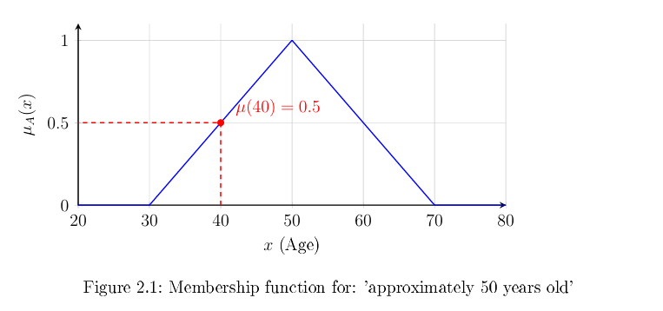
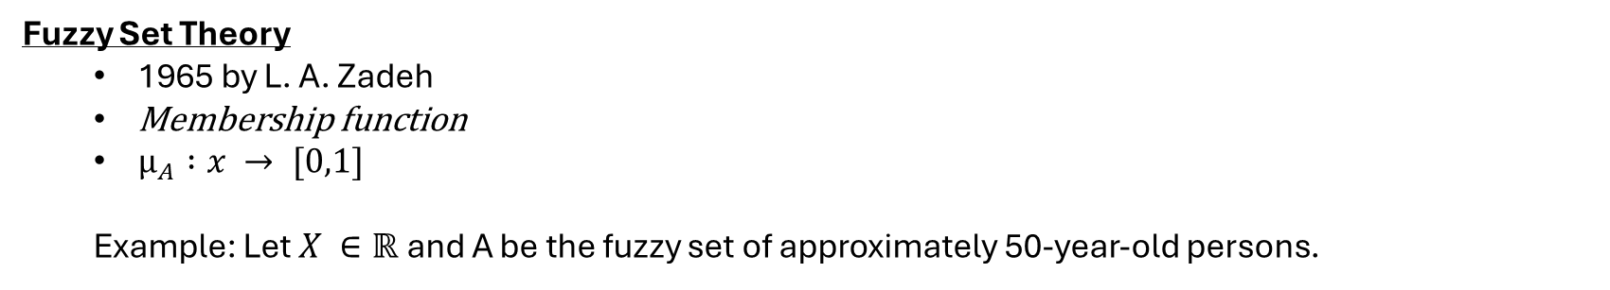
Fundamentals of fuzzy logic
Fuzzy Set Theory
1965 by L. A. Zadeh
Membership function
$µ_{A} :x → [0,1]$
Example: Let $X ∈ℝ$and A be the fuzzy set of approximately 50-year-old persons.
Fuzzyfication
$µ_{50 years} (40) = 0.5$
Notes:
As you saw in the first example fuzzy sets solve the problen, when there is no destinct cut between „yes“ and „no“ as in classical set theory where an set either contains an element or not. It was 1965 when Zadeh introduced his idea how to describe fuzzy sets mathematical. For this purpose he used the so called „membership function“ where each element is assigned a value between 0 and 1, where 0 stands for: the element is deinitly not in the set, and 1: the set deinitly contains the value. The resulting value is calles mue of the set A of the element x Example:…..
In this example „mu of approximately 50 years at 40 years equals 50%.“ This process is called the “fuzzyification“: a crisp input value can now be decribed using a fuzzy value.
But where does the membership function come from? If you remember my first Question for the second text: The text was better, but still not very good: If I wanted to create a membership function from this: I would start a poll. This could meen you would have to chose between „yes“ and „no“ and later I would evaluate how many of you said yes and how many said no, or you could assigne it a value between 0 and 1 and I would then calculate the average. The result of the poll will be the membership function. This membership function doesn‘t need to look like this:

Slide 4
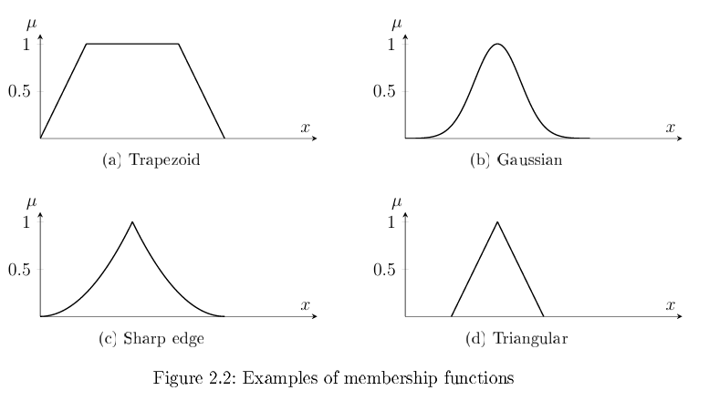
Fundamentals of fuzzy logic
Notes:
Membership functions can be described using different shapes. The most common ones are:…
Fuzzy sets, like Classical sets do have certain characteristics

Slide 5
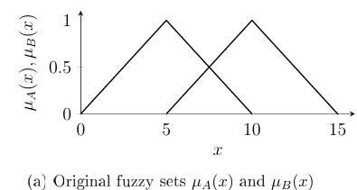
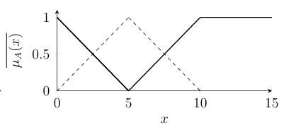
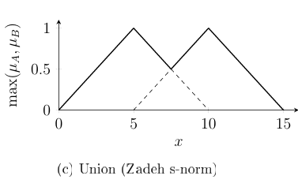
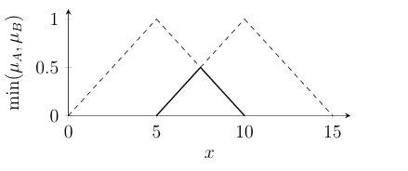
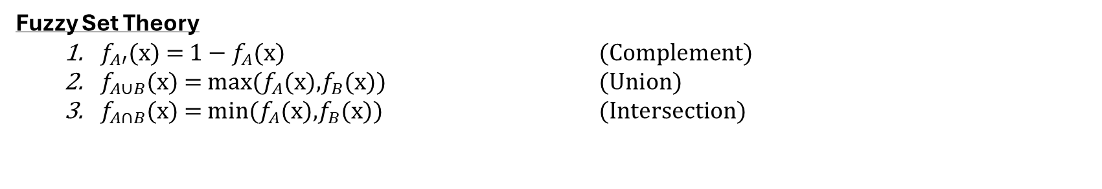
Fundamentals of fuzzy logic
Fuzzy Set Theory
$f_{A′}$(x) = 1 − $f_{A}$(x) (Complement)
$f_{A∪B}$(x) = max($f_{A}$(x),$f_{B}$(x)) (Union)
$f_{A∩B}$(x) = min($f_{A}$(x),$f_{B}$(x)) (Intersection)
Union Zadeh s-norm
Intersection Zadeh t-norm
Notes:
As calssical set theory fuzzy set theory provides methods for operations like Complement union and intersection. The most important ones of these operationsa for fuzzy control are the union and intersection – called s-norm for union an t-norm for the intersection

Slide 6
From Fuzzy Logic to Fuzzy Control
1975 Ebrahim Mamdani
fuzzy control system
rule-based reasoning and defuzzication
Mamdani model
Example: Temperature
If the temperature is too high, then slightly reduce the heating power.
Notes:
The first one to actualy use the conceot of fuzzy as inrtroduced by zadeh was 1975 Mamdani. He proposed the use of fuzzy logic in a control system. He introduced a rule based reasoning and a solution to again gain a crisp output value, which can be used by an activator. This process is then called the defuzzification, the defuzzification is a process where from a fuzzy output membership function a crisp output value is calclulated. The model became established and is now commonly known as the Mamdani Model. One often used example for rule based reasoning is temperature ajustment of air conditioning. This was for example used in the mobility industry by Toyota or Lexus . (e.g. Fuzzy Control for Automatic Train Operation System).

Slide 7
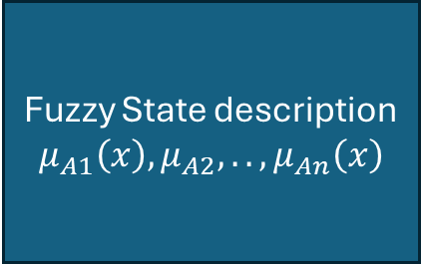
Mamdani Model Overview
Fuzzy State description
$$μ_{A1}\left(x\right),μ_{A2},..,μ_{An}\left(x\right)$$
Rule Base (Premise)
1.If A1 and A2 then B1
2.If A2 or A3 then B2
.
n. if.. (And/or).. Then…
Fuzzy Inference
2. If A2 or A3 then B2
5. if..then..
.
m. if..then..
Fuzzification
Defuzzification
Input value
x
Output value
(concusion)
y
Notes:
For a better overview I will now prenet to you the rough scheme how a fuzzy controller with the mamdani model works.
So we have a system which measures a value, which it likes to process. This value is the input value x.
With membership functions for different statements the fuzzy controller then evaluates the fuzzy state despription. In the fuzzy state description the fuzzy values for a statement Ai are given.
The fuzzy state description is then processed over the Fuzzy Rule Base which represents the Premise. In the rule base are rules for each combination of statements Ai. Here you can see why we need the operations if the fuzzy logic, since different statements can be connected using set operations like “and” or “or”. In the next step in the fuzzy inference the active rules are evaluated.
For the final step the controller needs to calculate the conclusion to give it back to the system so an activator can use the crisp value for adjustment of the system.

Slide 8
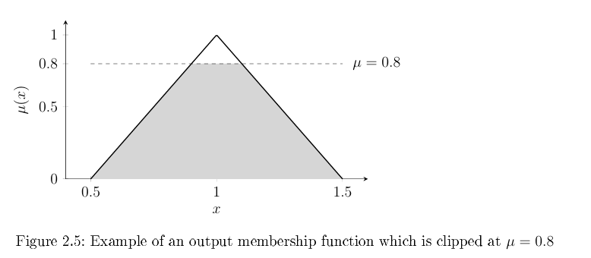
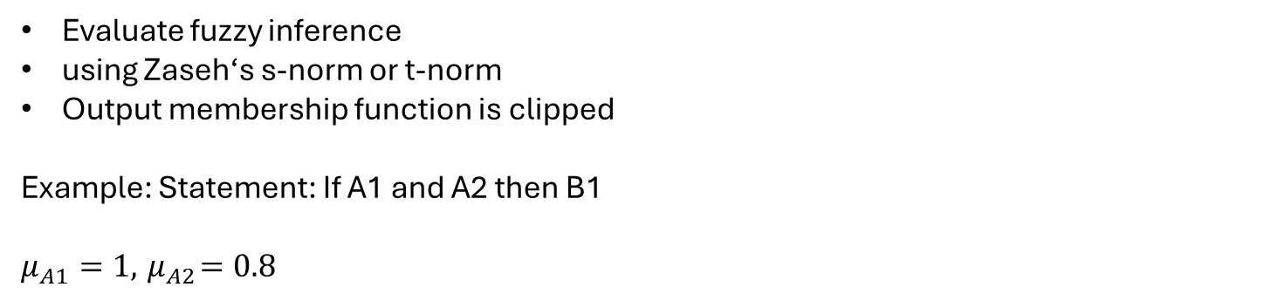
Fuzzy Conclusion
Evaluate fuzzy inference
using Zaseh‘s s-norm or t-norm
Output membership function is clipped
Example: Statement: If A1 and A2 then B1
$μ_{A1}=1,{ μ}_{A2}=0.8$
Notes:
For the Conclusion we have again membership functions for all statements.
After the evaluation of the fuzzy inference we have different statements that are true (e.g. they apply with a degree of more than 0%).
If we think of the “if..then” rules one can see that also the consusion has assigned a set name (B in my example). That implies that also for the conslusional statement a membership function must be given.
The different rules are then combined using Zadehs s-norm or t-norm.
In this example we have two statements A1 and A2. ( For example: if my presentation is good and many people are listening I get a good grade) With Mu A1 =… and Mu A2 =… since both statements are connected via an “and” operator Zadeh’s t-norm is applied which uses the minimum of both statements which is 0.8.
The output membership function is then clipped at the corresponding value.
For the last step of the defuzzification various strategys can be used. The most common one is the center of gravity method.

Slide 9
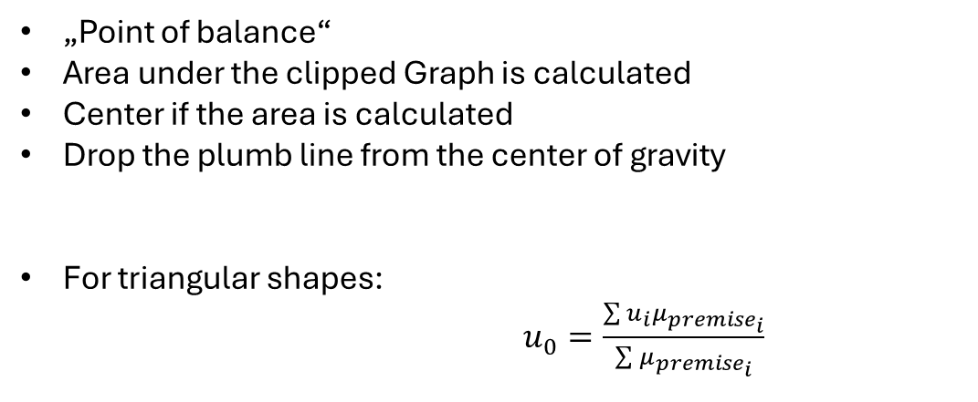
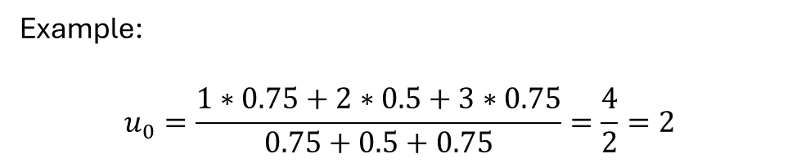

Center of Gravity Method
„Point of balance“
Area under the clipped Graph is calculated
Center if the area is calculated
Drop the plumb line from the center of gravity
For triangular shapes:
$u_{0}=\frac{\sum{u_{i}μ_{{premise}_{i}}}}{\sum{μ_{{premise}_{i}}}}$
$$μ$$
1
0.75
0.5
x
Example:
$$u_{0}=\frac{1∗0.75+2∗0.5+3∗0.75}{0.75+0.5+0.75}=\frac{4}{2}=2$$
1 2 3
Notes:
The center of gravity method dropps the plumb line where you would put your finger to balance the structure.
To calculate this the area under the clipped graphs is calculated and finally the plumb line is dropped from the center of the area.
Since this has a high computational effort there are several approaches to reduce the effort. The easiest way is for triangular shapes:
In this example it’s the sum of centres of the triangles times their corresponding maximum value devided by the sum of the maxima. However: this method has it’s flaws:

Slide 10
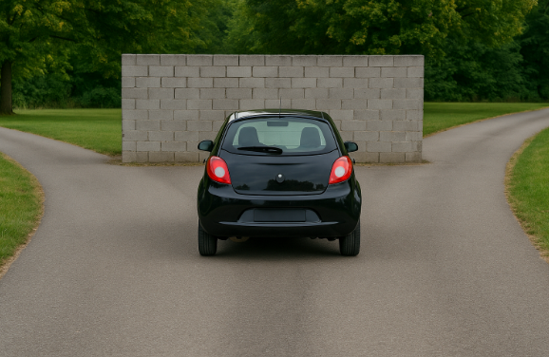
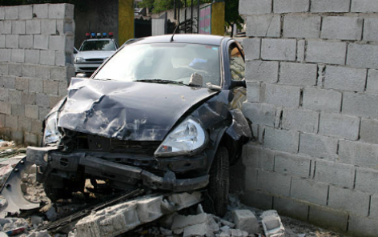

Center of Gravity Method
$$μ$$
x
left 0 right
Notes:
So if you would use this method for steering a car in a scenario like this, you would come up with membership functions like this: The evaluation will then lead to something like the following scenario which probably wasn’t the intended result…. (A solution to these kinds of problems give XCOA or XCOG)
But none the less. Fuzzy systems were and are used in automotive technoglogy. One of the first proposed example was indeed a line keeping asssistent 1985 by Sugeno and Nishida. (I will come back to this one a little bit later as they introduced an alternative Model for fuzzy control in embedded systems.) First of I want to introduce you to an Example of a Lane Keeping Assistant for a toy car, which uses the Mamdani Model and is a great example what can be achived with very simple methods and equipment.

Slide 11
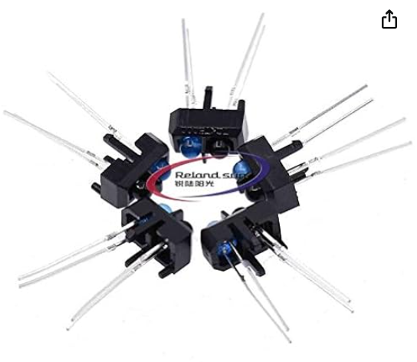
Example: Lane Keeping Assistent
S1
S2
S3
S4
Toycar
TCRT5000 (Bild: amazon.de)
Deviation measured by four TCRT5000L sensors
According to the number of sensors crossing the line: Small, Big or Neutral Deviation
Source: N. C. Basjaruddin, Kuspriyanto, Suhendar, D. Saefudin, and S. A. Aryani, Lane keeping assist system based on fuzzy logic, in 2015 International Electronics Symposium (IES)
Notes:
10 Stück 3,26 € For the lane Keeping assistent a toy car is equiped with four TCRT5000L sensors, which are very cheap: 10 pieces cost around 3 € on amazon. Alongside those sensors only the speed needs to be measured and an actuator that controls the steering angle.
The lateral deviation is detected using two simple infrared sensors positioned on either side of the car. Those can detect very easy the crossing of the white line.
On each side two of the sensors are attached which then represent the fuzzy terms: small left (SL), big left (BL), normal (N), small right (SR), or big right (BR) according to the amount of sensors crossing a white line: one represents “small” both of them “big” and none accordingly “normal”.

Slide 12
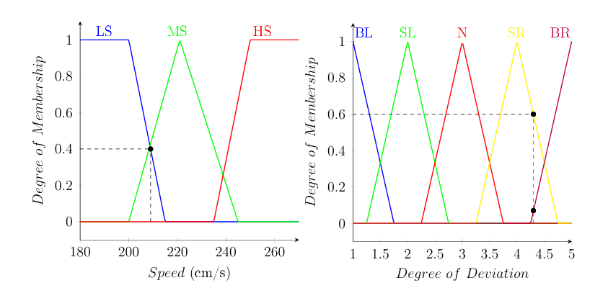
Example: Lane Keeping Assistent
Speed three membership functions
Degree of Deviation five membership functions
Deviation assigned numbers from 1 (Big Left Deviation) to 5 (Big Right Deviation)
LS: Low Speed
MS: Medium Speed
HS: High Speed
BL/BR: Big Left/Big Right
SL/SR: Small Left /Small Right
N: Neutral
Source: N. C. Basjaruddin, Kuspriyanto, Suhendar, D. Saefudin, and S. A. Aryani, Lane keeping assist system based on fuzzy logic, in 2015 International Electronics Symposium (IES)
Notes:
So for the two sensor types the group proposed these two membership funkctions. As you can see we got three membership functions for „speed“: Low Speed (LS), Medium Speed (MS) and Highspeed (HS). You can see how the membership functions overlap, and we got values for which sometimes too statements might aply. You may notice that the Degree of Deviation isn‘t given in an actual angle: the reason for this is the four sensors which mesaure the deviation. Remember: one crossing the line is defined as a small deviation. It‘s not uncommon that in fuzzy modelling a linguistic variable is asigned to an number which is the case here: 1 stands for a Big left deviation… and 5 for a big right deviation.

Slide 13
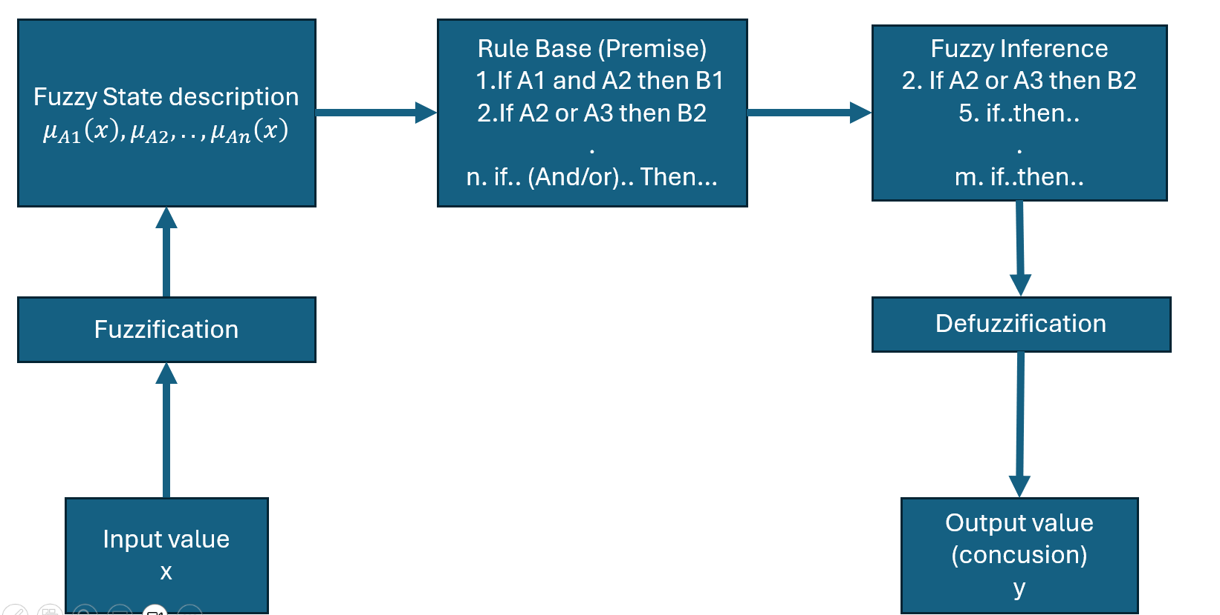
Example: Lane Keeping Assistent
Source: N. C. Basjaruddin, Kuspriyanto, Suhendar, D. Saefudin, and S. A. Aryani, Lane keeping assist system based on fuzzy logic, in 2015 International Electronics Symposium (IES)
Notes:
With those informations we can start with the first step: the fuzzification and statedescription

Slide 14
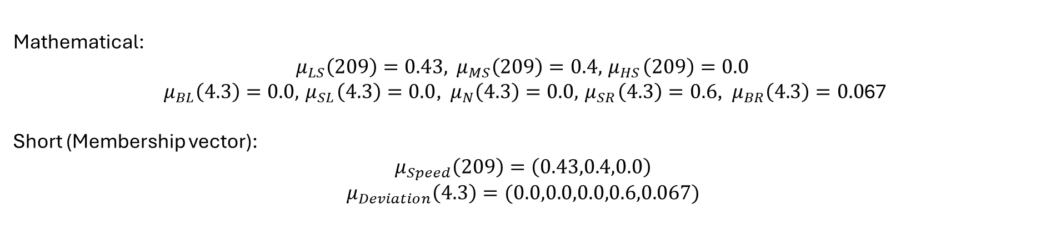
Example: Lane Keeping Assistent
Source: N. C. Basjaruddin, Kuspriyanto, Suhendar, D. Saefudin, and S. A. Aryani, Lane keeping assist system based on fuzzy logic, in 2015 International Electronics Symposium (IES)
Fuzzy State description
Speed: 209 cm/s
Deviation: 4.3
In lingustic terms: The car is between low speed an medium speed with a little bit more than small deviation to the right.
Mathematical:
$μ_{LS}\left(209\right)=0.43,$ ${ μ}_{MS}\left(209\right)=0.4, { μ}_{HS}\left(209\right)=0.0$
${ μ}_{BL}\left(4.3\right)=0.0, { μ}_{SL}\left(4.3\right)=0.0$, ${ μ}_{N}\left(4.3\right)=0.0,{ μ}_{SR}\left(4.3\right)=0.6$, ${ μ}_{BR}\left(4.3\right)=0.0$67
Short (Membership vector): $$μ_{Speed}\left(209\right)=\left(0.43,0.4,0.0\right)$$
$$μ_{Deviation}\left(4.3\right)=(0.0,0.0,0.0,0.6,0.067)$$
Notes:
We consider the following scenario: The car has a speed of 209 cm/s and a deviation of 4.3 (which meens that one sensor has completely crossed the white line, and the other one little bit)
In lingusistic terms one would describe it like this:
Mathematical we can look at the membership function and can assigne the specific (Zugehörigkeitsgrad) membership degree mue for the specific value of the set.
For speed this means: …
For Deviation this means:…
A shorter Notation could be using a membership-vector

Slide 15
Example: Lane Keeping Assistent
Source: N. C. Basjaruddin, Kuspriyanto, Suhendar, D. Saefudin, and S. A. Aryani, Lane keeping assist system based on fuzzy logic, in 2015 International Electronics Symposium (IES)
Rule Base is needed:
if speed is medium speed and deviation is normal then zero steering angle
if speed is low speed and deviation is small right then medium steering angle
if speed is low speed and deviation is big left then medium steering angle
…
Notes:
To proceed we need a Rule Base: something like….
And so on. For each scenario there needs to be a rule. To store it better and more efficiently the Rule Base can be stored in an Array.

Slide 16
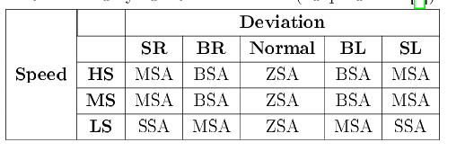
Example: Lane Keeping Assistent
Source: N. C. Basjaruddin, Kuspriyanto, Suhendar, D. Saefudin, and S. A. Aryani, Lane keeping assist system based on fuzzy logic, in 2015 International Electronics Symposium (IES)
Array of the Rule Base (Premise)
SR/L: Small Right/Left
BR/L : Big Right/Left
HS: High Speed
MS: Medium Speed
LS: Low Speed
SSA: Small Steering Angle
MSA: Medium Steering Angle
BSA: Big Steering Angle
Notes:
With this Array we can now start the Fuzzy Inference to decide which rules are activated in our scenario. For each rule there is given a conclusional statement: „MSA“ for Medium Steering Angle“, …

Slide 17
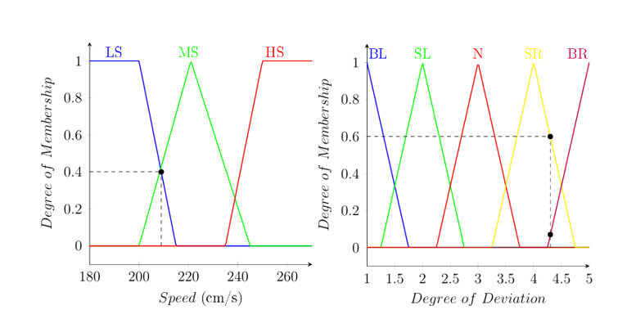

Example: Lane Keeping Assistent
Source: N. C. Basjaruddin, Kuspriyanto, Suhendar, D. Saefudin, and S. A. Aryani, Lane keeping assist system based on fuzzy logic, in 2015 International Electronics Symposium (IES)
Notes:
We need to look for rules containing: Low Speed, Medium Speed, Small Right Deviation and Big Right Deviation. Since every combination most be covered this results in a total of 2*2 rules: 4 Rules that need to be activated.

Slide 18
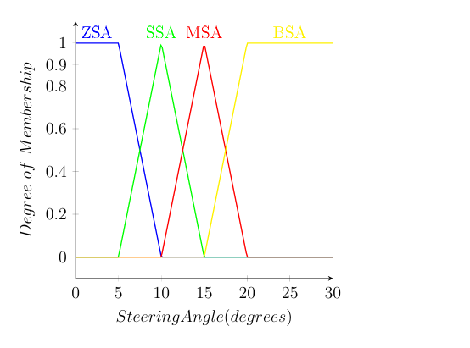
Example: Lane Keeping Assistent
Source: N. C. Basjaruddin, Kuspriyanto, Suhendar, D. Saefudin, and S. A. Aryani, Lane keeping assist system based on fuzzy logic, in 2015 International Electronics Symposium (IES)
Notes:
For the final Step the Defuzzification we need an output membership function. If you remember the output will be the steering Angle.

Slide 19
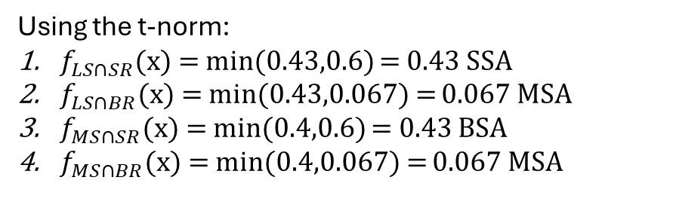

Example: Lane Keeping Assistent
Source: N. C. Basjaruddin, Kuspriyanto, Suhendar, D. Saefudin, and S. A. Aryani, Lane keeping assist system based on fuzzy logic, in 2015 International Electronics Symposium (IES)
$$μ_{Speed}\left(209\right)=\left(0.43,0.4,0.0\right)$$
$$μ_{Deviation}\left(4.3\right)=(0.0,0.0,0.0,0.6,0.067)$$
Using the t-norm:
$f_{LS∩SR}$(x) = min(0.43,0.6) = 0.43 SSA
$f_{LS∩BR}$(x) = min(0.43,0.067) = 0.067 MSA
$f_{MS∩SR}$(x) = min(0.4,0.6) = 0.43 BSA
$f_{MS∩BR}$(x) = min(0.4,0.067) = 0.067 MSA
Notes:
Those are the Inforamtions we need to process. Since the Rules are in the form of: „If Speed is Low speed AND Deviation is Small Right“…. And we have an „AND“ Operator, we need to use Zadeh‘s t-norm to and thus the minimum of both values. For LS AND SR this means…

Slide 20
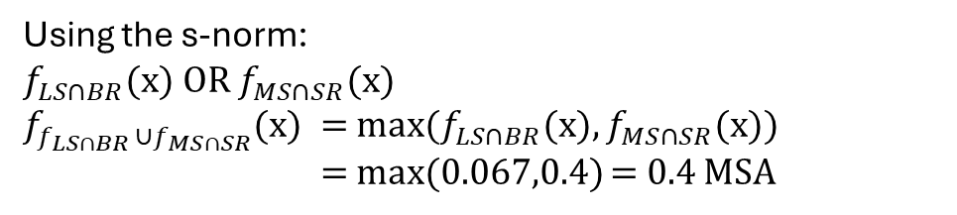
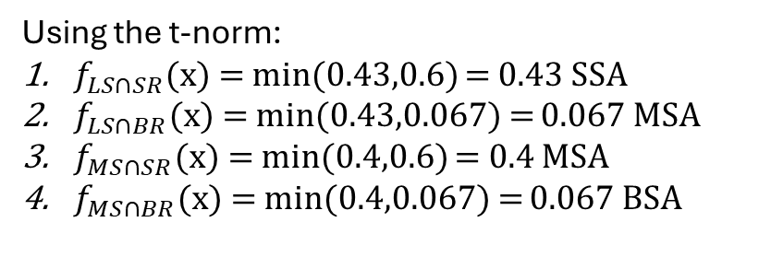
Example: Lane Keeping Assistent
Source: N. C. Basjaruddin, Kuspriyanto, Suhendar, D. Saefudin, and S. A. Aryani, Lane keeping assist system based on fuzzy logic, in 2015 International Electronics Symposium (IES)
Using the t-norm:
$f_{LS∩SR}$(x) = min(0.43,0.6) = 0.43 SSA
$f_{LS∩BR}$(x) = min(0.43,0.067) = 0.067 MSA
$f_{MS∩SR}$(x) = min(0.4,0.6) = 0.4 MSA
$f_{MS∩BR}$(x) = min(0.4,0.067) = 0.067 BSA
Using the s-norm:
$f_{LS∩BR}$(x) OR $f_{MS∩SR}$(x)
$f_{f_{LS∩BR }∪f_{MS∩SR}}$(x) = max($f_{LS∩BR}$(x), $f_{MS∩SR}$(x))
= max(0.067,0.4) = 0.4 MSA
Notes:
What do we do with this information now?
We need to clip the corresponding membership functions according to their membership degree.
For Rule Number 1 this means SSA needs to be clipped at 0.43. For Rule Number 4 this means BSA needs to be clipped at 0.067
But what about Rules 2 und 3? Both apply to the same output.
Since it is either Rule Numer 2 OR Rule Number 3 maybe you can already guess what we need to do?
To connect the both rules the s-Norm is required

Slide 21
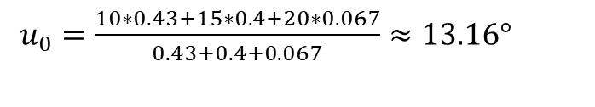
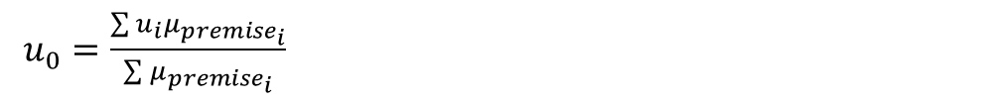
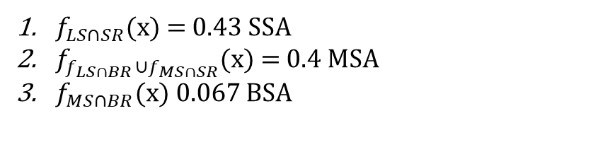
Example: Lane Keeping Assistent
Source: N. C. Basjaruddin, Kuspriyanto, Suhendar, D. Saefudin, and S. A. Aryani, Lane keeping assist system based on fuzzy logic, in 2015 International Electronics Symposium (IES)
$f_{LS∩SR}$(x) = 0.43 SSA
$f_{f_{LS∩BR }∪f_{MS∩SR}}$(x) = 0.4 MSA
$f_{MS∩BR}$(x) 0.067 BSA
$u_{0}=\frac{\sum{u_{i}μ_{{premise}_{i}}}}{\sum{μ_{{premise}_{i}}}}$
$u_{0}=\frac{10∗0.43+15∗0.4+20∗0.067}{0.43+0.4+0.067}≈13.16°$
Notes:
For the Center of Gravity Method we will cheat a little bit to make the calculations easier. As you remember the computational effort can be reduced if the membership function is triangular. So we pretend it to be triangular. As you see the error will be very small. (indeed I compared it and the resulting degree is about 0.01 Degree bigger, than it should be).
As a reminder the formular for the pbumb center of gravity is:
If we insert the values we get:

Slide 22
Example: Lane Keeping Assistent
Source: N. C. Basjaruddin, Kuspriyanto, Suhendar, D. Saefudin, and S. A. Aryani, Lane keeping assist system based on fuzzy logic, in 2015 International Electronics Symposium (IES)
Easy set up
Two small sensor types
One activator
Low computational effort
Simple Line Keeping assistent was achieved

