Slide 1
marimo.phys

Slide 2
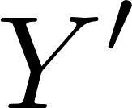





$d$-dimensional boundary
$$X$$
$$Y$$
$(d+1)$D SPT phase
gapless
gapped
$$f$$

