Slide 1

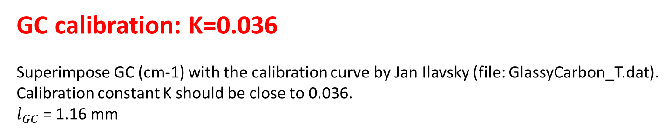
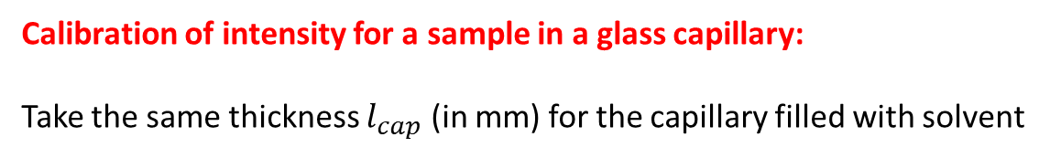
GC carbon calibration for SWING data
$$I_{GC }\left({cm}^{−1}\right)=K\frac{I_{Swing_GC }{− I}_{Swing_air }}{l_{GC} (mm)}$$
In Foxtrot macro, use K=0.036 for the calibration constant (instead of K=1)
GC calibration: K=0.036
Superimpose GC (cm-1) with the calibration curve by Jan Ilavsky (file: GlassyCarbon_T.dat).
Calibration constant K should be close to 0.036.
$l_{GC}$= 1.16 mm
$$I_{cap_norm_sub }\left({cm}^{−1}\right)=K\frac{I_{Swing_cap }{− I}_{Swing_cap_solvent }}{l_{cap} (mm)}$$
Calibration of intensity for a sample in a glass capillary:
Take the same thickness $l_{cap}$ (in mm) for the capillary filled with solvent
Thickness is not taken into account in Foxtrot data reduction

Slide 2
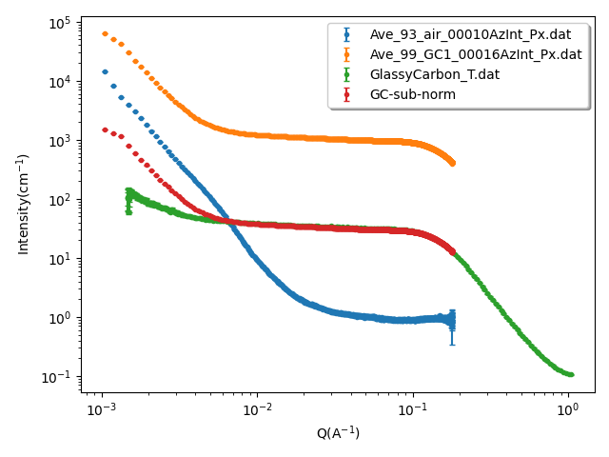

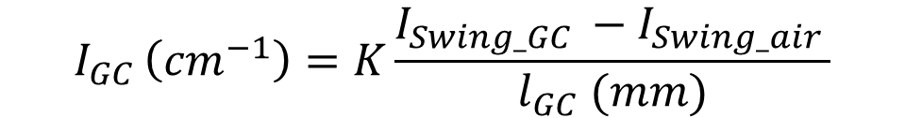
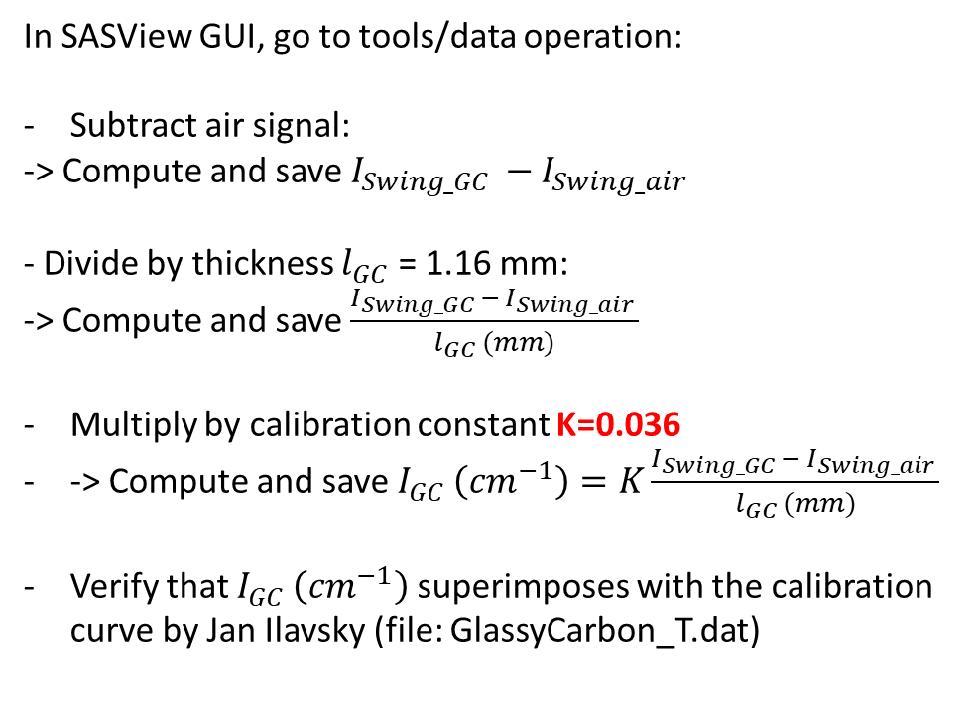
SWING data April 26: GC calibration
$$I_{GC }\left({cm}^{−1}\right)=K\frac{I_{Swing_GC }{− I}_{Swing_air }}{l_{GC} (mm)}$$
In SASView GUI, go to tools/data operation:
Subtract air signal:
-> Compute and save $I_{Swing_GC }{− I}_{Swing_air }$
- Divide by thickness $l_{GC}$ = 1.16 mm:
-> Compute and save $\frac{I_{Swing_GC }{− I}_{Swing_air }}{l_{GC} (mm)}$
Multiply by calibration constant K=0.036
-> Compute and save $I_{GC }\left({cm}^{−1}\right)=K\frac{I_{Swing_GC }{− I}_{Swing_air }}{l_{GC} (mm)}$
Verify that $I_{GC }\left({cm}^{−1}\right)$superimposes with the calibration curve by Jan Ilavsky (file: GlassyCarbon_T.dat)
$l_{GC}$ = 1.16 mm
GC calibration: K=0.036

Slide 3
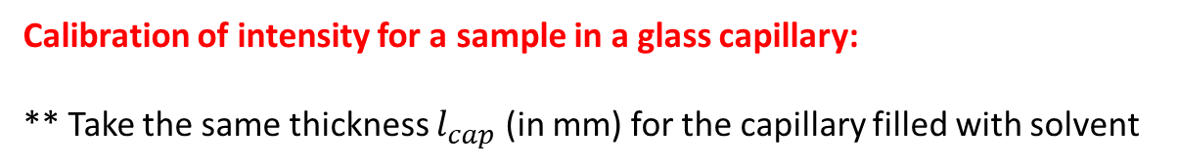
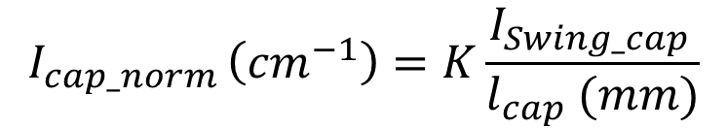
For all SWING data
In Foxtrot, use K=0.036 for the calibration constant (instead of K=1) and run again the macro
$I_{cap_norm_sub }\left({cm}^{−1}\right)=K\frac{I_{Swing_cap }{− I}_{Swing_cap_solvent }}{l_{cap} (mm)}$ $=K\frac{I_{Swing_cap }}{l_{cap} (mm)}−K\frac{I_{Swing_cap_solvent }}{l_{cap} (mm)}$
$$I_{cap_norm }\left({cm}^{−1}\right)=K\frac{I_{Swing_cap }}{l_{cap} (mm)}$$
Calibration of intensity for a sample in a glass capillary:
** Take the same thickness $l_{cap}$ (in mm) for the capillary filled with solvent

