Slide 1
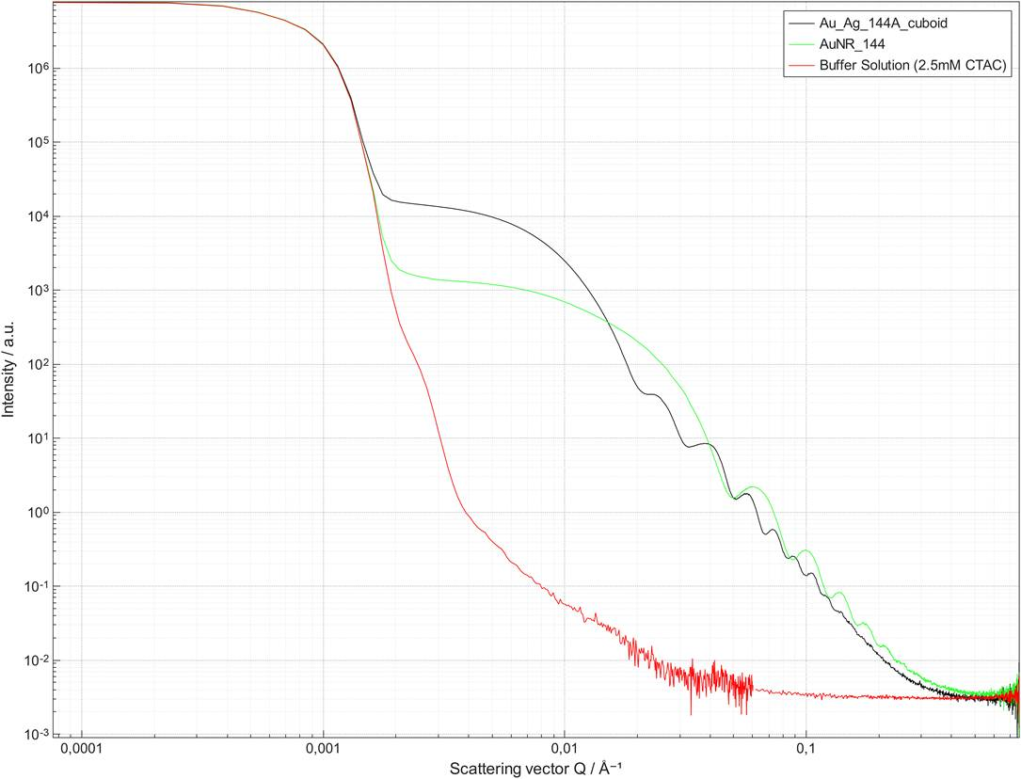
Cuboid: Regrowth with 8 Ag equivalent
Au NRs

Slide 2
Au NR 144 data after buffer subtraction
Buffer subtraction
Cut to get:
qmin close to 0.002 A-1
qmax close to 0.3 A-1
Slicing step: 4
Errors bars changed to 10% of intensity
https://github.com/marimperorclerc/rods-2d

Slide 3
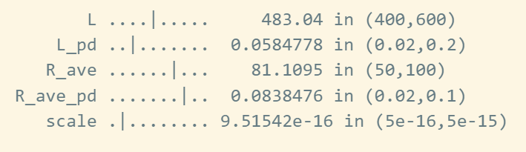
Au NR 144 fit with new model nanoprisms.py
n=8 (octogonal cross-section)
R_ave=8.1 nm
Polydispersity on R: 0.08
L=48 nm
Polydispersity on L: 0.06

Slide 4
AuAg cuboids 144A data after buffer subtraction
Buffer subtraction
Cut to get:
qmin close to 0.002 A-1
qmax close to 0.3 A-1
Slicing step: 4
Errors bars changed to 10% of intensity
Regrowth adding Ag to 144 Au NRs
with 8 Ag equivalent
https://github.com/marimperorclerc/rods-2d

