Slide 1
Homochiral ideas
Marianne Imperor-Clerc
October 2025

Slide 2
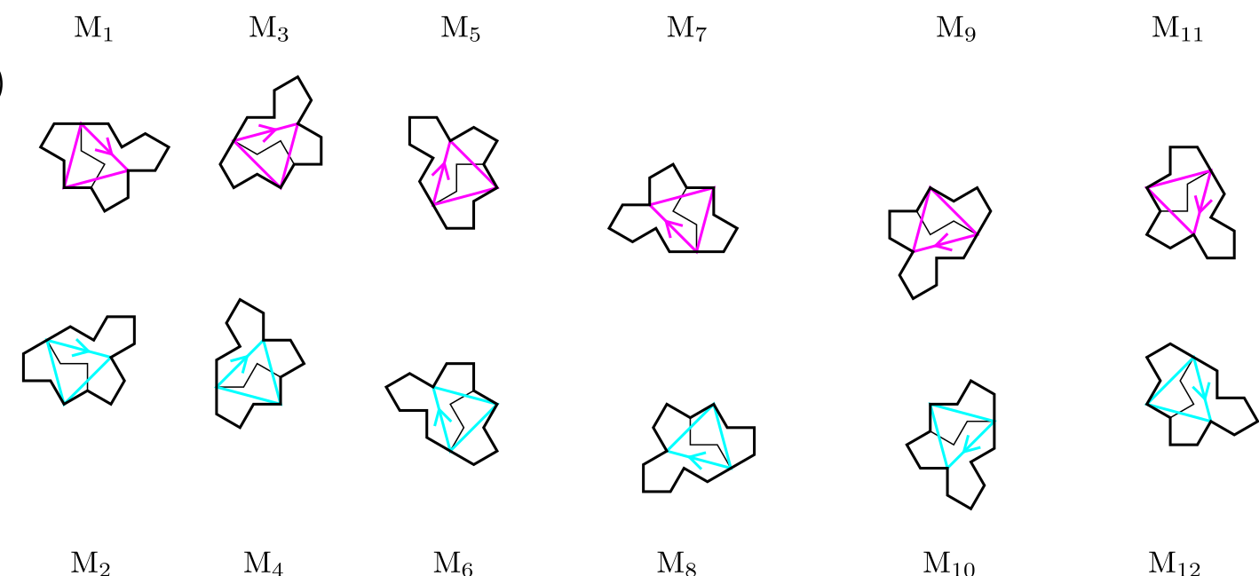
ODD and EVEN orientations for Tile(1,1)

Slide 3
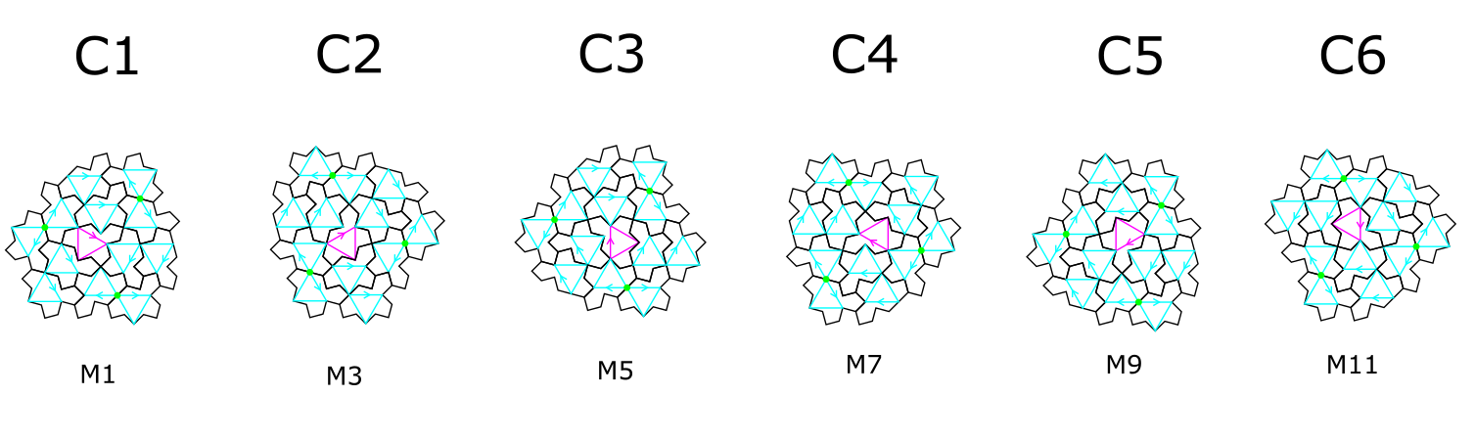
full cluster with its six rotations: n(2pi/6)
Tile(1,1)
13 tiles in a full cluster: one ODD tile at the center + 12 EVEN tiles around
Blue triangles (EVEN) have one horizontal edge when pink (ODD) have a vertical one

Slide 4
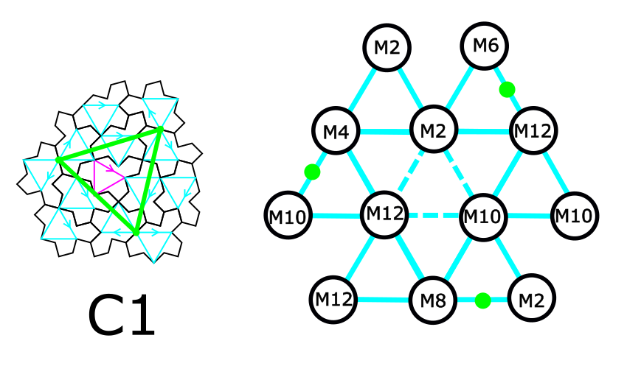
Orientation of the 12 EVEN tiles in a full cluster
Tile(1,1)
6 tiles in the C-cluster (corona made of M12, M4, M2, M12, M10, M8)
3 translated (M2, M10, M12) (along blue lines, the edges of blue triangles)
3 half-turned (M4->M10, M12 -> M6, M8 -> M2)

Slide 5
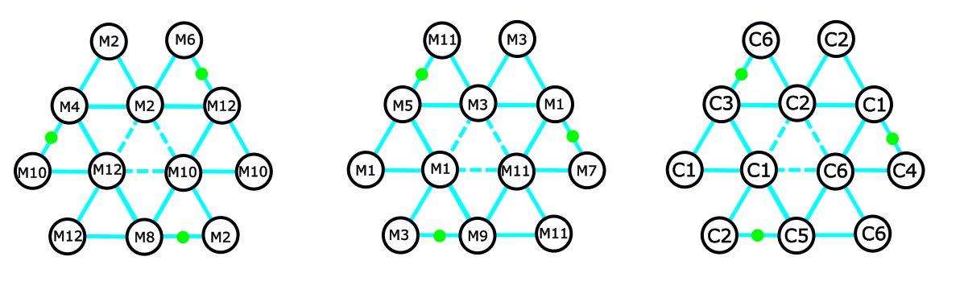
Inflation step 1: substitution rule for C1
EVEN tiles in C1
ODD tiles for step 1
same as full clusters
ODD tiles for step 1 are obtained by adding 1 (mod 12) to all EVEN tiles in the C cluster (6 tiles)
Directions of translated and half-turned tiles are exchanged (see the change of position for green points). Then three tiles are translated (M1, M3, M11) and three are half-turned (M5->M11, M1 -> M7, M9 -> M3)
ODD tile index is equivalent to the orientation of a full C cluster ☺

Slide 6
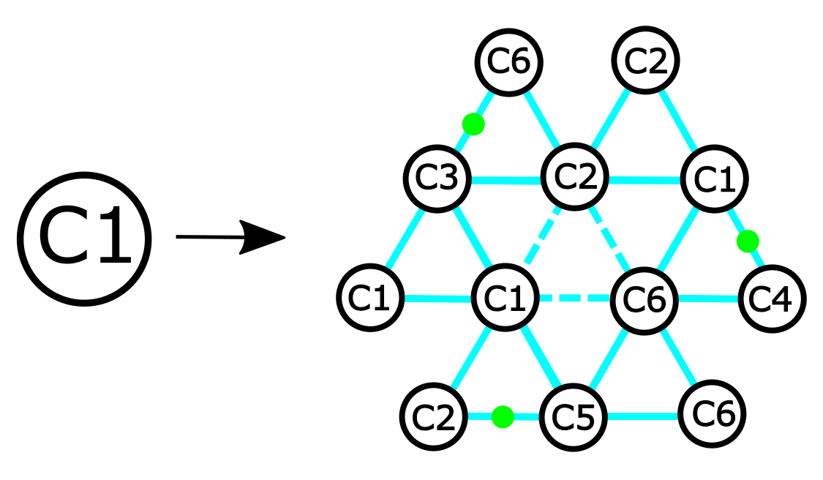
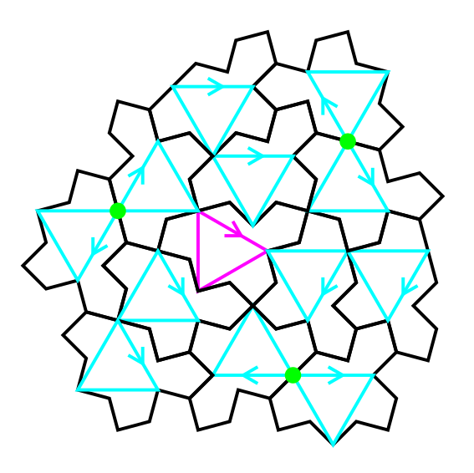
Inflation step 1

Slide 7
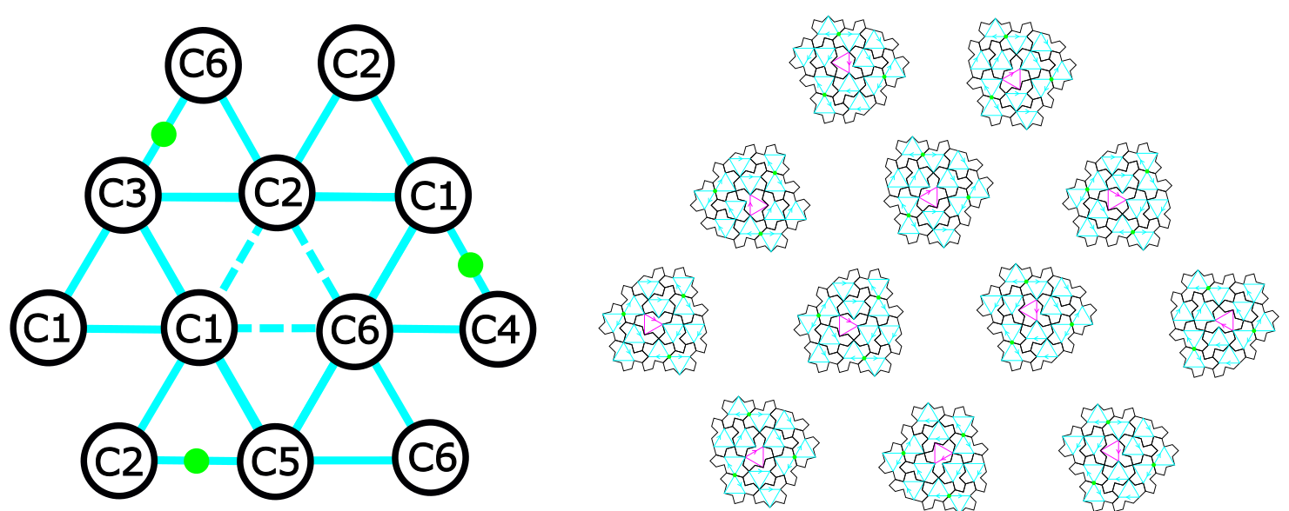
Inflation step 1
Directions along the blue lines are the edge directions of the blue triangles !!!

Slide 8
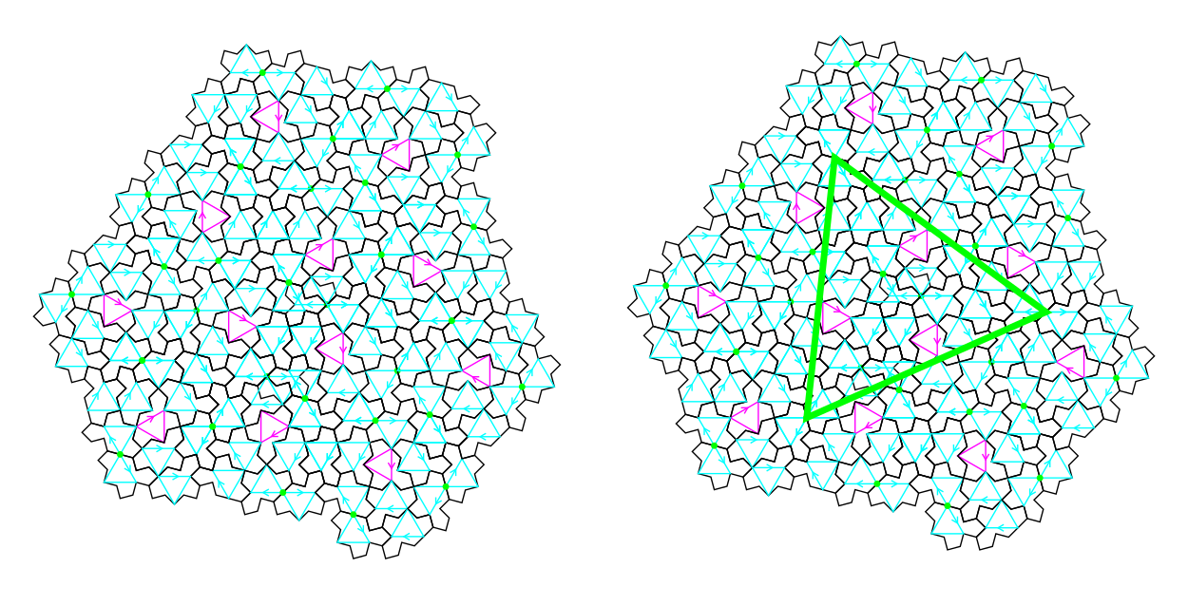
Inflation step 1 for full cluster C1
Assembly of the 12 full clusters works fine !!! (done manually so far for the relative positions of clusters)
Some tiles are superimposed
Some half-turned tiles need to be removed with a simple rule: translation wins over half-turn !
A bigger green triangle is identified, centered on a trifle at the center of the figure ☺

Slide 9
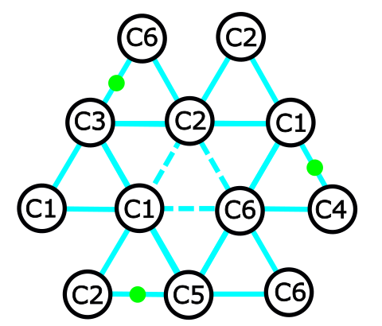
Inflation step 1 for full cluster C1
TO DO: Find a rule for the relative positions between clusters in the assembly
Clusters are translated from each other along the blue lines
Use superposition of green points from two adjacent clusters ???

Slide 10
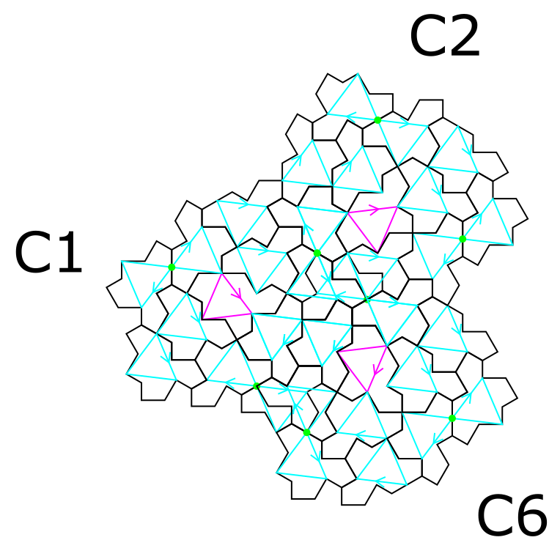
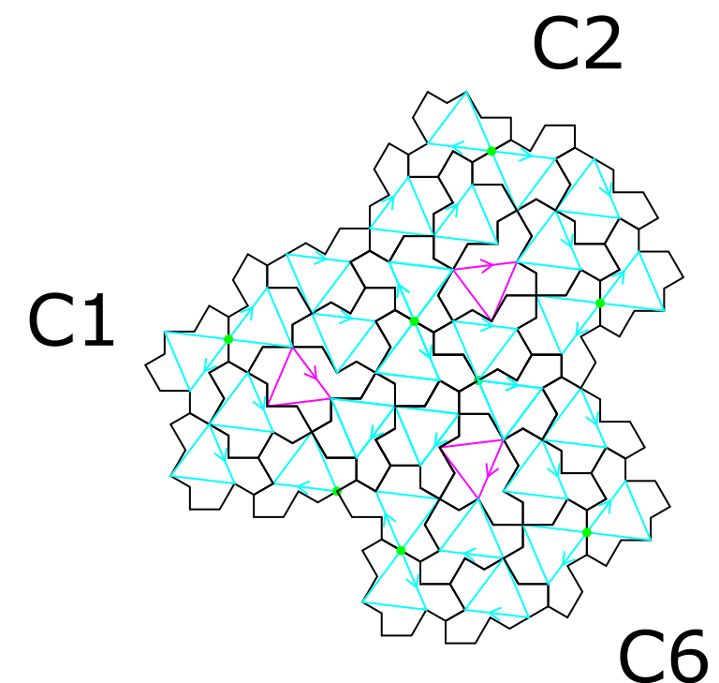
Defect healing
Starting point for worms ☺
After removing two half-turned tiles

Slide 11
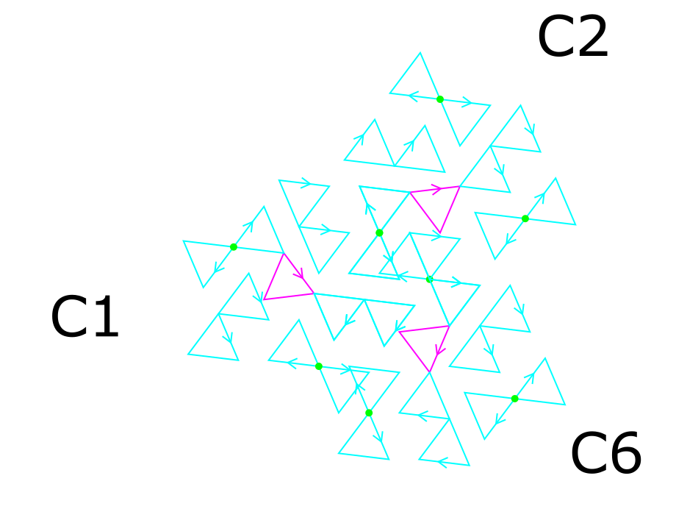
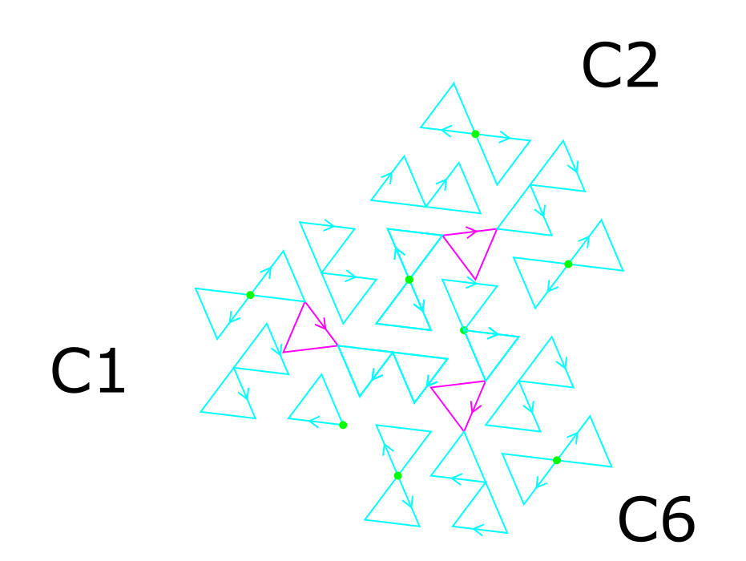
Defect healing
Starting point for worms ☺
After removing two half-turned tiles

Slide 12
TO DO: Step 2
Replace all the 12 full clusters in this pattern with the same rule used previously for C1 (just a rotation of the pattern for C2, C3, C4, C5 and C6)

Slide 13
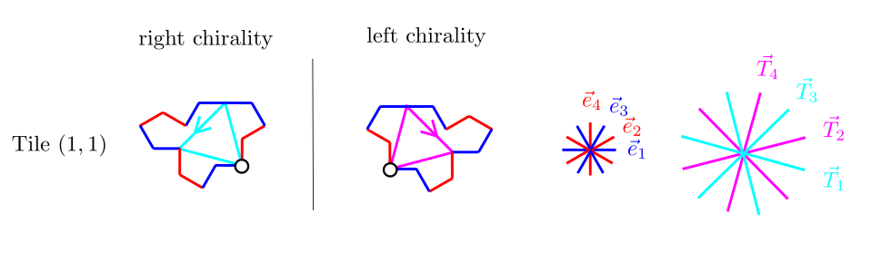
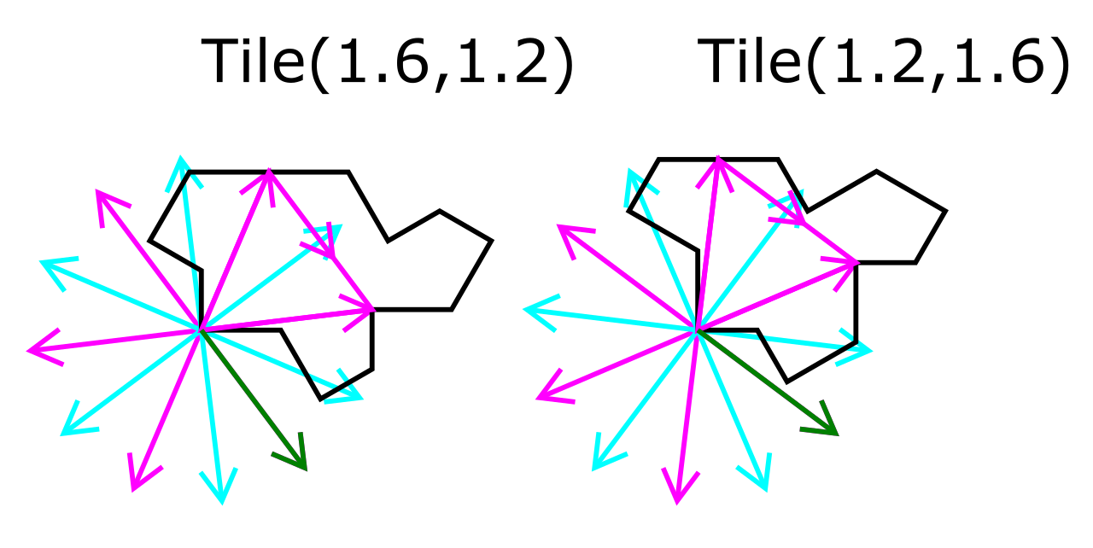
New reference triangle in Tile(a,b)
Robust for any T(a,b) tile ☺
a=1.6
b=1.2

Slide 14
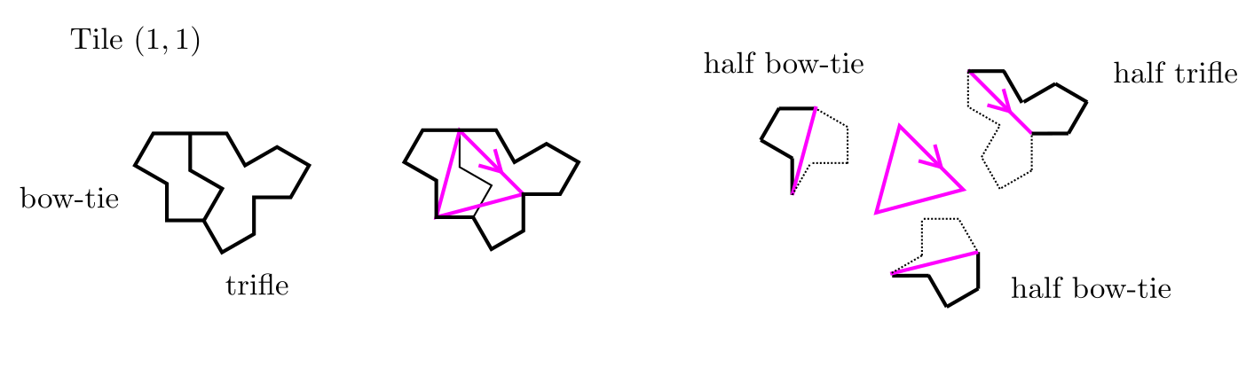
Link with trifle and bow-tie in Tile(1,1)

Slide 15
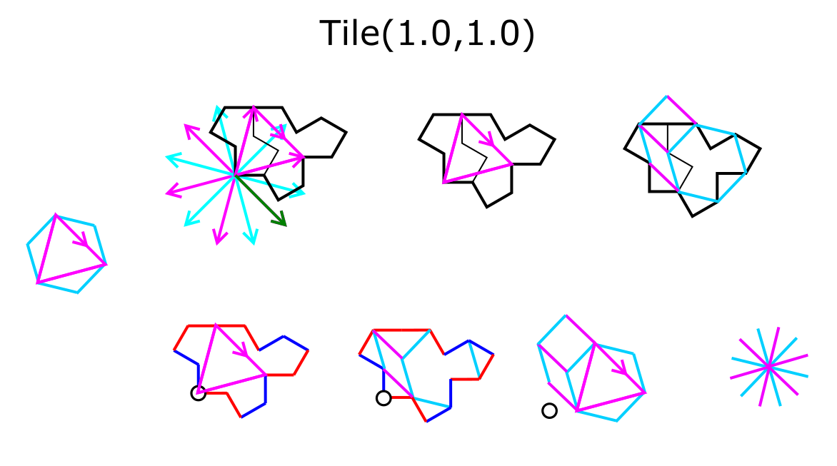
Comparison with hexagon/square/rhombus decomposition

Slide 16
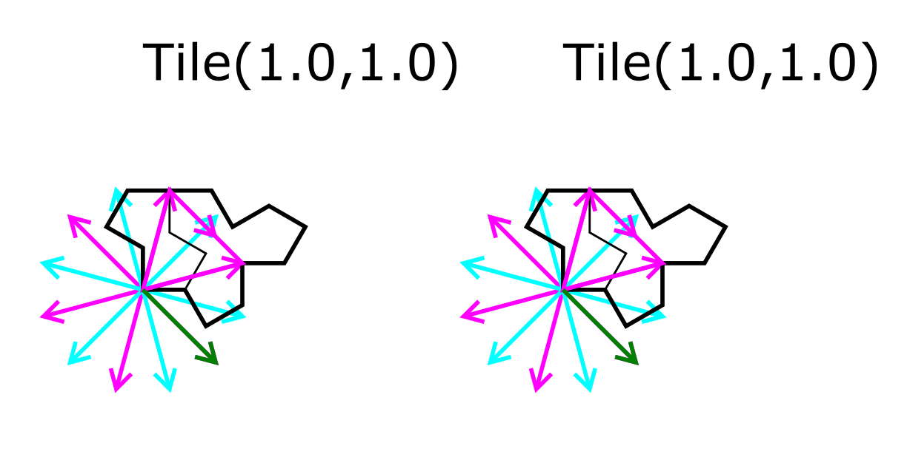
Tile(1,1) : spectre tile

Slide 17
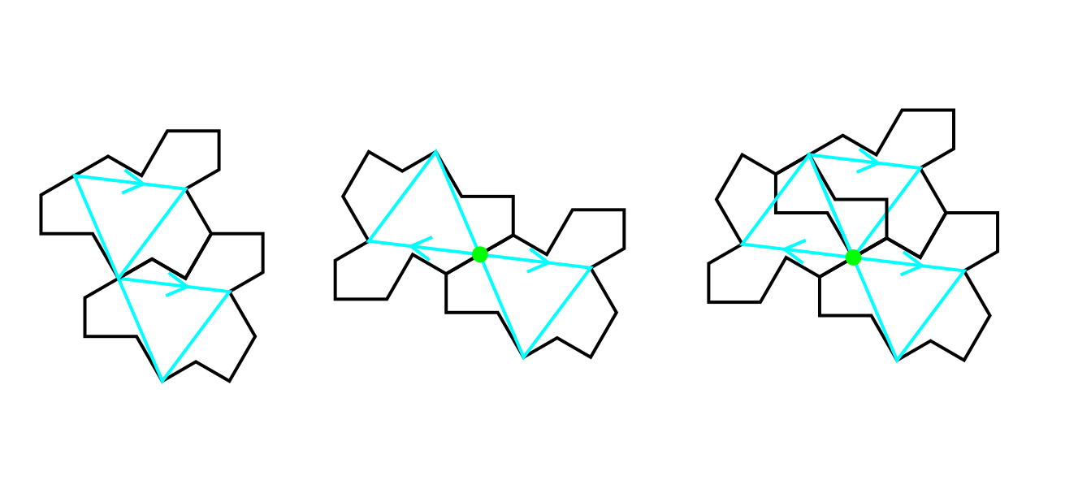
translation versus half-turn for any Tile(a,b)
a=1.6
b=1.2

Slide 18
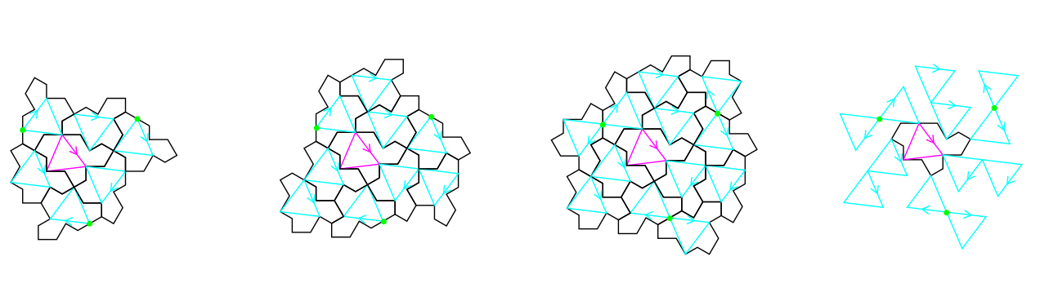
Cluster and full cluster
a=1.6
b=1.2
C cluster
(corona around a ODD tile)
The three translated tiles are all in the tiling
Three more possible tiles with half-turn around the green points

Slide 19
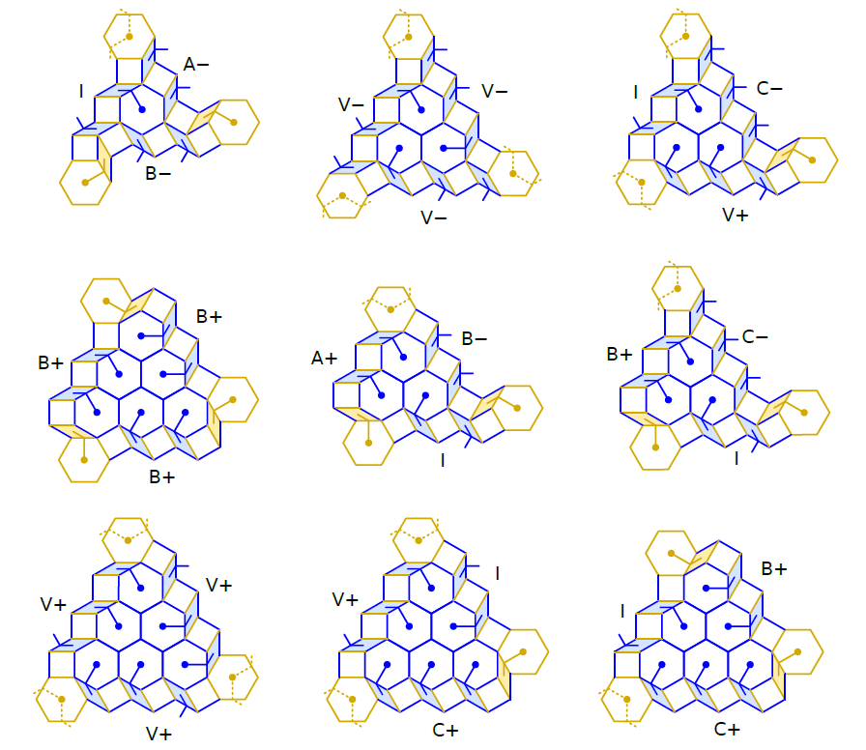
8 types of hexagonal clusters
Combinatorial properties
Chéritat, A., (2024). Observations on the hex clusters of the spectre tilings. https://arxiv.org/abs/2407.05359

Slide 20
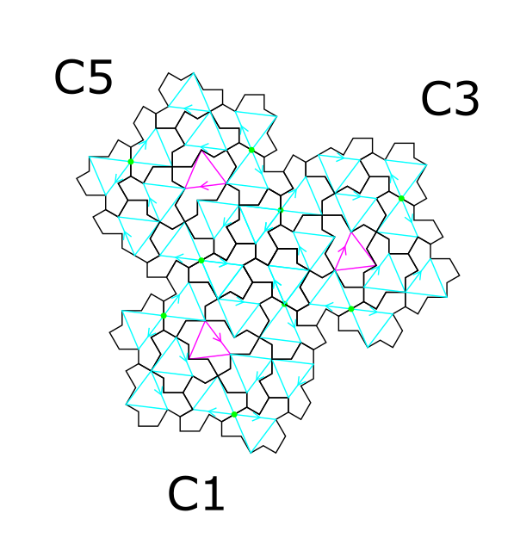
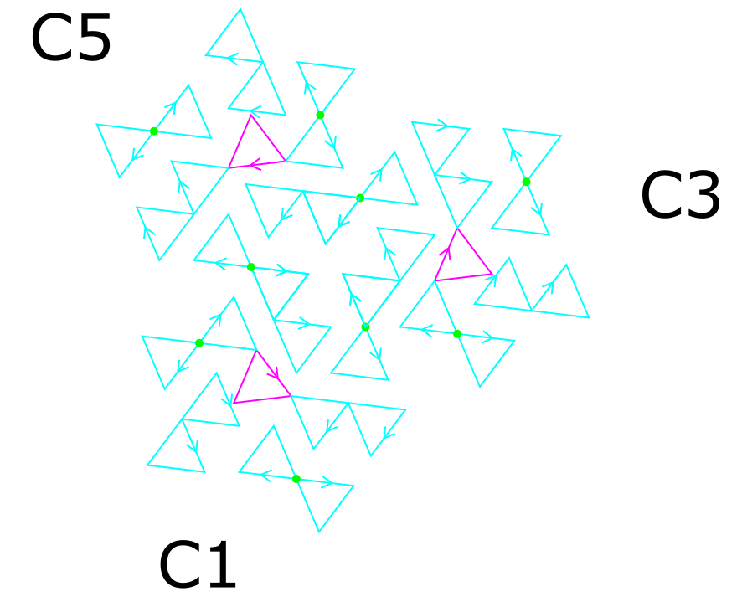
Find equivalence with the hexagonal clusters ?
?
Chéritat, A., (2024). Observations on the hex clusters of the spectre tilings. https://arxiv.org/abs/2407.05359

Slide 21
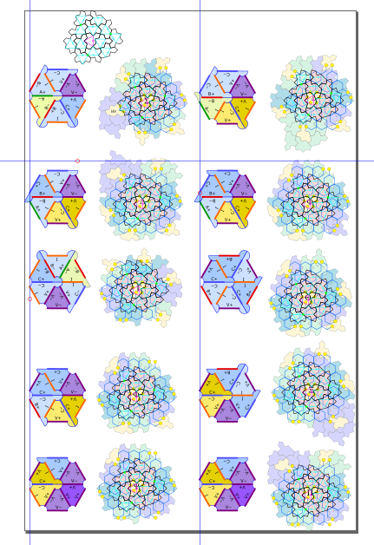
Full cluster superposition on the 9 combinations
WHY ???

Slide 22
Homochiral python code on github
Under construction !
https://github.com/marimperorclerc/homochiral
python code for drawing clusters with Tile(a,b) in svg graphics.
References
Code is based on the drawsvg package:
https://pypi.org/project/drawsvg/
And the python code with alternate chirality for inflation for spectre tiling:
https://github.com/shrx/spectre/blob/master/spectre.py

