Slide 1
SmartCity: A Guide to Sustainable Living
Module: CCS1210 - Introduction to Web Technologies
Group Name: The EcoCoders
Team Members: Marina Chatziefraimidou, Dimitris Terpos, Mary Varzakakou, Konstantinos Chatzimichail, Georgia Charari.

Slide 2
Project Overview & Target Audience
Concept: An educational website dedicated to sustainable living in an urban environment.
Core Modules: Energy, Waste, Water, Transport, Lifestyle.
Target Audience: Urban residents and students (ages 18-45) looking for practical, eco-friendly tips.

Slide 3
Team Roles
Members
Marina (Leader): GitHub management, Global Design (CSS), Transport Module, Integration.
Dimitris: Energy Module.
Georgia: Waste Module.
Konstantinos: Water Module.
Mary: Lifestyle Module.

Slide 4
Management
Process
Weekly meetings (physical & online).
Use of GitHub for version control.
Use of a Journal to track decisions.
Each member also built a personal bio page as per requirements.

Slide 5
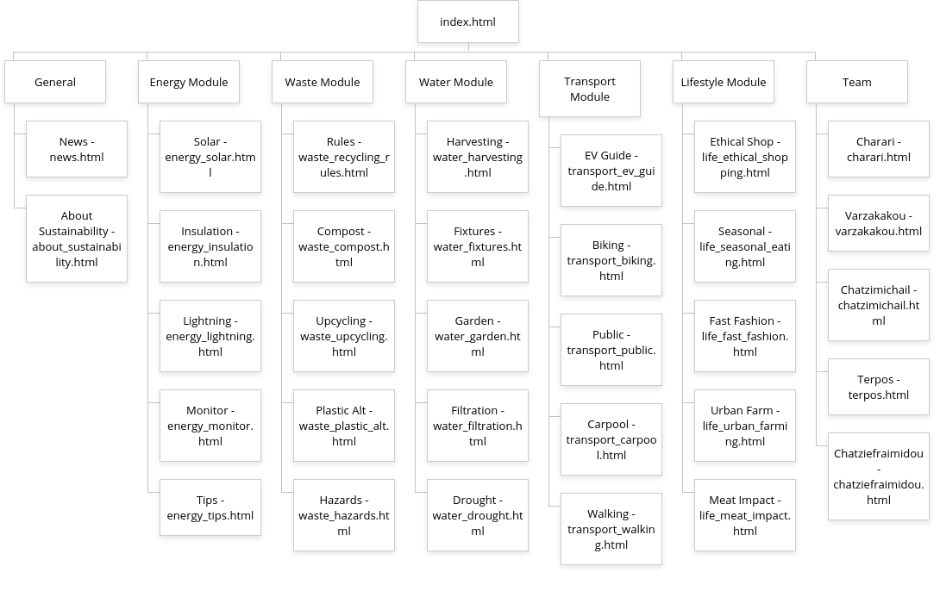
Planning & Architecture

Slide 6
Design & User Experience
Visual Identity: Emerald Green & Slate Grey palette (for an “Eco” feel).
Layout: Used CSS Flexbox & Grid for responsive cards and alignment.
Navigation: Implemented a Dropdown Menu so users can jump between modules easily (solving the “navigation problem” found in Week 7).
Consistency: Used a global style.css and a Master HTML Template so all pages look uniform.

Slide 7
Technologies & Development
Tech Stack: HTML5, CSS3, JavaScript.
Tools: VS Code, GitHub.
AI Policy: GenAI (ChatGPT) was used only for text content and image ideas, but NOT for code generation.

Slide 8
Key Features (The “Interactive Tools”)
Transport: Commute CO2 Calculator.
Energy: Phantom Power Calculator.
Waste: Recycling Code Sorter.
Water: Shower Water Saver.
Lifestyle: Seasonal Food Filter.

Slide 9
Content & Sources
Text: Generated via GenAI (verified by students).
Images: Royalty-Free sources (Pexels, Unsplash).
Code: 100% Hand-written.

Slide 10
Challenges & Solutions
Challenge: Navigation was difficult between modules.
Solution: Upgraded to a Dropdown Menu in Week 7.
Challenge: Ensuring consistent design across 5 developers.
Solution: Leader created a “Master Template” in Week 5 that everyone adopted after discussion and agreement with the whole team.

Slide 11
Conclusion & Demo
GitHub Repository Link: https://github.com/marina04-dev/Smart_City.git
Thank you. Any Questions?

