Slide 1

Movie recommendation system
By Marina delvecchio, tye leckinger, joe lomonaco

Slide 2

Introduction
Relevance: In today's digital age, movie consumption has skyrocketed with popular streaming platforms such as Netflix and HULU, personalizing movie recommendations is highly valuable to users and companies
A well-designed movie recommendation system can enhance user experience, drive user engagement and increase platform loyalty, we thought this was interesting and that’s why we chose this project

Slide 3
contribution
Traditional Recommendation Systems: Collaborative filtering is one main method streaming platforms use, Collaborative filtering utilizes the collective behavior of users to make recommendations, It can be User-Based (Users Share Similar Interest) or Item-Based(Find movies that are similar to what the user has interacted with)
Our Deep Learning Model: We utilize Content Based Filtering to enhance personalization, this approach recommends movies based on similar features to previously watched movies by the user(genre, actor, etc.) For individual users this can provide flexibility in data where they might enjoy certain movie styles

Slide 4

Dataset
Found on Kaggle, 270,000 users, 45,000 movies, 26 million ratings. Had to shrink this down due to laptop capabilities with 700 Users, 9,000 Movies
Data Cleaning: Combined all the tables into one CSV file in R, removing most of the irrelevant information we did not plan on using (poster pictures, Non-American movies, etc.), I also added a "Liked_movie" column into the dataset where if the user rated 3.5 or higher it was marked as 1 for liked, otherwise marked 0, Cleaning continued the further we got into development based on what we deemed we needed

Slide 5
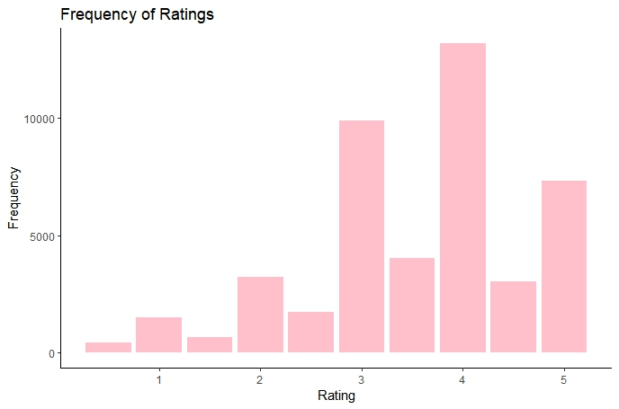
visualization

Slide 6
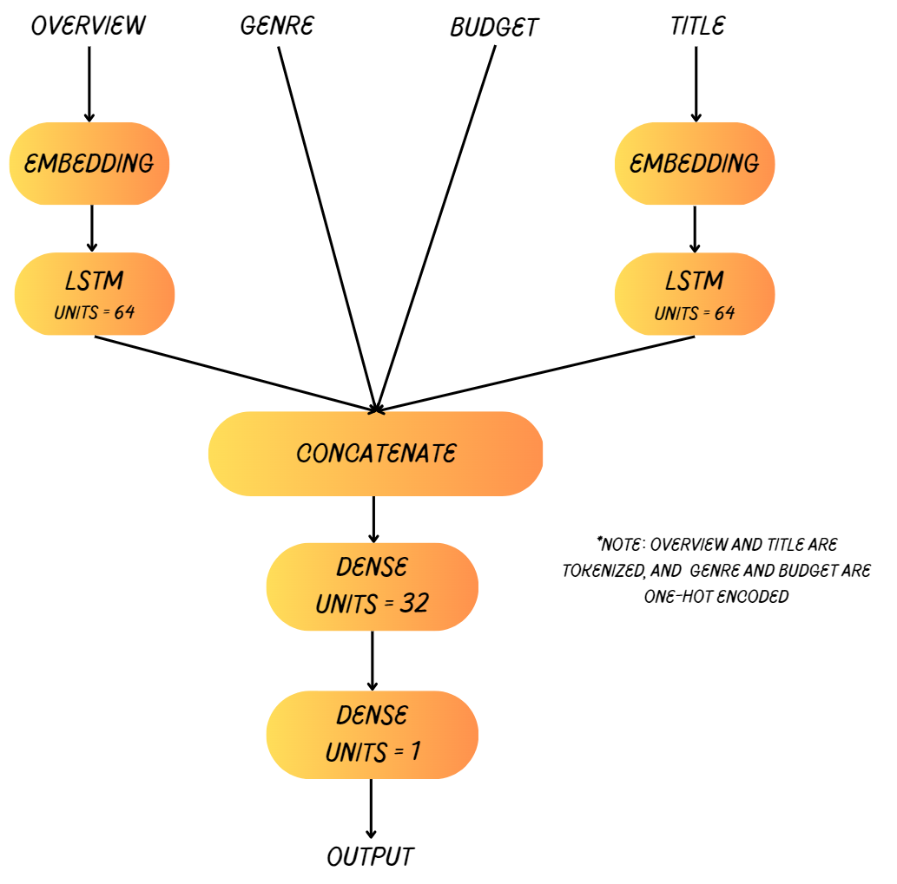
method

Slide 7
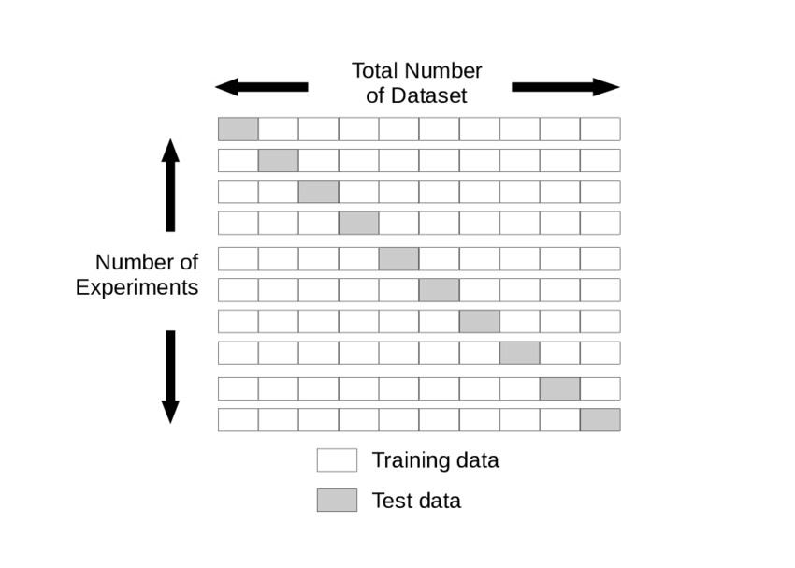
validation
K-Fold Cross Validation
For each iteration (Example: K = 10)
Set the test to the next chunk
Set the train to everything else
Train the model and make the predictions with test set
Add the accuracy to the list of accuracy's.
Get the average of all accuracy's
Benefit: provides a more accurate representation of the true accuracy for small dataset

Slide 8
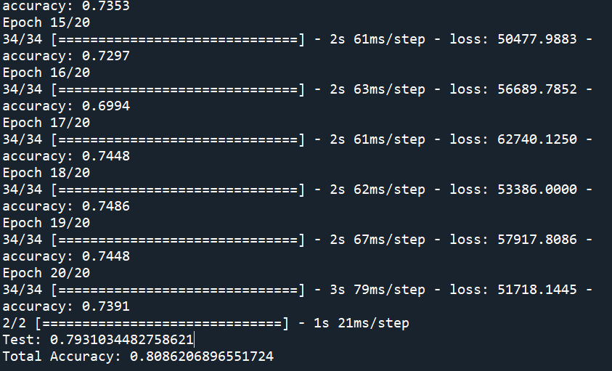
result
Our Model: 0.808
Collaborative filtering:
MovieLens: 0.707
Pintrest: 0.873

Slide 9
discussion
Due to time constraints, we couldn’t develop our system as much as we wanted to
Wanted to test results with collaborative filtering
Best accuracy was 70% using collaborative filtering
Next steps would be to test out different types of filtering methods, including collaborative, to see which one yields the most accurate results

Slide 10
Project management
We split up the work based on our strengths
Tye has experience using deep learning methods, so he contributed his expertise in that area
Joe has experience cleaning data in R, so he cleaned our data set to the specifications that we needed
Marina performed the visualization in R and organized the proposal and final report so that we had clear goals and a precise conclusion
Overall, we worked as a team to make sure our project was completed to the best of our abilities, and we all learned something we didn’t know previously

Slide 11
conclusion
After creating our own system using content-based filtering, we can now appreciate the benefits and drawbacks of each filtering style
Previously mentioned content-based filtering allows recommendations to be more personal, but it doesn’t allow us to group users and utilize data to its fullest
Collaborative filtering most likely would have been more accurate, although we didn’t have time to test this theory.

Slide 12

Code demo

Slide 13
references
[1] X. He et al., “Neural Collaborative Filtering,” https://arxiv.org/pdf/1708.05031.pdf (accessed May 9, 2023).
[2] Ashirwad, “IMDb dataset,” Kaggle, https://www.kaggle.com/datasets/ashirwadsangwan/imdb-dataset (accessed May 9, 2023).
[3] A. Ibtesam, “Getting started with a movie recommendation system,” Kaggle, https://www.kaggle.com/code/ibtesama/getting-started-with-a-movie-recommendation-system (accessed May 9, 2023).

Slide 14

Appendix
https://github.com/tyeleck/AI_Project_Team_5
https://www.kaggle.com/datasets/ashirwadsangwan/imdb-dataset

