Slide 1
大学生数学建模竞赛辅导讲座
—— 概 率 统 计 篇

Slide 2
1992 A题施肥效果分析
1997 A题 零件的参数设计
1999 A题 自动化车床管理
2000 A题 DNA 序列分类
2002 B题 彩票中的数学
2004 C题 饮酒驾车
2005 A题 长江水质的评价和预测
2005 C题 雨量预报方法的评价
2006 B题: 艾滋病疗法的评价及疗效的预测
2006 D题 煤矿瓦斯和煤尘的监测与控制
2007 A题 中国人口增长预测
2008 B题 高等教育学费标准探讨
2009 B题 眼科病床的合理安排
2010 A题 储油罐的变位识别与罐容表标定
2010 B题 2010年上海世博会影响力的定量评估
2011 A题 城市表层土壤重金属污染分析
2011 C题 企业退休职工养老金制度的改革
2012 A题 葡萄酒的评价
2012 C题 脑卒中发病环境因素分析及干预
2013 A题 车道被占用对城市道路通行能力的影响
2013 C题 古塔的变形
2014 C题 生猪养殖场的经营管理
2016 C题 电池剩余放电时间预测
2017 B题 “拍照赚钱”的任务定价
2017 C题 颜色与物质浓度辨识

Slide 3
几个常用概率分布

Slide 4
均匀分布
（一维连续型）
（多维连续型）
X | x₁ | x₂ | …… | x_{n}
p | 1/n | 1/n | …… | 1/n
（离散型）

Slide 5
使用场合：
1）该问题具有某种均匀性；
2）该问题无任何先验信息。

Slide 6
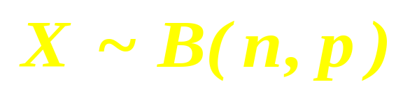
二项分布
设试验 E 只有两个结果：Ａ和 ，记:
独立地重复 n 次。
记作：

Slide 7
使用场合：
只有两个结果：Ａ和 ，
独立地重复 n 次。

Slide 8
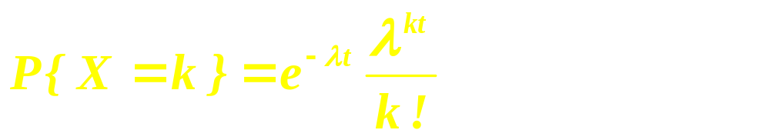
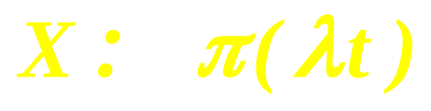
Poission 分布

Slide 9
使用场合：
具有：
平稳性
独立增量性
普通性

Slide 10
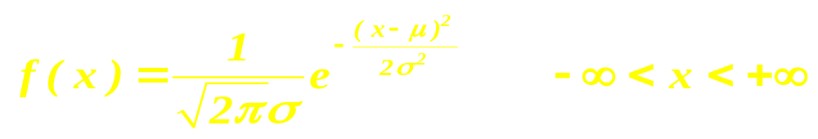
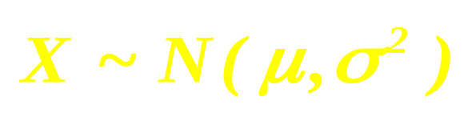
正态分布（normal）

Slide 11
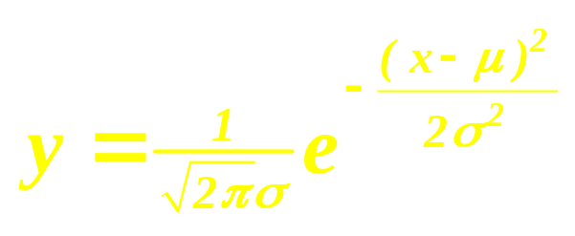
y

Slide 12



三倍标准差原则：
可以认为，Y 的取值几乎全部集中在
区间内。

Slide 13
几个常用的数字特征
数学期望
方差、标准差
协方差
相关系数

Slide 14
常用统计方法

Slide 15
描述性统计量
Mean，
Median
Variance ，
Std. Deviation，
Skewness ，
Kurtosis ……

Slide 16
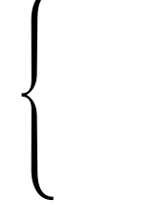
参数估计
点估计
参数估计
区间估计

Slide 17
假设检验
参数假设检验
非参数假设检验

Slide 18
方差分析（ANOVA）

Slide 19
回 归 分 析

Slide 20
一元线性回归
[例1] 某超市年销售额统计如下表：
年份 x_{i} | 1994 | 1995 | 1996 | 1997 | 1998 | 1999 | 2000 | 2001 | 2002
销售额y_{i} (万元） | 114 | 127 | 128 | 153 | 169 | 184 | 208 | 203 | 205

Slide 21
240
220
200
180
160
140
120
100
1994
1995
1996
1997
1998
1999
2000
2001
2002

Slide 22
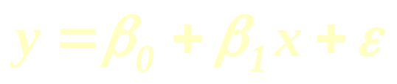
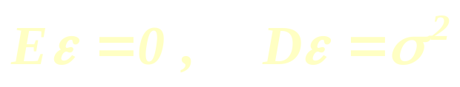
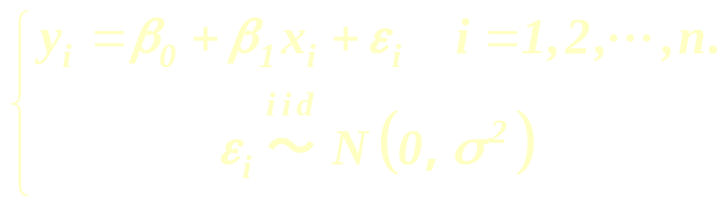
进一步对ε 作正态假设
一元线性回归的统计模型

Slide 23
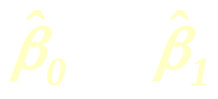
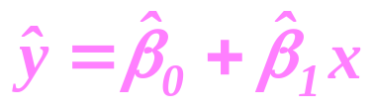
利用已经获得的数据（x_{i} ，y_{i} ）i = 1 ,…, n ，可以对未知的模型参数β₀、 β₁作出估计。
记为
拟合方程或回归方程 ：

Slide 24
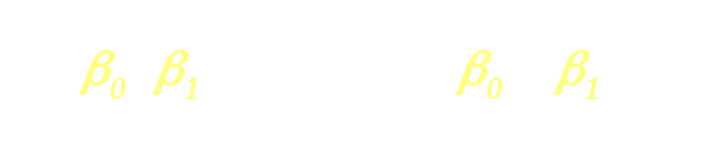
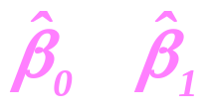

回归系数的最小二乘估计( LSE )
找
使

Slide 25
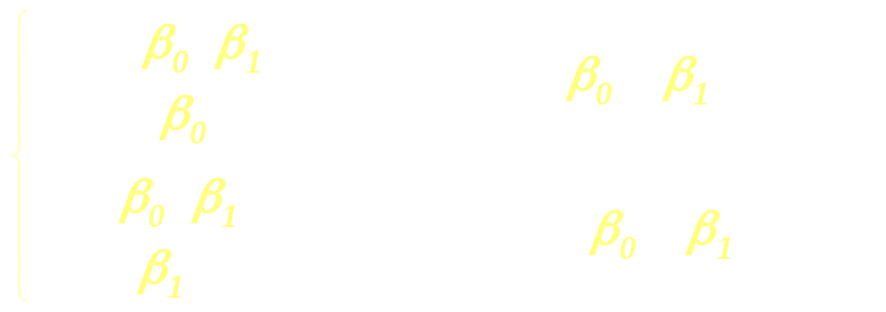
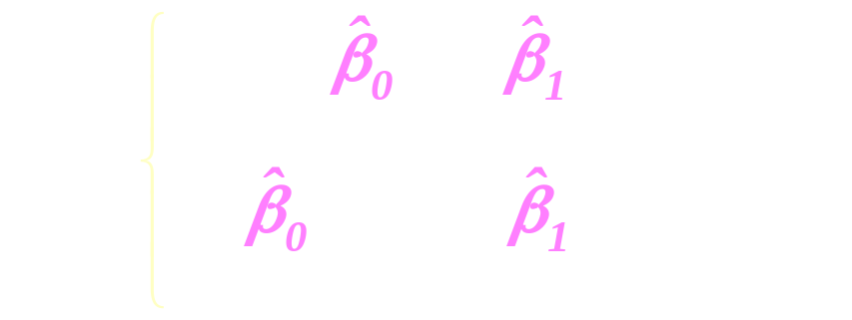

Slide 26
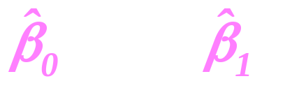

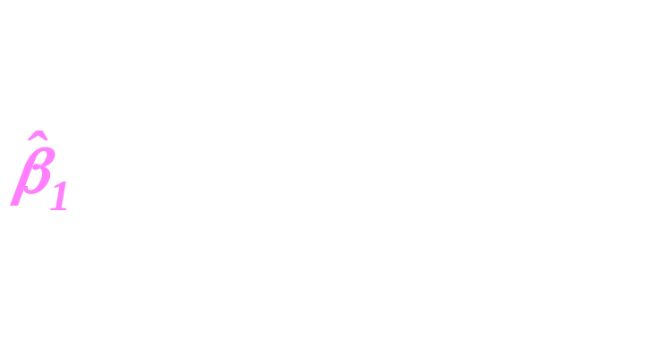
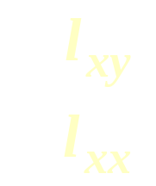
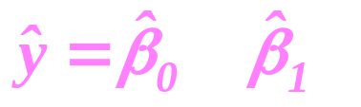
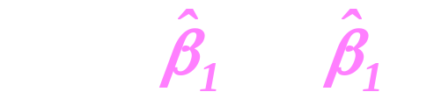
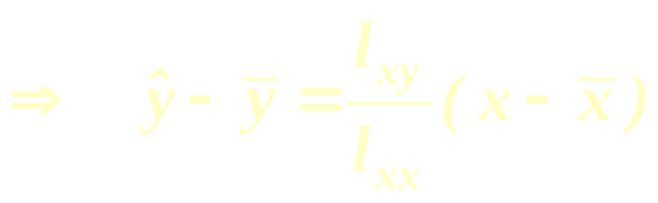
回归方程

Slide 27
可化为线性回归的非线性回归
根据中华人民共和国信息产业部发布的统计资料，1997年5月至1998年12月每月上网人数见下表：
序号 | 1 | 2 | 3 | 4 | 5 | 6 | 7 | 8 | 9 | 10
时间 | 97.5 | 97.6 | 97.7 | 97.8 | 97.9 | 97.10 | 97.11 | 97.12 | 98.1 | 98.2
人数 | 35 | 39 | 43 | 47 | 52.8 | 57.2 | 63.9 | 68 | 74.3 | 80.2
序号 | 11 | 12 | 13 | 14 | 15 | 16 | 17 | 18 | 19 | 20
时间 | 98.3 | 98.4 | 98.5 | 98.6 | 98.7 | 98.8 | 98.9 | 98.10 | 98.11 | 98.12
人数 | 90.2 | 98.1 | 108.4 | 120.2 | 128.9 | 135.5 | 147.8 | 170.4 | 188.9 | 215.7

Slide 28
220
200
180
160
140
120
100
80
60
40
20
0
5
10
15
20

Slide 29
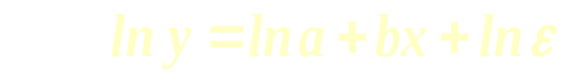
对此,我们假设（ x , y ）满足：
y = a e^{bx}ε
令 lny = y* , lna = a* , lnε = ε* 则有：
y* = a* + bx + ε*

Slide 30
2
1.5
0
4
8
12
16
20

Slide 31
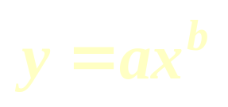
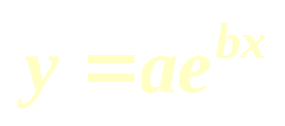
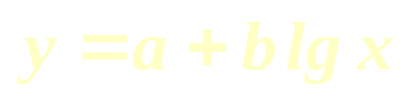
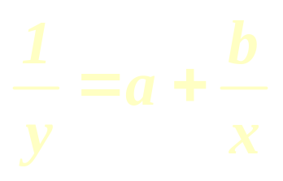
可以用变换方法处理的函数类型有：
幂函数趋势
指数函数趋势
对数函数趋势
双曲函数趋势

Slide 32
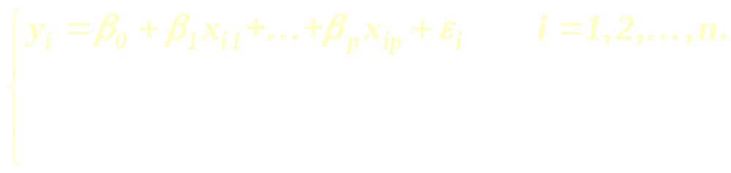
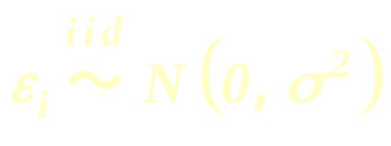
多元线性回归
多元线性回归的统计模型

Slide 33
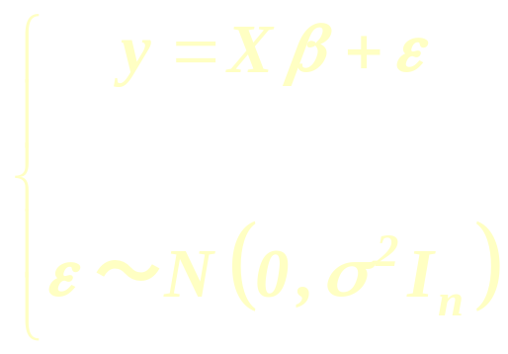

Slide 34
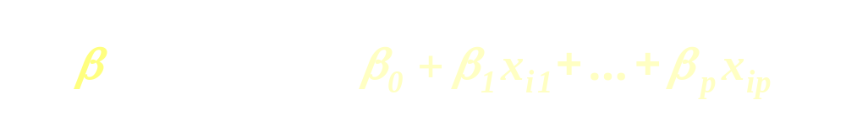





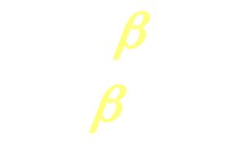

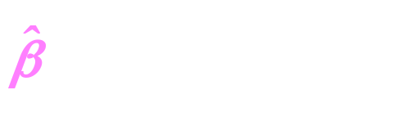
回归系数的最小二乘估计( LSE )

Slide 35
随机模拟与蒙特卡洛方法
计算机随机模拟利用概率论、数理统计中提供的概率统计模型，在数字计算机上进行模拟计算、对试验观测数据或随机模拟数据进行统计分析或处理，给出实际问题性质的统计描述、统计预测和适时控制．
蒙特卡洛方法的基本思想是把各种随机事件的概率特征 (如概率分布、数学期望等)与数学分析的解联系起来，用试验的方法确定事件的相应概率与数学期望。因而，蒙特卡洛方法的突出特点是，概率模型的解是由试验得到的，而不是计算出来的。它可以解决其它方法无法解决的实际问题、对理论研究也可以起到补充及辅助作用。

Slide 36
单服务台排队系统模拟
利用随机模拟来了解在单服务台排队系统中第 i 个顾客在系统中的平均排队时间。
假设第 i 个顾客到达服务台的时刻为 t_{i} ；第 i 个顾客在系统中的排队时间为W_{i}；第 i 个顾客接受服务需要的时间为S_{i}；第 i-1个顾客至第 i 个倾客到达的时间间隔为A_{i}
（i =1，2，…）。

Slide 37
有下列递推公式：
W₁＝0
W_{i}＝ max( W_{t-1}-A_{i}+S_{i-1}，0 ) i=2，3，…
W_{t-1}
S_{i-1}
t_{i-1}
W_{i}
A_{i}

Slide 38
假设 S_{i} 与第 i 个顾客的购物数量 K_{i} 成正比，而 S_{i}=aK_{i}，K_{i}为在 1,2,…,N 中等概率取值的随机数，其中 a 为每件商品的平均服务时间，N为顾客最大购物数。
假设 A_{i} 服从参数为lamed（即相继来到服务台的顾客到达的时间间隔的平均值为lamed）的指数分布
为计算平均排队时间E(W_{i})，我们需重复试验 M 次，在每次试验中都计算第 i 个顾客的排队时间，最后统计出其平均值

Slide 39
假定平均服务时间 a=3（秒）顾客最大购物数 N=15（件）；重复试验次数 M=100；
分别对顾客到达的时间间隔的平均值 lamed=10（秒），lamed=20（秒），lamed=30（秒），lamed=50（秒）进行模拟。
MATLAB程序如下：
clear;
for j=1:100 w(1)=0;
for i=2:10
w(i)=w(i-1)+3*random('Discrete Uniform',15)-random('exp',lamed);
end
c=w>0; b(j,:)=w.*c;
end
mean(b)

Slide 40
运行以后的结果见下表：
i lamed | 1 | 2 | 3 | 4 | 5 | 6 | 7 | 8 | 9 | 10
10 | 0 | 16.85 | 30.71 | 40.35 | 52.94 | 68.87 | 81.00 | 95.07 | 106.85 | 117.54
20 | 0 | 12.48 | 18.51 | 23.63 | 30.53 | 34.54 | 39.59 | 48.91 | 53.36 | 61.65
30 | 0 | 7.11 | 10.27 | 12.40 | 12.09 | 14.22 | 17.01 | 16.38 | 16.21 | 17.78
50 | 0 | 7.46 | 7.52 | 7.56 | 5.10 | 5.01 | 3.68 | 2.85 | 2.99 | 3.20
从模拟结果来看，当顾客到达的平均时间间隔大于30秒左右时，系统基本稳定，不会产生顾客积压，队伍越排越长的现象。

Slide 41
The Contest Judging Problem（1996 MCM )
When determining the winner of a competition like the Mathematical Contest in Modeling, there is generally a large number of papers to judge. Let's say that there are P=100 papers. A group of J judges is collected to accomplish the judging. Funding for the contest constrains both the number of judges that can be obtained and the amount of time that they can judge. For example, if P=100, then J=8 is typical.

Slide 42
Ideally, each judge would read all papers and rank-order them, but there are too many papers for this. Instead, there are a number of screening rounds in which each judge reads some number of papers and gives them scores. Then some selection scheme is used to reduce the number of papers under consideration: If the papers are rank-ordered, then the bottom 30% that each judge rank-orders could be rejected. Alternatively, if the judges do not rank-order the papers, but instead give them numerical scores (say, form 1 to 100), then all papers falling below some cutoff level could be rejected.

Slide 43
The new pool of papers is then passed back to the judges, and the process is repeated. A concern is that the total number of papers that each judge reads must be substantially less than P. The process is stopped when there are only W papers left. These are the winners. Typically, for P=100, we have W=3.

Slide 44
Your task is to determine a selection scheme, using a combination of rank-ordering, numerical scoring, and other methods, by which the final W papers will include only papers from among the "best" 2W papers. (By "best" we assume that there is an absolute rank-ordering to which all judges would agree.) For example, the top three papers found by your method will consist entirely of papers from among the "best" six papers. Among all such methods, the one that requires each judge to read the least number of papers is desired.

Slide 45
Note the possibility of systematic bias in a numerical scoring scheme. For example, for a specific collection of papers, one judge could average 70 points, while another could average 80 points. How would you scale your scheme to accommodate for changes in the contest parameters (P, J, and W)?

Slide 46
The Algorithm of the Simulation
产生100个1—-100的随机整数，服从N(70,100) 作为“真实”分数。 → paper_score [ 1，i ]
产生8个随机整数d_{j} ，服从离散均匀分布（0~d）作为8个评委的标准差。judge[ 1，j ]
e 为系统偏差值，令1，0，—1表示过激、中庸、保守。对paper赋值。→ paper_score[ 0，i ]
对 judge 赋值。 → judge[ 0，j ]

Slide 47
计算系统偏差：
s = e * paper_score[ 0，i ]*judge[ 0，j ]
令 u = paper_score[ 1，i ] + s ，产生1~100的服从 N( u , d_{j}² ) 的整数。→ judge _ score[ i，j ]

Slide 48
Determining the Parameters
Law 1.
Law 2.

Slide 49
The Ideal Model

Slide 50
The Round-Table Model
e | d | n | % failure rate | expense
0 | 3 | 1 | 1.2 | $1000
 | 5 | 2 | 4.4 | $ 2400
 | 7 | 5 | 3.2 | $ 10400
 | 9 | 8 | 2.8 | $ 22400
5 | 3 | 1 | 3.6 | $ 1000
 | 5 | 2 | 4.7 | $ 2400
 | 7 | 5 | 4.8 | $ 10400
 | 9 | 8 | 4.4 | $ 22400

Slide 51
The Classical Model
e | d | % failure rate | expense
0 | 0 | 0.0 | $4851
 | 5 | 2.0 | $5022
 | 9 | 4.1 | $5563
5 | 0 | 1.1 | $5462
 | 5 | 1.9 | $5779
 | 9 | 4.8 | $6250
10 | 0 | 5.5 | $6528
 | 5 | 6.3 | $6653
 | 9 | 10.7 | $7395

Slide 52
The Cutoff Model
The Advanced Round-Table Model

Slide 53
Airline Overbooking（2002 MCM)
You're all packed and ready to go on a trip to visit your best friend in New York City. After you check in at the ticket counter, the airline clerk announces that your fright has been overbooked passengers need to check in immediately to determine if they still have a seat.
Historically, airlines know that only a certain percentage of passengers who have made reservations on a particular flight will actually take that flight. Consequently, most airlines overbook —— that is, they take more reservations than the capacity of the aircraft. Occasionally, more passengers will want to take a flight than the capacity of the plane, leading to one or more passengers being bumped and thus unable to take the flight for which they had reservations.

Slide 54
Airlines deal with bumped passengers in various ways. Some are given nothing, some are booked on later flights on other airlines, and some are given some kind of cash or airline ticket incentive.
Consider the overbooking issue in light of the current situation:
fewer flights by airlines from point A to point B;
heightened security at and around airports,
passengers' fear, and
loss of billions of dollars in revenue by airlines to date.

Slide 55
Build a mathematical model that examines the effects that different overbooking schemes have on the revenue received by an airline company, in order to find an optimal overbooking strategy --that is, the number of people by which an airline should overbook a particular flight so that the company's revenue is maximized. Ensure that your model reflects the issues above and consider alternatives for handling "bumped" passengers. Additionally, write a short memorandum to the airline's CEO summarizing your findings and analysis.

Slide 56
Technical Considerations and Details
If the airline arranges substitute transportation such that the passenger will reach his/her destination within one hour of the original flight's arrival time, there is no obligatory compensation.
If the airline arranges substitute transportation such that the passenger will reach his/her destination between one and two hours after the original flight's arrival time, the airline must pay the passenger an amount equal to the one-way fare for flight to the final destination.

Slide 57
If the substitute transportation is scheduled to arrive any later than two hours after the original flight's arrival time, or if the airline does not make any substitute travel arrangements, the airline must pay an amount equal to twice the cost of the fare to the final destination.
Frontier offers only one class of service to all passengers. Thus, we base our overbooking models on single-class aircraft.

Slide 58
Airline booking considerations are frequently based on the break-even load-factor, a percentage of airplane seat capacity that must be filled to acquire neither loss or profit on a particular flight. The break-even load-factor for Flight 502 in 2001 was 57.8%.
we need concern ourselves only with the sale of restricted tickets. Frontier's are nonrefundable, save for the ability to transfer to another Frontier flight for $60 [Frontier 2001]. Restricted tickets represent all but a very small percentage of all tickets, and many ticket brokers, such as Priceline.com, sell only restricted tickets.

Slide 59

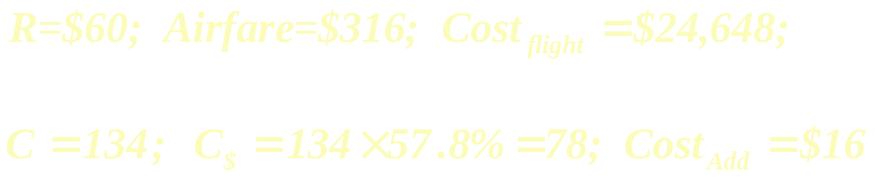

Slide 60
Modeling:
No Overbooking
Bump Threshold Model
Linear Compensation Plan

Slide 61
Nonlinear Compensation Plan
Time-Dependent Compensation Plane

Slide 62
Results:
No Overbooking
Lost opportunity cost $300*16 = $4800 !

Slide 63
Bump Threshold Model
Linear Compensation Plan
Bump cost | Optimal to book | Expected profit
200 | ∞ | ∞
316 | 162 | $17,817
500 | 153 | $17,121
900 | 150 | $16,601

Slide 64
Nonlinear Compensation Plan
Bump function | Optimal to book | Expected profit
 | 160 | $18,700
 | 158 | $18,240
 | 156 | $17,722
 | 154 | $17,363

Slide 65
Time-Dependent Compensation Plane
Profitability is maximized around B=160

Slide 66
Thank you for listening

